Slide 1


Slide 2
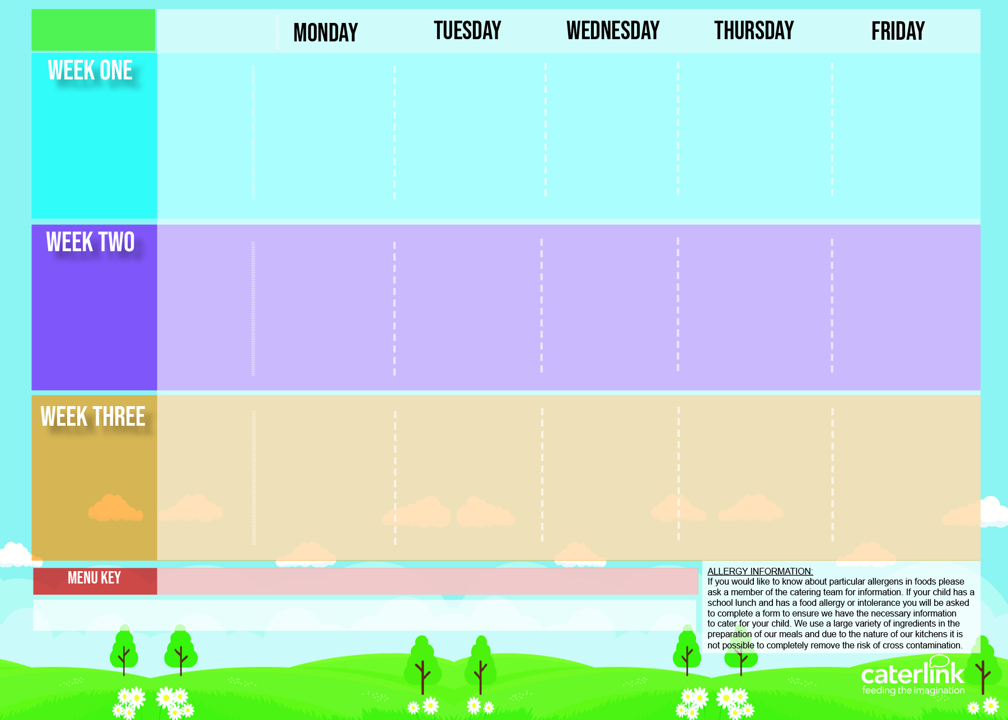
Autumn winter 2025/26
Packed Lunch Menu
Tuna Mayo Baguette
Served with
Carrot and Cucumber sticks
Fruit
Dessert of the day
Hot Roast Baguette
Served with
Carrot and Cucumber sticks
Fruit
Dessert of the day
Ham Bap
Served with
Carrot and Cucumber sticks
Fruit
Dessert of the day
Fish Finger Bap
Served with
Carrot and Cucumber sticks
Fruit
Dessert of the day
3rd November
24th November
15th December
19th January
9th February
9th March
Cheese Bap
Served with
Carrot and Cucumber sticks
Fruit
Dessert of the day
Sandwich Option
BLUE
Egg Mayonnaise Bap
Served with
Carrot and Cucumber sticks
Fruit
Dessert of the day
Cheese and Ham Baguette
Served with
Carrot and Cucumber sticks
Fruit
Dessert of the day
Hot Roast Baguette
Served with
Carrot and Cucumber sticks
Fruit
Dessert of the day
Cheese Bap
Served with
Carrot and Cucumber sticks
Fruit
Dessert of the day
Fish Finger Baguette
Served with
Carrot and Cucumber sticks
Fruit
Dessert of the day
10th November
1st December
5th January
26th January
23rd February
16th March
Sandwich Option
BLUE
Tuna Mayo and cucumber Bap
Served with
Carrot and Cucumber sticks
Fruit
Dessert of the day
Cheese Bap
Served with
Carrot and Cucumber sticks
Fruit
Dessert of the day
Hot sausage Baguette
Served with
Carrot and Cucumber sticks
Fruit
Dessert of the day
Ham Bap
Served with
Carrot and Cucumber sticks
Fruit
Dessert of the day
Fish Finger Bap
Served with
Carrot and Cucumber sticks
Fruit
Dessert of the day
Sandwich Option
BLUE
17th November
8th December
12th January
2nd February
2nd March
23rd March

