Slide 1
ARTS WEEK
BY ARTS COUNCIL

Slide 2
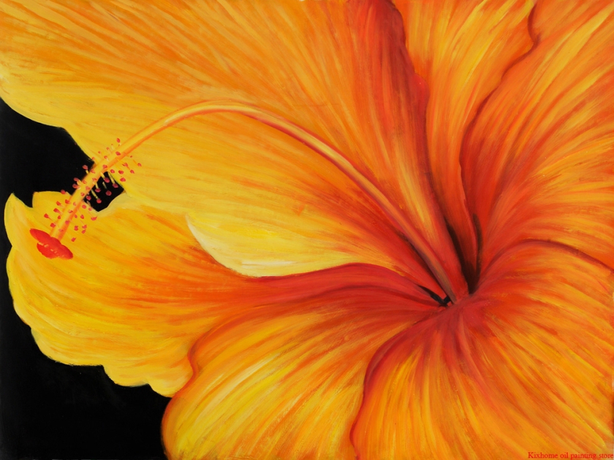
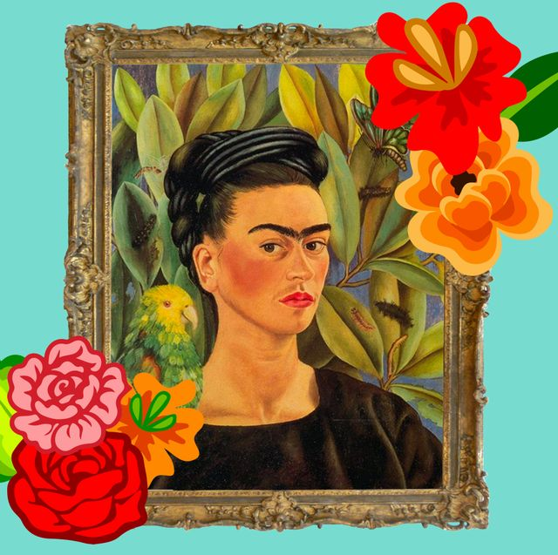
WHAT IS ARTS WEEK
During every half term we will be holding an arts week which will be focusing on a different country each time . This half term we will be focusing on South America and the country Mexico .
the artwork will be most influenced by flowers self portraits and day of the dead which is a very big event in Mexico that happens on the first and second of November .

Slide 3
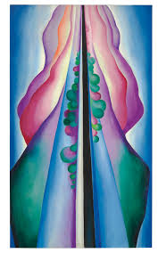
Class 1
Class one will be focusing on Georgia o keef .
Georgia O keef was famous for her drawings on flowers her art is a wonderful way to let your mind wander.

Slide 4
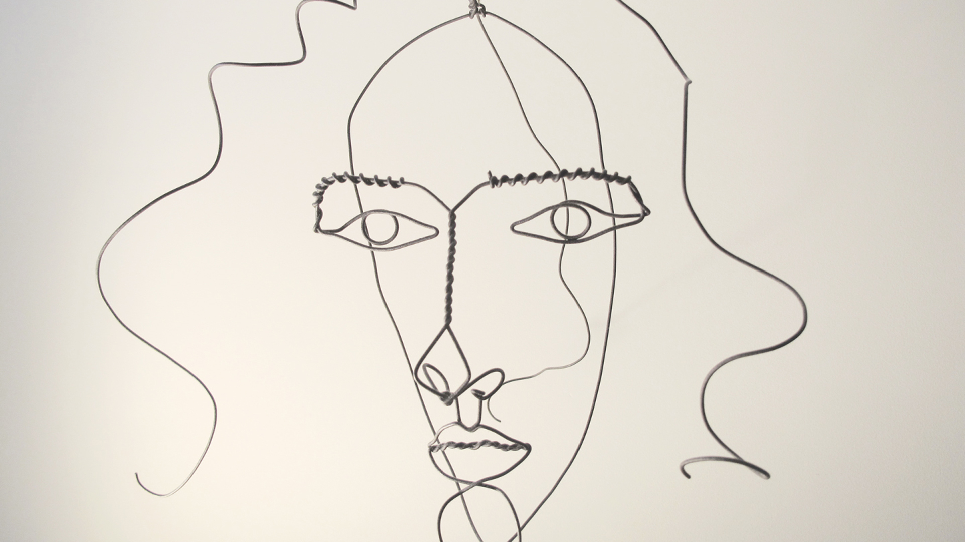
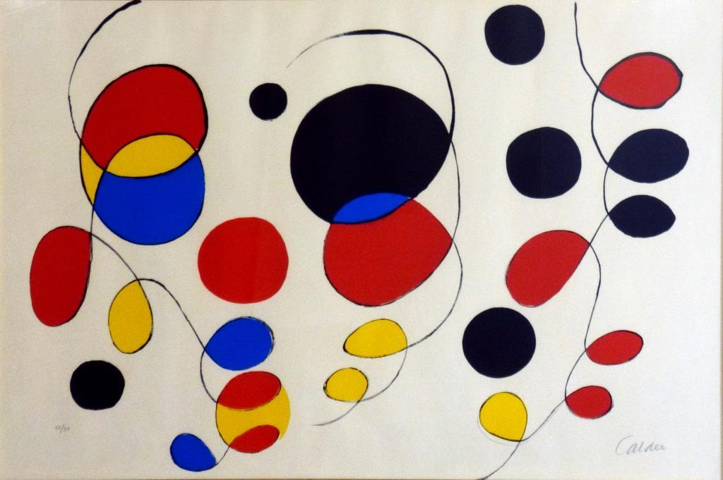
Class 2
Class 2 will be focusing on Alexander Calder who did very abstract paintings and drawings and models nothing can go wrong with him here are some of his classic drawings\paintings\models

Slide 5
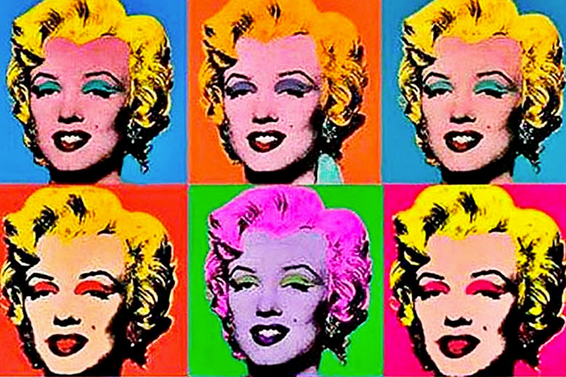
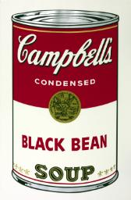
Class three
Class three will be looking at Andy Warhole he was the artist that took a face and repeated in different colours he also painted every day objects that we use , some of his artwork was inspired by Truman Capote’s words . Here some examples .

Slide 6
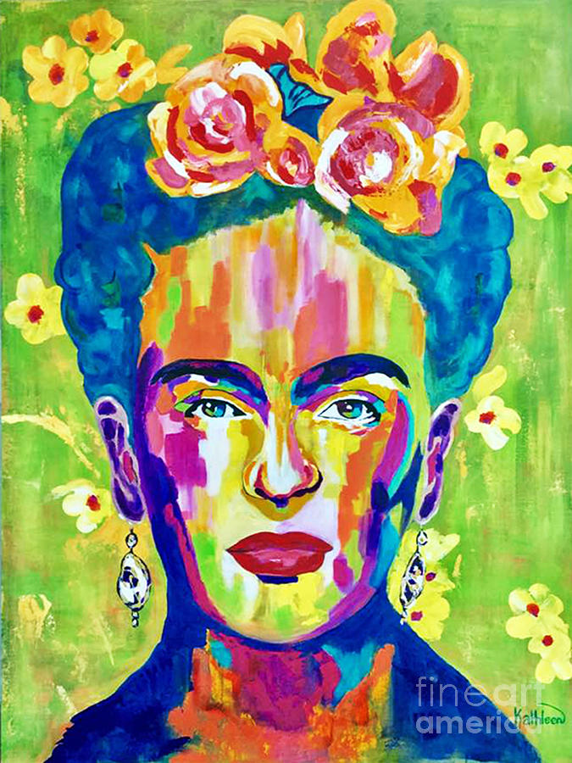
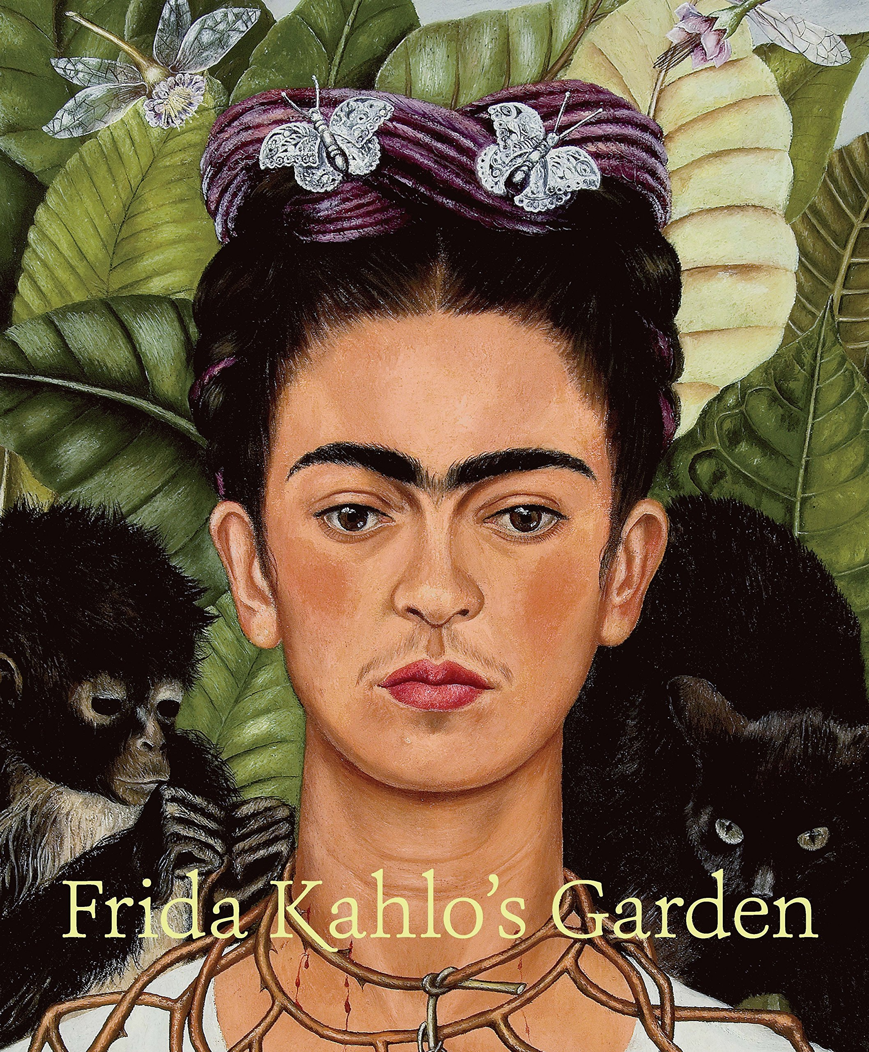
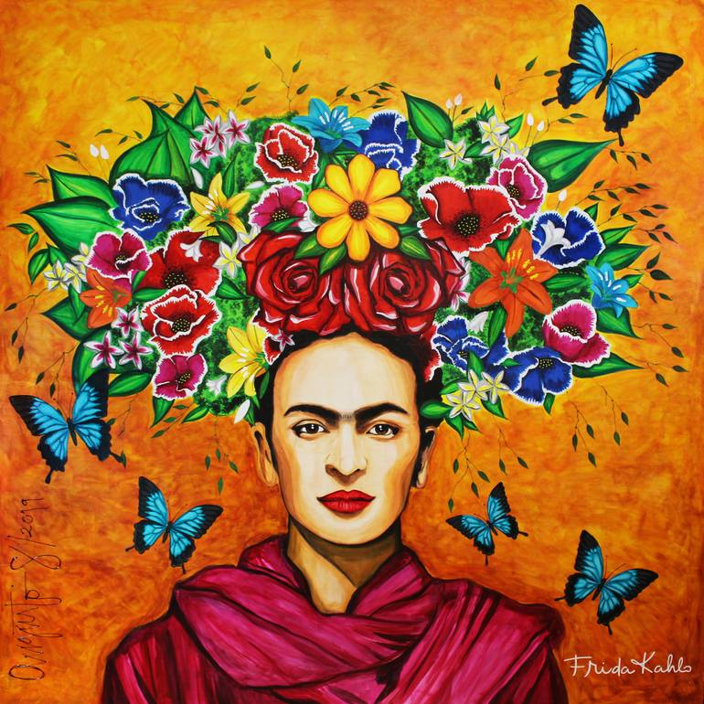
Class four
Class four will be focusing on Frida Khalo the artist from Mexico who focused her artwork on self portraits in many different ways using inspiration from her hometown and the day of the dead .

Slide 7
Thank you for listening
Does anyone have any questions?

