Slide 1

January 2023
Safeguarding in our School
Aberford C of E Primary School
What does it mean?

Slide 2
Aberford C of E Primary School
Who is responsible?
All schools have a duty of care to keep children safe
Everyone who works in school has the responsibility to keep children safe

Slide 3
Aberford C of E Primary School
How do we keep children safe in school?
School Rules
E.g. Good behaviour, walk in the corridors, use kind hands, feet and voice, do not bully, play sensibly at play time.

Slide 4
Aberford C of E Primary School
Staff Checks
All staff and visitors who work in school are checked to make sure they are safe to work with children.
Staff have a photo card ID with a school lanyard saying ‘Staff’ and visitors wear various coloured lanyards saying ‘visitor’ .

Slide 5
Aberford C of E Primary School
Building Safety
All the outer doors are locked and only open using a code
Gates are kept closed during school hours

Slide 6
Aberford C of E Primary School
Attendance
Teachers take the register every day to make sure children are at school.
Mrs Goddard carries out regular checks when children’s attendance is not good at school and they start missing lots of school.
Mrs Goddard always checks if someone doesn’t come to school and we don’t hear them.

Slide 7
Aberford C of E Primary School
What is bullying?
It is when children are deliberately mean and unkind to each other, not just once but again and again, targeted at the same person. They might push a child around, leave them out or send nasty texts or messages online. This can hurt on the inside or on the outside, and often both.

Slide 8
Aberford C of E Primary School
What is neglect?
It is when a parent or carer does not look after a child properly. This might be by give them enough to eat or not getting them the proper medical care when they are sick or injured. It can also be when a child is left on their own for too long without an adult looking after them.

Slide 9
Aberford C of E Primary School
What is physical abuse?
It is when an adult deliberately hurts a child. They might hit, kick, punch, bite or shake them. This may leave marks on the body such as cuts and bruises. It is never ok for an adult to deliberately hurt a child.

Slide 10
Aberford C of E Primary School
What is emotional abuse?
It is when an adult deliberately hurts a child's feelings. They might call them mean names (not just the sort of light hearted fun families have), belittle them or make a child feel bad about themselves. This hurts children on the inside.
Seeing or hearing parents or carers hurting each other can also make a child feel bad.

Slide 11
Aberford C of E Primary School
What is the pants rule?
The pants rule is a simple way to understand how you can stay safe. By learning five easy sayings you can help yourself and others stay safe.

Slide 12
Aberford C of E Primary School

Slide 13
Aberford C of E Primary School
Staff training
All school staff are trained to know what to do if they think anyone is not safe.
Abuse is never your fault.
Any abuse is NOT OK and it needs to stop.

Slide 14
Aberford C of E Primary School
What can children do to keep themselves safe?
Adults work hard to keep you safe but it is also very important that you know how to keep yourself safe.
Tell an adult if you are worried about something.
Always follow the rules in school – they’re there to keep you safe!
Always stay safe when using the internet and follow internet safety rules.

Slide 15
Aberford C of E Primary School
Designated people in school
Do you know who our Designated Safeguarding Leaders are?

Slide 16
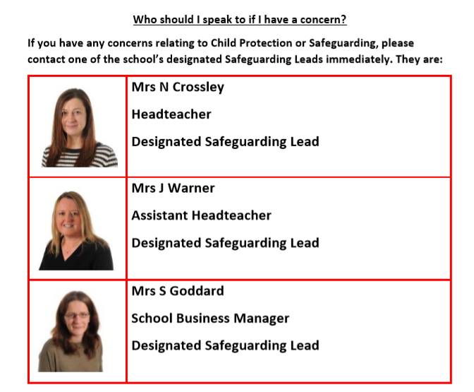
Aberford C of E Primary School

Slide 17
Aberford C of E Primary School
ChildLine
•Children and young people can contact ChildLine24 hours a day, seven days a week.
•It’s free and confidential.
•Remember the number:
•0800 1111
•Remember the site:www.childline.org.uk

Slide 18


Aberford C of E Primary School
Any Questions?

