Slide 1
Zulu Nation
By Arts Council

Slide 2
What is Zulu nation?
The Universal Zulu Nation is an international hip hop awareness group formed by and formerly led by hip hop artist Afrika Bambaataa. They strongly promote that Hip-Hop was created to provide 'peace, love, unity and having fun' for those in the ghetto, and eventually onward to all those supportive of the culture.

Slide 3
When was Zulu Nation formed?
Zulu Nation was formed in 1973 and the founder was Afrika Bambaataa and he created this hip hop international group. Afrika is 63 years of age and was born in 1957 and he was born in the Bronx, New York, United States.

Slide 4
African art!
Sculpture - Sculpture was one of the most important types of art in Ancient Africa. Sculptures were mostly made of people and sometimes animals. African artists often used wood for their sculpture, but they also used bronze, terracotta, and ivory. Masks - Masks were an important part of art.

Slide 5
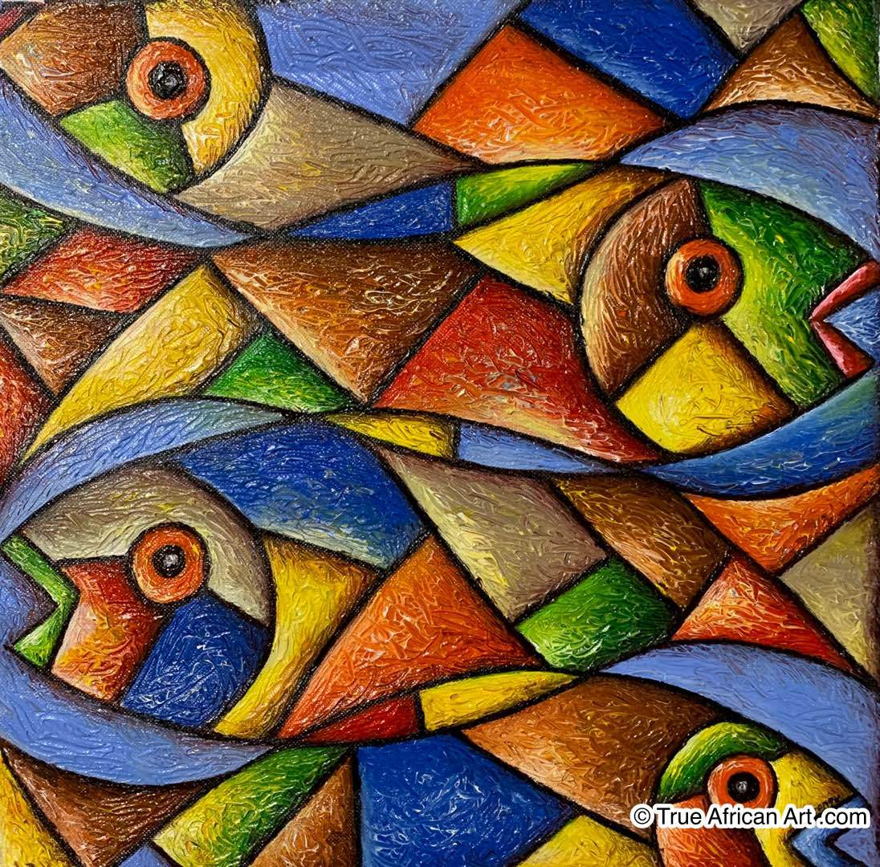
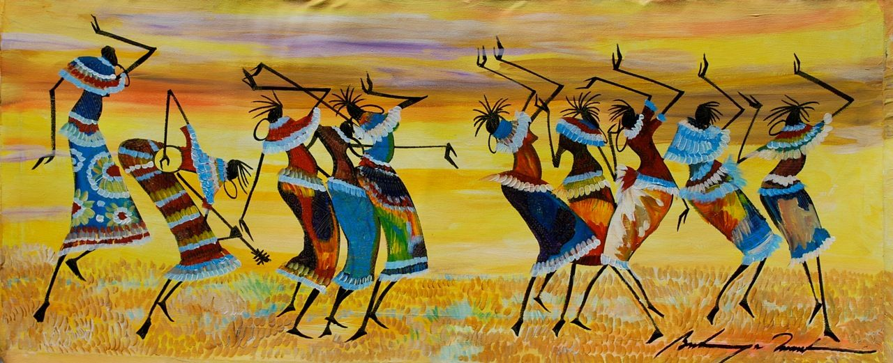
Here are some pictures of African Art

Slide 6
You will be doing pointillism hand trees☺☺ g

Slide 7
You will need:
Any colour paint
A piece of white card
Your hand to make a print for the tree
Paint brush☺

Slide 8
Thank you for listening☺☺☺☺☺☺☺☺☺☺☺☺☺☺☺☺☺☺☺
Arts Council

