Slide 1
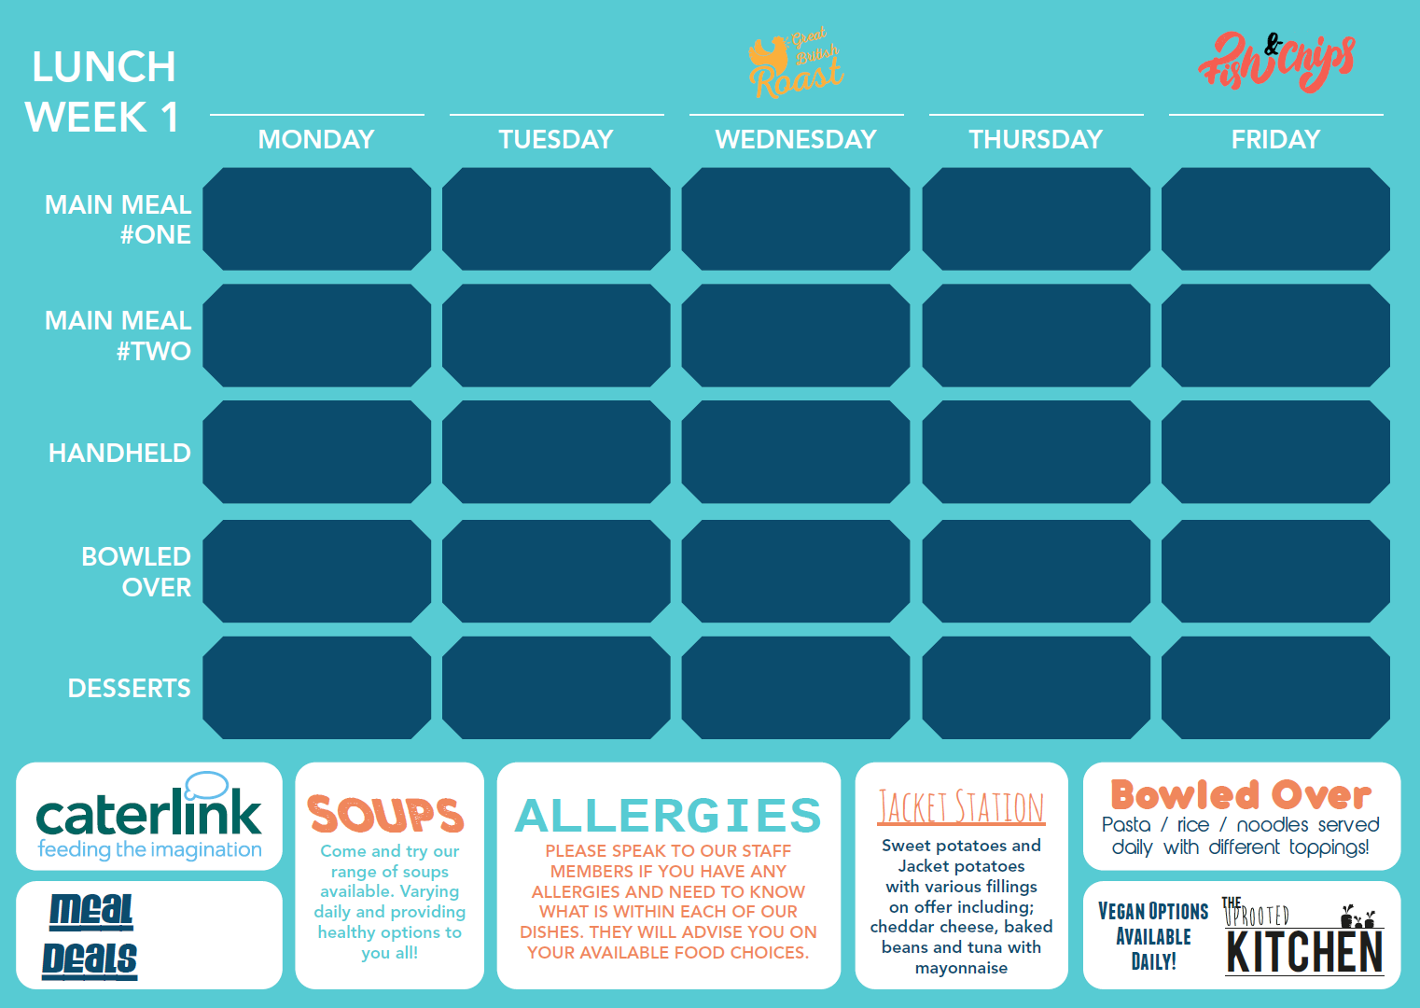
Cottage Pie Topped with Sweet potato & Carrot mash |  | Marinated Chicken Pieces, Wings & Sides |  | Roast Pork Loin Apple Sauce Apricot & Parsley Stuffing, Gravy. |  | Delhi Tikka Chicken Masala, Rice and Sides |  | Battered Fish, Chips, Peas, Lemon & Tartare Sauce
Quorn & Lentil Cottage Pie |  | Spicy Bean Burger, Sweet Chilli & Lettuce |  | Mac n Cheese With Veggie Toppers |  | Mughlai Vegetable Korma, Rice & Sides |  | Chilli Quorn Dog, Fairground Onions & Sauce
 |  |  |  |  |  | Wiltshire
Brazilian Chicken Wrap |  | Authentic Italian Pizza Slice |  | Fish Finger Ciabatta & crisp lettuce |  | Authentic Italian Pizza Slice |  | Shredded Chicken Fillet wholemeal Baguette
Pasta Kitchen |  | Noodle Street |  | Egg & Soy seasoned Rice Bowl |  | Pasta Kitchen |  | Pasta Kitchen
Chocolate & Mandarin Brownie |  | Peach Upside Down cake |  | Baked Rice Pudding With Apple Compote |  | Lemon Drizzle |  | Jam & Coconut Sponge

Slide 2
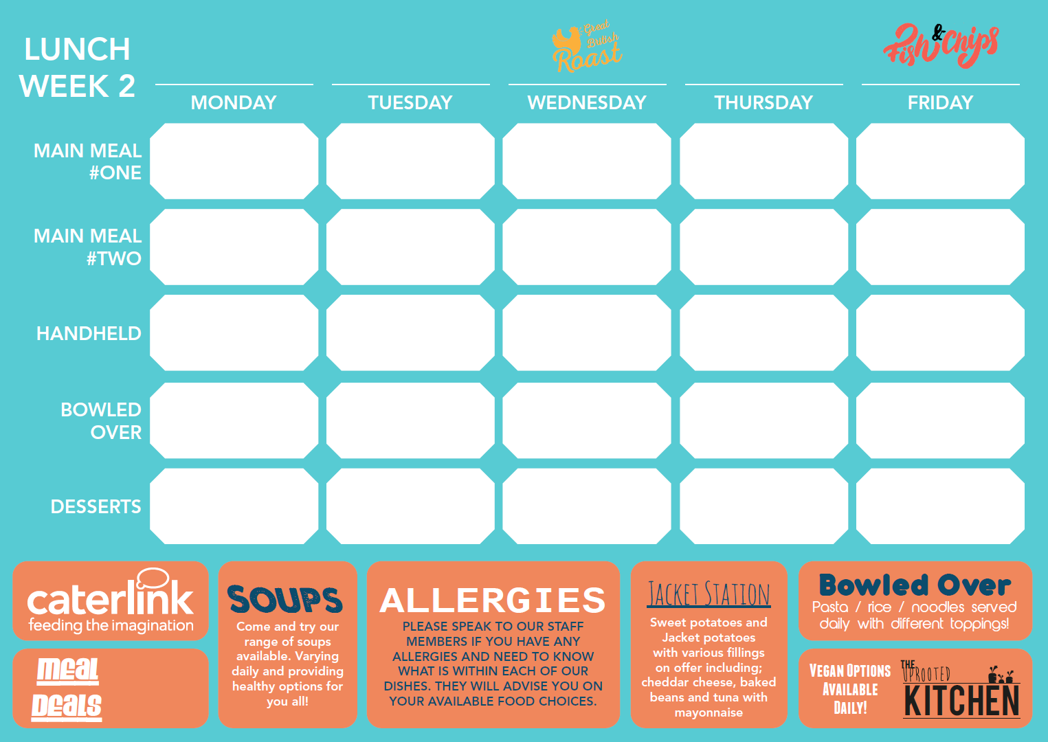
Baked Chicken Meatballs in a Spicy Tomato & Basil Sauce Served With Rice |  | Beef Chilli Nachos, Salsa, Guacamole & Paprika Rice |  | Roasted Turkey Cranberry Sauce, Seasonal Vegetables, Stuffing & Gravy |  | Flavoured Chicken Strips served in Flatbread with Authentic Salads |  | Battered Fish, Chips, Peas, Lemon & Tartare Sauce
Quorn Dog With Fairground Onions & Seasoned Baked Wedges |  | Chunky Vegetable Chilli Nachos, Salsa, Guacamole & Paprika Rice |  | Mac n’ Cheese with Garlic Mushrooms And Tossed Salad |  | Falafels & Hummus served in a Flatbread with Authentic salads |  | Old School Cheese & Red Onion Plate Pie Served with seasonal Vegetables
Authentic Italian Pizza Slice |  | Tikka Chicken Flatbread With Slaw & Sauce |  | Authentic Italian Pizza Slice |  | BBQ Beef Burrito |  | Authentic Italian Pizza Slice
Pasta Kitchen |  | Pasta Kitchen |  | Sweet & Sour Noodles |  | Pasta Kitchen |  | Spicy Chicken Rice Bowl
Chocolate & Apple Cake |  | Toffee Apple & Pear Granola Crumble |  | Summer Fruit Trifle |  | Carrot & Courgette Sponge |  | Chocolate Chip Shortbread

Slide 3
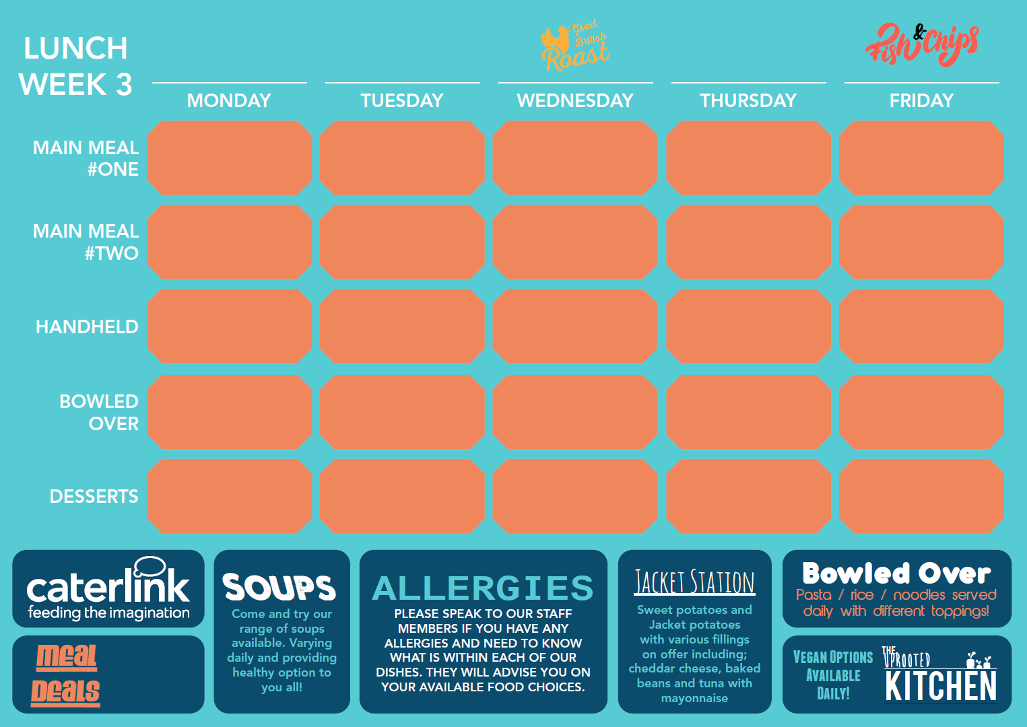
Bangers & Mash with Garden Peas & Red Onion Gravy |  | Italian Beef Lasagne Served With House Salad & Garlic Bread |  | Roasted Honey Glazed Gammon, Roast & Gravy |  | Chicken Tikka Masala, Rice & Sides |  | Battered Fish, Chips, Peas, Lemon & Tartare Sauce
Quorn Sausage Served With Buttery Mash, Peas & Red Onion Gravy |  | Vegetarian Lasagne Served With House Salad & Garlic Bread |  | Mac n’ Cheese With Veggie Toppers |  | Mughlai Vegetable Korma, Rice & Sides |  | Vegan Spinach & Kale Burger, Vegan Mayo & Salad
Authentic Italian Pizza Slice |  | Sweet Chilli Chicken Wrap |  | Authentic Italian Pizza Slice |  | Ham & Cheese Panini |  | Authentic Italian Pizza Slice
Pasta Kitchen |  | Vegetable Chow Mein Noodles |  | Pasta Kitchen |  | Black Bean Noodles |  | Pasta Kitchen
Warm Red Cherry Pancake |  | Multi Seed Flapjack |  | Wholemeal Apple & Cinnamon Crumble |  | Sticky Toffee Pudding |  | Chocolate Orange Sponge

