Slide 1
The Role of the SEND Governor
Professor Adam Boddison
Chief Executive – nasen
Chair – Whole School SEND
Follow me on Twitter for regular SEND updates from across the sector.
@AdamBoddison @nasen_org

Slide 2
Areas to be covered today…
Brief national update
SENCOs: strategic vs operational
Technology and SEND in schools
Effective questions about SEND and inclusion that could be asked at board meetings.
SEND Learning Walks as an effective governance tool.

Slide 3
Brief National Update
nasen and Whole School SEND
National SEND Reference Group
DfE SEND Review
Ofsted EIF
Notes:
No school can achieve outstanding unless they can demonstrate they are also inclusive

Slide 4
Maximising the Impact of the SENCO
Strategic
Operational

Slide 5
SENCO: Strategic Responsibilities
Notes:
Sorting task: strategic vs operational

Slide 6
SENCO: Strategic Responsibilities
Notes:
Sorting task: strategic vs operational

Slide 7
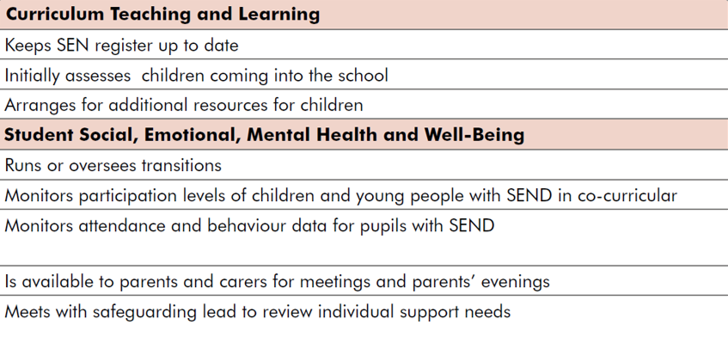
SENCO: Operational Responsibilities
Notes:
Sorting task: strategic vs operational

Slide 8
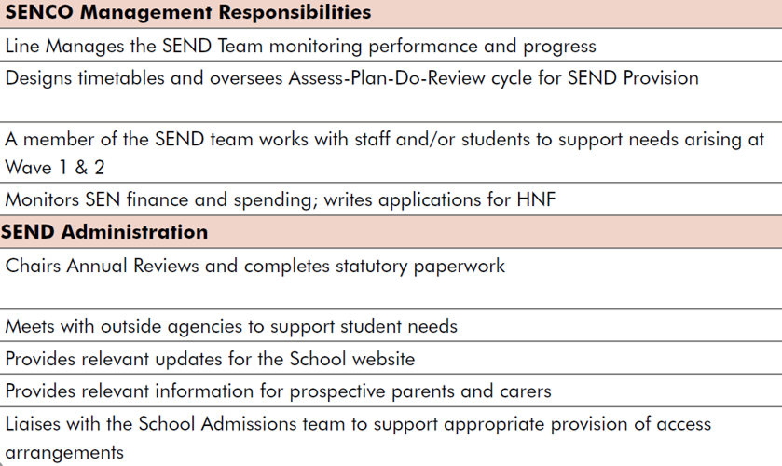
SENCO: Operational Responsibilities
Notes:
Sorting task: strategic vs operational

Slide 9
Maximising the Impact of the SENCO

Slide 10
What technology are schools using in relation to SEND?
Access Arrangements (examinations)
Scanning pens
Screen overlays
Screen magnifiers
Teaching and Learning
Noise-cancellation earphones/headphones
Voice-to-text software
Voice recognition software
Tools to support those with sensory impairments (hearing aids, audio books, alternative keyboards, eye-gaze technology, etc)
School Administration and Assessment
CRM/CMS systems for provision mapping, collating evidence for EHC plan assessments, mapping across local EHCP templates, monitoring interventions, enabling co-production
Identification of needs (e.g. GL Assessment)
Meeting Individual Needs
Physical Mobility
Scooters
Wheelchairs (with features)
Artificial Intelligence
to support emotional regulation
Virtual Reality
to support trauma recovery
Social Gaming
to develop social skills (autism, preparation for adulthood)
to remove physical barriers (e.g. Fifa – physical disabilities)

Slide 11
What technology are schools not using in relation to SEND?
Built-in accessibility features within software they already own (e.g. Microsoft Office, Apple devices, etc)
Personal mobile devices
Evidence-based mobile apps?
To improve mental wellbeing (e.g. Pokémon Sleep)
To support mindfulness (e.g. Headspace)
Inclusive technologies at universal level

Slide 12
The Four Broad Areas of Need
Communication and Interaction
Cognition and Learning
Sensory and/or Physical
Social, Emotional, Mental Health
Notes:
Provide Ch 6 of the SEND CoP 2015 (20 pages, rather than the full 292).

Slide 13
SEND Code of Practice Chapter 6

Slide 14
When does the absence of a particular ability become a disability?
Imagine a world in which 2% of people could fly, but 98% could not fly. If you were part of the group that could not fly, would you consider yourself to have a disability?
Imagine a world in which 98% of people could fly, but 2% could not fly. If you were part of the group that could not fly, would you consider yourself to have a disability?
At what point does not being able to fly make you a have a disability?

Slide 16
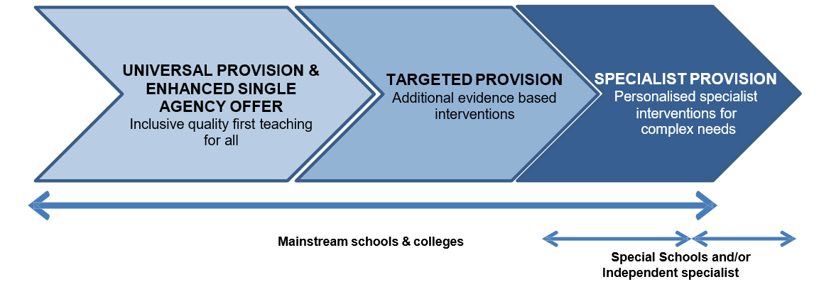
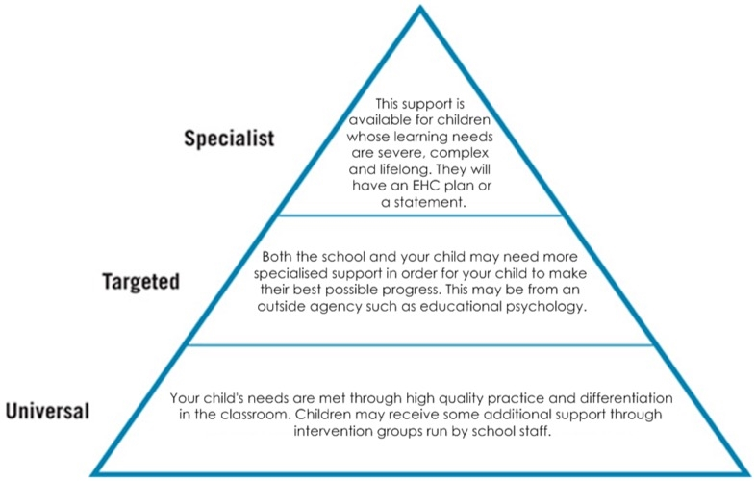
3%
The JCQ’s latest guidance for access arrangements and reasonable adjustments is clear that ‘not putting in place appropriate arrangements for candidates with known and established learning difficulties/disabilities’ constitutes malpractice (section 4.2.11)
12%
85%

Slide 17
National SENCO Survey 2020 – Key Findings
96% of SENCOs believe they should have protected time to undertake the role.
85% of Headteachers who responded also agreed there should be protected time (n=36)
Half of SENCOs reported having picked up additional responsibilities with no additional time (e.g. safeguarding, AHT).
74% reported that paperwork took up the vast majority of their time (up from 71%).
Inconsistencies in the national approach to assessment within LAs was identified as an area creating unnecessary administration.

Slide 18
Questions for SEND Governors to ask
How many pupils are on the SEND register? | How does the school manage SEND? | How do you support other teachers who work with pupils with SEND?
How do the attendance rates for pupils with SEND compare to those without SEND? | What is the progress and attainment of pupils with SEND compared to those without SEND? | Do you have a SEND/inclusion action plan? What have you put in place for each target and how do you know it’s working?
Are there resources you don’t have, which you may need to carry to the role effectively. | How are parents/carers of pupils with SEND involved with the process? | How do the exclusion rates for pupils with SEND compare to those without SEND?
What is being done to improve the progress and attainment of pupils with SEND? How do you know it’s working? | ??? | ???
Notes:
Sorting task… Rank from 1 to 10, then share with AB to feed into overall ranking…

Slide 19
SEND Governor Documents Role Description Key Questions

Slide 20
SEND Learning Walks: The road to inclusion…
Segregation
Integration
Inclusive Practice
Inclusion
EQUITY
EXCELLENCE
Fairness that allows every student to reach their full potential.
Notes:
In line with the policy framework, the aim is to educate as many children as possible within mainstream education over time, although some specialist settings may always be needed.

Slide 21
SEND Learning Walks: the five key ingredients…
01
02
03
04
05
SENCO / HT self-assessment
Child-centred family voices (focus groups)
Lesson observations (including individual / small group interventions)
Book Scrutiny (consider sequencing over 5/6 lessons)
Inclusive
curriculum…
Notes:
In line with the policy framework, the aim is to educate as many children as possible within mainstream education over time, although some specialist settings may always be needed.

Slide 22
Governors | Headteachers | SENCOs
Ensure you are familiar with Chapter 6 of the SEND Code of Practice (Jan 2015) including the 4 broad areas of need. It is 20 pages long. |  | Ensure you are familiar with the SEND Code of Practice (Jan 2015). It is 292 pages long.
Ensure SEND and Pupil Premium receive similar coverage at board meetings. What is the offer for pupils who are double-disadvantaged and triple-funded? | Consider the deployment of the SENCO. Could they focus more on high quality teaching and less on paperwork? | Think about how to progress through the stages of coproduction (done to, done for, done with) and how to embed the ‘graduated approach’.
Use profile of need to inform strategic decision making (e.g. resource allocation and CPD priorities). Is our school a ‘SEND magnet’? |  | Use profile of need data to probe the accuracy of identification (and reduce exclusions) and to inform targeted small-group interventions.
Would you feel confident in articulating why your school (and its curriculum) is inclusive? Is this intent for inclusion consistently understood (including by families)?
Is your school fully compliant with statutory guidance (in particular the SEND Code of Practice 2015 and the Equality Act 2010). Ensure your school has a high quality, accessible SEN Information Report | What does it mean for students with SEND to ‘achieve exceptionally well’ in your school? Is this only about academic outcomes?
Ensure that SEND is ‘built in’ to your school improvement plans and not a ‘bolt-on’. Undertaking SEND reviews at a range of levels could inform this. |  | Ensure that teaching assistants are being deployed effectively (e.g. how much teacher-time do learners with SEND receive?)
Familiarise yourself with the SENCO Induction Handbook to ensure a triangulated approach to SEND leadership.
Notes:
Ensure that teaching assistants are being deployed effectively (e.g. how much teacher-time do learners with SEND receive?)

Slide 23
Thank you! adamb@nasen.org.uk

