Slide 1
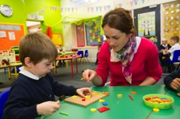
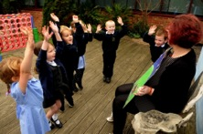
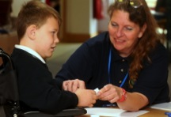
Governor Survey

Slide 2
Roles

Slide 3
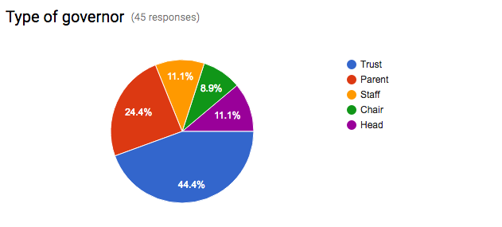

Slide 4
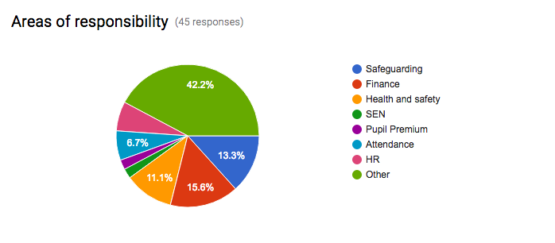
Notes:
All of the above
All areas
Role to be confirmed
Curriculum and Standards
I have not attended a goveners meeting as I have only just joined the governing team.
I have not got a responsibility yet as I have only just joined the governing team.
Governor Training and Website
HR and Finance
Autism
Finance and health safety
Standards
Teaching and Learning
As Head, all areas apply
Staff
All areas
I will be at oersonnel and finance and premises meetings as well as FGB meetings
all
Finance & Personnel committee
Chair of governors Chair of Excellence and Standards committee
Chair of Governors
Vice-Chair, UKS2 Link, Training
Safer recruitment and attendance
Personnel, Curriculum and CEIAG.
Finance comitee
Standards (progress and attainment)
Attainment, progress, pupil premium, SEND, LAC and finance committee
Pupil Premium, LAC
IT
Pupil Premium, English.
Member of Finance Committee
Curriculum, PP, finance
SEN
EYFS link gov
PE Governor
Strategic view of all areas, communicated to governors through HT report

Slide 5
Governor meetings

Slide 6
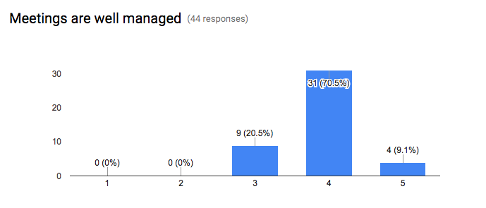

Slide 7
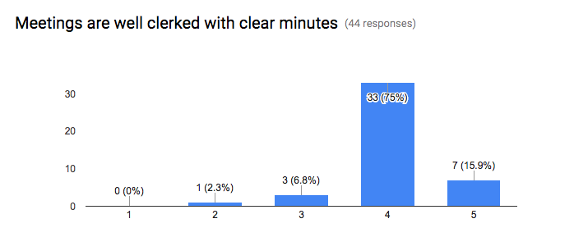

Slide 8
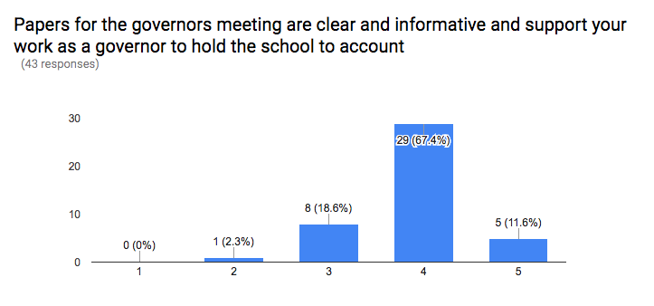

Slide 9
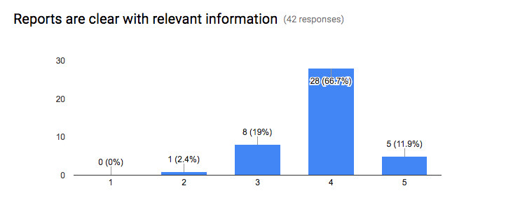

Slide 10
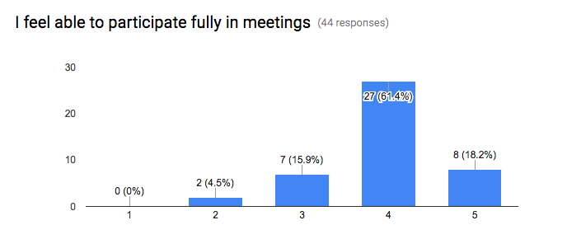

Slide 11
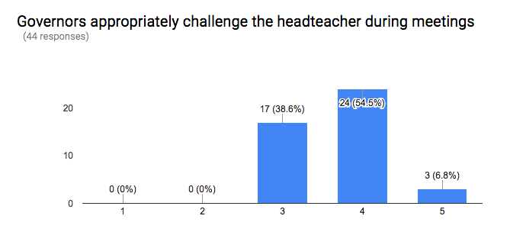

Slide 12
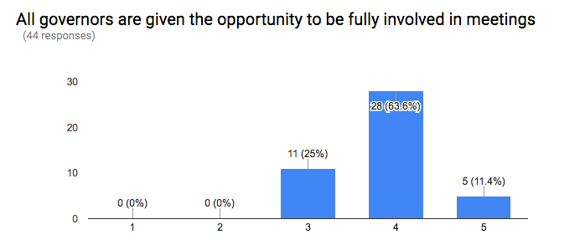

Slide 13
Governor visits

Slide 14
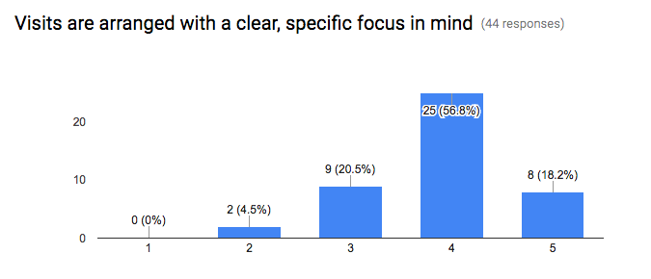

Slide 15
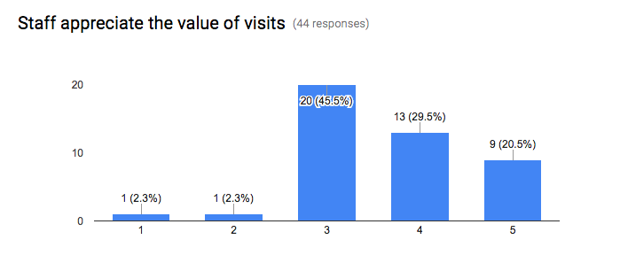

Slide 16
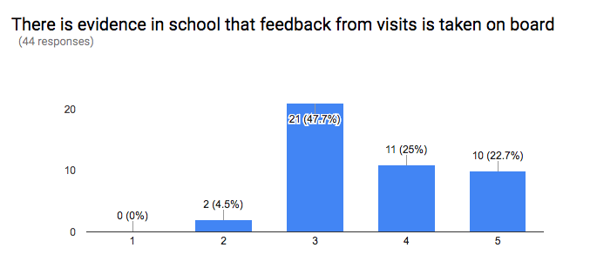

Slide 17
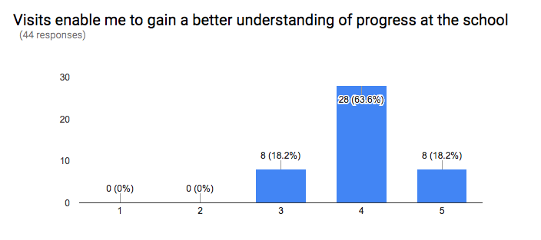

Slide 18
Thinking about how the local governing body works

Slide 19
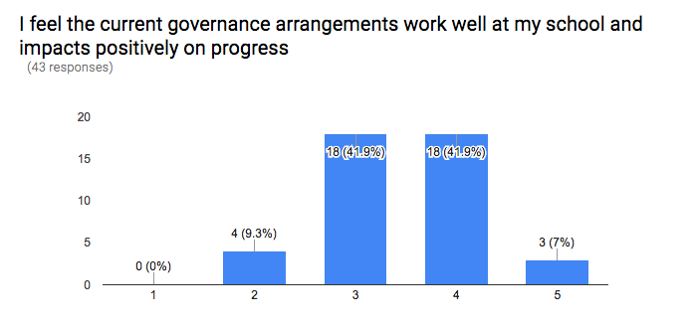

Slide 20
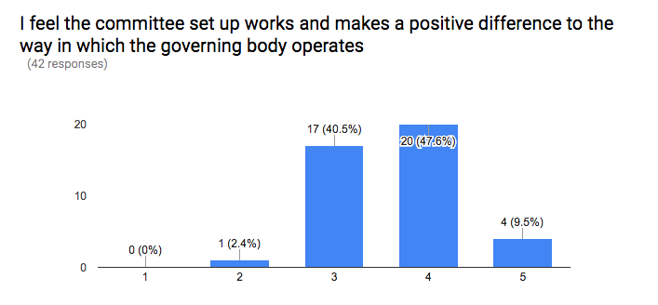

Slide 21
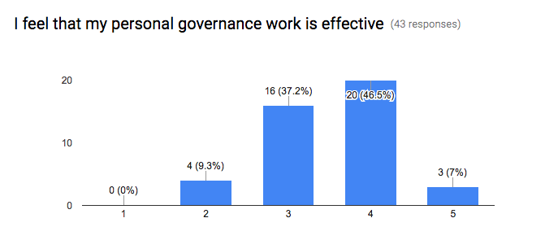

Slide 22
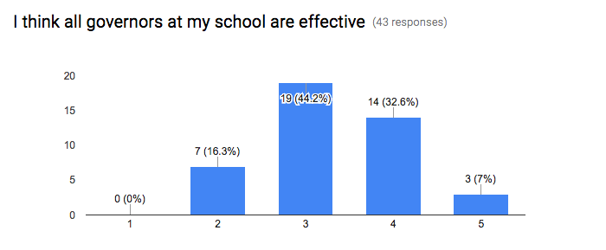

Slide 23
Attendance at meetings

Slide 24
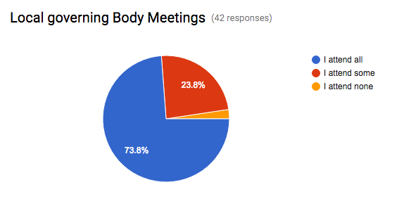

Slide 25
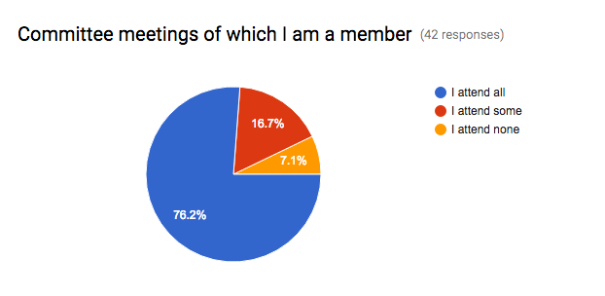

Slide 26
