Slide 1
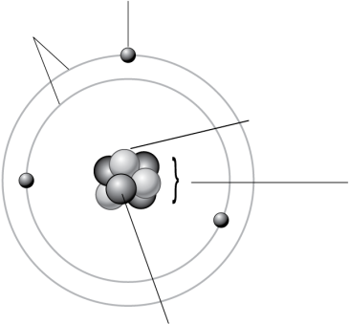
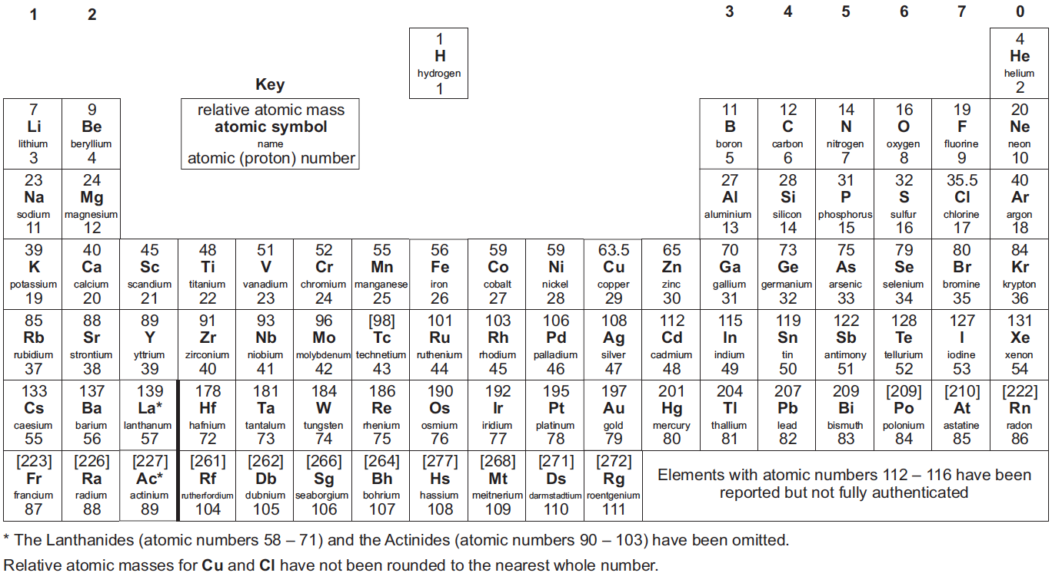
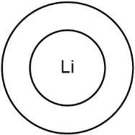
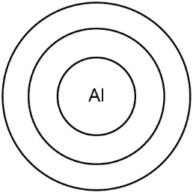
Complete the labels on the diagram of this atom.
Subatomic particle | Relative charge | Relative mass | Where found in atom
proton |  |  | in the nucleus
 |  | 1
 | −1 | negligible (almost 0) | around the nucleus
Use the periodic table to complete the table below, then draw the electron configurations in the space below. The correct number of shells have already been drawn for you.
1
2
O
3
4
5
Ar
6
Element | Li | O | Al | Ar
Atomic number | 3 | 8 | 13 | 18
Mass number
Number of protons
Number of electrons
Number of neutrons
Electron configuration
Complete the sentences

Slide 2
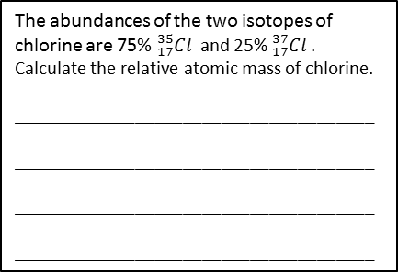
What is an isotope of an element?
______________________________________
______________________________________
______________________________________
On the periodic table on the other side of this sheet, mark on the metals and non-metals.
 | Group 1 | Group 2 | Group 3 | Group 4
Outer electrons | 1 |  |  | 7
Electrons lost or gained |  | 2 lost |  | 1 gained
Charge on ion |  |  |  | 1-
Example |  | Ca²⁺
John Dalton predicted that all matter was made of very small particles called atoms.
How has this model changed over time?
Plum pudding model
____________________________________
____________________________________
____________________________________
____________________________________
Rutherford’s model
____________________________________
____________________________________
____________________________________
____________________________________
Bohr model
____________________________________
____________________________________
____________________________________
____________________________________
The abundances of the two isotopes of chlorine are 75% ${}_{17}^{35}{Cl }$ and 25% ${}_{17}^{37}{Cl }$. Calculate the relative atomic mass of chlorine.
______________________________________
______________________________________
______________________________________
______________________________________
Draw dot and cross diagrams for the following compounds
NaCl
MgCl₂
Li₂O
Describe how Mendeleev arranged the elements in the period table
______________________________________
______________________________________
______________________________________
How did Mendeleev use his table to predict the existence and properties of some elements not then discovered?
______________________________________
______________________________________
______________________________________

