Slide 1
Ionic and Covalent Bonding
What will the ionic formula of the following compounds be:
Sodium chloride:
Calcium sulphate:
Lithium oxide:
Aluminium chloride:
Magnesium hydroxide:
Aqueous (dissolved)
___________________________________________________
___________________________________________________
What is an ion?
______________________________________
______________________________________
Draw dot and cross diagrams for the following compounds
H₂O
CO₂
CH₄
N₂
Give the charge on the following ions:
Mg:
SO₄:
Cl:
O:
K:
What holds ions together in an ionic bond?
____________________________________
What determines the melting and boiling points of ionic compounds?
____________________________________
____________________________________
Draw the dot and cross diagrams for the following compounds:
K₂O
CaCl₂
Discuss the electrical conductivity of ionic compounds in the following states:
Solid
____________________________________
____________________________________
Liquid
____________________________________
____________________________________

Slide 2
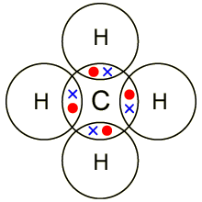
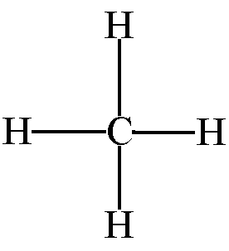
What is a simple molecular compound?
______________________________________
______________________________________
______________________________________
______________________________________
______________________________________
______________________________________
______________________________________
______________________________________
______________________________________
______________________________________
______________________________________
______________________________________
______________________________________
______________________________________
______________________________________
______________________________________
______________________________________
______________________________________
______________________________________
______________________________________
______________________________________
______________________________________
______________________________________
Draw a diagram showing the bonding in a metal
Complete the sentences:
Metals are good _______________ of electricity. They have this property because they have a ______ of _______________ ______________.
Metals are _______________ (the opposite of brittle) because they the ______________ can rearrange themselves if the positive ions move.
Metals have _________ melting and boiling points because of the strong _______________ attractions.
Describe the bonding in simple molecular compounds and explain why they have low boiling points
______________________________________
______________________________________
______________________________________
______________________________________
______________________________________
______________________________________
Give an advantage and a disadvantage of each of these bonding models:
_____________________________________________________
_____________________________________________________
_____________________________________________________
_____________________________________________________
___________________________________________________
_____________________________________________________
_____________________________________________________
_____________________________________________________
_____________________________________________________
Give the name, and describe the bonding in each of the following diagrams:
______________________________________
______________________________________
______________________________________
______________________________________
______________________________________
______________________________________
______________________________________

