Slide 1
Home learning – a student guide

Slide 2
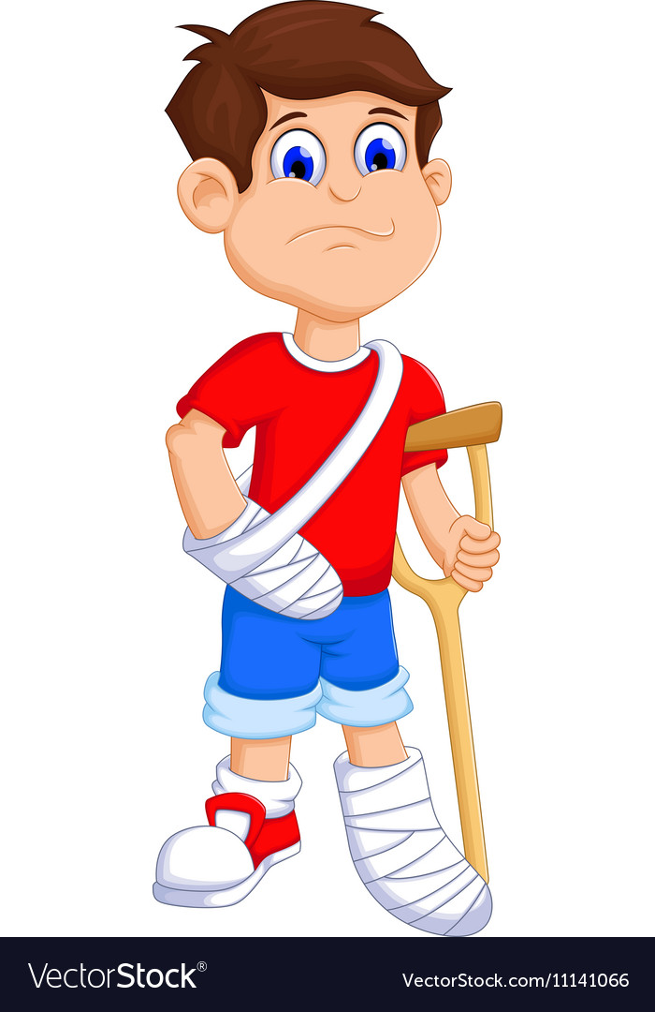
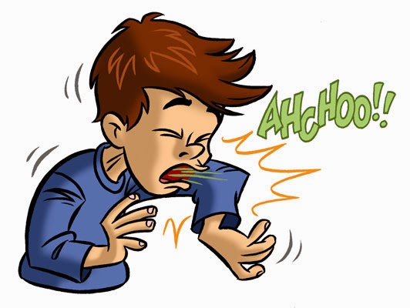
General illness:
If you are not attending school due to illness you will not be expected to complete home learning tasks.

Slide 3
How do I complete my home learning work?
What do I need?
Your computer/tablet
School timetable
Class books (or paper)
A pen and ruler

Slide 4
How do I complete my home learning work?
What do I do first?
Log into Office 365.
Check you can do this when you get home this afternoon!

Slide 5
What do I do next?
Open your school emails (you may have been sent
information about your home learning).
Open up Teams.
From here you will be able to navigate to each of your classes.

