Slide 1
GCSE English Language
Structure of the Papers
Techniques for answering questions

Slide 2
Starter : Attempt one of these warm-up tasks
Write three sentences using colons to introduce lists. She wanted three things: her own house, her own car, and revenge.
Pick three household objects. If they had human characteristics, what would they be? Practise writing about them using personification. The toaster was reluctantly always open for business, he had no choice. People would rudely interrupt his sleeps by sticking bread into him and he would burn with rage until he gained the strength to push the bread back out in protest. This took all of his energy and he would go back to sleep again, grumbling and fuming. hree things: her own car, her own house, and revenge.
Write this sentence five times. Start each sentence with a different adverb e.g. Reluctantly, the man walked down the long corridor to see his boss. Explain briefly how the adverb affects the mood.

Slide 3
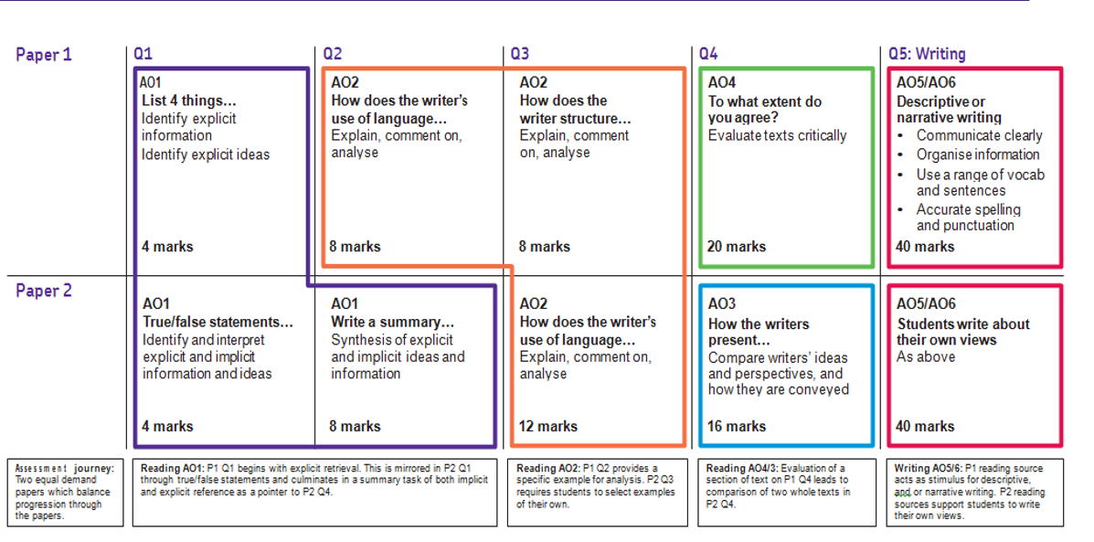
GCSE ENGLISH LANGUAGE – HOW THE PAPERS ARE ORGANISED
50% of marks are awarded for analytical reading skills
50% of marks are awarded for writing skills
Creative reading and writing
Viewpoints and perspectives

Slide 4
English Language Paper 1 – marked out of 80. 1 hour 45 minutes’ duration
Have a look at the paper that I have given you.
What do you think might make this a challenge for pupils? Discuss with the person with / next to you.

Slide 5
How to help
Test your child on their recall of subject terms. Use the terms that are on the back of their exercise book – any English exercise book from year 7-11 will have key terminology and sentence builders.
Ask your child to build sentences using the sentence starters that are on the back of their exercise books.
Draw more out of an answer by asking your child to continue with a phrase like ‘Despite this…’ or ‘Even though…’
Encourage your child to read all written work aloud – for whatever subject – paying attention to the punctuation. This will help them to hear sentence structures more fluently.

Slide 6
English Language Paper 2 – marked out of 80. 1 hour 45 minutes’ duration
Have a look at the paper that I have given you.
What additional challenges does this paper present? How is it more difficult?
Discuss with the person with / next to you.

Slide 7
Writing section is the one where students find it most difficult to move up a level, particularly with planning and writing an opinion piece.
Why do you think that students might struggle with expressing their viewpoint or perspective in one of these written forms:
Letter
Article
Speech
Text for a leaflet
Essay

Slide 8
Generating ideas
‘Scientists say that teenagers are not like adults; they learn and socialise differently and need sleep at different times. Education needs a radical re-think to meet the needs of students.’
Write a letter to the Minister of Education explaining your point of view on this statement.
Start with the victim(s)… and your personal connection to them.
Who is / are the victim ?
Make a list of 8 synonyms for the victim.

Slide 9
How to help at home – as with Language Paper 01…
Test your child on their recall of subject terms. Use the terms that are on the back of their exercise book.
Ask your child to build sentences using the sentence starters that are on the back of their exercise books.
Draw more out of an answer by asking your child to continue with a phrase like ‘Despite this…’ or ‘Even though…’
Encourage your child to read all written work aloud – for whatever subject – paying attention to the punctuation. This will help them to hear sentence structures more fluently.

Slide 10
Final message
Reading widely – openings; single pages; endings of novels
Having awareness of the world – podcasts; BBC news online; discussion about topics

