Slide 1


Welcome to Saturn Class
Early Years Foundation Stage. EYFS
Parents Meeting

Slide 2
This PPT:
To help you to understand the curriculum that your child will be covering in the Reception Year.
To understand how children learn in order to cover the requirements of the Early Years Foundation Stage.
To identify the key ways in which you can help your child at home and in school.

Slide 3
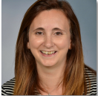
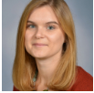



The Staff
Mrs Lambert -Teacher 3 days
Mrs Lodge – Teacher 2 days and SENDCo
Mrs Smither – TA
Mrs Beasley – Executive Deputy Headteacher
Mrs Howe - Executive Headteacher
There are other staff and volunteers that may spend time in our class

Slide 4
Where can you find more information?
School website:
The Village Saints Partnership (demat.org.uk)
Class Dojo: When you have filled in a consent form you will receive an email invite to join our Class Dojo page.
We will use Dojo to show you your child learning throughout the year, you will also be able to add any learning they do at home here too.
Notes:
I will show you the website later

Slide 5
What is the Early Years Foundation Stage?
The Early Years Foundation Stage (E.Y.F.S.) is the stage of education for children from birth to the end of the Reception year.
It is based on the recognition that children learn best through play and active learning.
New EYFS framework (2021) means we don’t have to record as much as we previously had.
Notes:
We no longer need to record all of the children’s learning all of the time – teacher knowledge

Slide 6
There are seven areas of learning and development. All areas are connected to one another and are equally important.
Communication and language – Listening, attention, understanding and speaking
Physical development – Gross motor skills and fine motor skills
Personal, Social and Emotional Development – Self regulation, managing self and building relationships
Literacy – Comprehension, word reading, writing
Mathematics – Number and numerical patterns
Understanding the World – Past & present, people, culture & communities, the natural world
Expressive Art and Design – Creating with materials, being imaginative and expressive

Slide 7
What are the seven areas of learning?
Communication and language development involves giving children opportunities to experience a rich language environment; to develop their confidence and skills in expressing themselves; and to speak and listen in a range of situations mostly through play.
• Physical development involves providing opportunities for young children to be active and interactive; and to develop their co-ordination, control, and movement. Children must also be helped to understand the importance of physical activity, and to make healthy choices in relation to food.
• Personal, social and emotional development involves helping children to develop a positive sense of themselves, and others; to form positive relationships and develop respect for others; to develop social skills and learn how to manage their feelings; to understand appropriate behaviour in groups; and to have confidence in their own abilities.
Notes:
Language - we also do this through talk partners to develop their thinking in talk tasks.
Physical development – you will see we have an extensive outdoor area.

Slide 8
What are the seven areas of learning?
• Literacy development involves encouraging children to link sounds and letters and to begin to read and write. Children must be given access to a wide range of reading materials (books, poems, and other written materials) to ignite their interest.
• Mathematics involves providing children with opportunities to develop and improve their skills in counting, understanding and using numbers, calculating simple addition and subtraction problems; and to describe shapes, spaces, and measures.
• Understanding the world involves guiding children to make sense of their physical world and their community through opportunities to explore, observe and find out about people, places, technology and the environment.
• Expressive arts and design involves enabling children to explore and play with a wide range of media and materials, as well as providing opportunities and encouragement for sharing their thoughts, ideas and feelings through a variety of activities in art, music, movement, dance, role-play, and design and technology.
Notes:
Phonics scheme – RWI and wide range of books during story time and during our topic lessons.

Slide 9
The Early Learning Goals
All of the areas of development lead the Early Learning Goals that we hope your child will be able to achieve by the END of the Reception Year.
We look for children developing these skills in child-initiated activities and independently.
what-to-expect-in-the-eyfs-d99a9272.pdf (cdn-website.com) document uploaded to website contains the Early Learning Goal statements for each area and some ideas to help you to support your child to achieve them by the end of the academic year.

Slide 10

We use Class Dojo to communicate with parents in various ways:
Information is shared on class pages e.g. trips, homework, events etc.
Even if you have another child on Dojo, you need to connect to Saturn class page, so you don’t miss class information.
We also share whole school information on the whole school Dojo page.
We will use Dojo portfolio to show you your child learning throughout the year, you will also be able to add any learning they do at home here too.
Please contact the school office if you experience any difficulties with Class Dojo.
Notes:
Any one with older siblings will know that we used to use Tapestry to inform you of your child’s learning. Last year we moved away from tapestry to make it easier for parents to have things all in one place so we now use Dojo portfolio to record children’s learning WOW moments.

Slide 11
A Dojo contribution could be…
“Angela has counted the candles on her brothers birthday cake all on her own! She counted all the way to 10! Well done Angela!” Numbers
“Ferguson has written every bodies name on this piece of paper with a little bit of help from mummy for his sisters name. He sounded out and remembered all the letters in ‘mum’ and ‘dad’.” Literacy
“We baked fairy cakes at the weekend. Rosie remembered how many tablespoons of water we needed for the icing. She measured and added them herself.” Shape and measure
“Elliot helped his twin sisters to share a new toy by taking turns to play with it.” Personal, social and emotional

Slide 12
The first few weeks
We will find out what the children
already know and can do
and use this information to help us develop an understanding of your child and their learning and development.
Please complete your ‘All about me’ booklet which you can find in your welcome pack and return it at the next session. This will give us some very important insights into your child's world! It helps us to plan learning opportunities that may interest them.

Slide 13
Learning in EYFS
We plan the environment and resources to inspire play linked to the Early Learning Goals.
We observe children and use what we learn to plan the environment.
We follow the children's interests and inspirations.
We should be busy playing to learn and practice our skills.
We have a Knowledge rich curriculum that is taught to be remembered.

Slide 14
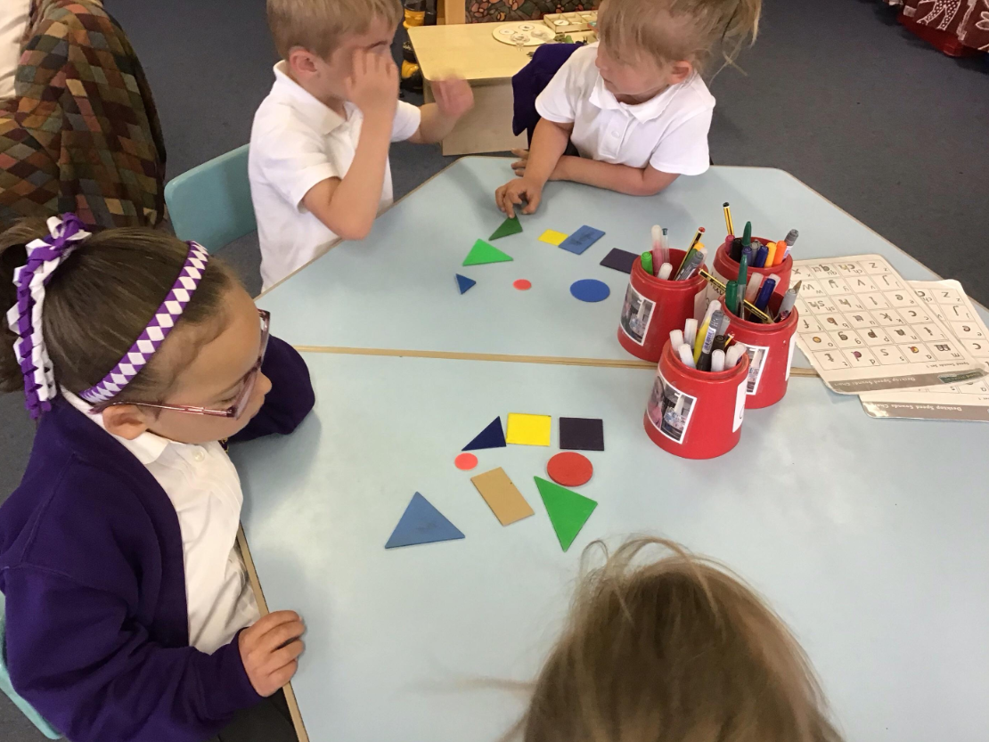
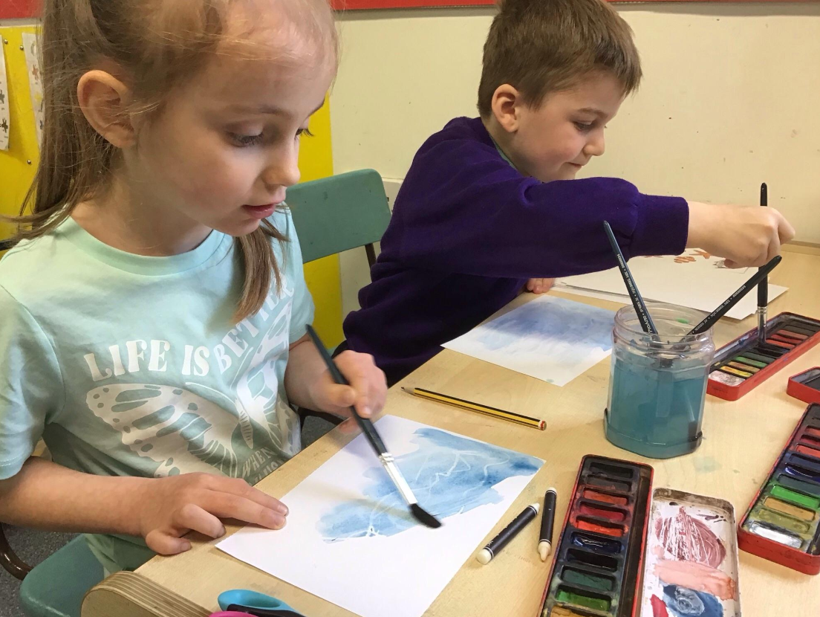
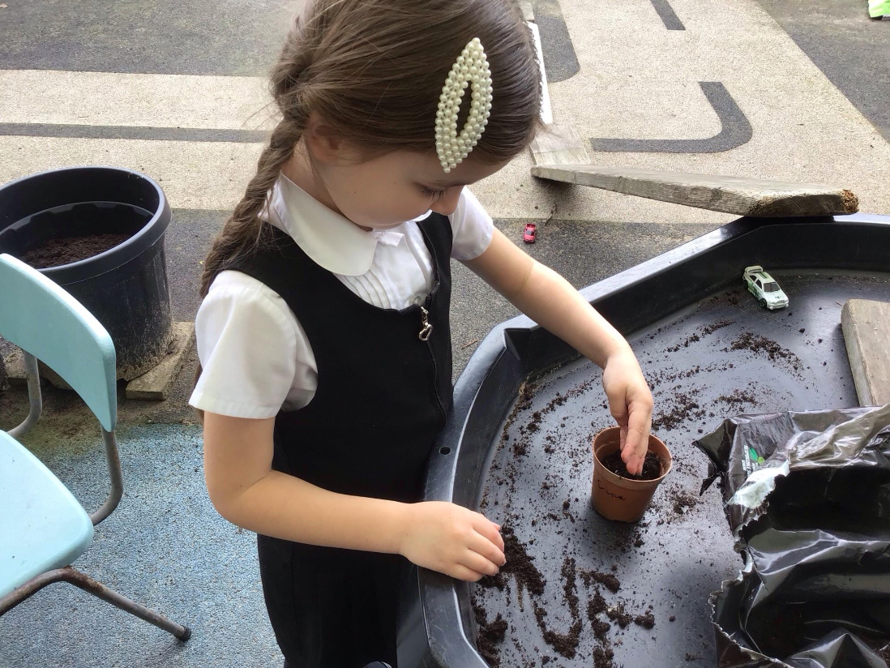
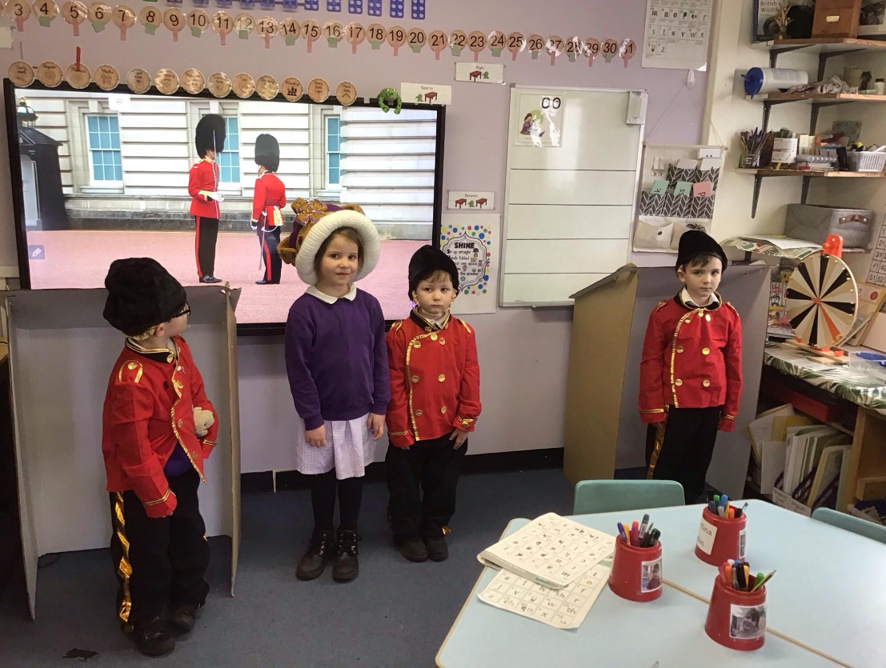
How we teach:
Playful adults
Model
commentate
Pose questions
Set challenges

Slide 15
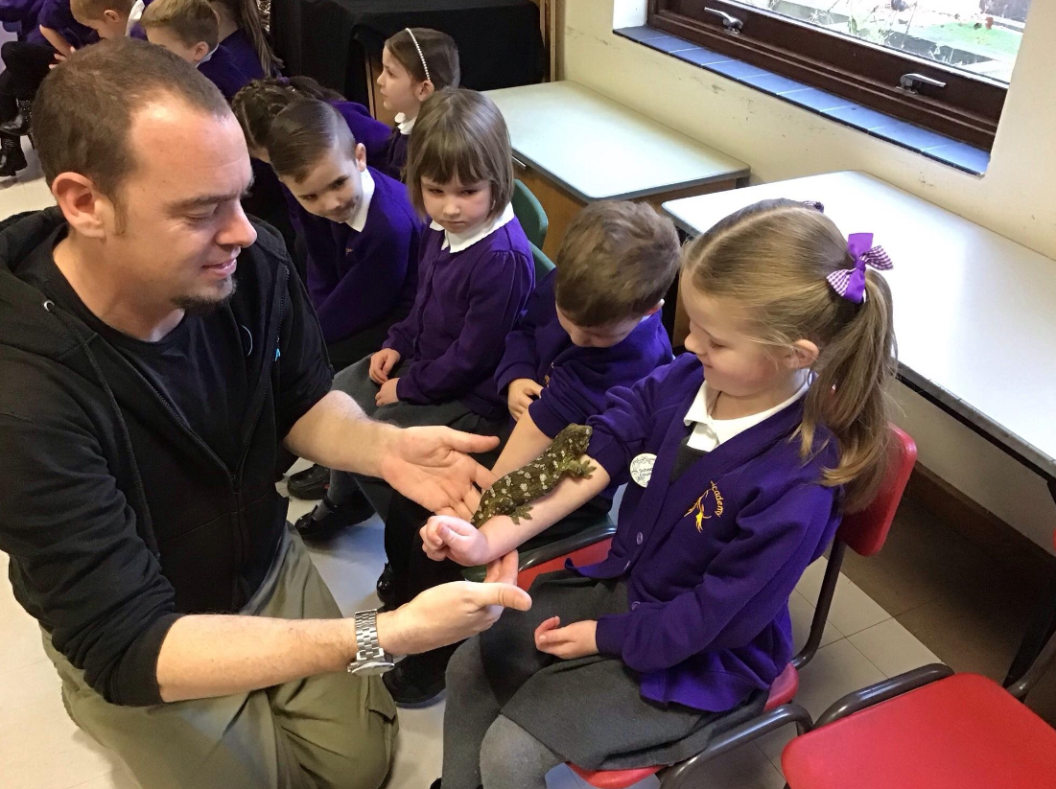
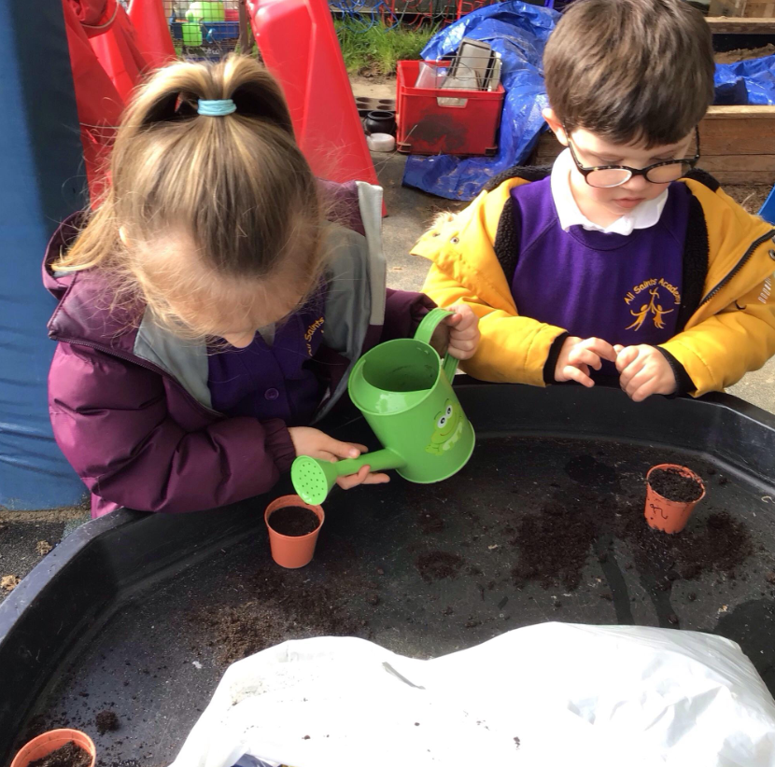
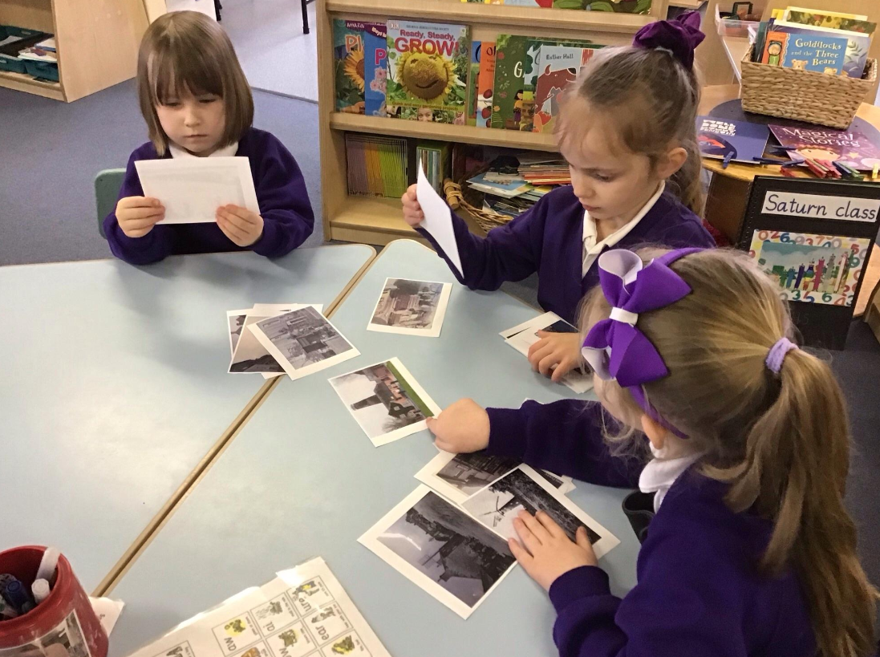
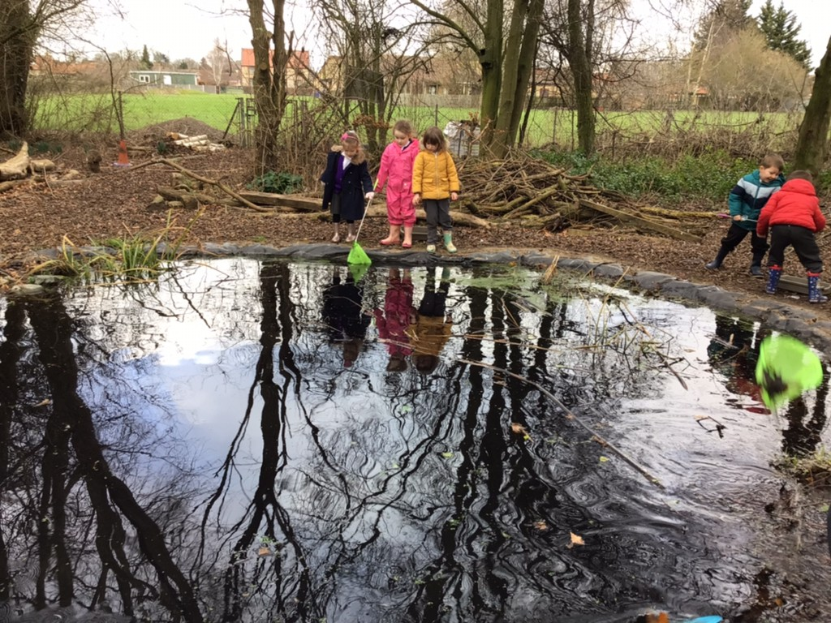
How we learn:
First hand
Messy
Creative
Child led

Slide 16
A Typical day in Saturn Class
8.40 - 8:45 – Children say goodbye to parents and are led into their class from the playground by their teacher. We hang up our coats and put our lunch boxes and book bags away. Then we do the register.
8:45 – 9:00 – Early morning tasks
9:00 – 9:30 – Phonics
9.30 – 10:00 - Maths
10:00 – 10-15 – Snack time
10:15 – 11:15 – Child initiated playful learning
11:15 – 11:45 – Drawing club
11:45 – 12:00 – Wash hands ready for lunchtime sing a song/story/maths meeting
12:00 – 1:00 – Lunch time
1:00 – 1:30 – Guided learning task e.g. topic, RE, music, PE followed by snack
1:30 – 2:45 – Child initiated playful learning
2:45 – tidy up and story
3:00 - 3:15 – home time

Slide 17
Book Bags
We encourage children to have a book bag to carry books, work and letters in.
We will give your child a folder which will contain your child's reading book, reading record, library book and phonics learning, please can these be in school everyday.
Please check your child's book bag and folder everyday for homework and any letters or invitations from the school.
We will visit the library once a week to change our books, we usually do this on a Thursday. We encourage the children to bring their library books everyday so that the children can read and share them.

Slide 18
Snack time and Lunch time.
Children up to the age of 7 are entitled to a piece of fruit daily which is funded by the government. Children are welcome to bring a snack from home. As a school we encourage children to eat as healthily as possible and request that snacks are fruit or vegetables.
Children up to the age of 7 are also entitled to a free school lunch – we have a lot of choice on our menu – pasta, hot school meal, packed lunch, jacket potato.
As much as possible home packed lunches need to consist of healthy and nutritious food with tasty treats such as sweets, chocolate, crisps, biscuits and cakes kept to an absolute minimum. Lunches can be book by yourself on the my child at school app.
Water is extremely important for busy children. Well hydrated children are ready and more able to learn successfully. Children will need a school bottle which we will send home for a wash and a refill at the end of the day. Please only put water in water bottles – our ants love squash and juice.
Notes:
Please can we encourage you to book lunches –especially for the first few weeks as it will help us when settling the children in.

Slide 19
Reading – How can you help?
We have a daily Read Write Inc. session where children learn and practice reading and writing with an adult. These books will also be shared with you to practice at home too.
We hope that you will listen to your child with their reading book. We like reading books to be read at least 3 times, for accuracy, speed and comprehension. We change books once a week and we encourage children to spend time looking at other books too.
We love to hear about other books, poems, songs, signs etc. that your child has been reading so please leave us a comment in your child's reading record to tell us all about it! Or upload a video to Dojo.
There is additional information on Saturn class page on the school website about supporting your child's reading development.

Slide 20
Homework
Each week your child will receive phonics homework consisting of sounds and words to learn linked to the phonics teaching at school.
Children will also have a homework grid with things you can do at home with your child linked to our topic for each half term. Most of this will be play based ideas.

Slide 21
Learning is fun!
Please remember that children learn so much through play and games. We try to bring important learning to their play and games rather than dragging them away from play to ‘learn’.

Slide 22
Useful Websites
www.pinterest.com Under the education section Parents, T.As and Teachers from around the world post really fun and interesting learning activities and ideas
www.phonicsplay.co.uk Great phonics games to support reading.
http://www.earlylearninghq.org.uk/ Good information and resources
http://www.education.gov.uk/schools/teachingandlearning/curriculum/a0068102/early-years-foundation-stage-eyfs
What to expect, when? - Foundation Years - what to expect when – a parents guide
http://www.bbc.co.uk/schools/websites/eyfs/ and http://www.bbc.co.uk/schools/ Great activities, videos, songs and information

Slide 23
Medical Matters
Head lice are common! Please check regularly and treat as recommended.
As much as possible we would prefer the administration of medicines to be carried out by parents or carers. (e.g. medicines 3 times a day taken before school, after school and after tea).
We can only administer medicines prescribed by a doctor or nurse.

Slide 24
Attendance
If your child is unwell or unable to attend school, you must phone the school and inform us in the morning.
Please inform us of any known absences or medical appointments as soon as you can. Please do this through the school office.
We recommend arranging appointments outside of the school day and around registration time at 9am and 1pm.

Slide 25
Other matters…
Please name all clothing, footwear and belongings. Be aware that pen fades and washes out.
We like to learn outside and, at times, in very messy ways. We would appreciate a set of spare clothes in a carrier bag in the children’s book bags. It would also be helpful to include a set of waterproofs and wellington boots.
We love celebrating children's birthdays! And for this special occasion we do allow the special birthday person to bring in small treats like cakes/sweets.
We know children love their toys and special things from home, but they can be very upset if they get lost or broken so, please discourage children from bringing them in.
On PE days children need to come dressed in PE kit, we will inform you at the beginning of term which day this will be.

Slide 26
Uniform
Boys uniform
Black shoes (no backless shoes and no boots), grey or black socks.
Purple All Saints Academy sweatshirts or purple ‘V’ or round neck pullover.
White shirt or a plain white polo shirt.
Grey or black long trousers.
Girl's uniform
Black ‘flat’ shoes (No backless shoes and no boots), grey, black or white socks.
Purple All Saints Academy sweatshirt or purple ‘V’ or round neck pullover or purple cardigan.
White blouse or a plain white polo shirt.
Grey or black skirt/pinafore dress or grey or black tailored trousers.
All Saints Academy | Birds of Dereham

Slide 27
Uniform
PE Kit:
Plain black shorts
Black Trainers
White t-shirt (school printed purple ones are available from birds)
Jogging bottoms or tracksuit (black or dark blue with no hoodies).
NB: Plimsolls are not part of our PE Kit

Slide 28
And Finally…
If you have any worries or concerns, please message either of us via Class Dojo or contact the school office 01366 501050 office@allsaintsacademy.norfolk.sch.uk

