Slide 1

www.kooth.com
Time to talk about mental health

Slide 2


Where do I go for help?
Kooth.com is a website you can use to get advice, support and guidance from qualified counsellors via a live chat service, or from young people your own age via moderated forums, for any problem, no matter how big or small.
Notes:
Kooth.com is an online counselling service that provides support for YP in a variety of different ways, including self help research, peer support and 1-1 counselling.

Slide 3

What can Kooth.com help with?
Friendship problems
Depression
Stress
Anxiety
Family issues
Self harm
Bullying
Body image
Loneliness
Social media
Issues around eating
Relationships
Anything
Just having a bad day…..
Notes:
Some of the main issues we deal with regularly at Kooth are above, there is no criteria they have to meet to use the site and the most important thing is that YP know they can talk to us about anything.

Slide 4

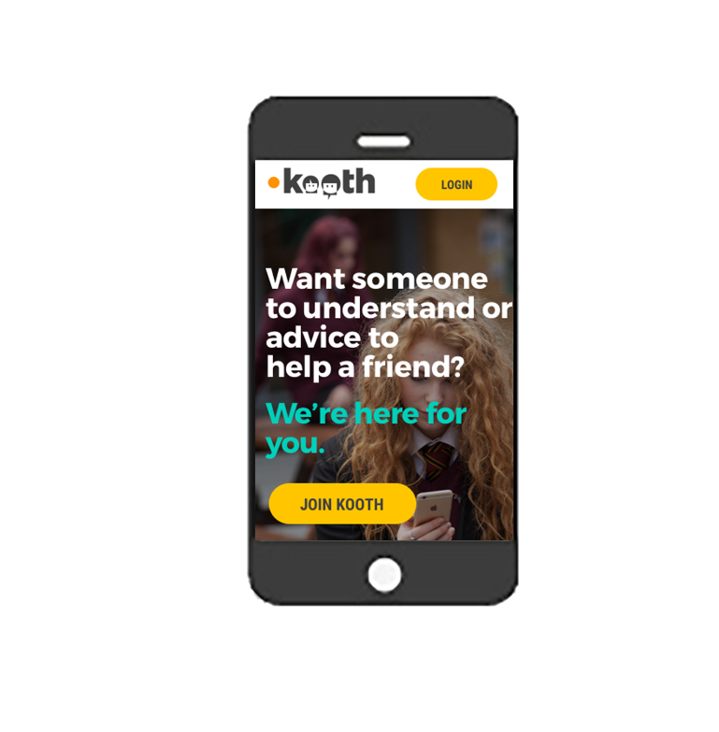


How do I access Kooth?
Kooth.com is available on any internet enabled device
Click
Notes:
Its really quick and simple to use, and can be used on any device that can access the internet. No app currently but the phone site works effectively.

Slide 5
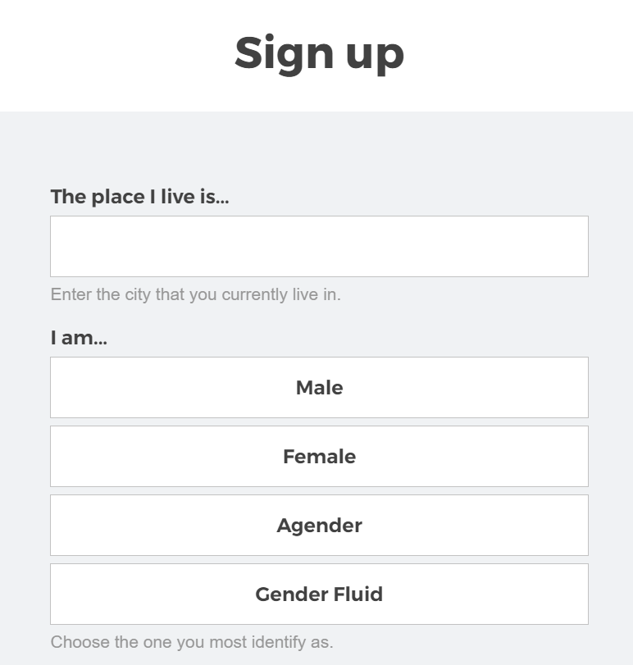
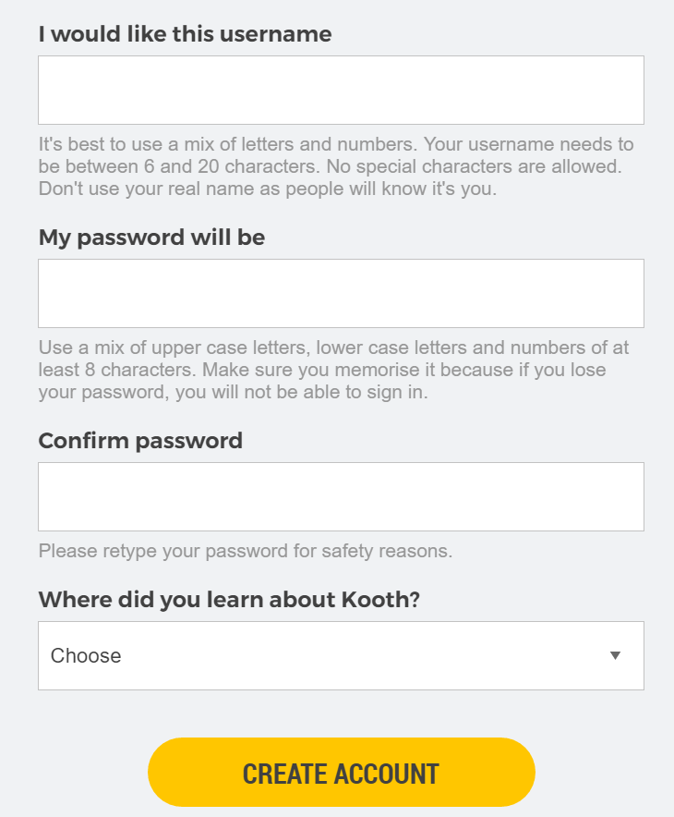
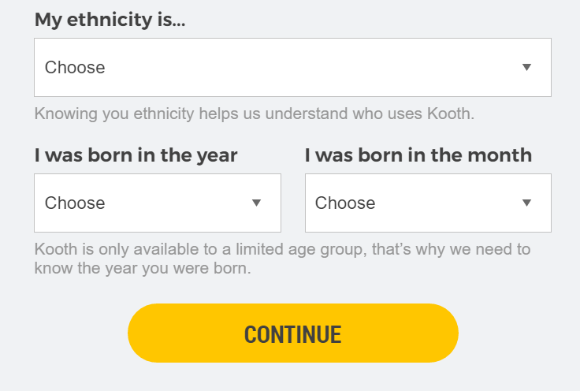
Notes:
We ask them 4 basic questions about themseleves when they sign up to Kooth (Location, - drop down box and non specific, Gender – 4 gender options as identified by YP, Ethnicity and their age and the month they were born. We don’t have any specific info about the YP and can’t identify them in any way. They have the option to remain anonymous throughout their use of the site.

Slide 6
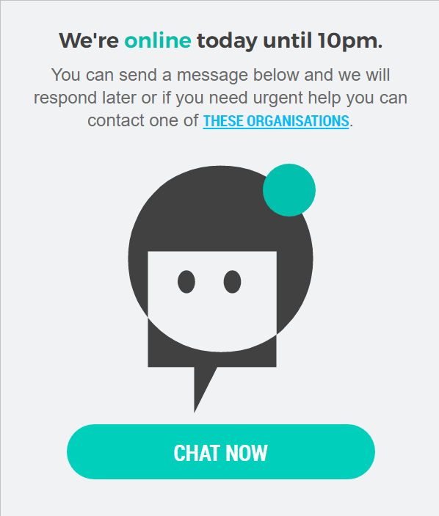
How do I speak to a counsellor?
Click ‘Chat now’ to have an anonymous, text based conversation with a counsellor
Chat is open:
  12noon – 10pm Mon – Fri
  6pm – 10pm Sat & sun
  365 days a year
Notes:
Once a YP clicks on Chat Now they are put in to a queue where counsellors can see they are waiting. As soon as they are available they will notify that YP they are ready to chat. YP can wait in some cases up to 1hr at busy times , but will receive a message from a counsellor regarding their wait if they are longer than 15 mins. We are not a crisis service so YP in crisis will always be advised to call more emergency services if that is the case.

Slide 7

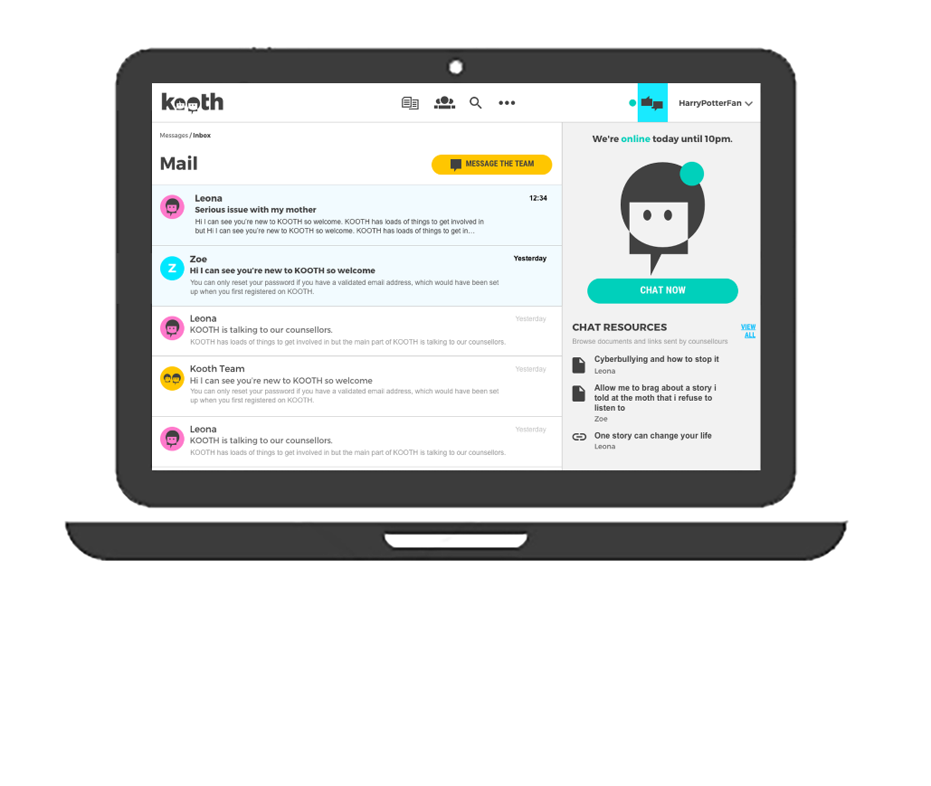
Email the Team
To all the team or a specific counsellor

Slide 8
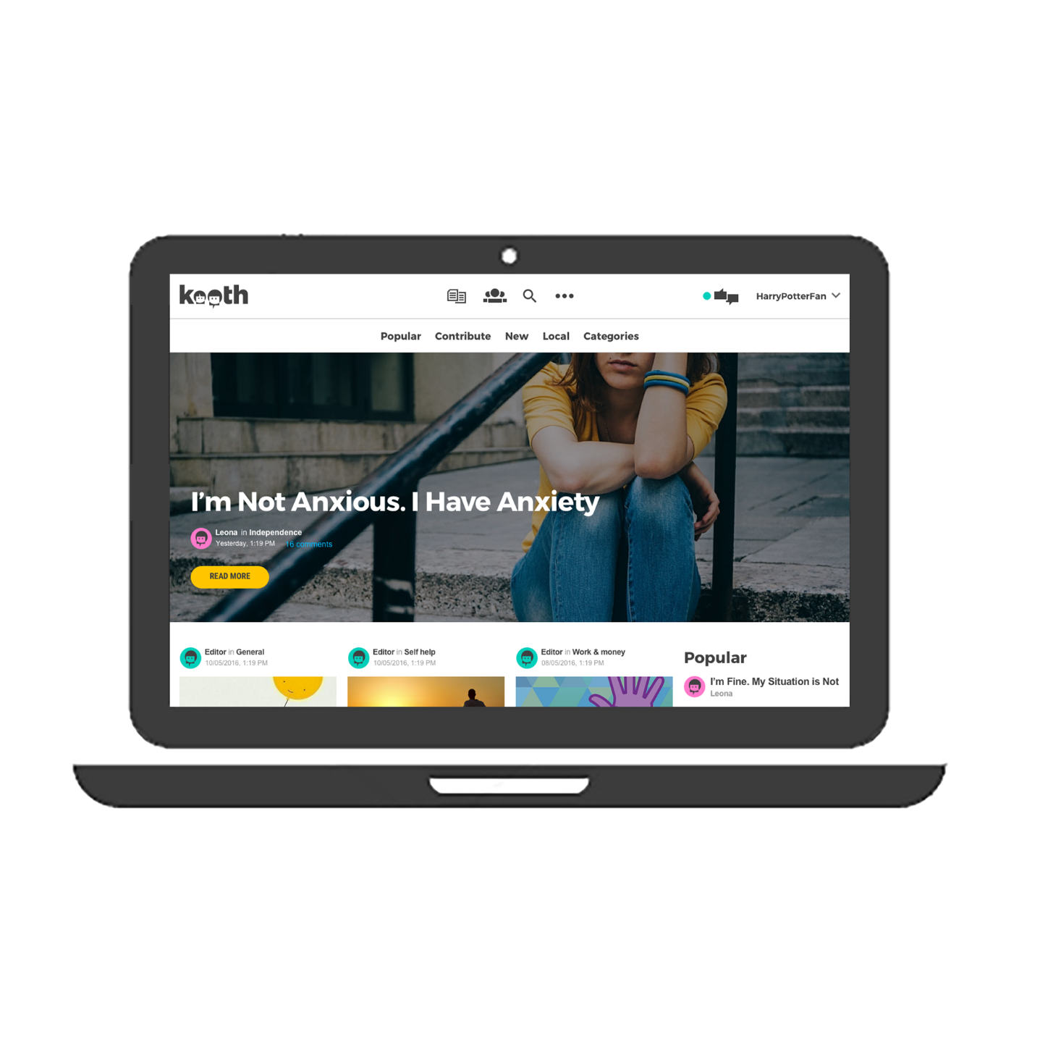
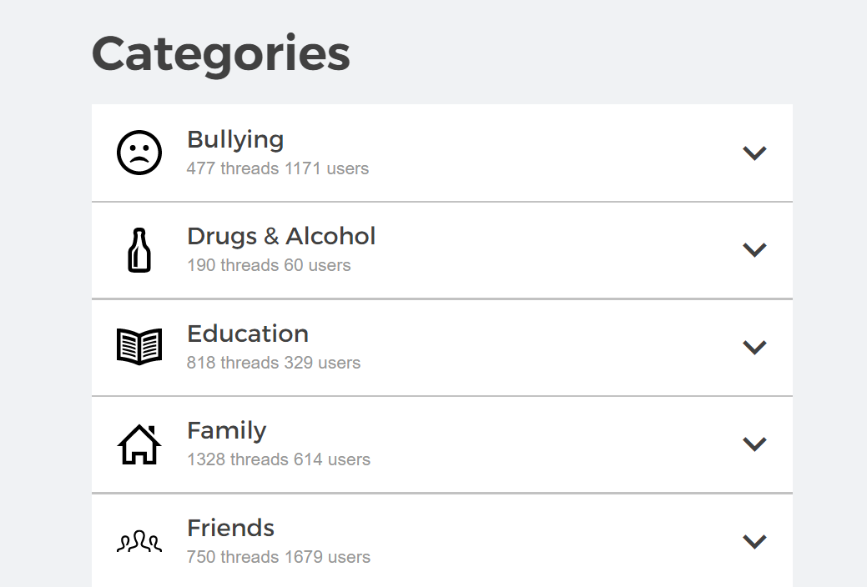
What else can I do on the website
Post a message in our moderated forums
Connect with young people who are feeling the same as you
Receive messages of advice & support
We check all messages before they go live so we can guarantee you will get a helpful and positive response
Notes:
YP can get support from their peers in the forum part of the site. All messages are monitored BEFORE they go live on the site to prevent disclosures of identity or any other behaviours that don’t sit within our community guidelines.

Slide 9
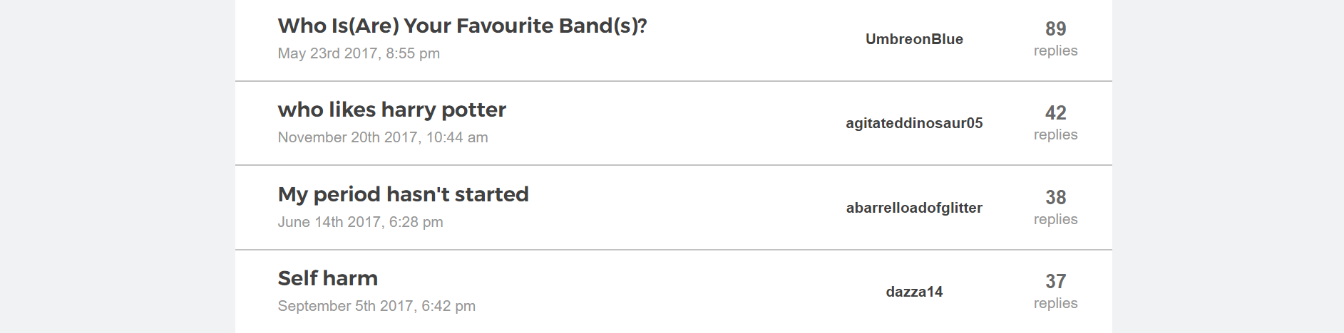
Forums & Message boards

Slide 10

Live forums
Mon, Wed and Fri from 7.30-9:00pm
Every live forum has a different theme
You can participate in as many forums as you want
All forums are hosted and moderated in the moment by our Kooth staff

Slide 11

Read articles & share your story
We have loads of articles on hundreds of different topics
Find answers, gain information & learn strategies to help you cope
Write your own article & upload it to the site
Notes:
The magazine contains articles written by our staff members and YP who have contributed to the site.

Slide 12
www.Kooth.com
Everything is moderated and confidential
No personal details or real names
All the counsellors are trained, qualified and are used to working with young people
If you needed, we would talk to you about face-to-face services as well as talking to us online

Slide 13

Don’t bottle things up –
Talk!
Sign up today at Kooth.com

