Slide 1
Year 11
Examination Preparation
Science
Miss Bohan– Head of Faculty

Slide 2
Introduction to the subject to help with revision
Name of subject
GCSE Science
Type of qualification
GCSE Science Qualifications received will be 2 GCSE Science grades 9-1
Exam board
AQA Syllabus, 9-1 AQA Trilogy specification for GCSE Combined Science
The components of the qualification
The course includes Biology Chemistry and Physics and Required practical components

Slide 3
Course Outline
The AQA combined Science course components
Biology 1. Cell biology 2. Organisation 3. Infection and response 4. Bioenergetics 5. Homeostasis and response 6. Inheritance, variation and evolution 7. Ecology | Chemistry 8. Atomic structure and the periodic table 9. Bonding, structure, and the properties of matter 10. Quantitative chemistry 11. Chemical changes 12. Energy changes 13. The rate and extent of chemical change 14. Organic chemistry 15. Chemical analysis 16. Chemistry of the atmosphere 17. Using resources | Physics 18. Energy 19. Electricity 20. Particle model of matter 21. Atomic structure 22. Forces 23. Waves 24. Magnetism and electromagnetism

Slide 4
Mock examinations
You will have 3 mock examination papers
Each will be 1 hour 15 minutes long
1 Biology
1 Chemistry
1 Physics
Example
Biology Paper 1
What's assessed Biology topics 1–4: Cell Biology; Organisation; Infection and response; and Bioenergetics.
How it's assessed Written exam: 1 hour 15 minutes Foundation and Higher Tier 70 marks 16.7% of GCSE
Questions Multiple choice, structured, closed short answer, and open response.

Slide 5
Year 11 Revision 2020-21
Mastering Science

Slide 6
Paper 1 Revision Timetable 11–Science GCSE (Higher and Foundation)
Put in your own dates to map out your revision. You should spend about 15-45 minutes on revision each day.
DATE | Paper | Topics | Revise | Practice | Review | Completed
 | 1 | Atomic structure and the periodic table | 88-93 | 110 | 128-129
 | 1 | Cell biology | 16-23 | 34-35 | 56-57
 | 1 | Energy | 170-173 | 181 | 201
 | 1 | Bioenergetics | 46-49 | 61 | 82
 | 1 | Chemical changes | 114-119 | 132-133 | 150-151
 | 1 | Organisation | 24-31 | 37-38 | 58-59
 | 1 | Structure bonding and the properties of matter | 94-101 | 111-112 | 129-130
 | 1 | Atomic structure Particle model of matter | 212-217 210-211 | 224-225 222 | 228-229 227
 | 1 | Infection and response | 40-45 | 60 | 80-81
 | 1 | Quantitate chemistry | 102-105 | 112-113 | 131
 | 1 | Energy changes | 120-121 | 134 | 152
 | 1 | Electricity | 188-197 | 204-205 | 219-221

Slide 7
Year 11 Revision 2020-21
Mastering Science
Top Tips
Read the information
Make any relevant notes
Complete quick test questions
Practice
Review

Slide 8
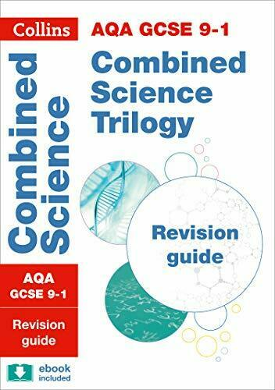
Key revision for success in this subject
Knowledge organisers for scientific terminology
All students have access to a Combined Science revision guide
Weekly Revision schedule linked to revision guide
Key questions outlined for completion in Revision guide
After school intervention sessions with a focus on required practical’s which is a vital component of the course

Slide 9
What can you do?
Completing revision schedule with Combined Science revision guide
Using Freescience videos to revisit required practical lessons
https://www.youtube.com/channel/UCqbOeHaAUXw9Il7sBVG3_bw
Using the National Oak academy lessons by topic
https://classroom.thenational.academy/subjects-by-key-stage/key-stage-4/subjects/combined-science
BBC Bitesize Combined trilogy multiple choice practice questions
https://www.bbc.co.uk/bitesize/examspecs/z8r997h
Ensuring definitions of scientific terminology is revisited using Knowledge organisers and homework application questions are completed

Slide 10
Any questions
If you have any questions regarding Science please email me directly s.bohan@alsophigh.org.uk
Or speak to your teacher
Good Luck!

