Slide 1
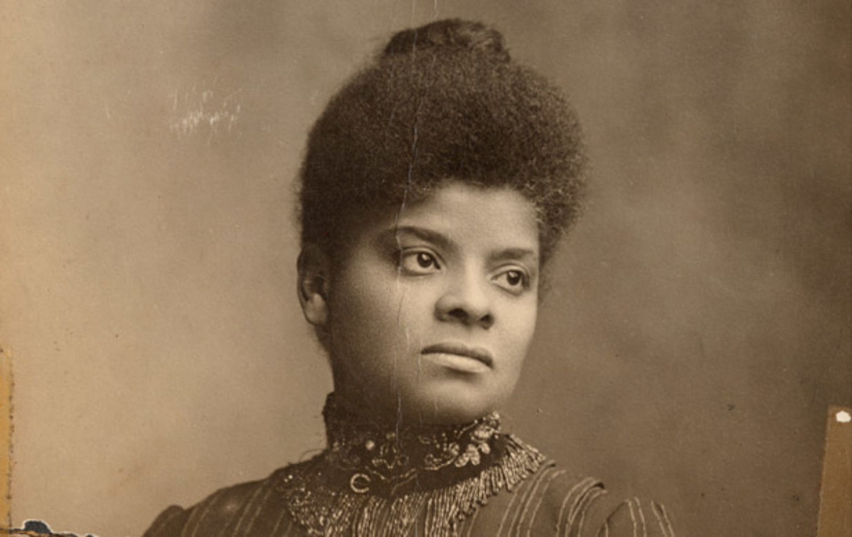
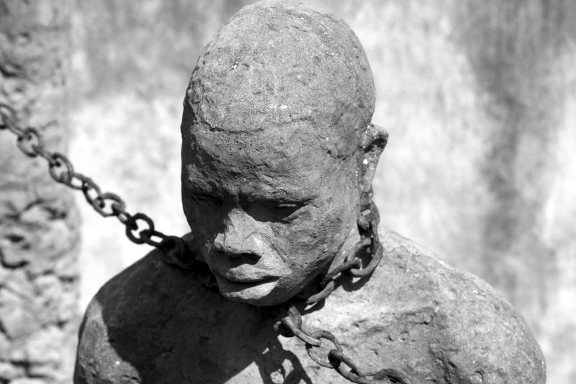
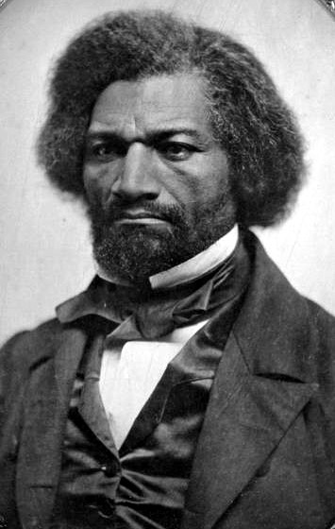
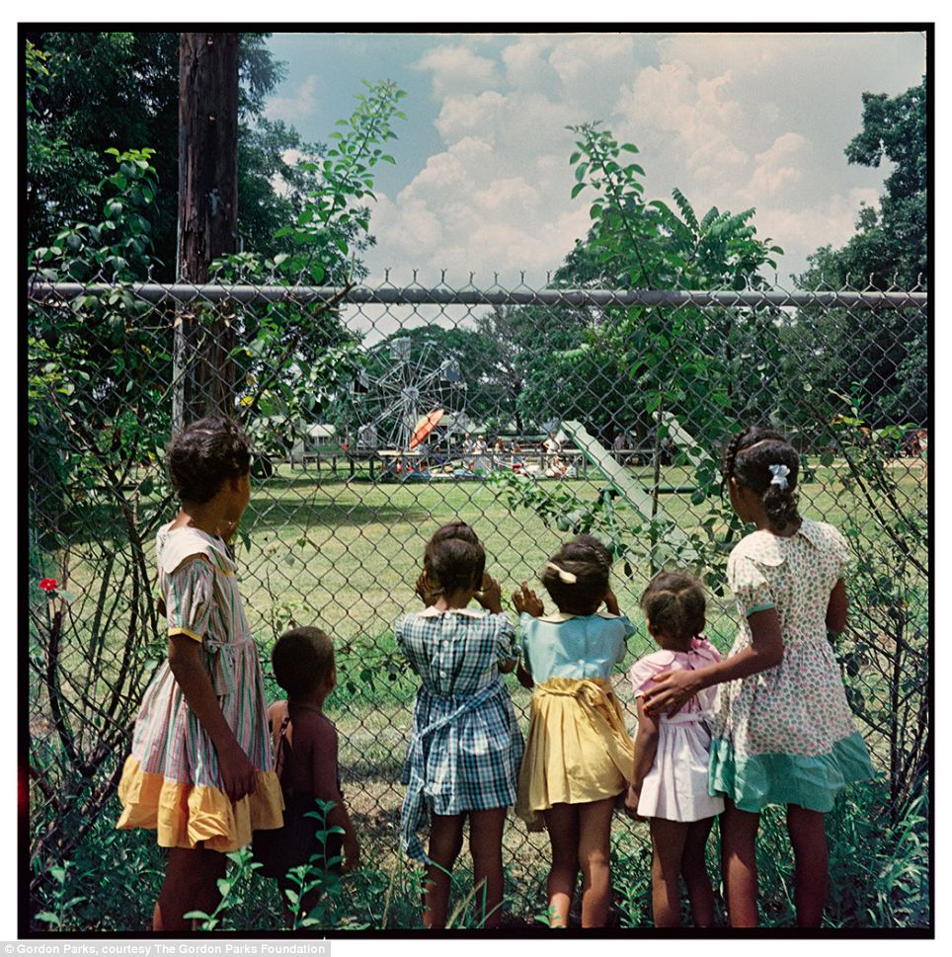
Year 13 Revision
African American Civil Rights
1865-1992

Slide 2
Thematic Study - 1865 - 1992
Threads / themes that affect African American Civil Rights
Social (education, poverty ‘society’)
Economic (employment, jobs, finance)
Political (Federal Government ‘legislative, executive, judiciary’
Black leaders – Dr King, Malcolm X, Booker T
White opposition – KKK, Mother’s League
Black groups – NAACP, SNCC etc.

Slide 3
Exam Tips
1 hour
3 main points – developed
Comparisons made across the period – similarly / conversely etc.
Show how Civil Rights was afforded and denied, won or lost
Comment / write from a helicopter perspective – the ‘Big Picture’
You have to cover the WHOLE period ACROSS the essay NOT in every paragraph.
12 minutes approximately for each paragraph

Slide 4
‘Black leaders’ exam question – paragraph model
When analysing the period 1865-1992 from a social perspective Dr King made an enormous, unparalleled impact on the African American Civil Rights movement. Like no other leader Dr king’s words and actions hit America’s conscience and his Birmingham and Washington campaigns in 1963 are emblematic of this nationwide impact. His conflict with Bull Connor and his ‘I have a dream’ speech did more to combat racist attitudes across the period than any other black leader as upon hearing his speech and seeing his confrontation with vicious racists like Connor many people’s racist attitudes changed as a result. Similarly, but perhaps less impactful on a social level was Booker T Washington in the 1800s who set up the Tuskegee Institute which provided a vital education for black society. This provided many black students with more social opportunities which allowed society to battle Social Darwinism and hierarchal supremacy proving to the white community it was a myth. Another prominent black leader who had a significant impact on a social level was Ida B. Wells who bravely published the horrors of lynching in her journal A Red Record. Wells was impactful because the said publicity helped change attitudes as people were appalled by the horrors of lynching and garnered more support across America for the Civil Rights Movement. Although Wells and Booker T had an important impact socially on changing racist attitudes in society it was Dr King who was the most important black leader in a social sense because in the 1960’s the mass media allowed his non-violent, impassioned messages to explode across the nation an hit the conscience of the people on a level never seen before or since.

Slide 5
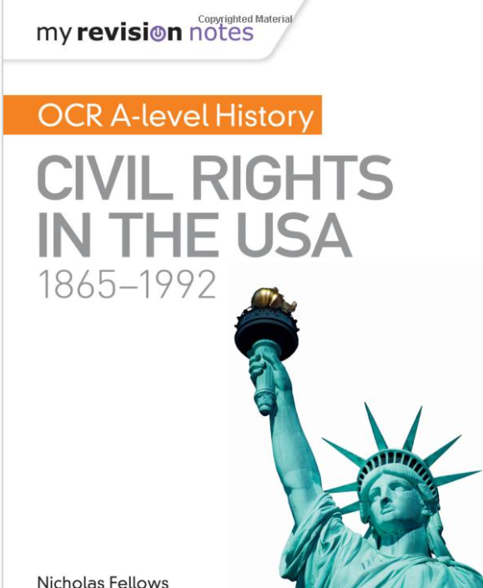
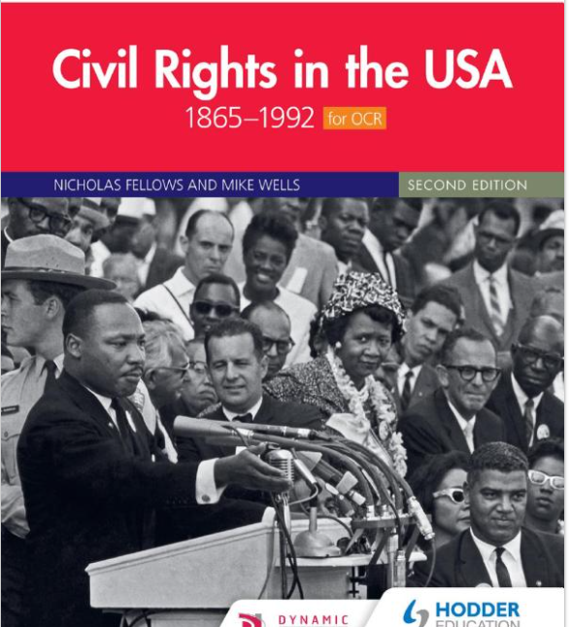
Revision Books – everyone should have these

