Slide 1

Welcome to​
Alston Lane
Reception Class
Meet the Teacher 2026

Slide 2
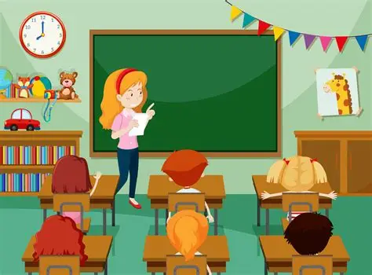
Meet the Team
Mrs Poulton: Early Years HLTA
Ms Wood: Reception Teacher

Slide 3
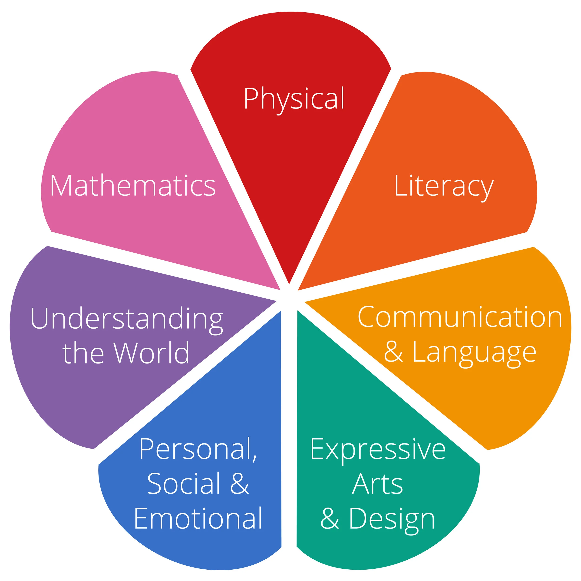
Curriculum Overview
7 Areas of Learning

Slide 4
Areas Of Learning
3 Prime Areas:
1. Communication and Language
2. Physical Development
3. Personal, Emotional and Social Development.

Slide 5
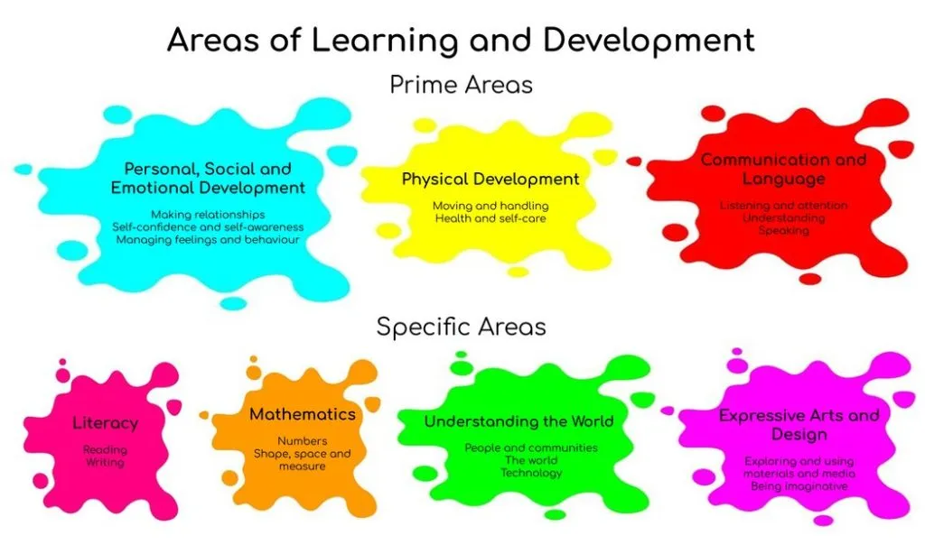

Slide 6
Communication and Language……
Involves giving children opportunities to experience a rich language environment; to develop their confidence and skills in expressing themselves; make comments about what they have heard, ask questions to clarify understanding, speak and listen in a range of situations. Speak in full sentences, use past, present & future tenses, use conjunctions, offer explanations.
Listening, Attention & Understanding.
Speaking.

Slide 7
Physical Development…
Involves providing opportunities for young children to be active and interactive; and to develop their strength, balance, co-ordination, control, and movement. Negotiate space & obstacles safely with consideration of selves & others. Focus upon effective pencil control & use of tools e.g. scissors, paint brushes & cutlery
Gross Motor Skills
Fine Motor Skills

Slide 8
Personal, Social and Emotional Development…
Involves helping children to develop a positive sense of themselves, and others; to form positive relationships and develop respect for others; to develop social skills and learn how to manage & regulate their feelings; to understand appropriate behaviour in groups; and to have confidence in their own abilities.
Self Regulation
Managing Self
Building Relationships

Slide 9
Provision is also made for 4 Specific Areas, through which the 3 Prime Areas are strengthened & applied.
1. Literacy,
2. Mathematics,
3. Understanding the World,
4. Expressive Arts and Design.

Slide 10
Literacy Development…
Involves encouraging children to apply of phonological awareness of letter sounds in reading and writing, knowledge of some tricky common exception words, Children must be given access to a wide range of reading materials (fiction & non-fiction books, poems, and other written materials) to ignite their interest. Focus upon letter formation, understanding of what has been read to them, use of linked vocabulary
Comprehension
Word Reading
Writing

Slide 11
Mathematics…
Involves providing children with opportunities to develop a deep understanding of numbers to 10, including composition, subitising simple numbers, automatic recall of simple number bonds including doubling facts. Focus upon improve their skills in counting orally to 20+, recognising the pattern of the counting system, comparing & contrasting numbers using vocabulary; greater, smaller, more than, less than, the same. Exploration of & ability to represent number patterns; doubling, sharing equally, odds & evens.
Numbers
Numerical Patterns

Slide 12
Understanding the world…
Involves guiding children to make sense of their physical world and their community through opportunities to explore, observe and find out about people, places & the environment. Finding out about people around them & their roles in society, explore past & present, explore fiction & non-fiction, maps, explore the natural world, seasonal change & change of state.
Past & Present
People, Culture & Communities
The Natural World

Slide 13
Expressive Arts and Design…
Involves enabling children to explore and play with a wide range of media, materials, tools & techniques, as well as providing opportunities and encouragement for sharing their thoughts, ideas and feelings through a variety of activities in art, music, movement, dance, role-play, and design and technology. Experimenting with colour, design, texture, form & function.
Creating with Materials
Being Imaginative & Expressive

Slide 14
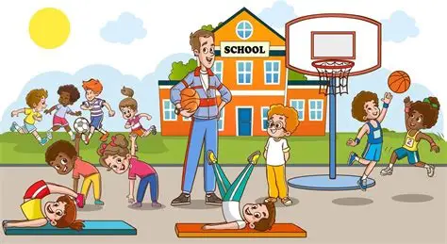
PE Days
PE is on a Thursday morning in the hall.
Long hair must be tied back with plain bobbles, no claw clips.
No Jewellery or friendship bracelets. plain, flat backed, plastic spacers may be worn in ears.

Slide 15
Safeguarding
All visitors to use the main entrance and sign in.
For assembly – use the playground door next to Year 1.

Slide 16
Communication
Email – staff@alstonlane.mecmat.org
We are available on the gate at 3:30 after all children have been handed over.
Make an appointment at the office.

Slide 17
Reading Records
Reading Records should be completed each time your child reads – at least three times per week but ideally daily

Slide 18
Phonics Evening Wednesday 16th September 5:00-5:45pm
Parents Evenings – Autumn 12th and 13th October and Spring Term 22nd and 23rd March in person in the hall.

