Slide 1



Reading & Phonics Parental Workshop
Alston Lane Catholic Primary School

Slide 2

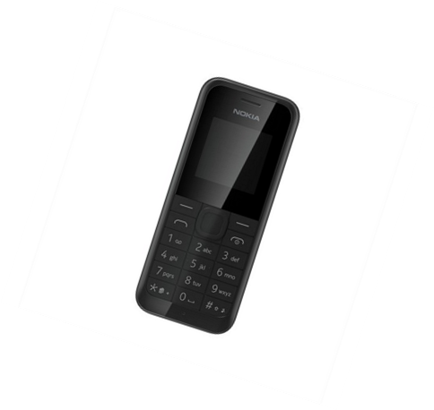
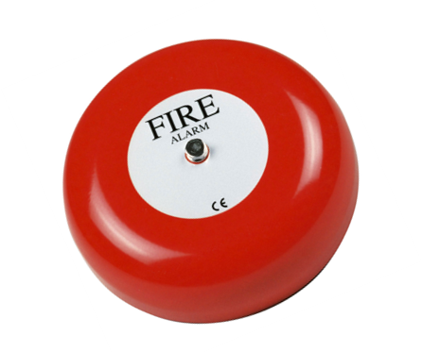
Introductions and Housekeeping
Mrs Woodrow – Assistant Headteacher and English Lead
Miss Rushton – Reception Class Teacher
Mrs Poulton – Reception TA

Slide 3

Session Aims
To gain an understanding of our intent for reading at Alston Lane.
To understand how children to learn to read.
To understand how we teach children to read.
To understand how you can help at home.

Slide 4

Our Reading Intent
At Alston Lane, we believe that reading is a master skill which creates opportunities for our pupils to develop culturally, emotionally, intellectually, socially, and spiritually. We aim to create successful, fluent readers who read to gain information and for pleasure. We are committed to exposing children to a rich and diverse reading curriculum and strive to instil a passion for reading in pupils, which they will continue develop throughout their education and in later life.

Slide 5
Learning to Read.
A complex process where word recognition and language comprehension work together.
Word recognition:
Ability to decode text to read words.
Language comprehension: The ability to understand what has been read.

Slide 6
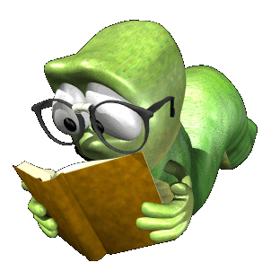
Good word recognition, good language comprehension
Word recognition
+
Good language comprehension, poor word recognition
-
+
Language Comprehension
Good word recognition, poor language comprehension
Poor word recognition, poor language comprehension
-
Notes:
So this diagram explains the relationship between the two elements word recognition and language comprehension and how this impacts upon a child’s ability to read.
Language comprehension is represented along the x axis – from poor to strong – e.g their ability to understand new vocabulary and comprehend what they have read.
Word recognition is represented on the y axis from poor through to strong – this is their ability to decode text.
Aim – to get children to be in the top right quadrant – so they can decode words and they understand what they have read. These children are fluent readers who are able to understand what they have read. Ideally we would want both these two strands to develop simultaneously throughout school.
So as your children have just entered into school, we don’t expect them to be there yet! Ideally we would like them to come into use in the top left quadrant. So here we don’t expect them to have a good word recognition as they have not started school. But ideally, we would like them to have developed age appropriate language comprehension through the conversations they have had at home with parents, grandparents, nurseries etc and hopefully all the reading exposure you have given them – e.g. sharing stories with them.
Now it maybe that some children enter into the reception class into bottom left quadrant – this is also common! Understandably, they have poor word recognition but they may also for a multitude of reasons have poor language comprehension. But where ever they come in – Mrs Andrew and Mrs Poulton will be expertly working with children to develop both. And in a minute – they are going to explain how they support children to develop in both areas.
The last quadrant is children who have good word recognition but poor language – and some children my fall into this quadrant as they progress through school but we would put lots of support in here.

Slide 7
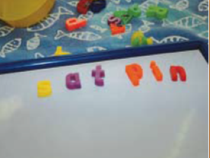
How we develop word recognition.
Phonics
Phonics is a method for teaching reading and writing of the English language by children learning sounds and linking them to letters.
A written language is basically a kind of a code. Teaching phonics is just teaching children to crack that code.
Notes:
Not how we learnt to read – so we appreciate it tricky for parents.

Slide 8
So what goes in to phonics?…
Phonics
Words are made up from small units of sound called phonemes. There are 44 sounds in the English language that we teach the children. A grapheme is the written version of the sound.
However, we only have 26 letters in the alphabet so some graphemes are made up from more than one letter. Digraphs are two letters that make one sound (sh, ch, th).
Trigraphs are three letters that make one sound (air, ear, ure).
At Alston Lane we follow the Red Rose Letters and Sounds systematic synthetic phonics programme starting when our children enter the nursery. Throughout the Early Years and KS1, phonics is given high priority and taught daily.
Notes:
Phoneme – is the sound (think of a phone)
Grapheme – is the written version of the sound (think of the word graphics)

Slide 9
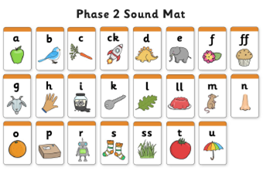
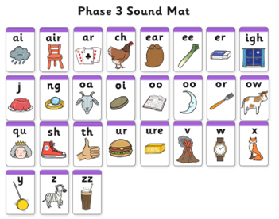
Linking letters and sounds
Phonics
GPC
Grapheme Phoneme Correspondence
Notes:
So our phonics scheme runs from phase 1 through to phase 5.
Nursery – phase 1 (really important phase which teaches listening skills, rhyming and sound discrimination) This is essential for children to read. They cannot move on to learning to read if they cannot distinguish sounds.
Mrs Andrew has been working on this with the children right from day one! And just this week she has moved onto phase 2 – where the children start to learn Grapheme Phoneme Correspondence.
So this week – s a t – they need to learn to hear the sound (phoneme) and match it to the grapheme (the written representation). They also need to learn to form the letter correctly. So learning S is quite tricky – Mrs Andrew
By the end of this year, if your child is progressing on the normal trajectory they will have learnt all phase 2 and 3 sounds and started to work on phase 4. However, most children will need some intervention for this – it is tricky. So your support at home, is imperative – which we will talk about later.

Slide 10
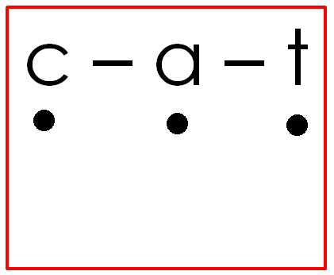
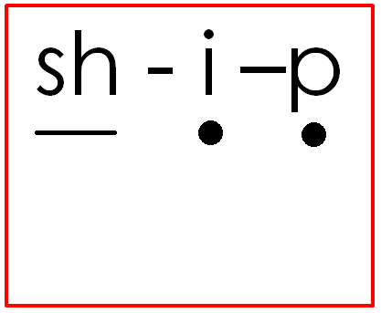
Main components of phonics…
Phonics
Blending for reading
the process of recognising the letter sounds in a written word and synthesising (merging) them in the order in which they are written to pronounce the word.
Emphasis on smooth reading is key here!
Children do go past this stage but need to be able to use this strategy when reading an unfamiliar word.
Notes:
So at the same time as learning the GPCs – (so that is matching the sound to the written representation) they also need to be able to blend the sounds together to read the words.
Read caption!
This is so tricky! Mrs Andrew is going to show you how she teaches this, and what to expect from your children as they learn to blend sounds together to read.

Slide 11
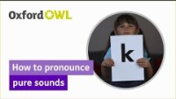
Notes:
Pure sounds! Sign post to the video.
It is so important that we as adults use the pure sounds to help the children blend! You cannot blend words if you swar your sounds.

Slide 12
Main components of phonics…
Phonics
Segmenting for Spelling
identifying the individual sounds in a spoken word and writing down letters for each sound to form the word.
tap
Children do go past this stage but need to be able to use this strategy when spelling an unfamiliar word.
Notes:
Another important part of phonics is segmenting for spelling.
Mrs Andrew is going to explain this.

Slide 13
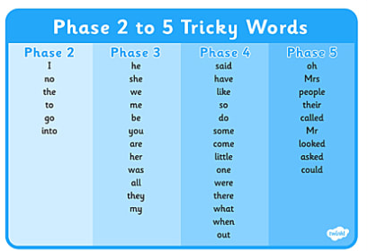

Tricky words is also part of phonics
Phonics
the
Notes:
Now if you didn’t think they had enough to learn ……. They also have to read and spell the tricky words!

Slide 14
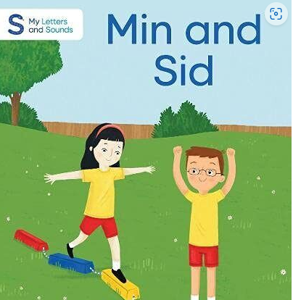
How you can help with phonics at home.
Listening to your child read – daily!
100% decodable books – this does not mean they can read them fluently. It means they can read them using the segmenting and oral blending strategy.
They will include tricky words – these will be linked to the correct phase.
Notes:
As you can see – learning to decode words is tricky! So children need practise and we need your help. Listening to your child read at home 10-15 mins per night is crutial to their progress.
If you do this, they get an extra hour reading practise per week = 52 hours per year!
Invested in a range of 100 % decodable phonics books which means that they are closely matched to your childs phonics ability – so they are practising what they are learning.

Slide 15
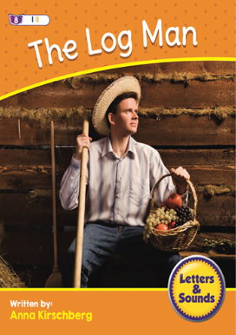
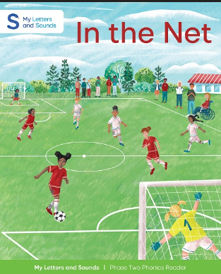
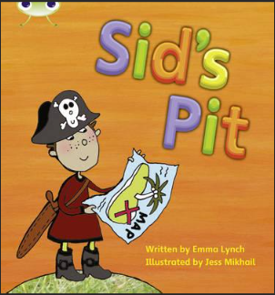
Notes:
Examples of these books

Slide 16
How to help your child read these books at home.
Book talk
Phonics and tricky word practise.
Listening to your child read (praise and support).
Follow up activity / questions.
Sign the reading diary.
Repeat this process multiple times with the same book. Repetition leads to fluency!
Notes:
Ask your child to look at the front cover and read the title. You may want to allow your child to flick through the book to look at the pictures as well, whilst you discuss what is happening.
On the inside of the front cover, there is some guidance outlining what to do before you ask your child to start reading the book and during reading. This exercise is essential as it will help your child practise the sounds, blend them in words and read the tricky words which are covered in the book.
When your child is ready to read the book, allow them time to segment and blend words if needed and prompt and praise where necessary. Encourage smooth reading.
After reading, there is a follow up activity (on the inside of the back cover of the book), which will support your child’s reading comprehension. We would highly recommend you spend time working through these activities with your child as this will help to build their comprehension skills alongside their phonetical awareness.
Please record in the diary – these books will be changed twice a week! WE CANNOT CHANGE THEM IF YOU DO NOT READ. YOUR HELP AT HOME IS ESSENTIAL TO YOUR CHILDS PROGRESS.
Guidance is in handout – videos will follow soon!

Slide 17

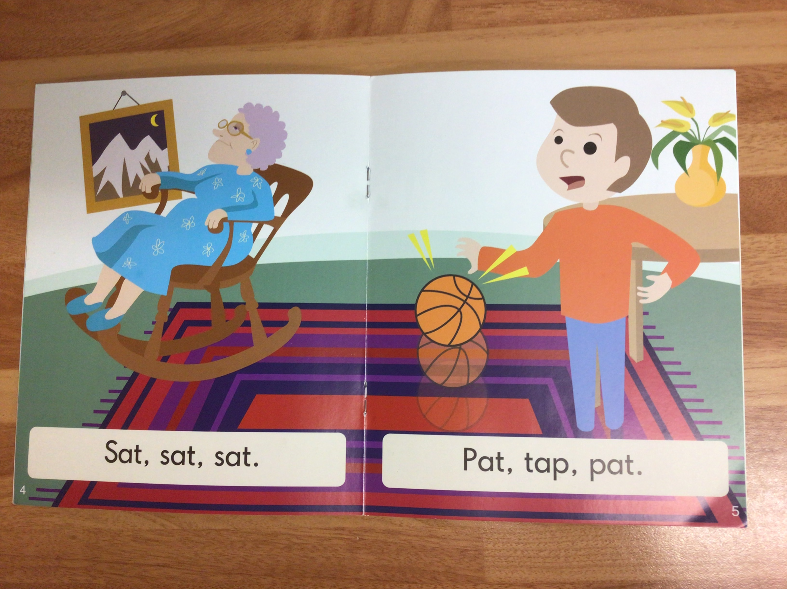
What to expect when reading with your child.
Notes:
This is not easy for the children – Mrs Andrew is going to explain some of the normal pitfalls / mistakes that children will make when learning to apply their phonics.

Slide 18

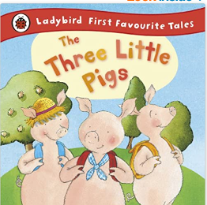


How we teach language comprehension and a love of reading!
Core Stories
Reading rich environment
Reading in other areas of the curriculum
Notes:
Now remember that learning phonics only helps children to learn to decode words it doesn’t teach them the other compoment of reading – language comprehension. Again in school we dedicate a lot of time to teaching language comprehension and Mrs Andrew is going to explain how we do this.
Explain core story – selected for their rich vocab etc
What you do to make your environment reading rich.
Adding texts to enhance learning in other areas.

Slide 19
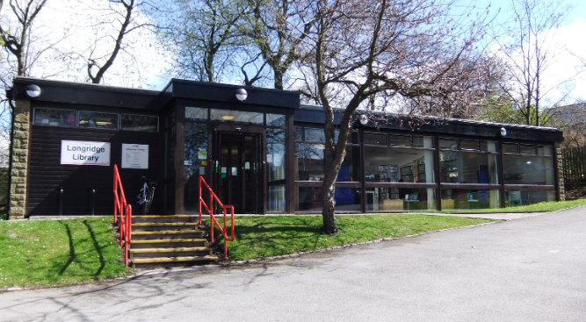
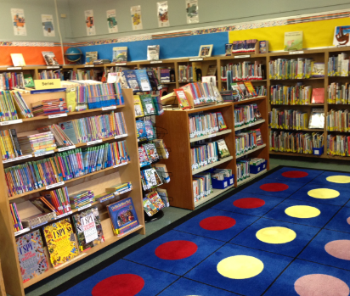
How you can help develop language comprehension at home.
LIBRARY BOOKS
Your child will choose a new library book each fortnight.
They are NOT fully decodable – you should share these with your child!
More relaxing – discuss characters, the plot or anything else your child finds interesting about the book.
Model fluency!
Notes:
• Model fluency
Ask some questions – to develop comrephension
Just enjoy reading!

Slide 20

How you can help develop language comprehension at home.
The magic of the bedtime story!
Reading to your child helps them to:
Understand the world around them.
Develop social and emotional skills.
Improve at school in English, science, maths and other subjects.
Build confidence with communication.
Strengthen their bond with you and other family members.
Increase their language comprehension.

Slide 21

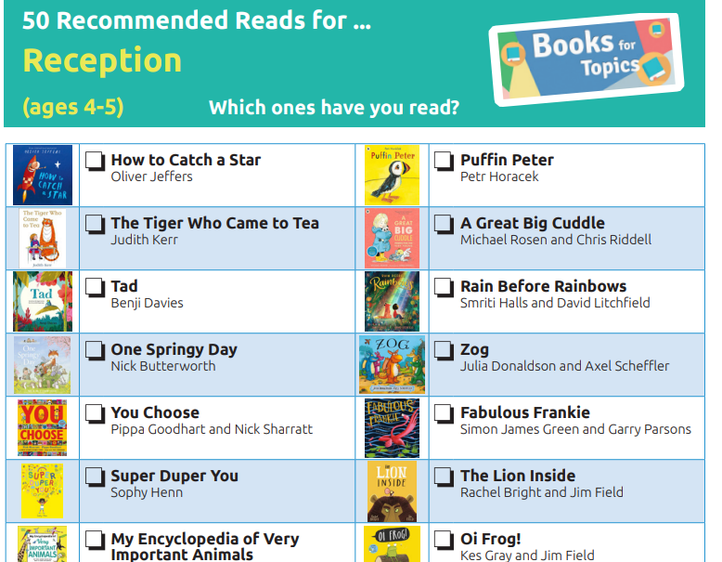
Recommended books.
Notes:
Signpost to the website.

Slide 22
The Core Message
Successful readers have good word recognition and good language comprehension.
Phonics supports word recognition and spelling.
Reading at home is so important. Ten minutes a night amounts up to a lot of extra practise!
Don’t underestimate the power of a bedtime story!

Slide 23

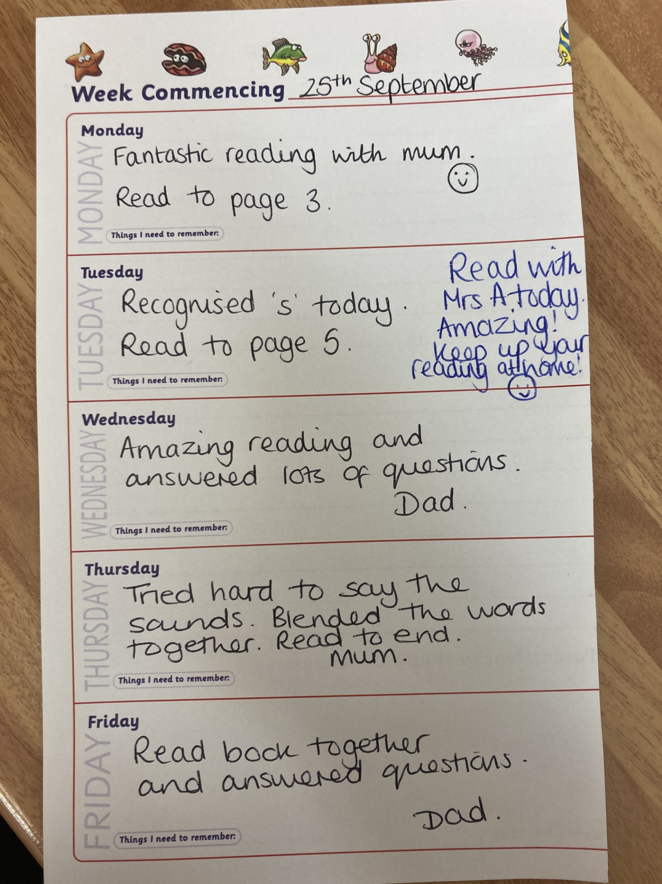
Practical Information
Record reading in reading diary
Changing the reading books – every Tuesday.
Books need to be in school everyday.
Sound cards sent home weekly/blending games
Website update every week with new Phonics sounds and tricky words we have learnt
Keep up / catch up intervention / guided reading groups later in the year
Come and read with your child day
Open door policy – please let us know if you have any concerns / questions!

Slide 24
Session Aims
To gain an understanding of our intent for reading at Alston Lane.
To understand how children to learn to read.
To understand how we teach children to read.
To understand how you can help at home.

Slide 25


