Slide 1


Welcome to Year 1! ‘Meet the Teacher’

Slide 2
Year 1 Teaching staff
Miss Liptrot (Class Teacher)
Mrs Wilkinson (Teaching Assistant)
Ms Batan (1:1 Teaching Assistant)
Mrs Ormerod (Thursday PPA cover Teacher)
If you would like to contact me at any point please use the email: staff@alstonlane.lancs.sch.uk or you are welcome to talk to me at the end of the day ☺

Slide 3
Uniform
Jewellery: If your child has had their ears pierced and they have now healed, please can they wear spacers rather than earrings. If their ears have not yet healed, please can you send plasters in for their PE day to cover them up.
Shoes: All children must wear black school shoes, not trainers.
Hair: Long hair should be tied back with a bobble. Please no claw clips.
Bags: Children should use the school book bags, not big backpacks.

Slide 4
Snacks and Water Bottles
If your child would like a snack at break you are able to pay for toast on Arbor. Alternatively, they may bring a piece of fruit for morning playtime.
Water bottles should only contain water and should be of a reasonable size. These will be sent home each night so they can be washed.

Slide 5
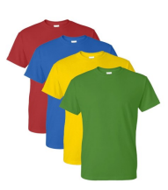
PE Day
Our class PE day is TUESDAY
Please make sure your child comes to school in their PE kit.
This is a house point colour T shirt with black leggings/joggers or their PE shorts. There is no need to bring uniform to get changed into afterwards as they will remain in their PE kit to come home.

Slide 6
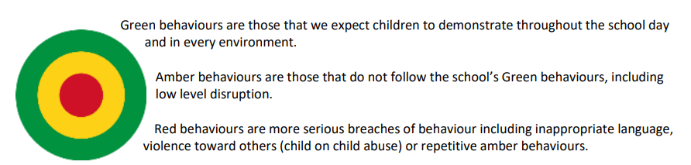
Behaviour for learning
Green Behaviour means:
Showing respect
Trying your best
Being honest
Being safe
Being forgiving
Being kind

Slide 7

Class rewards
In Year 1, our whole class reward system is our ‘star jar’. If the class fills the jar to the top we have a reward. Every half term we will vote for a reward. We will be deciding our award soon.
We also have house points which are given to those demonstrating outstanding green behaviour in class or around school.

Slide 8
Gold Awards and Super Citizen Awards
At the end of the week one child in class will receive the gold award for their hard work and green behaviour in class.
And one child will receive the super citizen award for showing the termly gospel value (this term is love).
They will receive these in Friday’s assembly at 2.45.
I will email you the day before to let you know if your child will be receiving the award. ☺

Slide 9
Arriving
Please make sure your child gets to school for 8:45 as this is essential for them taking part in morning work/fix it time and being ready to start the day.
In Year 1 we do morning work or fix it time every morning which aims to support and develop their learning.
Note for parents: If you are visiting school please use the main entrance by the office and make sure to sign in. If you are coming to assembly on Fridays you may use the entrance by the Year 1 classroom.
Notes:
attendance

Slide 10
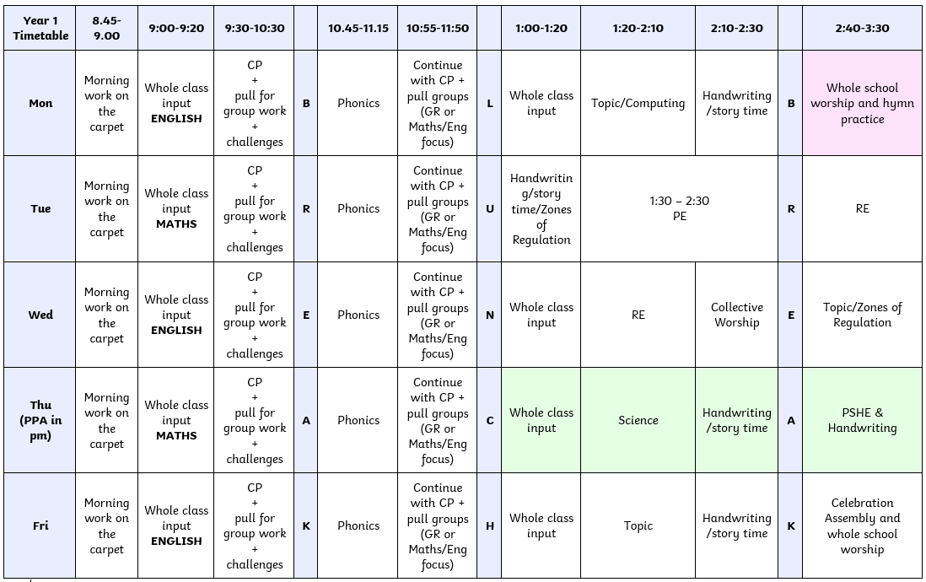
Our School Day
This is our current class timetable:
Notes:
Info on curriculum is on the website too.

Slide 11
At the end of the day
At the end of the day please make sure you come into the playground to collect your children.
As I do not know all of the parents/adults who will be picking up the children yet please give me a wave if your child is at the front of the line so I can make sure they are getting home safely. ☺

Slide 12
Reading
Reading is very important in Year 1 as it helps the children to practice their phonics, develop their English and strengthen their reading ability.
We ask that someone reads with your child at least 3 times during the week and writes this in their reading diary.
We will be beginning a reading raffle where if the children have read 3 times in the week and it is written in their diary, they will get a raffle ticket which will go into a draw for a special prize at the end of the week.
We are currently assessing the children’s reading abilities and will be sending home reading books as soon as possible. Once they have received their books, these will be changed weekly.

Slide 13
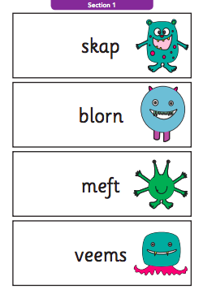
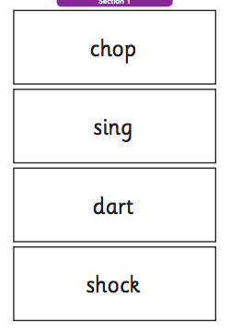
Phonics screening check
W/C 8th June 2026
Children tested on the phonemes/graphemes learned from Phases 2 – 5.
There are 40 words on the test – alien words and real words.
Historically a 32/40 pass rate but can change year to year.
We will do lots of practice in school and we will send home lots of resources to help your child nearer the time.
Reading at home will greatly help their phonics progress through practicing their phonics knowledge.

Slide 14
Homework and curriculum overviews
The homework grid and curriculum overviews will be available on the Alston Lane website under the class pages tab and the Year 1 section.
The children are to complete two topic-based pieces of homework per term.
When the children have completed their homework, they are welcome to bring it into class where they can present it to the rest of the class, so their homework is celebrated.
Notes:
Weekly homework

Slide 15
What can you do at home?
Read, read, and read some more! Please try to encourage your child to read, rather than you reading it to them (in relation to their home reading book!).
KS1 Reading Domains (you can search for these on google or email me for a copy) for key questions to ask your child during reading time.
Key Learning documents on the school website.
Phonics Play – some free games on here!
Maths games – TopMarks website.
Tricky words YouTube songs, counting by 2s, 5s and 10s YouTube songs.
If there is anything I can do to help or provide you with to support your child at home, just let me know. We are happy to help!

Slide 16
Class Worship
Our class worship will take place on 18th May at 3pm.
I will send out an email closer to the time!

Slide 17
Curriculum visits/trips
This term we will be going on a trip to Longridge as part of our Geography unit ‘Home Sweet Home’.
We will be taking the public bus up to Longridge before walking down Berry Lane, identifying human and physical features along the way. We will also stop at Station café for a healthy snack before getting the bus back to school in time for home time.
I will be sending out a letter soon with details of the trip.
We will have other trips during the year including another trip to Longridge and a trip to Blackpool! Information will be sent out about these closer to the time.

Slide 18
Parents’ evening
Parent’s evenings will take place in October to discuss how your child has settled in and the progress they are making.
These will take place on the 13th and 14th of October and will be online on Teams.
In person parent’s evenings will be held in March on the 23rd and 24th.

Slide 19
Arbor
Make sure you have access to Arbor.
Arbor is where you are able to pay for things (like trips, milk, toast, etc.) and receive messages.
Please read the newsletter which is posted on the school website every Friday for important information and upcoming dates for the diary.

Slide 20
Any Questions?
As mentioned, if you have any questions or concerns, please don’t hesitate to contact me!
Please use the email:
staff@alstonlane.lancs.sch.uk
Emails sent here will be directed to me and I will reply as soon as possible.
Alternatively, you are welcome to talk to me at the end of the day. ☺

