Slide 1
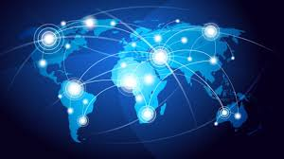
Trade:KS2 Knowledge Mat – Summer 2 - 2023
Subject Specific Vocabulary |  | Sticky Knowledge about Trade
Globalisation | Globalisation is the increasing connections between places and people across the planet, established through trade, politics and cultural exchanges, and helped by technology and transport. | · Buying and selling things is called trade.
Imports | Bringing goods or services into a country from another country. | · Trade is an important way for countries to make money and has been happening across the world for hundreds of years.
Exports | Taking goods or services out of a country to another country. | · People in the UK can sell things they make when people in other countries want them. This might be because they can’t make them themselves or because they are cheaper or better quality.
Trade | Buying and selling goods or services. | · Sending goods like this to other countries is called export .
International trade | Buying or selling goods or services from a different country. | There are also things, such as bananas or oranges, that are hard to grow in the UK and we have to buy these things from abroad. This is called import .
Politics | The activities associated with the governance of a country or area. | · Sometimes countries need experts from abroad such as engineers, scientists or teachers. These experts can sell their services to people around the world and this is called a service industry .
Economy | The financial system of a country. | The service industry is the UK's main industry today and we import more goods than we export.
GDP | Gross Domestic Product: the total value of goods and services provided in a country during one year. Richer countries have a higher GDP than poorer countries.

