Slide 1
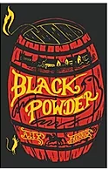
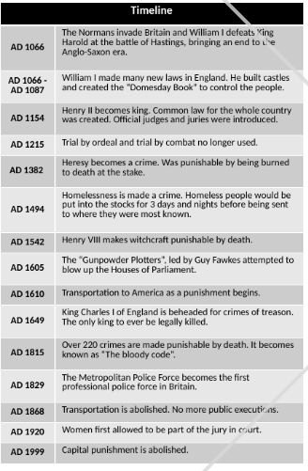
Crime and Punishment: KS2 Knowledge Mat - Summer 1 - 2023
Subject Specific Vocabulary
Capital punishment | Killing of the criminal
Corporal punishment | Physically hurting the criminal.
Court | A group of people, including a judge, who bring people to justice.
Crime | An activity that breaks the law.
Criminal | Someone who has committed a crime.
Heresy | Having religious beliefs that were different to the official religion of the country.
Hue and cry | A loud cry to chase or catch a criminal during medieval times.
Jury | A group of people who make decisions in court.
Oaths | A promise to tell the truth
Treason | A crime against the king or government
Exile | Being banned from your home
Weregild | A monetary punishment
Sticky Knowledge about crime and punishment
The Romans believed in deterring crime by harsh punishments and how you were punished depended on how important you were.
During the Anglo Saxon times, different amounts of compensation could be paid to the victim or victim's family for the loss of a person, an injury or theft.
Heresy became more common in the Tudor period because of King Henry VIII and his children changing the religion of the country.
During the early modern period,highwaymen became more popular due to the increase in wealth.
In the Victorian times, convicts were sent to Australia.

