Slide 3
Aims of the session
By the end of the session participants will:
have an understanding of Colourful Semantics;
be confident at colour coding short sentences using Colourful Semantics.
Notes:
Welcome participants to the group. Explain the session will be informative and have elements of working in groups to put the colour coding into practice.

Slide 4
What is Colourful Semantics?
A system to support spoken and written language.
Colourful Semantics can be used for:
  sentence development
  understanding questions
  developing narrative
  understanding written text
  developing vocabulary
Colourful Semantics can be used by a range of people, including speech and language therapists and education staff.
Notes:
Colourful Semantics was created by Alison Bryan, Speech and Language Therapist. Colourful Semantics is a popular Speech and Language therapy intervention being used with success in mainstream and specialist settings. Ask the participants if anyone has heard or used Colourful Semantics in their setting and how it has been used.

Slide 5
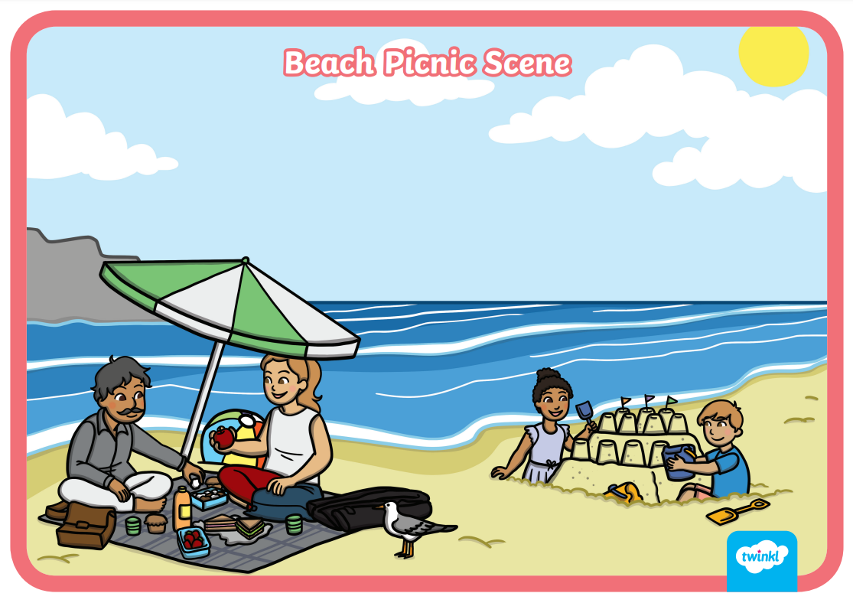
Notes:
Show the participants this picture. Ask them to look at the picture and think about the questioning words that they would use to get students to describe the picture (if they need help, use prompts: Who? Doing what? What? Where? When?). When the participants are giving examples, write them on the whiteboard/paper using the corresponding coloured pens to illustrate the concepts that are within Colourful Semantics.

Slide 6


The Colours and Shapes Explained
Orange words for who.
Yellow words for what they are doing.
Green words for what.
Blue words for where.
Pink words for to who(m).
Brown words for when.
Purple arrows for why.
Purple rectangle for joining up words.
Cloud words for what it is like.
Star words for whose.
Black words for how.
Notes:
Explain the participants will be taken through each colour in the next few slides.

Slide 7

Who? – Orange
‘Who?’ words describe:
People (man, woman, girl, boy and baby)
Occupations (speech and language therapist, teacher, doctor, cook)
Character names (Humpty Dumpty or any animal that has a character name Peppa/Spot).
Do we use who for animals?
We only use who for animals when they are characters, or if they
are doing human activities. We have a tendency to animate/
humanise animals as characters when describing them.
Notes:
Think about when you have visited the farm you would say what did you see at the farm? not who did you see at the farm?. Or if a mouse ran under the chair you would say what ran under the chair? not who ran under the chair?

Slide 8
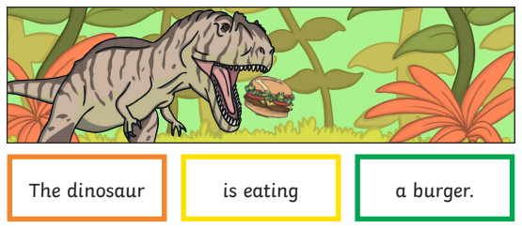
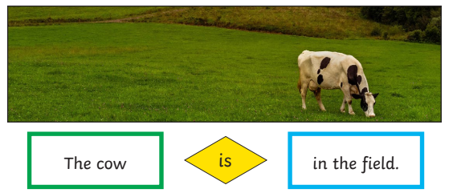
Working Examples
If it is a picture of an animal carrying out a human activity, it would be a who word, as seen in the ‘silly sentence’ below.
But, if it was a picture of a real animal doing what animals do, it would be a what word.
Notes:
Explain to participants that consistency is important to support the learners’ understanding of the different colours.

Slide 9

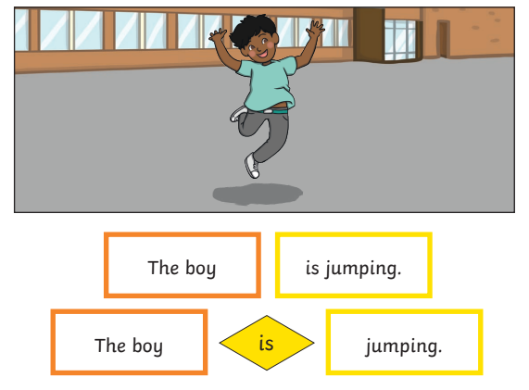
What Doing? – Yellow
What doing? words describe:
stand-alone verbs (run, sit, read, etc)
verbs associated with an object (wash hair, brush hair, etc)
different tenses (past, present, future)
linking verbs (is, was, has, had, etc)
Linking verbs can be introduced depending on the student’s level of ability and are shown in yellow diamond shapes.

Slide 10
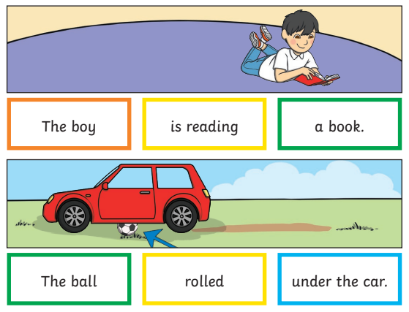

What? – Green
‘What?’ words describe:
objects and animals
what words can be in any position of the sentence
For example, ‘The boy is reading a book’.
It is OK to start the sentence with a what? word.

Slide 11

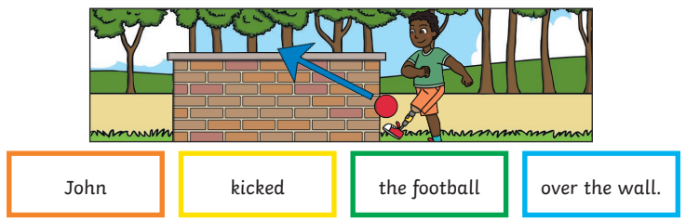
Where? – Blue
‘Where?’ words describe:
where the person or object is
prepositional phrases (e.g. under the table, in the box)
prepositions (e.g. on, in, over)
For example: ‘John kicked the football over the wall.’
Notice how ‘the wall’ is no longer a what word as the function in the sentence has changed. You would ask the student, ‘Where did John kick the ball?’ Over the wall.

Slide 12
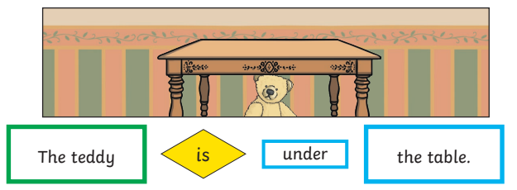
Little Blue Words
If working on prepositions with the student, you can introduce
little blue words.
For example, ‘The teddy is under the table.’

Slide 13

When? – Brown
‘When?’ words describe:
time concepts and words
These words can be used at the beginning or at the end of a sentence.
For example:
On Tuesday
I
went
to the shop.
I
brush
my
teeth
in the morning.
Notes:
Ask the participants to think of some more when? word prompts, such as days of the week, events, specific times in the morning or afternoon, etc.

Slide 14


What Like?
‘What like?’ words describe:
adjectives (old, tall, pretty, blue, etc)
feelings and emotions (angry, excited, hungry, etc)
These words are shown in cloud shapes because they can float around the sentence like real clouds. The student can ‘float’ their cloud words above the word in the sentence that they want to describe.
Examples:
The
big
dog
barked
loudly.

Slide 15

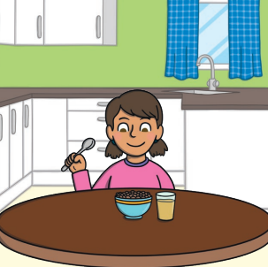

Whose?
‘Whose?’ words describe:
possessive pronouns (his, hers, our, my, your, their, etc)
The girl
is eating
her
breakfast
in the morning.

Slide 16
Useful Tips
You don’t have to colour code everything — you are in control of what is coded.
Use it to scaffold what your individual learners need.
Find the verb and ask the right question to get the answer you want. Then choose the colour/shape that goes with that question/word.
For example, in the sentence:
The boy kicked the ball in the garden.
Find the verb kicked (yellow)
Then ask yourself the following questions.
who kicked? the boy (orange)
kicked what? the ball (green)
where was it kicked? in the garden (blue)
The boy
kicked
the ball
in the garden.

Slide 17
Examples of Sentences
Have a look at the following sentences and have a go at colour coding them.
The boy is eating a sandwich
The girl kicked the football over the fence
The girls gave a big present to their friend.
The cat sat under the car.
The ball rolled under the red car.
The teacher gave a sticker to the student.
On Saturdays I visit my grandparents.

Slide 18
Answers
The boy is eating a sandwich.
The girl kicked the football over the fence.
The girls gave a big present to their friend.
The cat sat under the car.
The ball rolled under the red car.
The teacher gave a sticker to the student.
On Saturdays I visit my grandparents.

Slide 19
Twinkl Colourful Semantics Resources
Twinkl Colourful Semantic resources can be found here.
All Twinkl Colourful Semantics resources are editable so, if your setting uses different colours to those suggested in this training, the resources can be edited to remain consistent.
Many of the Twinkl Colourful Semantics Resources have two ability levels. The higher ability activity has text in colour-coded boxes. The lower ability activity also has an image in the colour-coded box to support those learners who are emergent readers.

Slide 20
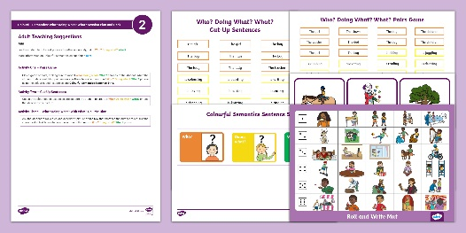
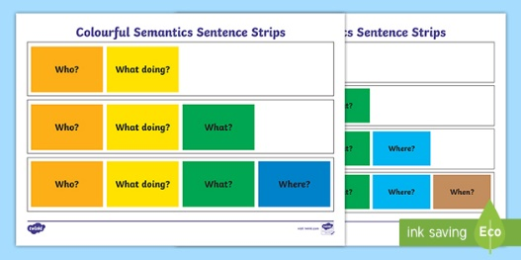
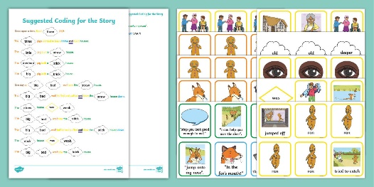
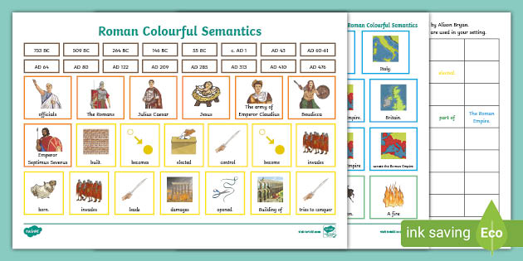
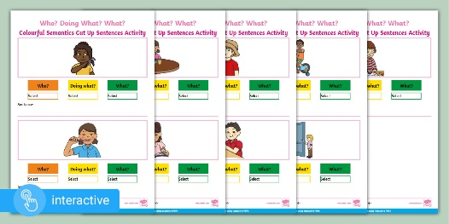
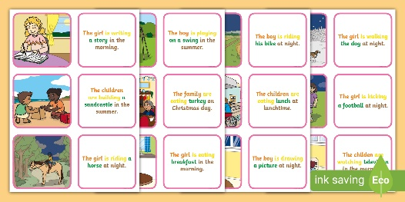
Types of Twinkl Colourful Semantic Resources
Session plans
Supporting resources
Stories
Topic specific
Interactive activities
Picture description
cards

Slide 21
Aims of the session
By the end of the session participants will:
have an understanding of Colourful Semantics;
be confident at colour coding short sentences using Colourful Semantics.
Notes:
Welcome participants to the group. Explain the session will be informative and have elements of working in groups to put the colour coding into practice.

