Slide 1

MATP
September 2023

Slide 2

What is MATP?
The Special Olympics Motor Activity Training Programme (MATP) is a unique programme specifically designed for athletes of all ages with Profound and Multiple Learning Difficulties (PMLD) or complex needs.

Slide 3

MATP provides genuine opportunities for training and competition for individuals with PMLD and complex needs. Opportunities are realistic and tailored to the individual. It focuses on the abilities and enables athletes to work and showcase motor skills and sporting achievements that are relevant to them.
https://youtu.be/wBHW6hzcU7E

Slide 4
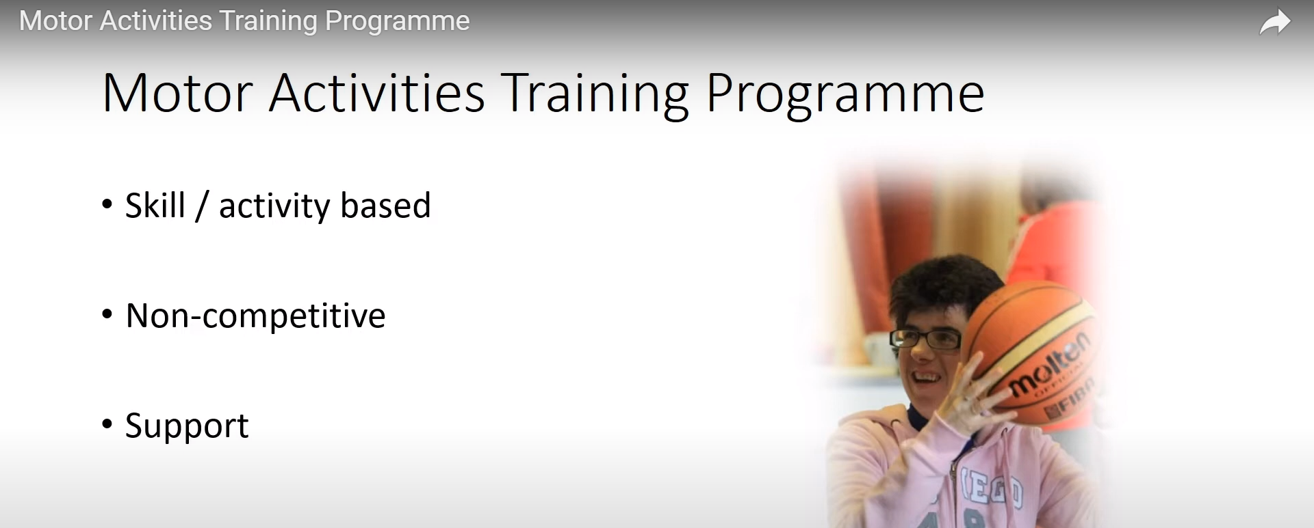

Slide 5
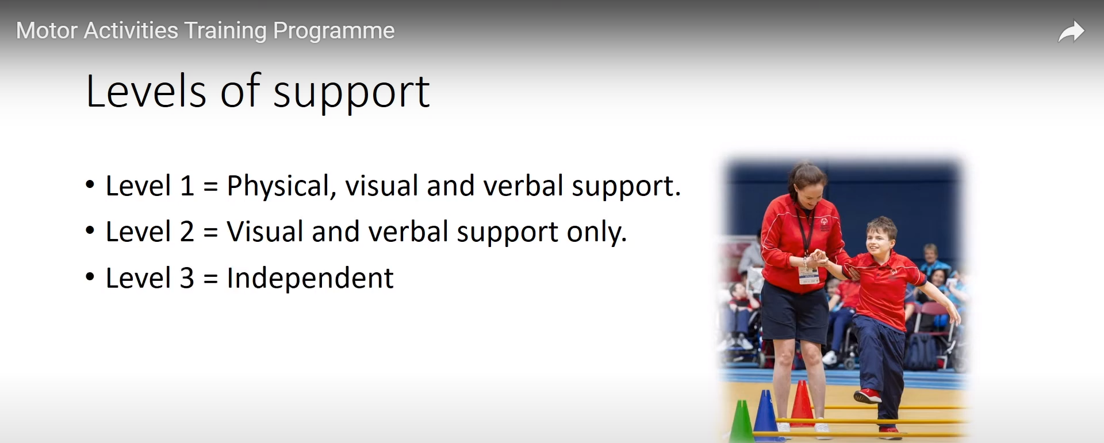

Slide 6
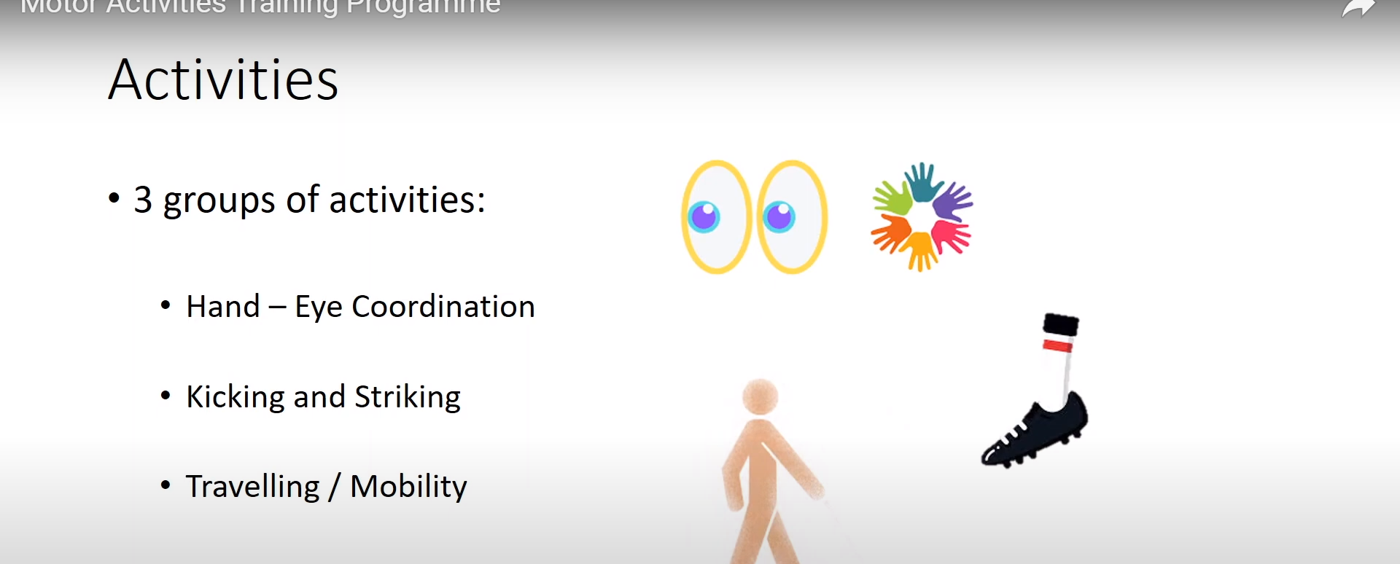

Slide 7
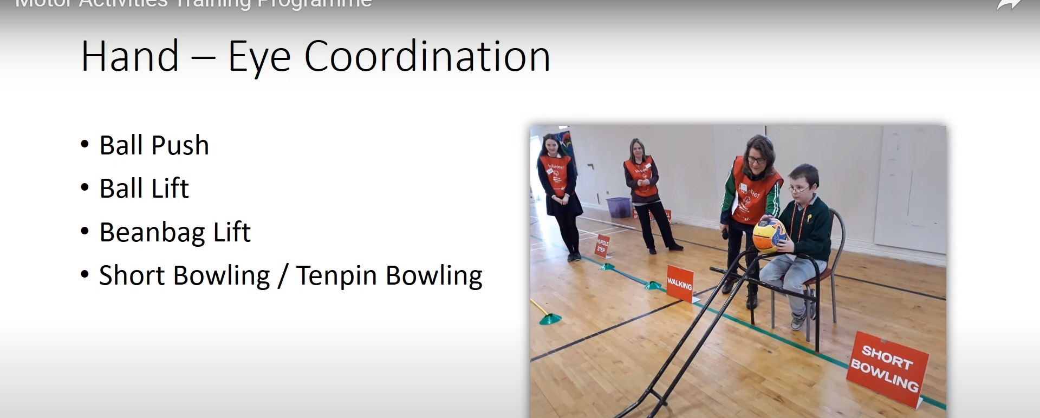

Slide 8
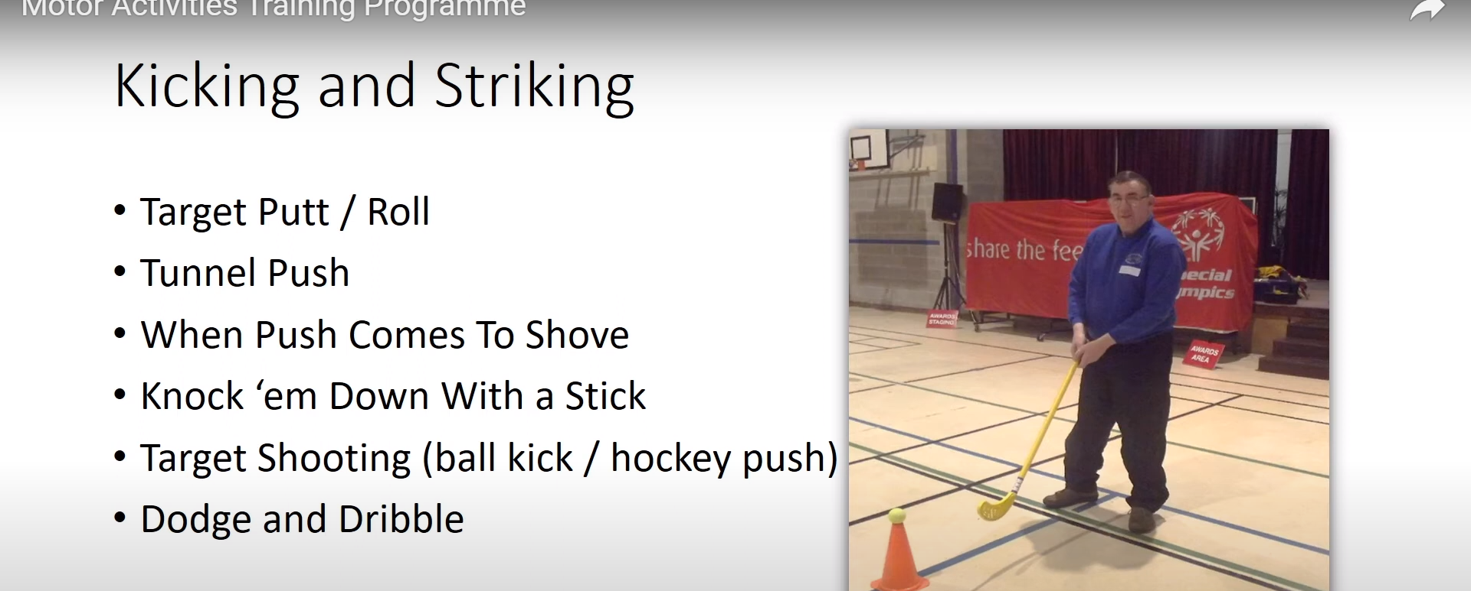

Slide 9
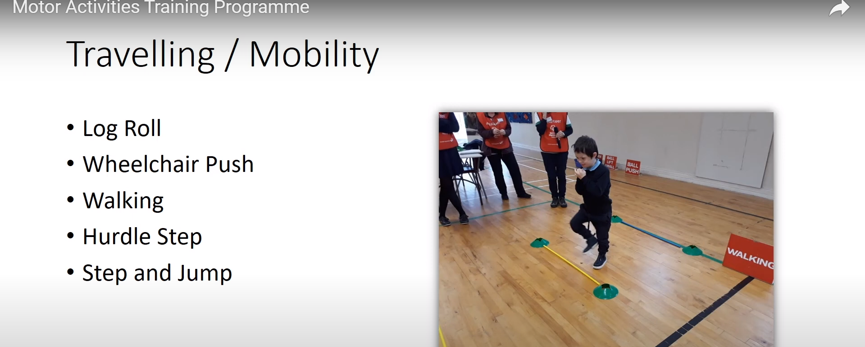

Slide 10

Setting up your
MATP events
Each child needs an event from each of
the three sections.
These are put on an achievement sheet.
They work towards them over a half term.
(They can work on others too. Some children
three will be enough some may manage 6 but
will only perform 3 at the celebration event.

Slide 11

https://youtu.be/1s9TPprOI28

Slide 12
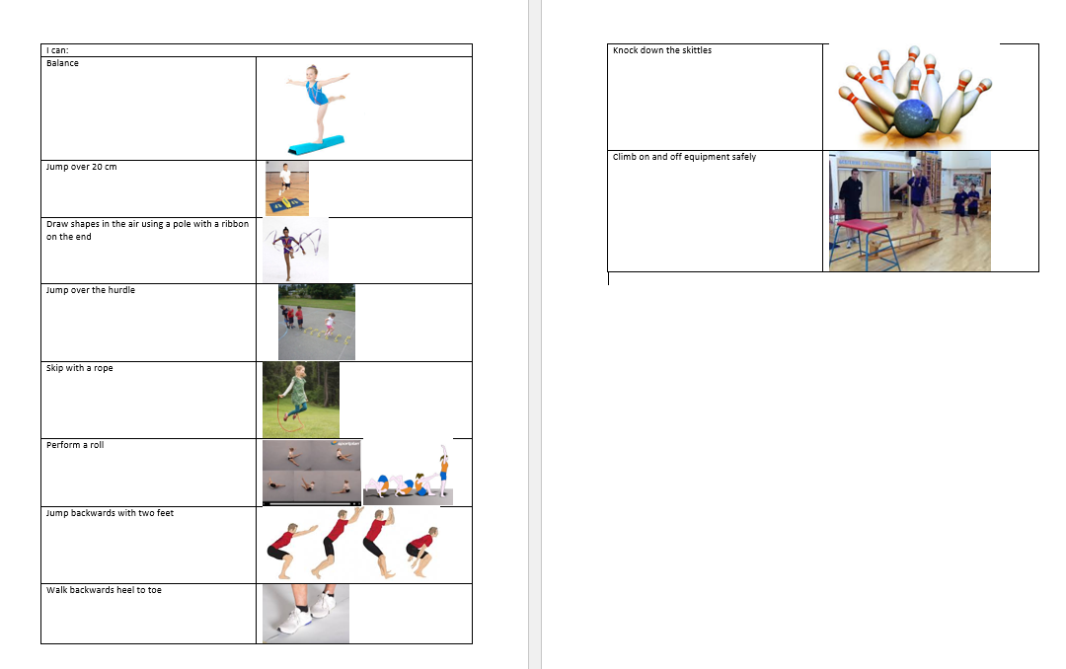

Slide 13
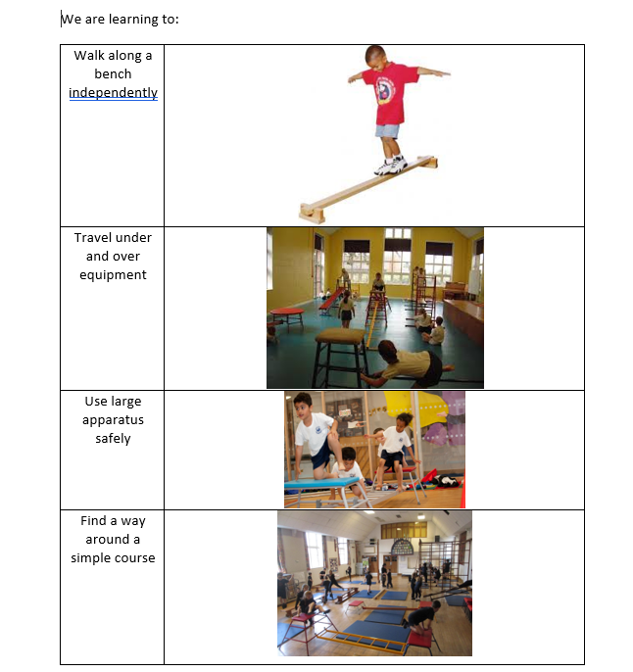

Slide 14
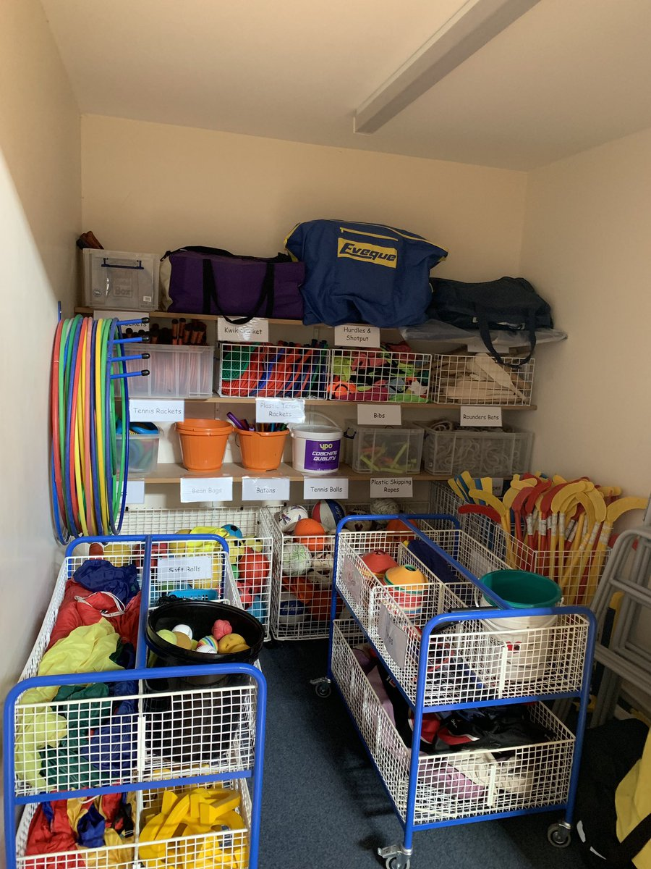
Remember to put the equipment away neatly.
Thank you

