Slide 1
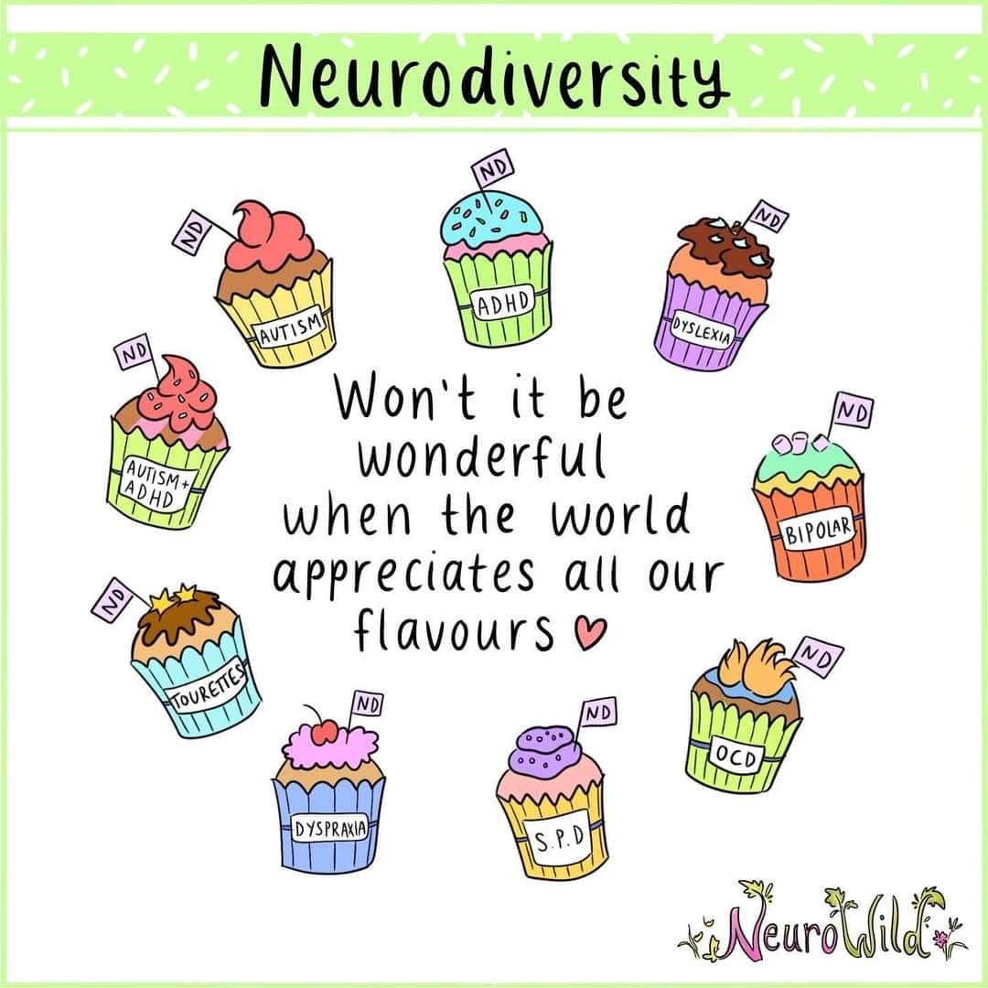
Neurodiversity is a term used to describe a variation in normal human evolution which means some people think different to others. Neurodiverse conditions include autism, attention deficit hyperactivity disorder (ADHD), dyslexia, dyspraxia, tourette syndrome and complex tic disorders.

Slide 2
Just because we are neurodiverse doesn’t mean we cannot be successful or amazing.
People who are neurodiverse see the world a little differently but make the world a better place.

Slide 3
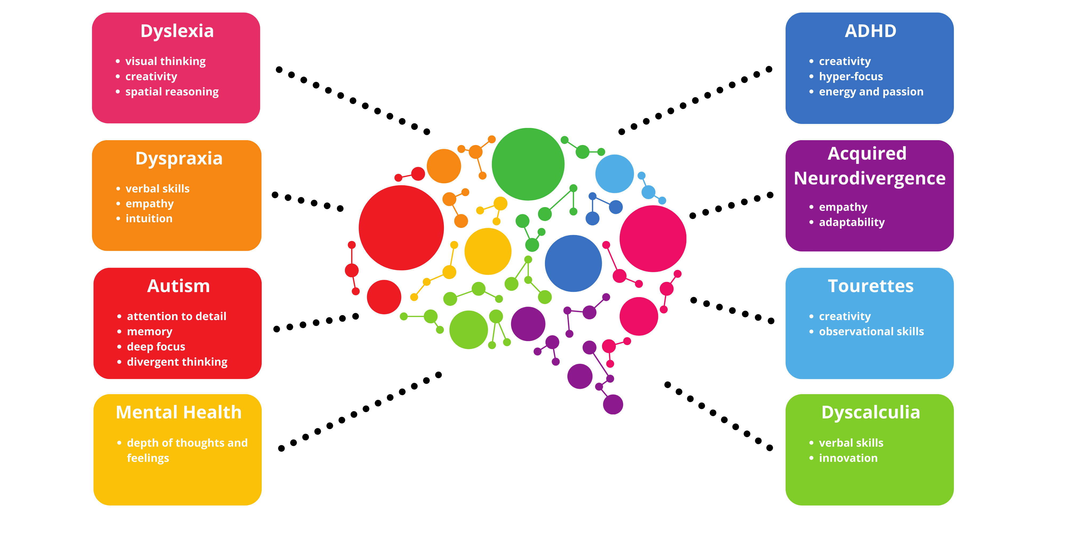
It’s our differences that make us unique.

Slide 4


Slide 5
Create an acrostic poem for a neurodiverse condition.
Amazing
Unique
Thoughtful
Intelligent
Successful
Marvellous
ADD
ADHD
Dyslexia
Dyscalculia
Autism
Tourettes

Slide 6
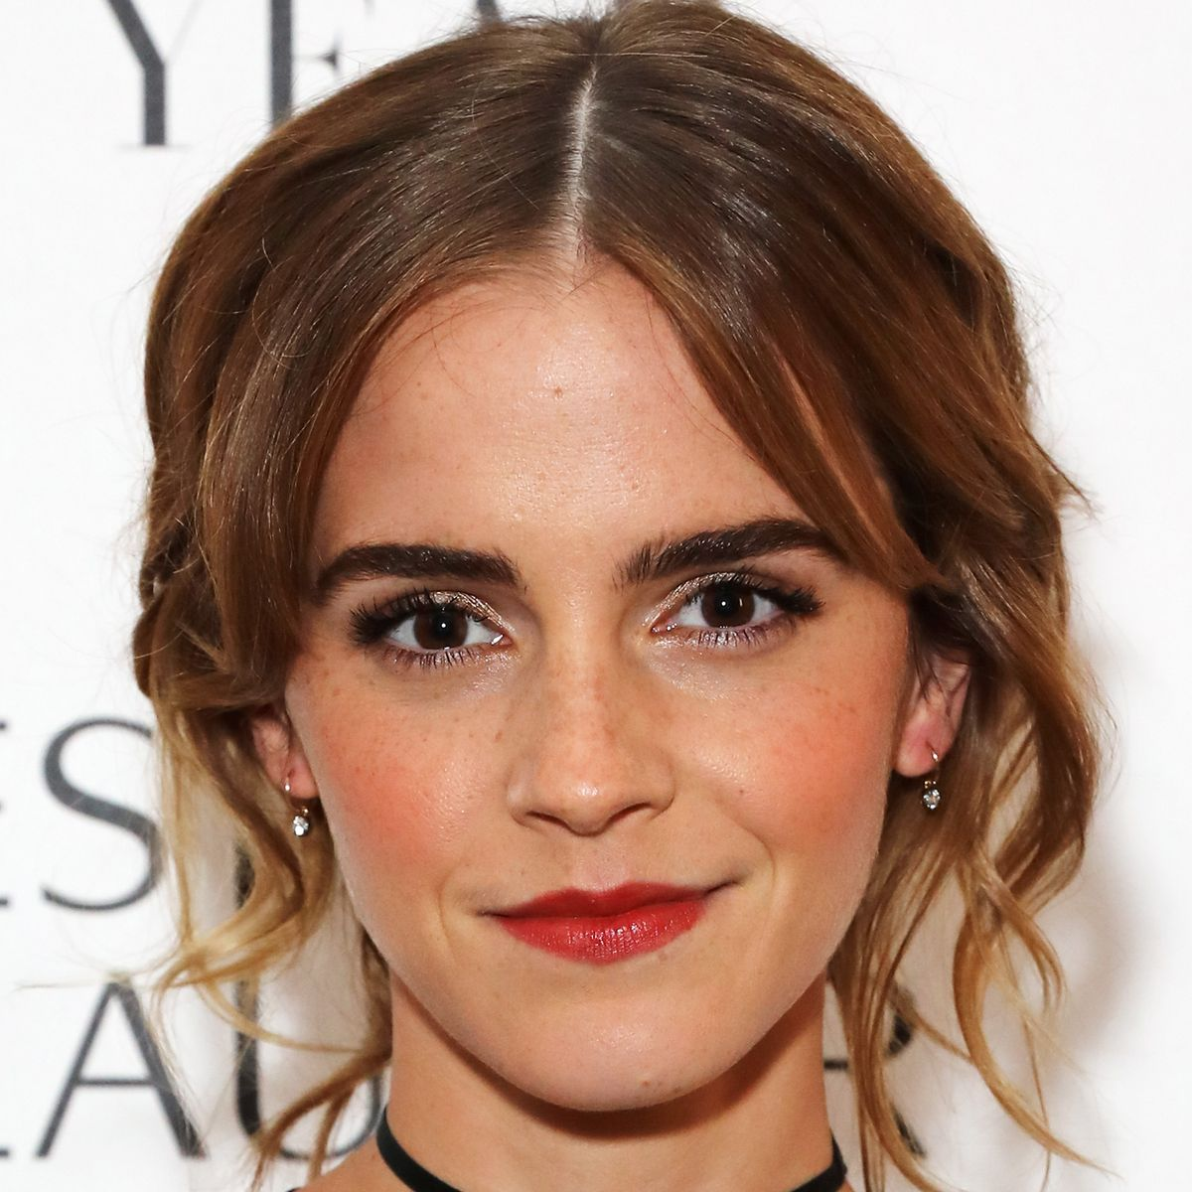
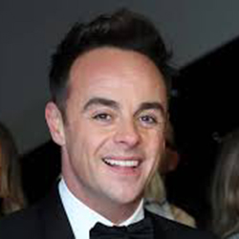

Just because we are neurodiverse doesn’t mean we cannot be successful or amazing.
People who are neurodiverse see the world a little differently but make the world a better place.
ADHD

Slide 7


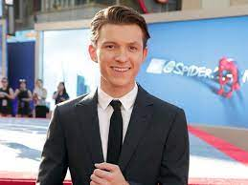
Just because we are neurodiverse doesn’t mean we cannot be successful or amazing.
People who are neurodiverse see the world a little differently but make the world a better place.
Dyslexia

Slide 8


