Slide 1
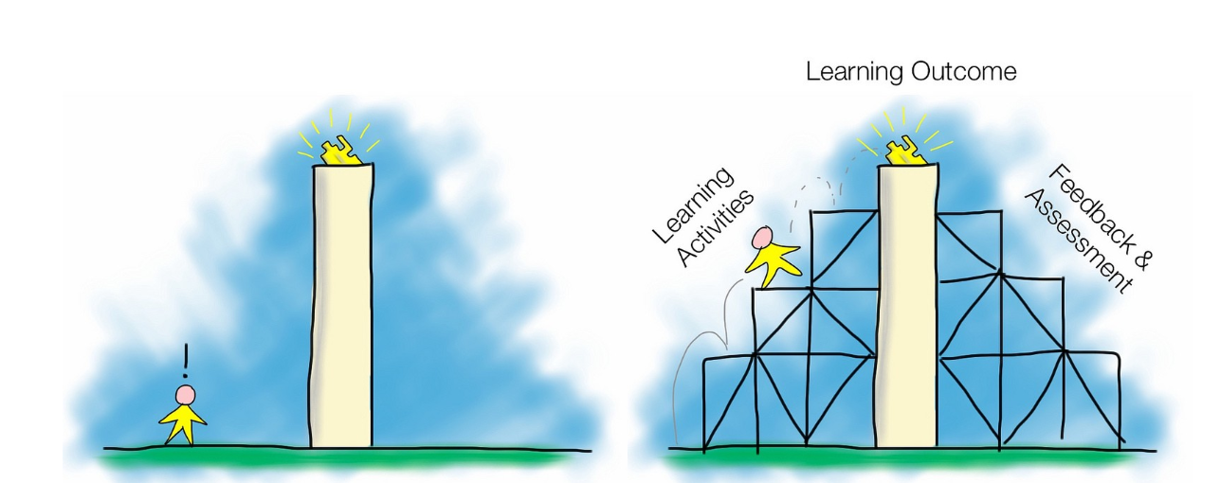
Scaffolding

Slide 2
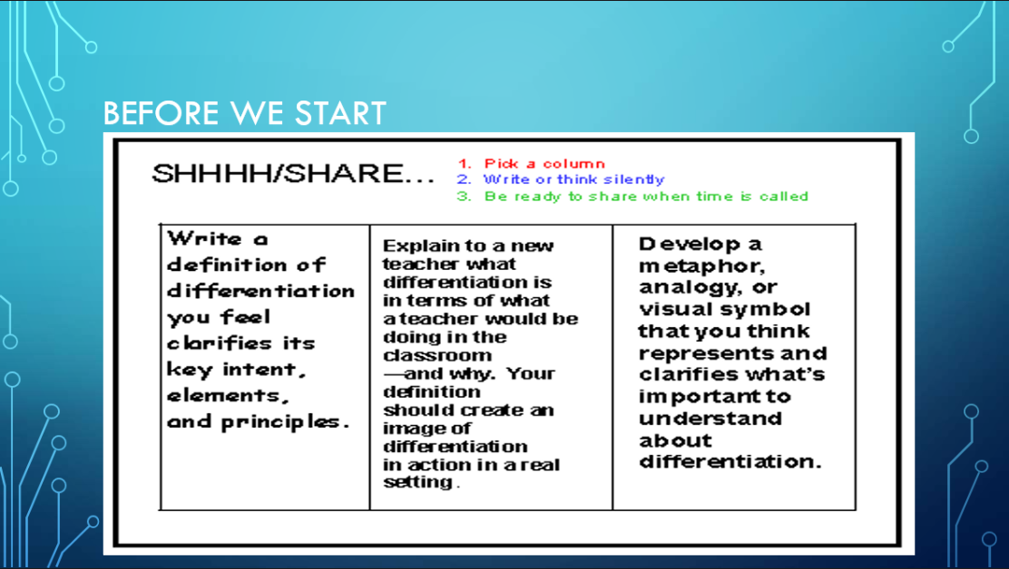

Slide 3
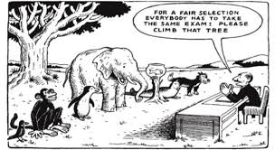
It shouldn’t take Einstein to know that….
"Everybody is a genius. But if you judge a fish by its ability to climb a tree, it will live its whole life believing that it is stupid."

Slide 4

Importance
It can be completely overwhelming the concepts and language we use to teach a wide range of students in one class:
Attainment?
Ability?
Experience?
Competence?
Knowledge?
Skill?
Confidence?
Fluency?
All different ways of quantifying types of knowledge…
…but we all have a wide range of students and, as their teacher, we have to provide them with access to the curriculum…right? It’s our JOB, it’s why we’re all here!

Slide 5
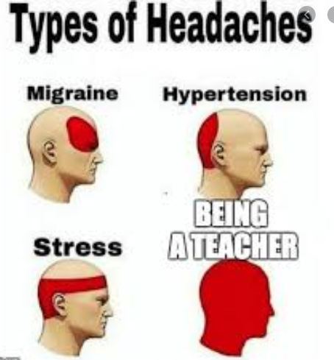
Let’s be real…
We all know that not all children learn at the same rate, either short-term or even long-term. We see a beautiful diversity in every day and that’s a wonderful thing…
…but it makes your job pretty tough too, right?…
How do you stretch everyone?
How do you push your gifted learners and make sure you aren’t holding them back while also extending your SEN and EAL pupils and accelerating their learning?

Slide 6
Why the terminology has changed..
Over the years, “differentiation” has become distorted and become something robotic, mechanical, a tick-box exercise.
Learning Objective:
MUST:
SHOULD:
COULD:
ALL:
MOST:
SOME:
CORE:
CHALLENGE:
MEGA TOUGH:
The problem with this is it lowers expectations and shows children exactly where they are in hierarchy of your esteem (or that’s’ how it feels to them). Trust me when I say, they already know the things they find harder than everyone else…
MILD:
SPICY:
FIREY:
It implies some parts of the curriculum are only for “some” and not for “all”.

Slide 7


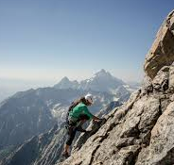


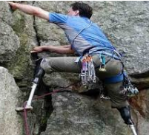
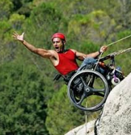
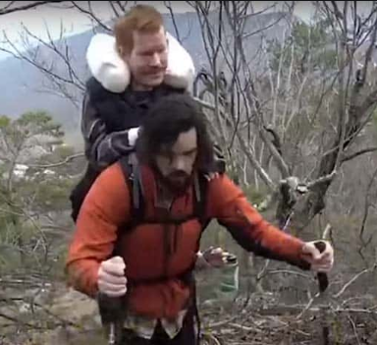
The End Goal…
EVERYONE should be aiming for excellence.

Slide 8
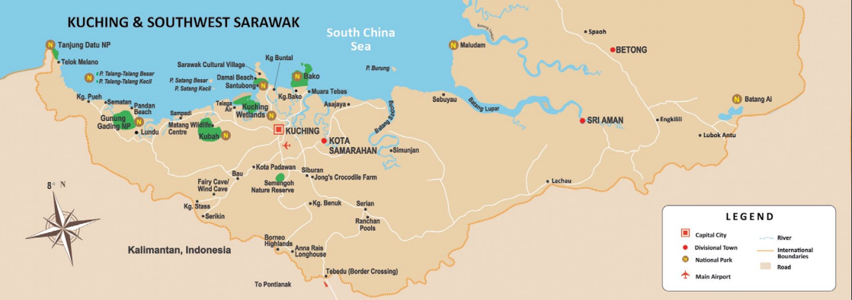
START WITH THE END IN MIND!
Then THINK how you can get each of your learners there…which road is best? Which route will enable them to succeed?...

Slide 9
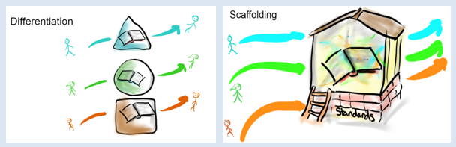
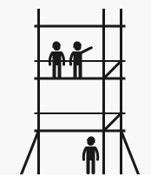
FOCUS MOVES FROM “DIFFERENT”…
DIFFERENTIATION
SCAFFOLDING
…to “supported”. Scaffolding stops us from falling (failing) and is TEMPORARY. It can be taken down…

Slide 10
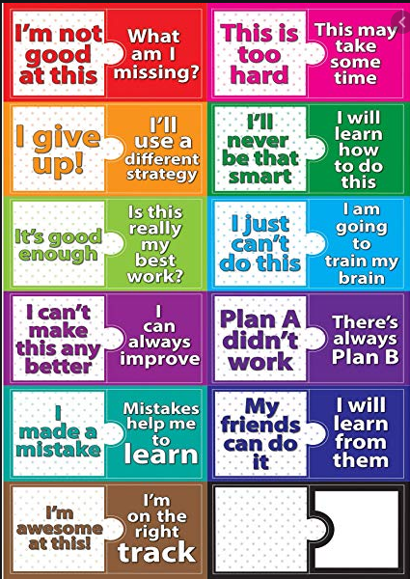

In practice, for you as a teacher, what does this mean?
It’s really about a change of mindset. It’s a fluid approach to making learning accessible. One child may need support in one area but excel in others….
Make it safe to make a mistake.

Slide 11
Cognition and learning difficulties
Specific Learning Difficulties eg dyslexia, dyscalculia, dyspraxia,
Moderate learning difficulties
Severe difficulties
Profound and multiple difficulties where children will have complex learning difficulties
However, we must take into account that they will not just have a primary need, but their needs can overlap across 2, 3 or even all areas.
These needs may also change over time.
Social , emotional and or mental needs
Depression, self harming
ADHD, substance misuse,
Eating disorder,
Anxiety Disorder,
Mental Health issues,
Social disorders,
Attachment disorder
Sensory and or Physical Needs
Some children have a disability that can be age related or hinder them over time eg
Visual Impairment
Hearing Impairment
Multi sensory impairment
Physical Disability
Also sensory relating to clothing , touch , sound, smells
Communication and Interaction needs
Speech , language and communication needs
Young people with Autistic spectrum disorder (ASD)/
Aspergers may struggle with all of the above and social interaction
Notes:
The send Code of practice 0-25 -2014 Page 97-99 . The 4 broad areas often interlink. Many SEND students may begin by only showing one area of need but overtime that may change. For example girls with Autism often mask their symptoms to fit in with their peers , but may actually present across several areas. Often children with ASD will present in one or more areas from a very young age. How they may present may alter at times of stress or when they go through puberty.

Slide 12



How is teaching SEND students like bowling ?
In a classroom situation we often miss the 2 outside pins by not targeting them with high quality teaching strategies. The reality is that we need to plan for our two pins and in by doing so we will not only target our hardest to reach learners but we will also help the rest of the learners as they too will benefit from similar strategies.
https://www.youtube.com/watch?v=RYtUlU8MjlY

Slide 13
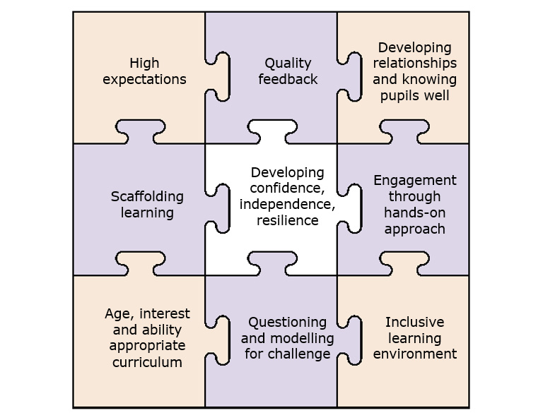
High Quality teaching jigsaw.
Embed the corner stones.
Add the rest
Resulting in the middle piece slotting into place.
The jigsaw on the slide is taken from Packer ( 2016 ) :The teachers guide to SEN ( p29)
‘We can think about a lesson as being a bit like a jigsaw that contains many different pieces, each one links in some way to several others” (p29) . Packer states that there are at least 9 elements to an inclusive lesson. We should always start with the cornerstones. Once these are established then we can piece the rest of the parts together . The overall aim of this jigsaw is to build independent and resilient learners.
Henshaw (2017) stated that “ high quality teaching for pupils with SEN is about the day to day interactions that take place in your classroom and the different pedagogical approaches you use to engage, motivate and challenge learners….. It is about providing support…..to enable them to achieve more”.

Slide 14

Be consistent in terms of routine.
silent bell tasks/ registers
6 part lesson, use of timers
Expectations
Praise.
Celebrate students strengths
IEP
talk to students while on duty
Model what completed work should look like, in particular exam answers
Show students how to improve
High Quality teaching jigsaw.
Embed the corner stones.
Add the rest
Resulting in the middle piece slotting into place.
Phone calls home
Repeat instructions using the same wording be explicit
Congratulate students for achievements in and out of school
Focus groups
Developing
Visuals
Use of scaffolding
word banks
sentence starters
Use white boards,
don’t copy off the board
Confidence
Collaborative tasks
presentations
Resilience
Real examples
Independence
Experiment recording information
using alternative methods
Repetition - consolidate knowledge & skills using bell tasks and plenaries.
Informal support from peers
through collaborative seating
Structures/ collaborative tasks
Ensure some work is within
ability range so can experience success
Model risk taking
Its fine to get it
wrong
Provide information from
board on desk to reduce
the load on visual memory. Does someone need a lap top / reading buddy
Types of questions we ask
Use of visuals
& concrete examples
Use TA to support with the task that has been set
Timetables sensory breaks

Slide 15
To ensure we ‘reach’ all children ( including the 2 pins) and give them the education they deserve. We use waves of intervention, these are part of the graduated approach to supporting young people with SEN
Wave 3
Specialist
Additional highly
personalised
interventions .
SALT, OT, Physio, VI, AP, HI
Wave 2 - Targeted
Additional interventions to allow children to work at achieve their outcomes supported by school staff.
Targetted interventions linked to pupil progress, activities planned by specialists and delivered by school TAs
Wave 1 – core offer
Inclusive high quality interventions for all. Meeting the needs of all and having high expectations for all. Quality first teaching or now as its known HIGH QUALITY TEACHING.
Notes:
These are the 3 waves of intervention set out by the SEND Code of practice ( 2014) . As teachers we should understand the different levels of SEND within school and understand why students are working at each wave. Many of our wave 1 students can go un noticed, until we start to peel back why they are behaving in certain ways . Is it because they have SPLD ? and really are struggling to understand the work that is put in front of them ? This is why it is important that we get a full picture from primary schools of each child's needs so we can support them in all lessons. We have some wave 2 and wave 3 students that require adaptations and adjustments in order for them to work towards the curriculum requirements . Some children require outside agencies like physiotherapists occupational therapists, speech and language, Childrens and Adults Mental Health Service ( CAMHS) to help support them to come to a mainstream school.

Slide 16
We show all students support by using a graduated approach
Regular assessment. Teacher assessment , step assessment.
Standardised eg reading tests, concessions.
Parent/ student questionnaire
Any Child
Assess
Plan
Do
Review
Has the planning worked? Did seating plan work , which collaborative tasks led to more
success and understanding
High Quality
teaching
EfL
Seating plans
Questioning
Go to first
Check learning after a
time
Notes:
NASEN ( 2014) , Sen support and the Graduated Approach ( p 1-20)
Support at any level has to come from a four part cycle . It has to begin at whole school level and should benefit all learners in the class. However this will change at wave 2 and wave 3 where students require additional support and a more personalised graduated plan to be put in place. We always have to begin at the assess cycle to see if students are progressing in line with their peers and nationally . If they are not progressing because they have a learning difficulty like dyslexia we need to refer to our High quality teaching strategies. We put in pace the strategies and then review whether they are actually working or not . If they don’t work then children would need to move onto another round of the graduated approach with different strategies . If the students continues to struggle then we consider moving them up a wave. If they moved into wave 2 they might require 1;1 support , an intervention in literacy.

Slide 17
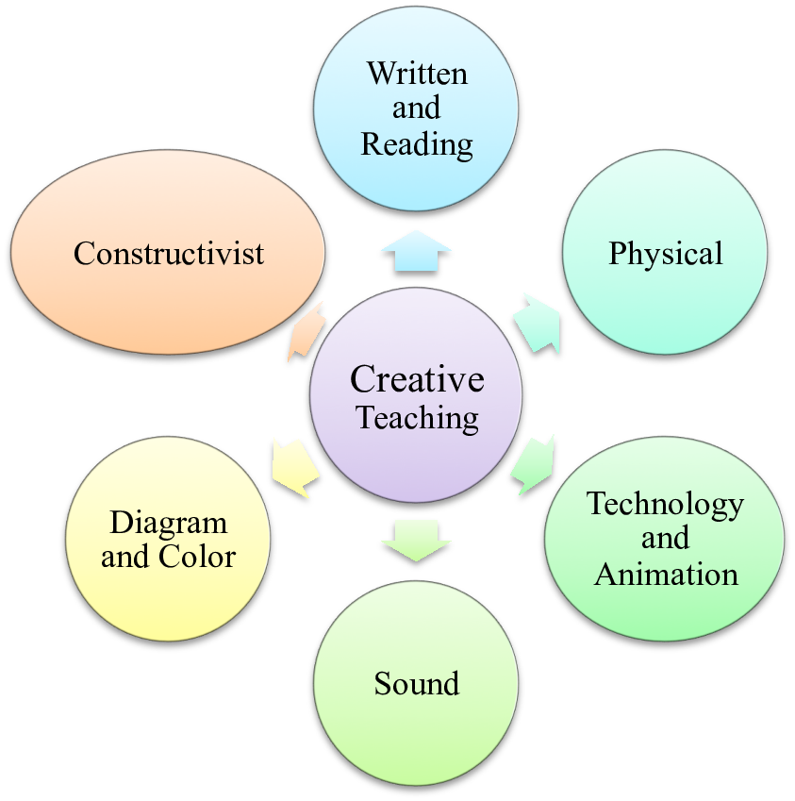
Teaching Methodologies
DISCUSS:
What teaching methods do you use in class?
“Remember, the greater the variety in the methodologies adopted by the teacher, the more pathways and entry points into learning s/he provides for the children.”
Lecture – you talk, they listen
Models and manipulatives – they touch and explore
Partner talk
Group discussion
Partner task
Group Taks
Individual Task
Problem solving – learning pit
Peer marking/assessment
Videos
Teacher modelling
Peer modelling
Flashcards
Games
ICT – interactive tools/research
Short application tasks
Project work
Inquiry – research – structured or independent

Slide 18
We can scaffold in different ways:
How we prepare the children for the lesson (preparation)
how the children will learn (process) and,
how they will demonstrate their learning (product).
If the gap in their learning is so wide they cannot access the concept because they are missing the foundations they need to do that, only then do we adapt the concept (content) and this is done with great care and attention to ensuring extension of learning and that the child doesn’t feel “stupid”. Most often, this will occur in withdrawal session or close liaison with the SENCO.

Slide 19
Useful Strategy - Pre-Teaching
Preparation
Consider prior knowledge – What do they already know? What do they *need* to know? Have you given them opportunity to practice these skills?
Vocabulary
This is NOT asking kids look up definitions and write them out
Introduce the words to kids in photos or in context with things they know and are interested in. Use analogies and metaphors, and invite students to create a symbol or drawing for each word. Give time for small-group and whole-class discussion of the words. Not until they’ve done all this should the dictionaries come out. And the dictionaries will be used only to compare with those definitions they’ve already discovered on their own.
With the dozen or so words front-loaded, students are ready, with you as their guide, to tackle that challenging text.
Skills
Can be done in a similar way – utilize support or set a project task for those who don’t need it (extending those who are gifted) while you do the pre-teaching

Slide 20
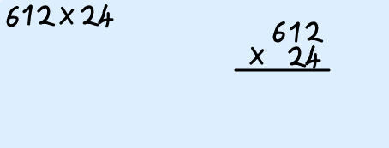
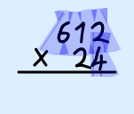
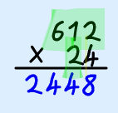
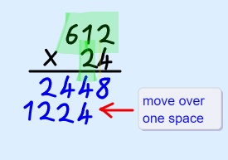
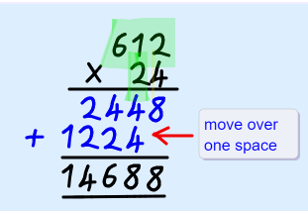
PROCESS - Strategies
Show not tell - WAGOLL – Visuals and manipulatives.
Get physical! DO! “Learning pit” – movement. https://www.youtube.com/watch?v=9VzJk5GF8sM
Modelling – “think aloud”
Groupings – ability groups or MAG
Repetition
Toolkits
Manipulatives
Chunking instruction - https://www.youtube.com/watch?v=hydCdGLAh00

Slide 21

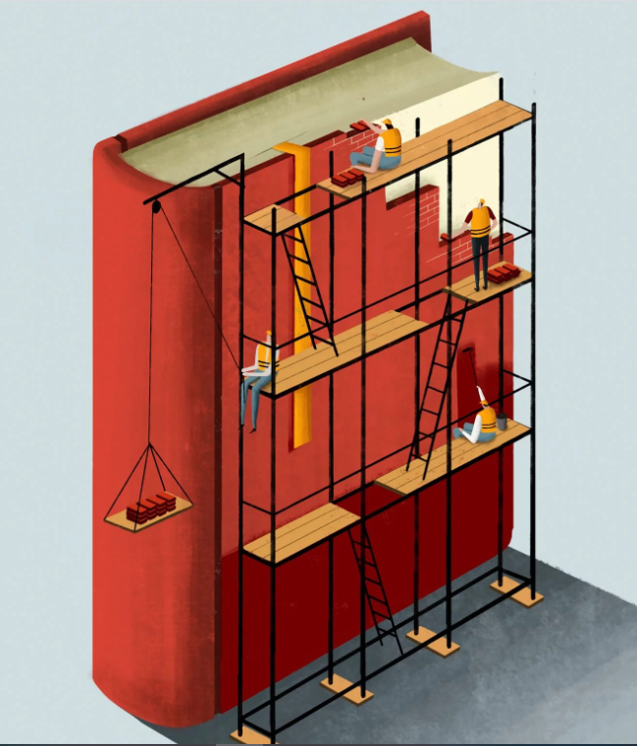
PRODUCT - Strategies
Chunking learning tasks
Knowledge connections
Pace – wait time
Questioning
Written Prompts
Frames and Scaffolds
Reminder of Pre-Taught Vocab
Sentence Starters
Written Scaffolds
Outcome
Coloured paper
Skeleton prompts

Slide 22
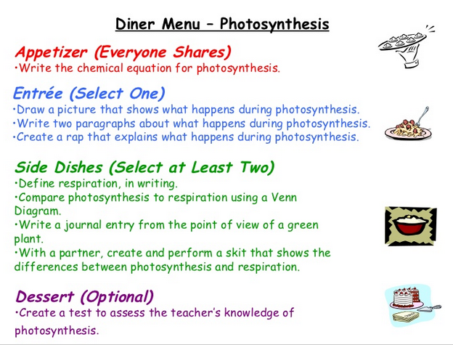
Menus – pick what you like…
Everyone works together (whole class) for the appetizer activity. It checks that everyone has the basic piece of information required.
The Entrée and Side Dish demonstrate understanding through different products.
The Desert is there for the quick finishers (but not necessarily the highest ability as often they are not your quickest finishers anyway.)

Slide 23
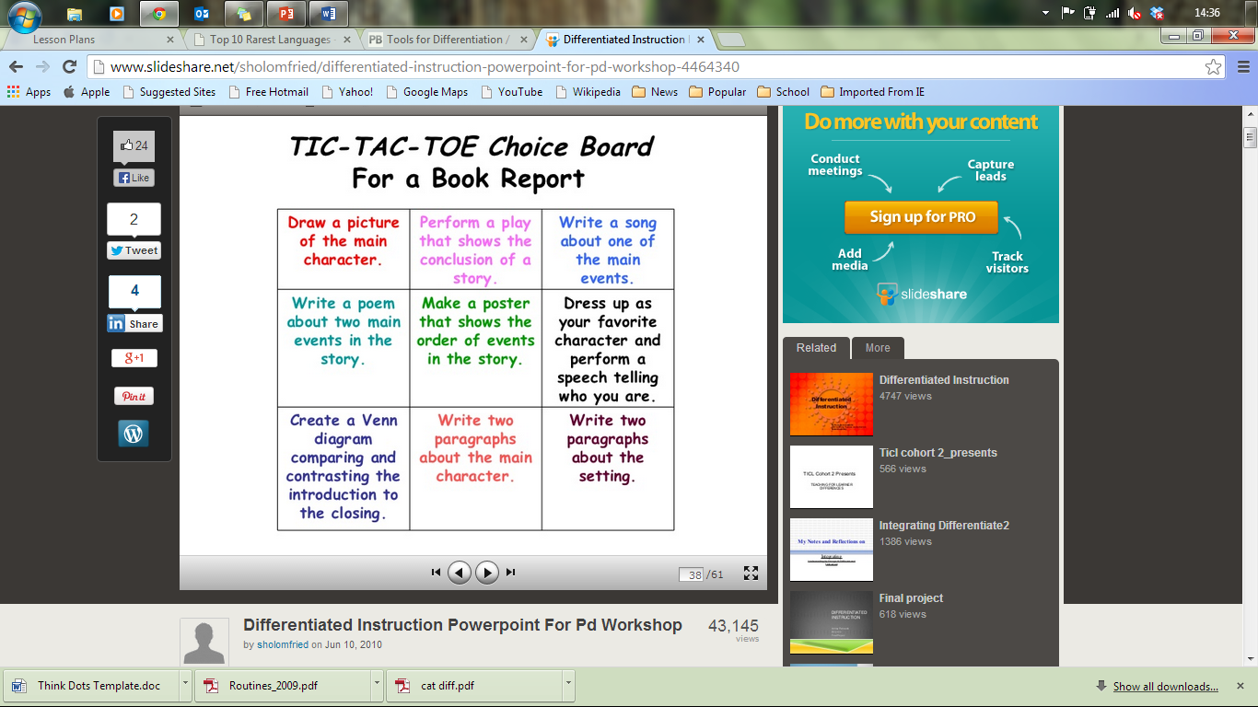
TIC-tac-toe – has elements of choice but must HAVE three in a line
If you choose carefully where you put statements then you can ‘force’ students into doing certain things!
Could be done as a pair activity – they can help each other with their chosen task but can only do their own piece of work.

Slide 24
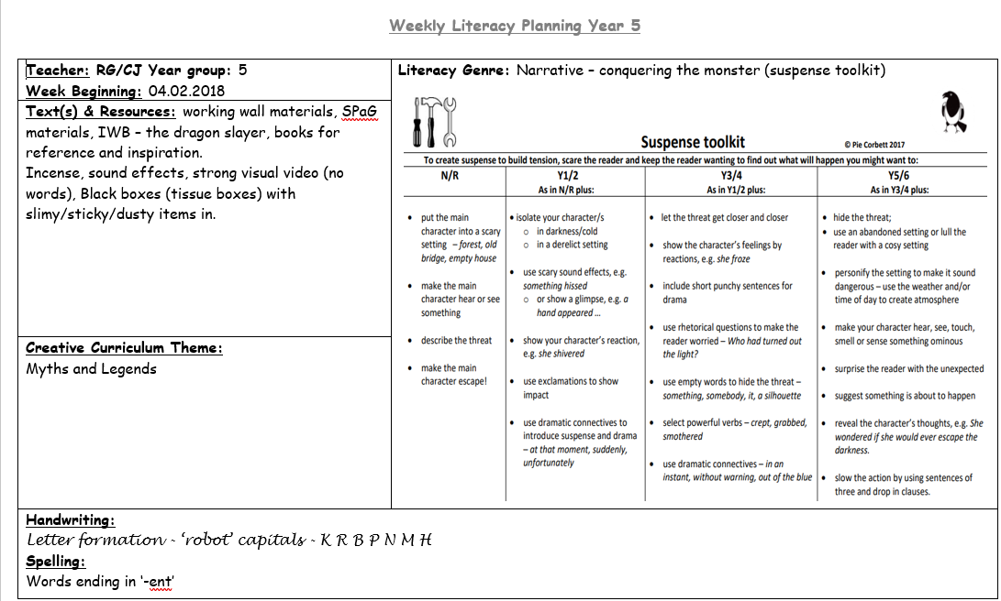

Slide 25
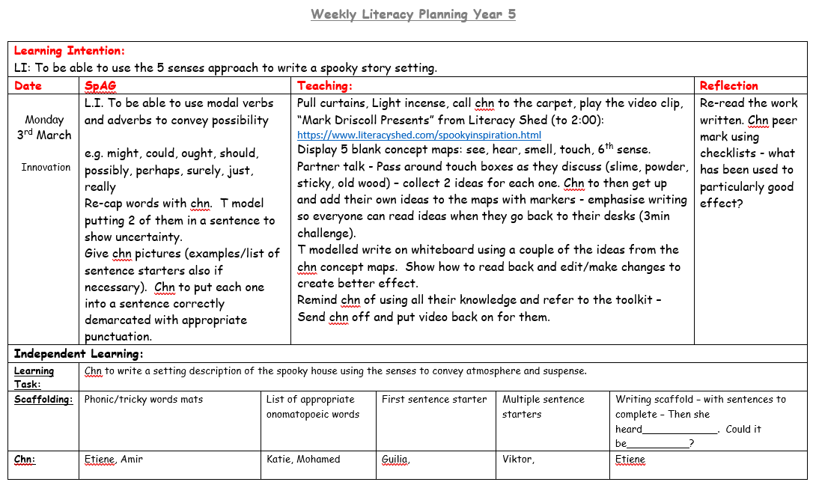

Slide 26
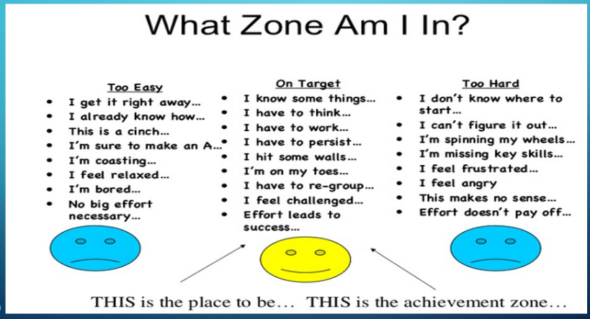
Planning
Pick a Learning Intention and, with a colleague, plan a lesson for it…what scaffolding could you put in place?...
IP2 – LI: To be able to use expanded noun phrases to add description (e.g. the blue butterfly)
IP3 – LI: To be able to identify lines which are perpendicular or parallel
IP4 – LI: To be able to find the perimeter of a shape
IP5 – LI: To be able to cube a number and use the cubed symbol (3)
IP6 – LI: To be able to add and subtract fractions with different denominators
Where are the students at?...
Remember - INDEPENDENCE IS KEY!
IP2 – LI: To be able to read the time on an analogue clock (to 5min intervals)
IP3 – LI: To be able to write an effective character description
IP4 – LI: To be able to use adjectival phrases to create imagery (e.g. biting cold wind).
IP5 – LI: To be able to use personification to create impact
IP6 – LI: To be able to use dialogue to convey character

Slide 27

REMEMBER:
EVERYONE is aiming for excellence and it is your job to make sure they can get there!

