Slide 2
Disclaimer
We hope you find the information on our website and resources useful. This resource contains links to external websites. Please be aware that the inclusion of any link in this resource should not be taken as an endorsement of any kind by Twinkl of the linked website or any association with its operators. You should also be aware that we have no control over the availability of the linked pages. If the link is not working, please let us know by contacting TwinklCares and we will try to fix it although we can assume no responsibility if this is the case. We are not responsible for the content of external sites.
Animations
This resource has been designed with animations to make it as fun and engaging as possible. To view the content in the correct formatting, please view the PowerPoint in ‘slide show mode’. This takes you from desktop to presentation mode. If you view the slides out of ‘slide show mode’, you may find that some of the text and images overlap each other and/or are difficult to read.
To enter slide show mode, go to the slide show menu tab and select either from beginning or from current slide.

Slide 3
Training Objectives
To improve knowledge about and skills for supporting pupils on the autism spectrum.
To develop an understanding of useful strategies for supporting autistic pupils.
To understand current resources available for supporting pupils on the autism spectrum.
To increase awareness of current resources for Autism Spectrum Condition (ASC).

Slide 4
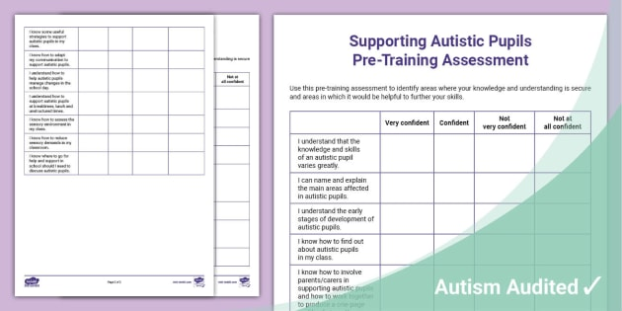
Pre-Training Assessment
Take a few minutes to read and complete the Pre-Training Assessment Sheet. This will help you to identify strengths in your existing knowledge and skills as well as areas for development and further exploration.

Slide 5
What Is Autism?
There are a number of definitions that are used across research and literature bases. One definition is:
Autism is a term used to describe a neurological difference in brain development that has a marked effect on how a person develops.
(Autism Education Trust, 2021)
Autism is a spectrum condition that includes a range of abilities in cognition, learning and language.

Slide 6
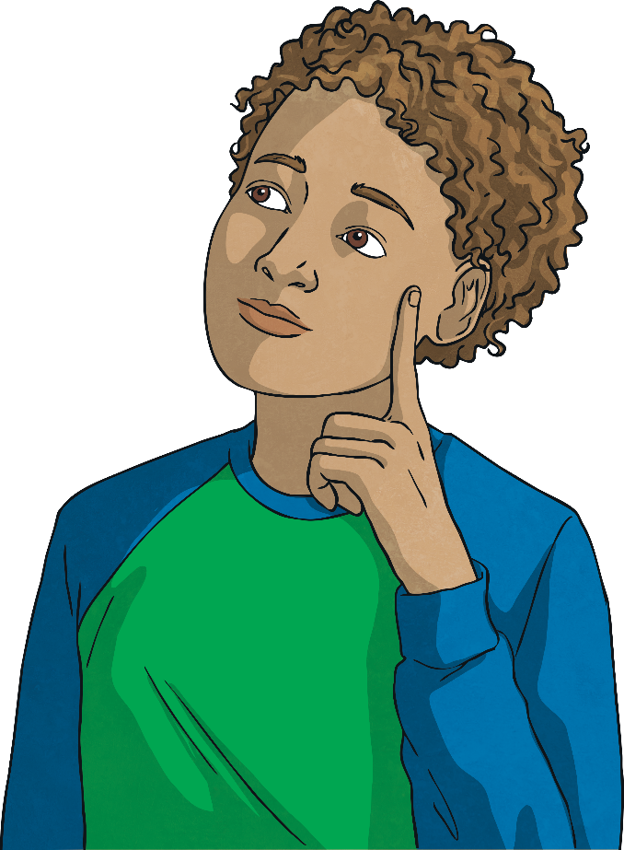
Thinking Point
?
?
What definitions have you seen used?
?
?
What is the commonly agreed term for pupils with ASC in your school?
?
?
In small groups, could you come up with your own definition that you think explains what ASC is?

Slide 7

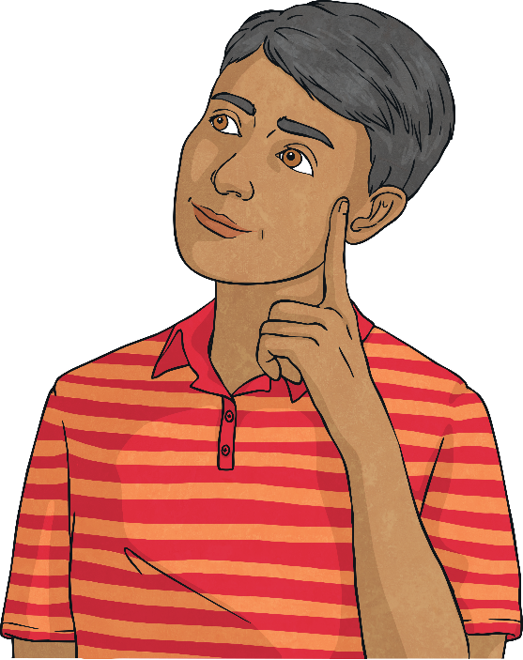
Current Statistics
There is no medical detection for Autism.
Boys are four times more likely than girls to be Autistic.
Normally, it manifests between the ages of 18 months to 3 years. However, ASC can be diagnosed at any age.
It is found throughout the world in families of all racial, ethnic and social backgrounds.

Slide 8
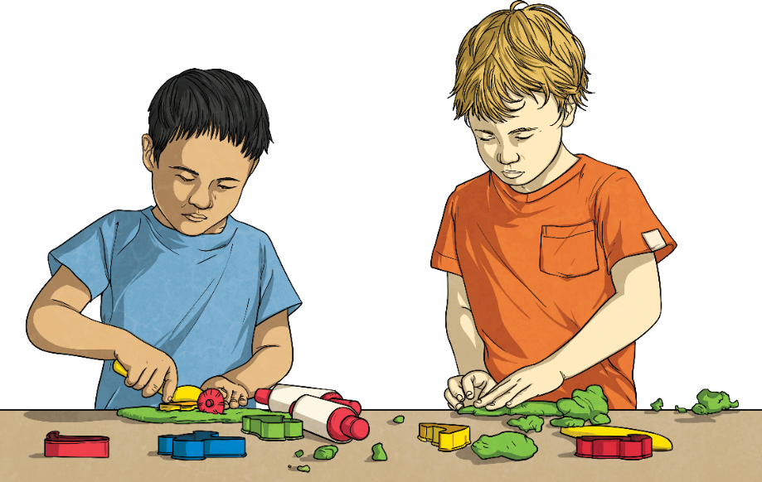
Potential Challenges for Autistic People
Autistic children have a range of diverse and individualised needs. Children may experience challenges in the following areas:
Social Communication and Interaction
These challenges can include interpreting both verbal and non-verbal language, such as gestures and tone of voice.
Repetitive and Restrictive Behaviour
The world can be an unpredictable place for all individuals. To help navigate this unpredictability, some Autistic children may want to keep the same routines, wear the same clothes or eat the same foods. Some individuals may also repeat movements, such as hand clapping, which can help them to calm themselves when they are feeling anxious or over-stimulated. This is known as ‘stimming’ and is a necessity for some children in order to regulate their feelings and emotions.

Slide 9
Causes of ASC
The cause of ASC is still unknown.
What is known, however, is that it is a developmental condition involving the brain.
Most research points to several causal factors.

Slide 10

Screening and Diagnosis
Diagnosing ASC can be very difficult as there is no medical test available.
ASC can overlap with a number of other individual needs and conditions.
Doctors and psychologists look at the child’s behaviour and development in order to make a diagnosis. They will be interested in the views of all professionals involved with the child.

Slide 11
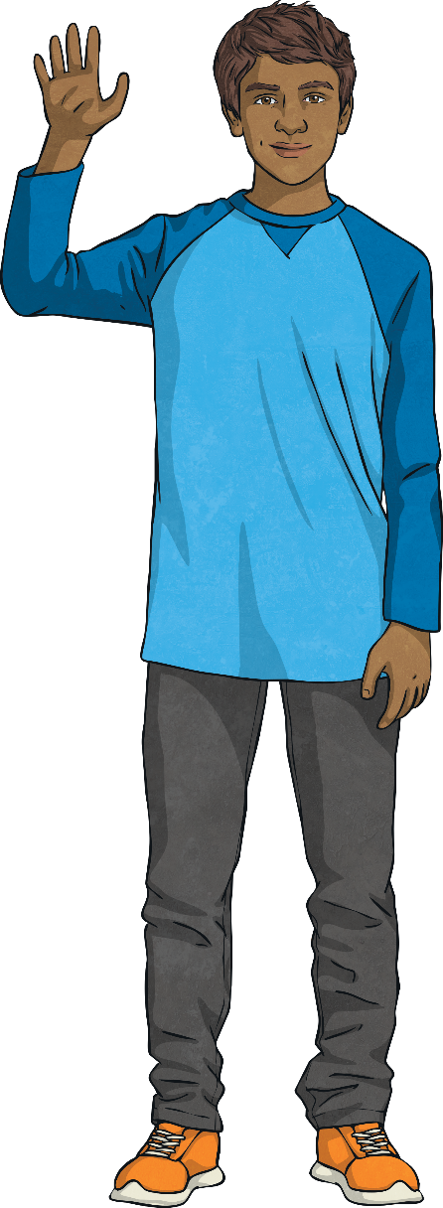
Screening and Diagnosis
ASC can sometimes be detected at 18 months or younger. However, many children do not receive a proper diagnosis until they are much older.
ASC becomes easier to diagnose as children get older, as it presents differently to other conditions.
It is important for professionals to do a full assessment of the developmental milestones a child is expected to reach.
A clinical psychologist is the only professional who can give a diagnosis, taking into consideration a full
multi-agency approach.

Slide 12
Sensory Differences
Autistic pupils often experience a range of difficulties with sensory processing.
This may affect the way that they present and how they behave in school.
Every pupil’s sensory experience is different and they each have a unique way of understanding and interpreting the world in which they live.
It is important that schools work to understand a pupil’s sensory needs. It is useful to conduct a sensory audit – some children may present as ‘sensory seeking’ whereas others may be ‘sensory avoidant’. It is important that each child’s own sensory diet is taken into consideration.

Slide 13
Sensory Differences
Pupils may have difficulties with:
sensitivity to sound and noises;
visual stimuli – sensitivity to light;
sensitivity to smell;
sensitivity to touch;
sensitivity to taste;
balance, movement and processing information.
Pupils can be over or under-sensitive to stimuli through all of their senses.

Slide 14
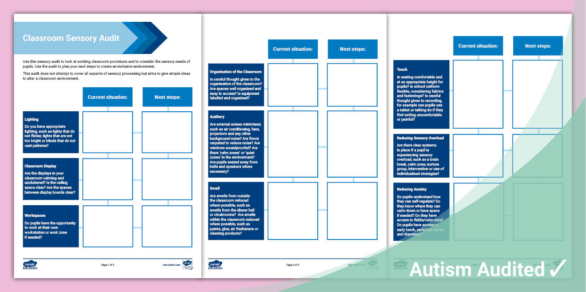
Sensory Audit
In small groups, think about your current classroom or working environment.
Complete a sensory audit of your classroom.
Highlight your current practice and areas for improvement. Think about the strategies you might put in place to reduce sensory overload.

Slide 15
Early Concerns of ASC
Every child has individualised needs, not just Autistic pupils. Therefore, each child should be treated uniquely in order to provide the level of support that is best for them. Below is a list of some of the challenges that Autistic children, as well as many children without a diagnosis, may show:
Differences in expressing emotions
Later to express language and communicate
May present as ‘quiet’ and find it difficult to engage in two-way communication
Sensory difficulties - this could cause young children to be overwhelmed or become distressed in response to certain smells, sounds, tastes and feelings
May find eye contact uncomfortable

Slide 16
Early Concerns of ASC
Stimming behaviours may be noticeable from an early age, e.g. flapping, rocking, repeating words
Difficulties with personal care, such as feeding and toileting
Challenges around sleeping - sleeping a lot or a little and experiencing difficulties with sleep routine
May display a difference in their approach to play
Respond differently to affection or feelings from others
(NHS, 2019)

Slide 17
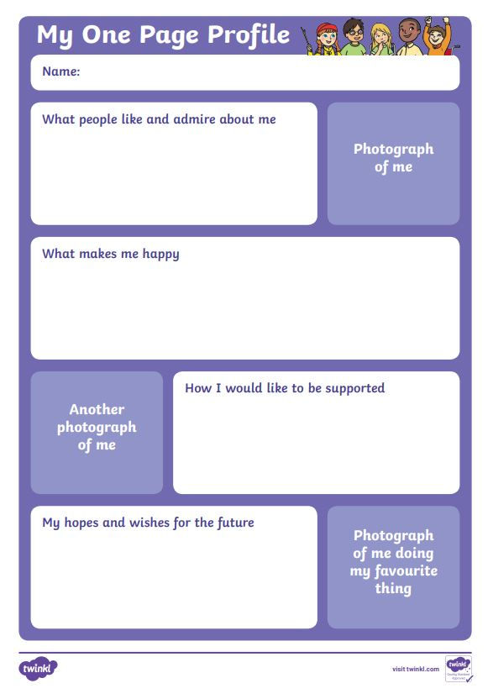
Group Activity
Think of a child you have worked with or are currently working with that has a diagnosis of ASC or Autism.
What do you think are the main barriers to learning?

Slide 18
Supporting the Behaviour of Pupils with ASC
Autistic children have a range of diverse and individualised needs when it comes to their behaviour. Most behaviours are a way of communicating feelings or emotions, such as a child feeling excited, tired or experiencing sensory overload.
Using a child’s individual interests to set obtainable goals is a positive way to support their behaviour, rather than a traditional consequence or reward approach.
Give clear explanations using the child's preferred mode of communication in order for them to understand why a certain behaviour is inadvisable as well as ways to move forward in the future.

Slide 19
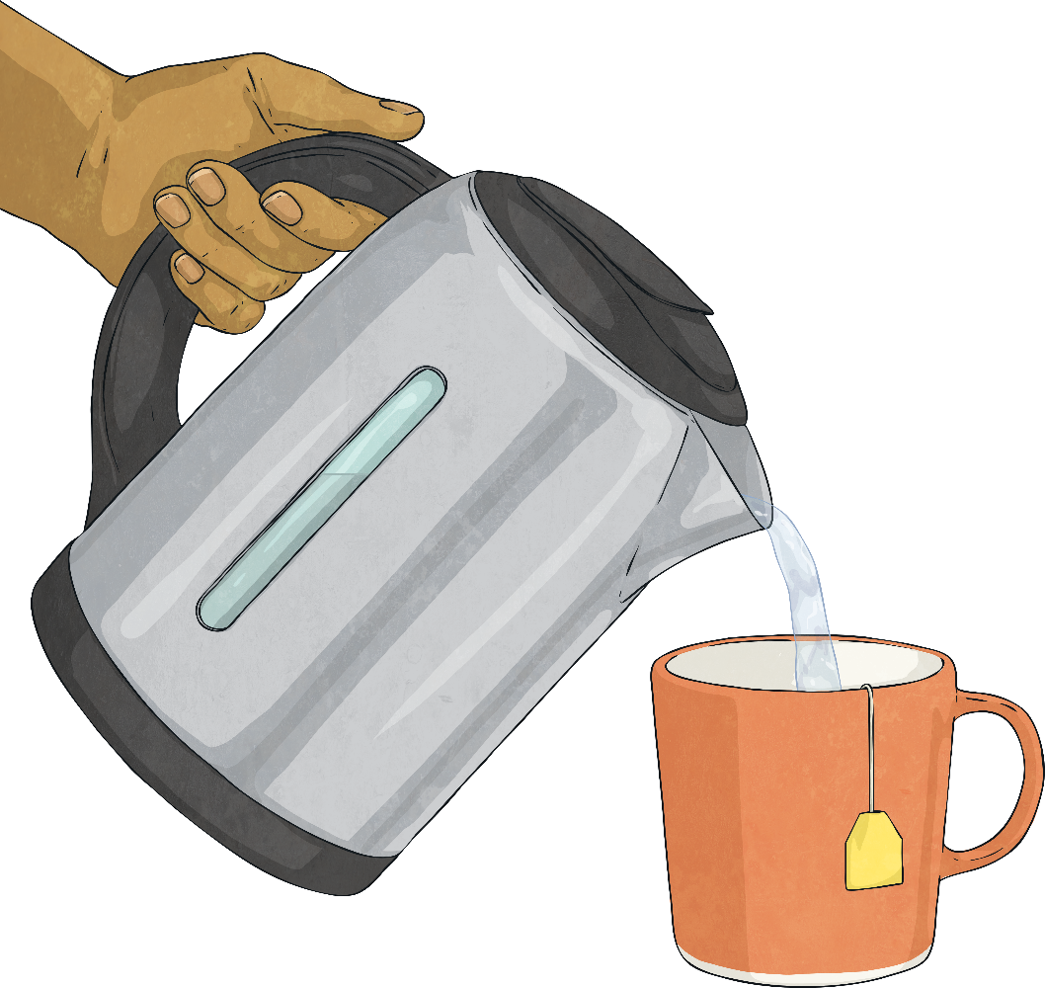


BREAK

Slide 20
Practical Strategies to Support Autistic Pupils

Slide 21
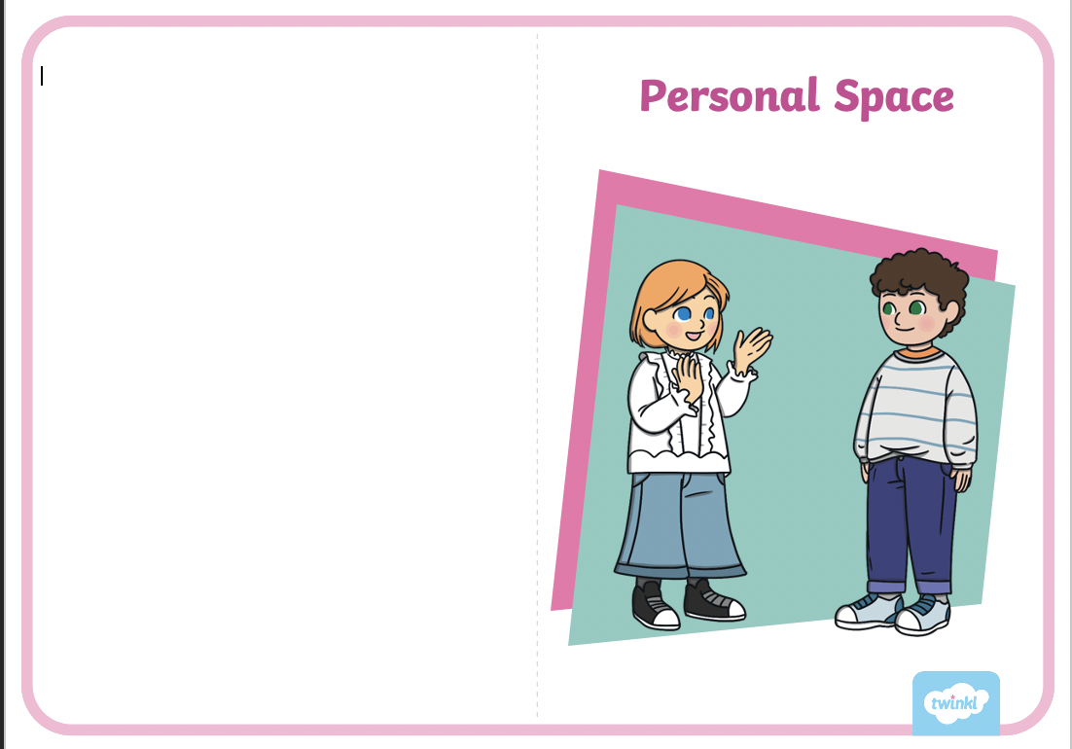
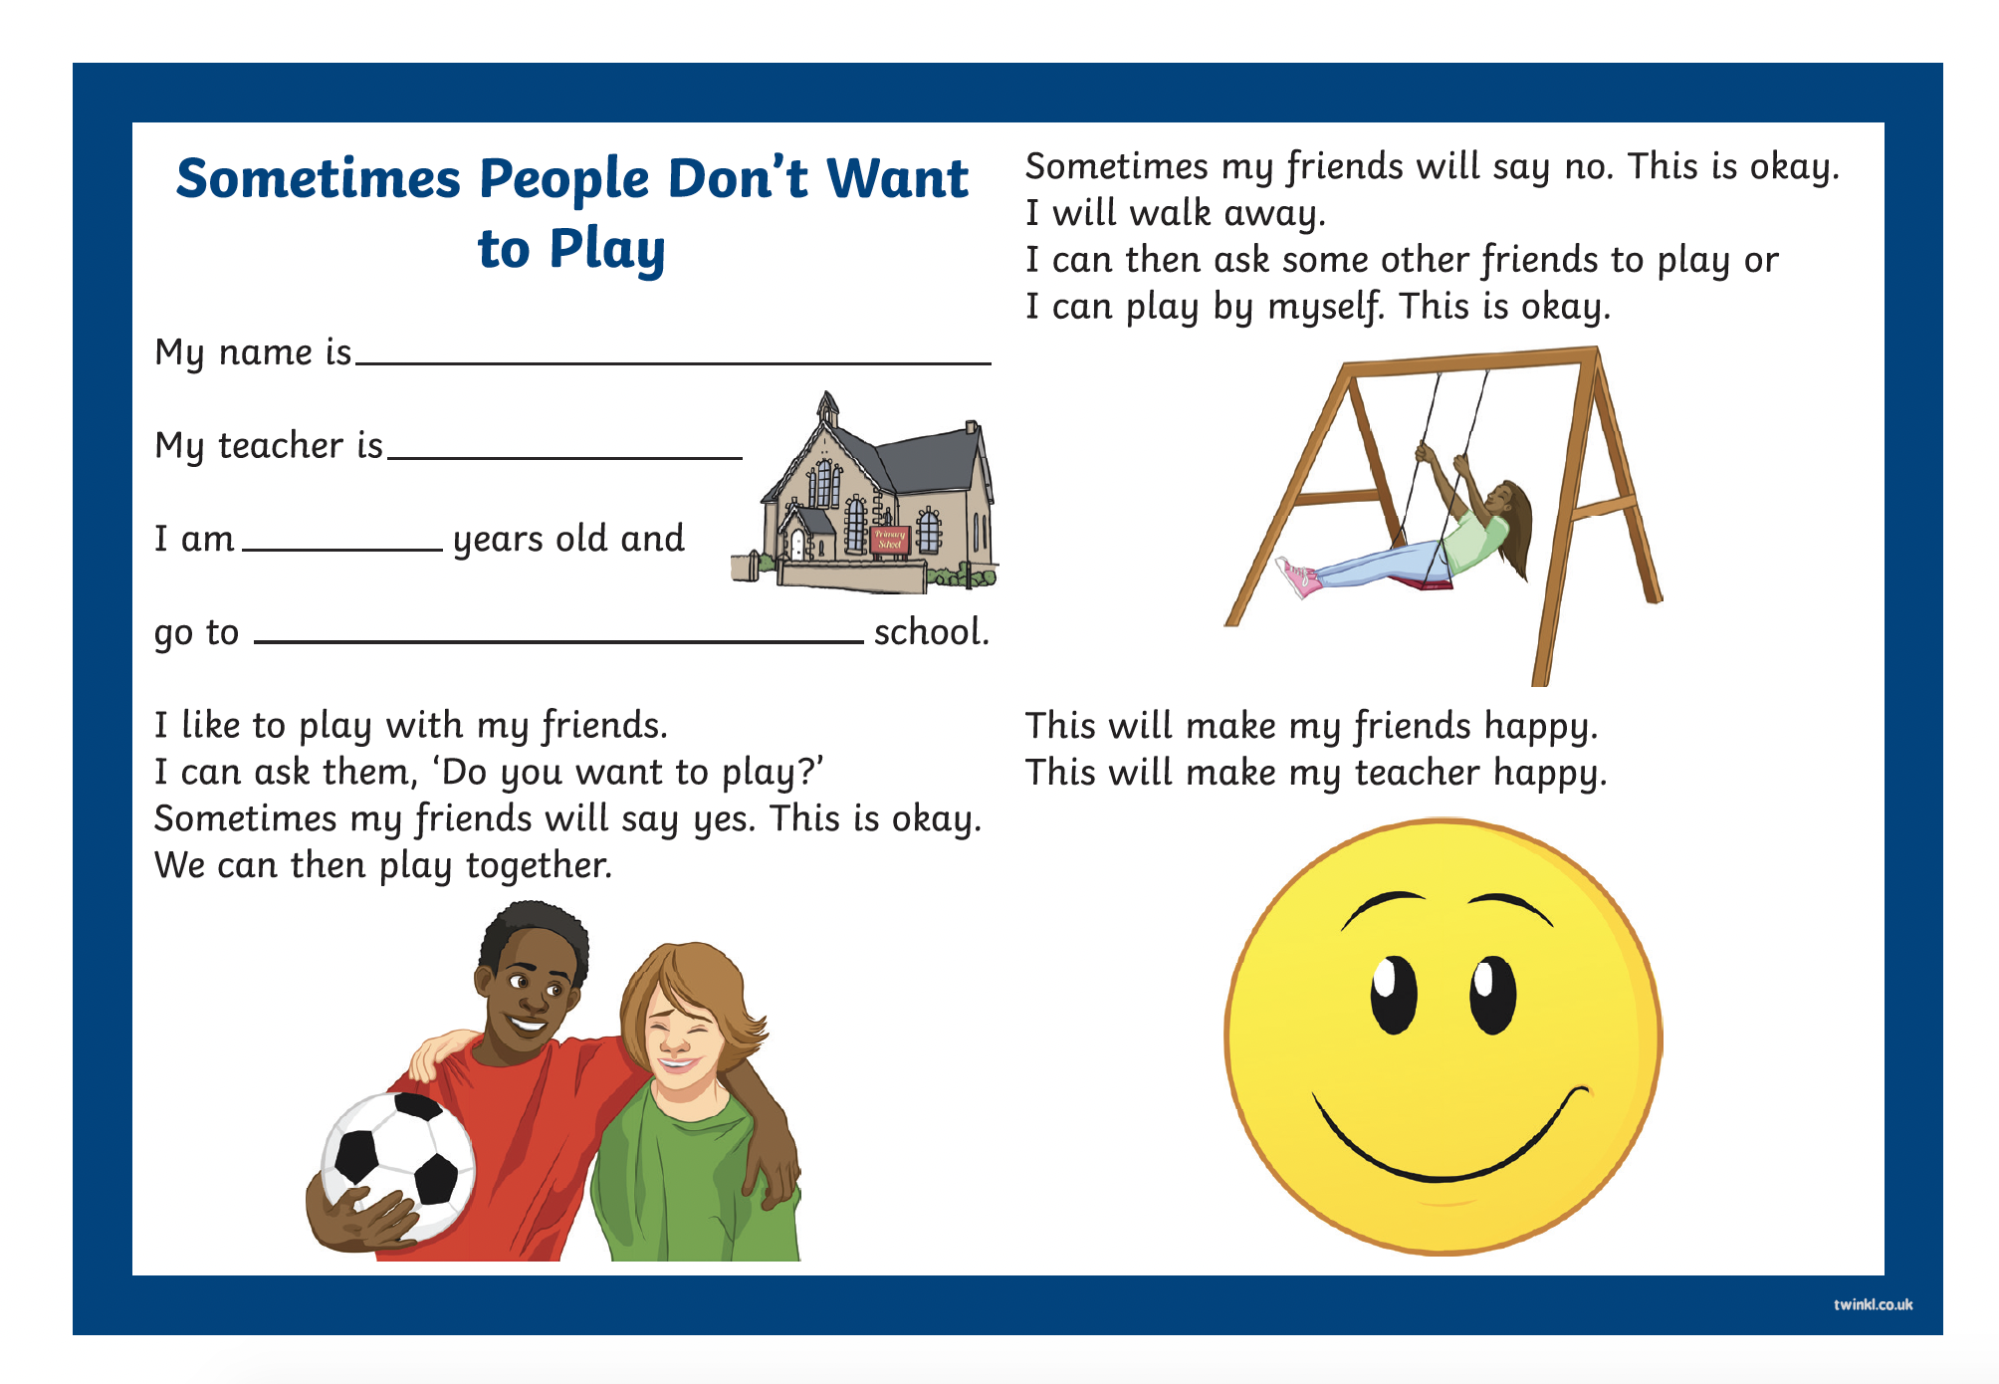
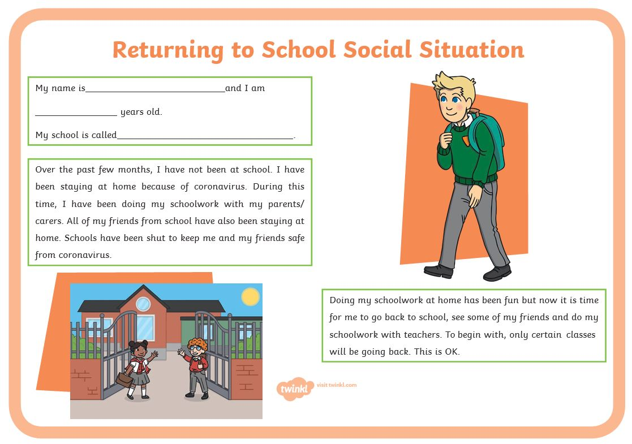
Strategies to Support
The next part of the training will offer a range of useful support strategies that you could implement in your classroom provision. This is not an exhaustive list but a range of some of the possible strategies for supporting pupils in the classroom environment.
Social situations help Autistic pupils to understand a variety of real-life situations, develop empathy and stay safe. Social situations include a description of an event or activity in order to help pupils understand what to expect and why.

Slide 22
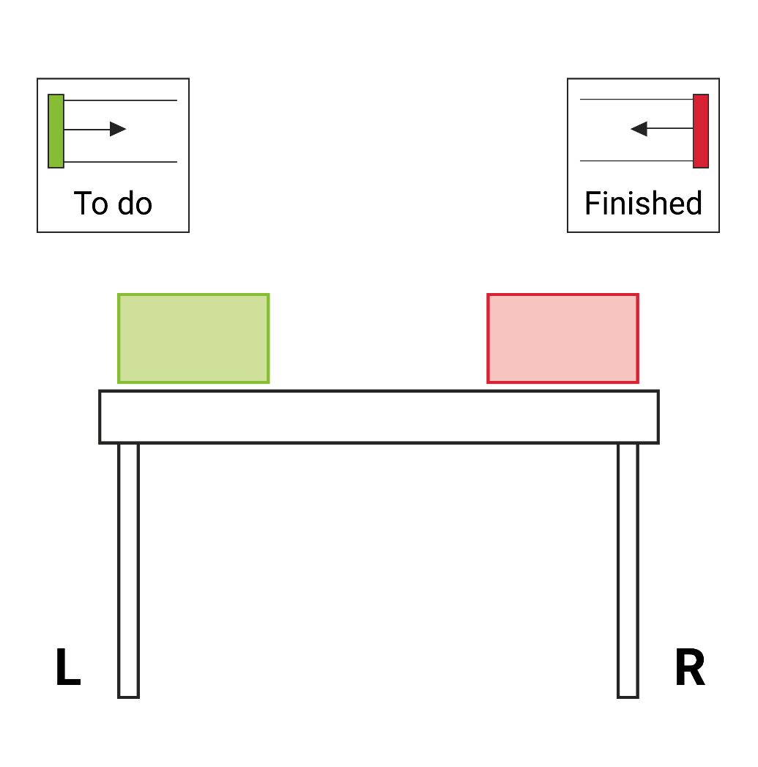
Strategies to Support
Structured teaching approaches, such as in and out systems, can help a pupil to work in a structured way, following a visual schedule and checklist to show what is expected from them. Workstations are very effective for Autistic pupils, giving them a separate, calm working space with structure and routine along with limited distractions.

Slide 23
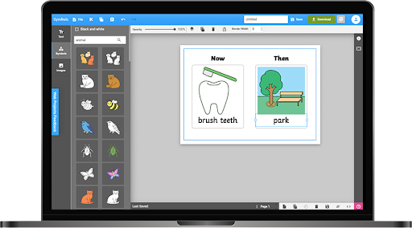
Strategies to Support
Alternative Communication Systems, such as Twinkl Symbols and objects of reference.

Slide 24
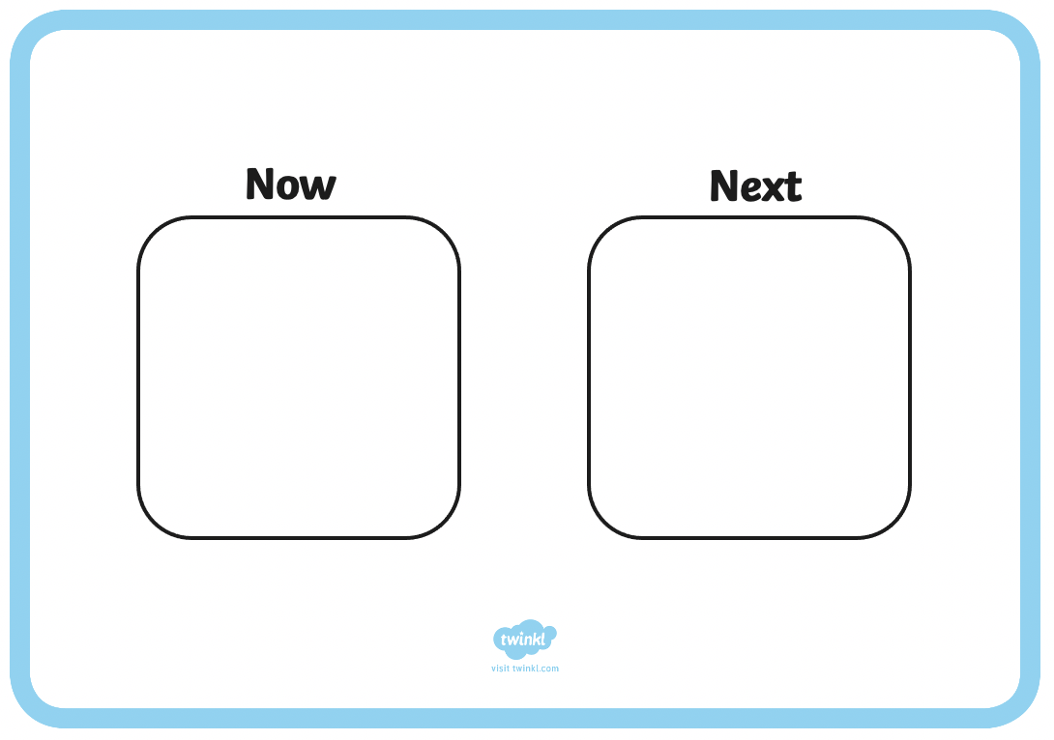

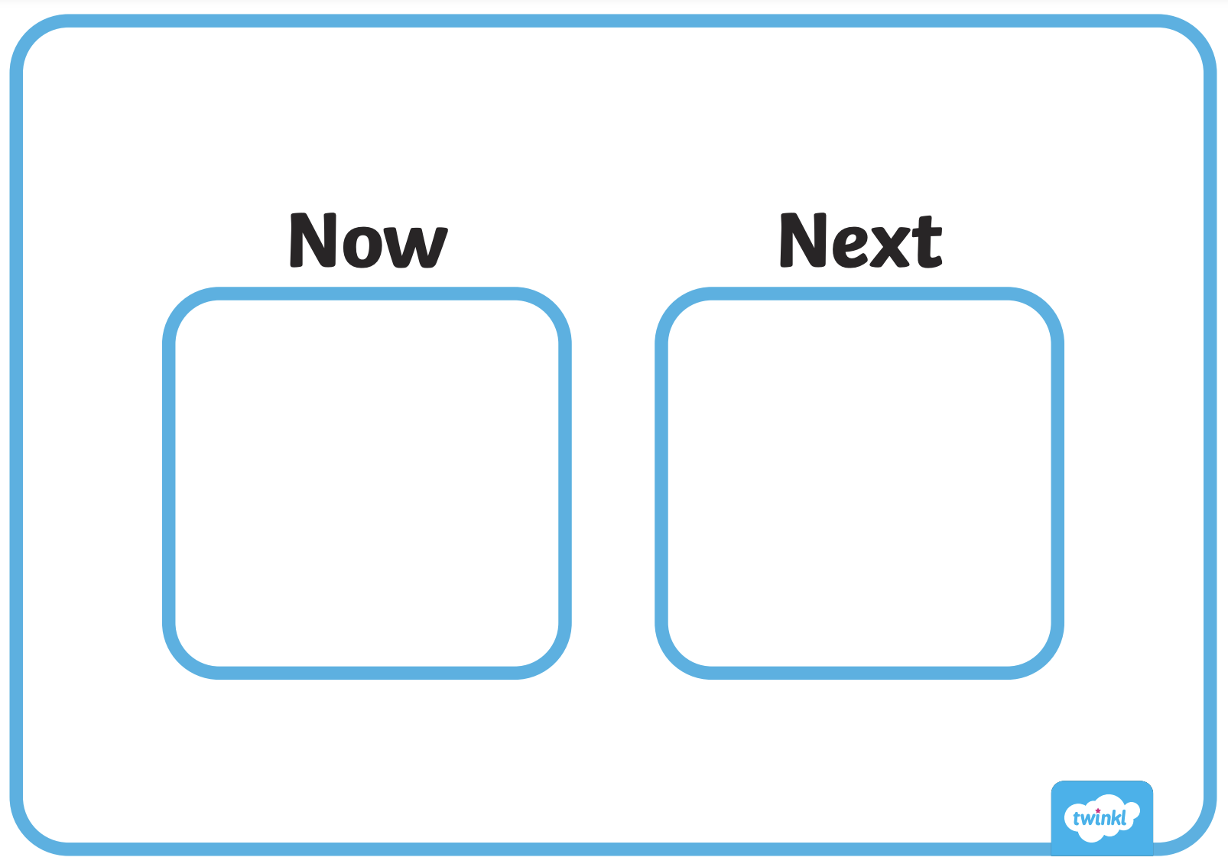
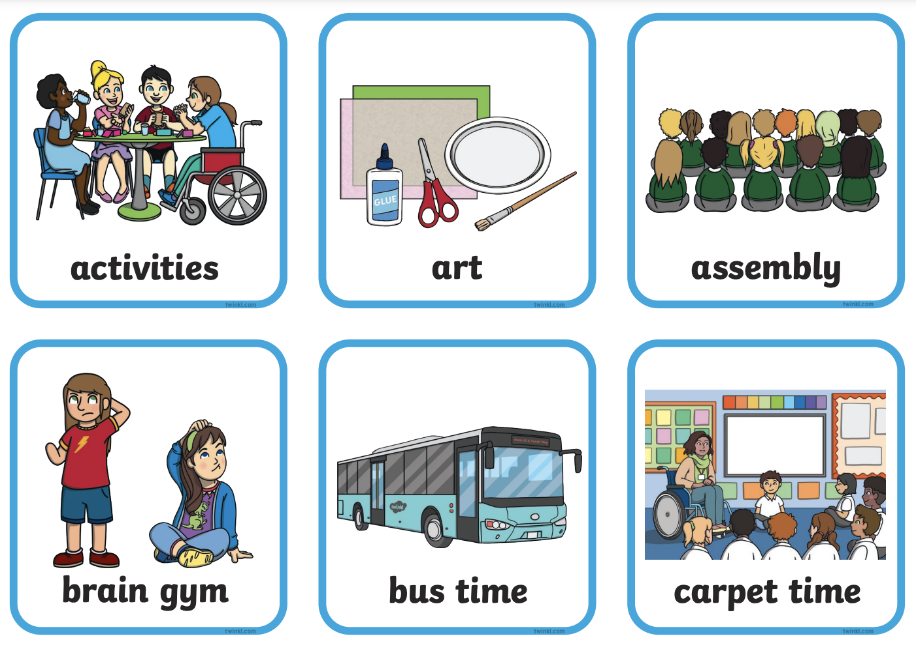
Strategies to Support
Visual timetables and visual supports, such as now and next boards.

Slide 25
Strategies to Support
Carefully organised classroom with structure and predictable routine.
Sensory audits to identify areas of good practice and areas for improvement in your setting.
Manage behaviour fairly and consistently. Use strategies to pre-empt dysregulation, such as offering calm time, reducing sensory overload and developing individualised strategies for each pupil. Use positive reinforcement, identify what is causing dysregulation and regularly liaise with parents/carers and outside agencies to apply a multi-agency approach for managing pupils’ regulation.

Slide 26
Strategies to Support
Offer pupils alternative ways to record activities, such as the use of recordable devices, tablets or word processors.
Use simple and clear language to support pupils' understanding of language. Keep language clear and free of ambiguity and take care not to use figurative language or idioms. Offer extra processing time and ask pupils to repeat back instructions to check they have understood.
Provide ongoing opportunities for pupils to develop social skills through day-to-day practise or intervention work. Allow pupils time to rehearse and role-play situations as well as to practise appropriate language, turn-taking, body language and social conventions of language. It is important to respect that some pupils may prefer their own company and if this is the case, they should not be expected to conform to any expectations around socialisation.

Slide 27

Causes for Concern
Note your concerns - make a list of what is concerning you and how your pupil presents in class and then arrange to speak to your SENCo in school. The SENCo will be able to observe the pupil and offer you support.
Speak to the parent/carer - explain your concerns and ask for them to share any useful information about their child and their development.

Slide 28

Further Information – Useful Websites
National Autistic Society
Mind
Structured Teaching
Scope
Twinkl Symbols
Carol Gray Social Stories

Slide 29
Questions and Discussion
?
?
?

Slide 30
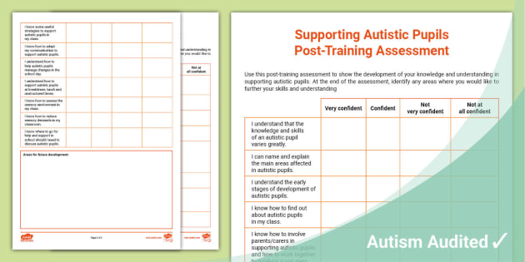
Post-Training Assessment
Take a few minutes to read and complete the Post-Training Assessment Sheet. This will help to identify areas for further exploration and to assess your development of knowledge, skills and understanding, following the training.
Remember to think about areas that you would like to research or explore further and note these at the bottom of your assessment sheet.

Slide 31
References
Autism Education Trust (2021), What is autism? Available at: https://www.autismeducationtrust.org.uk/what-is-autism/ (Accessed: 16 September 2021).
NHS (2019), Signs of autism in children. Available at: https://www.nhs.uk/conditions/autism/signs/children/ (Accessed: 16 September 2021).

Slide 32
Training Objectives
To improve knowledge about and skills for supporting pupils on the autism spectrum.
To develop an understanding of useful strategies for supporting autistic pupils.
To understand current resources available for supporting pupils on the autism spectrum.
To increase awareness of current resources for Autism Spectrum Condition (ASC).

