Slide 2
Training Objectives
To improve knowledge and skills about pupils with Dyspraxia.
To develop an understanding of useful strategies to support pupils with Dyspraxia.

Slide 3
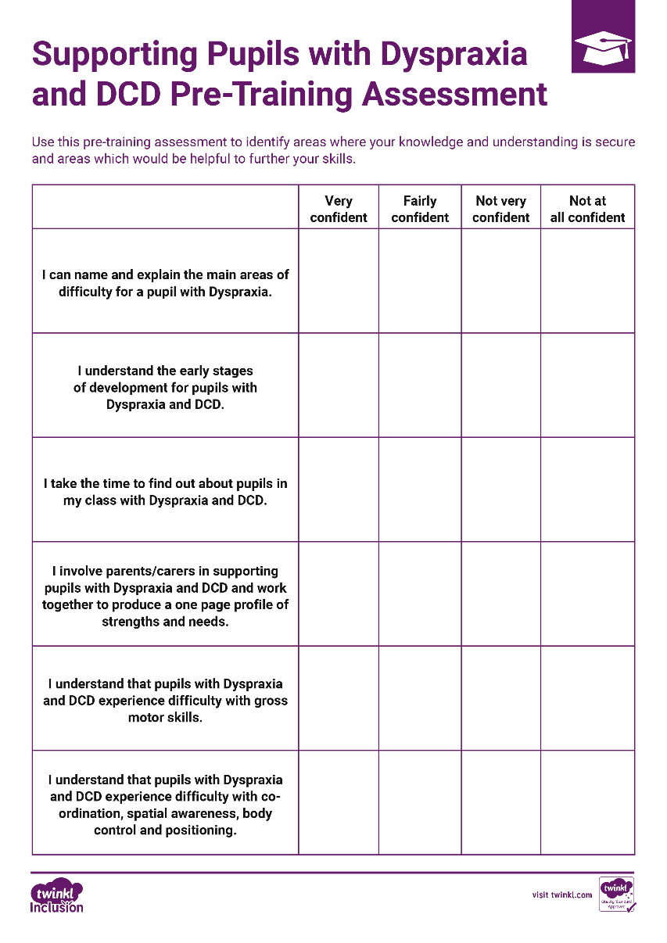
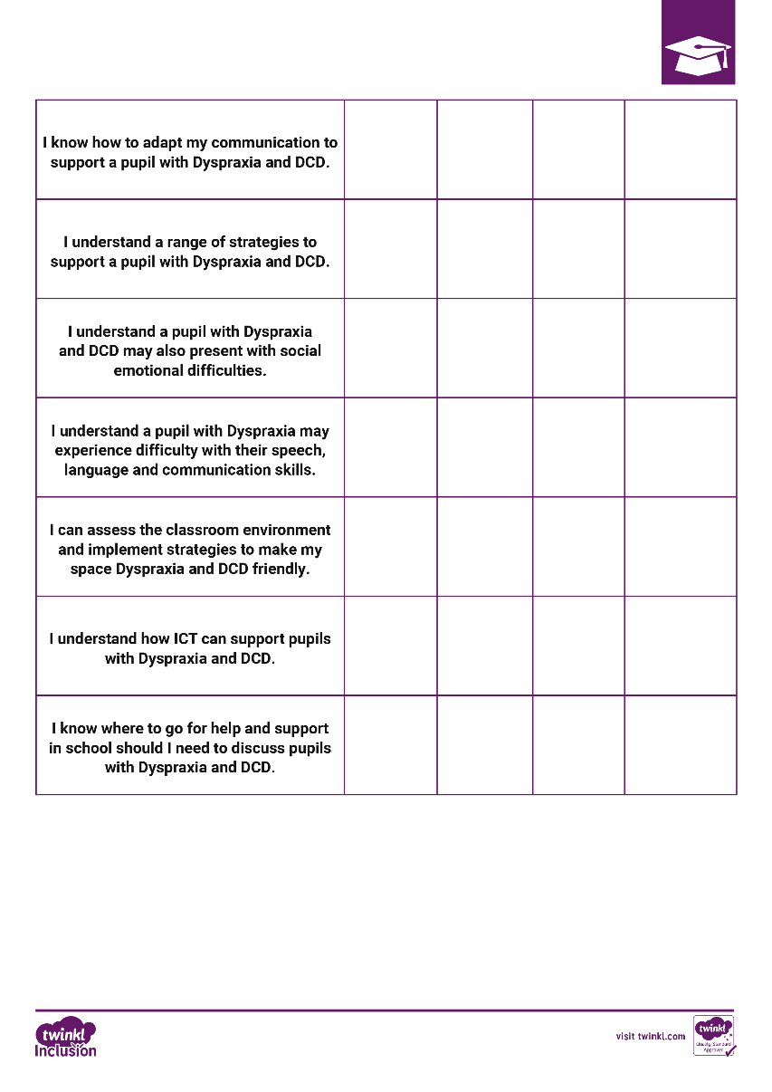
Pre-Training Assessment
Take a few minutes to read and complete the Pre-Training Assessment Sheet. This will help identify strengths in your existing knowledge and skills and areas for development and further exploration.

Slide 4
Definition of Dyspraxia
‘Dyspraxia is a form of developmental coordination disorder (DCD), it is a common disorder affecting fine/gross motor coordination, along with speech’.
from- Dyspraxia Foundation, 2019

Slide 5
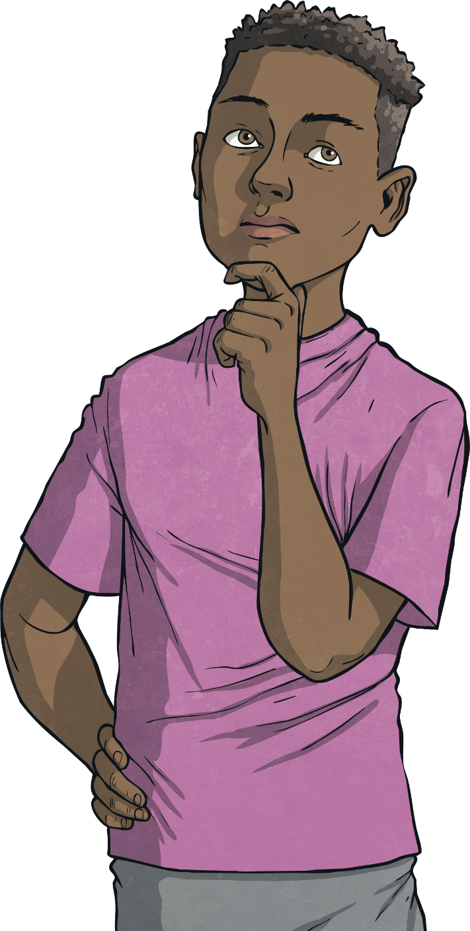
What Is Dyspraxia?
Dyspraxia affects development of fine and gross motor skills, coordination, hand-eye coordination, perceptual ability, speech and organisational skills.
Children may present with difficulties such as poor self-care, difficulties with riding a bike, kicking a ball, writing, play and many other educational activities.

Slide 6

What Is Dyspraxia?
Dyspraxia has been described as ‘difficulty getting our bodies to do what we want when we want them to do it’ (Ripley, Daines and Barrett) and this can be considered significant when it interferes with the normal range of activities expected of a child.

Slide 7
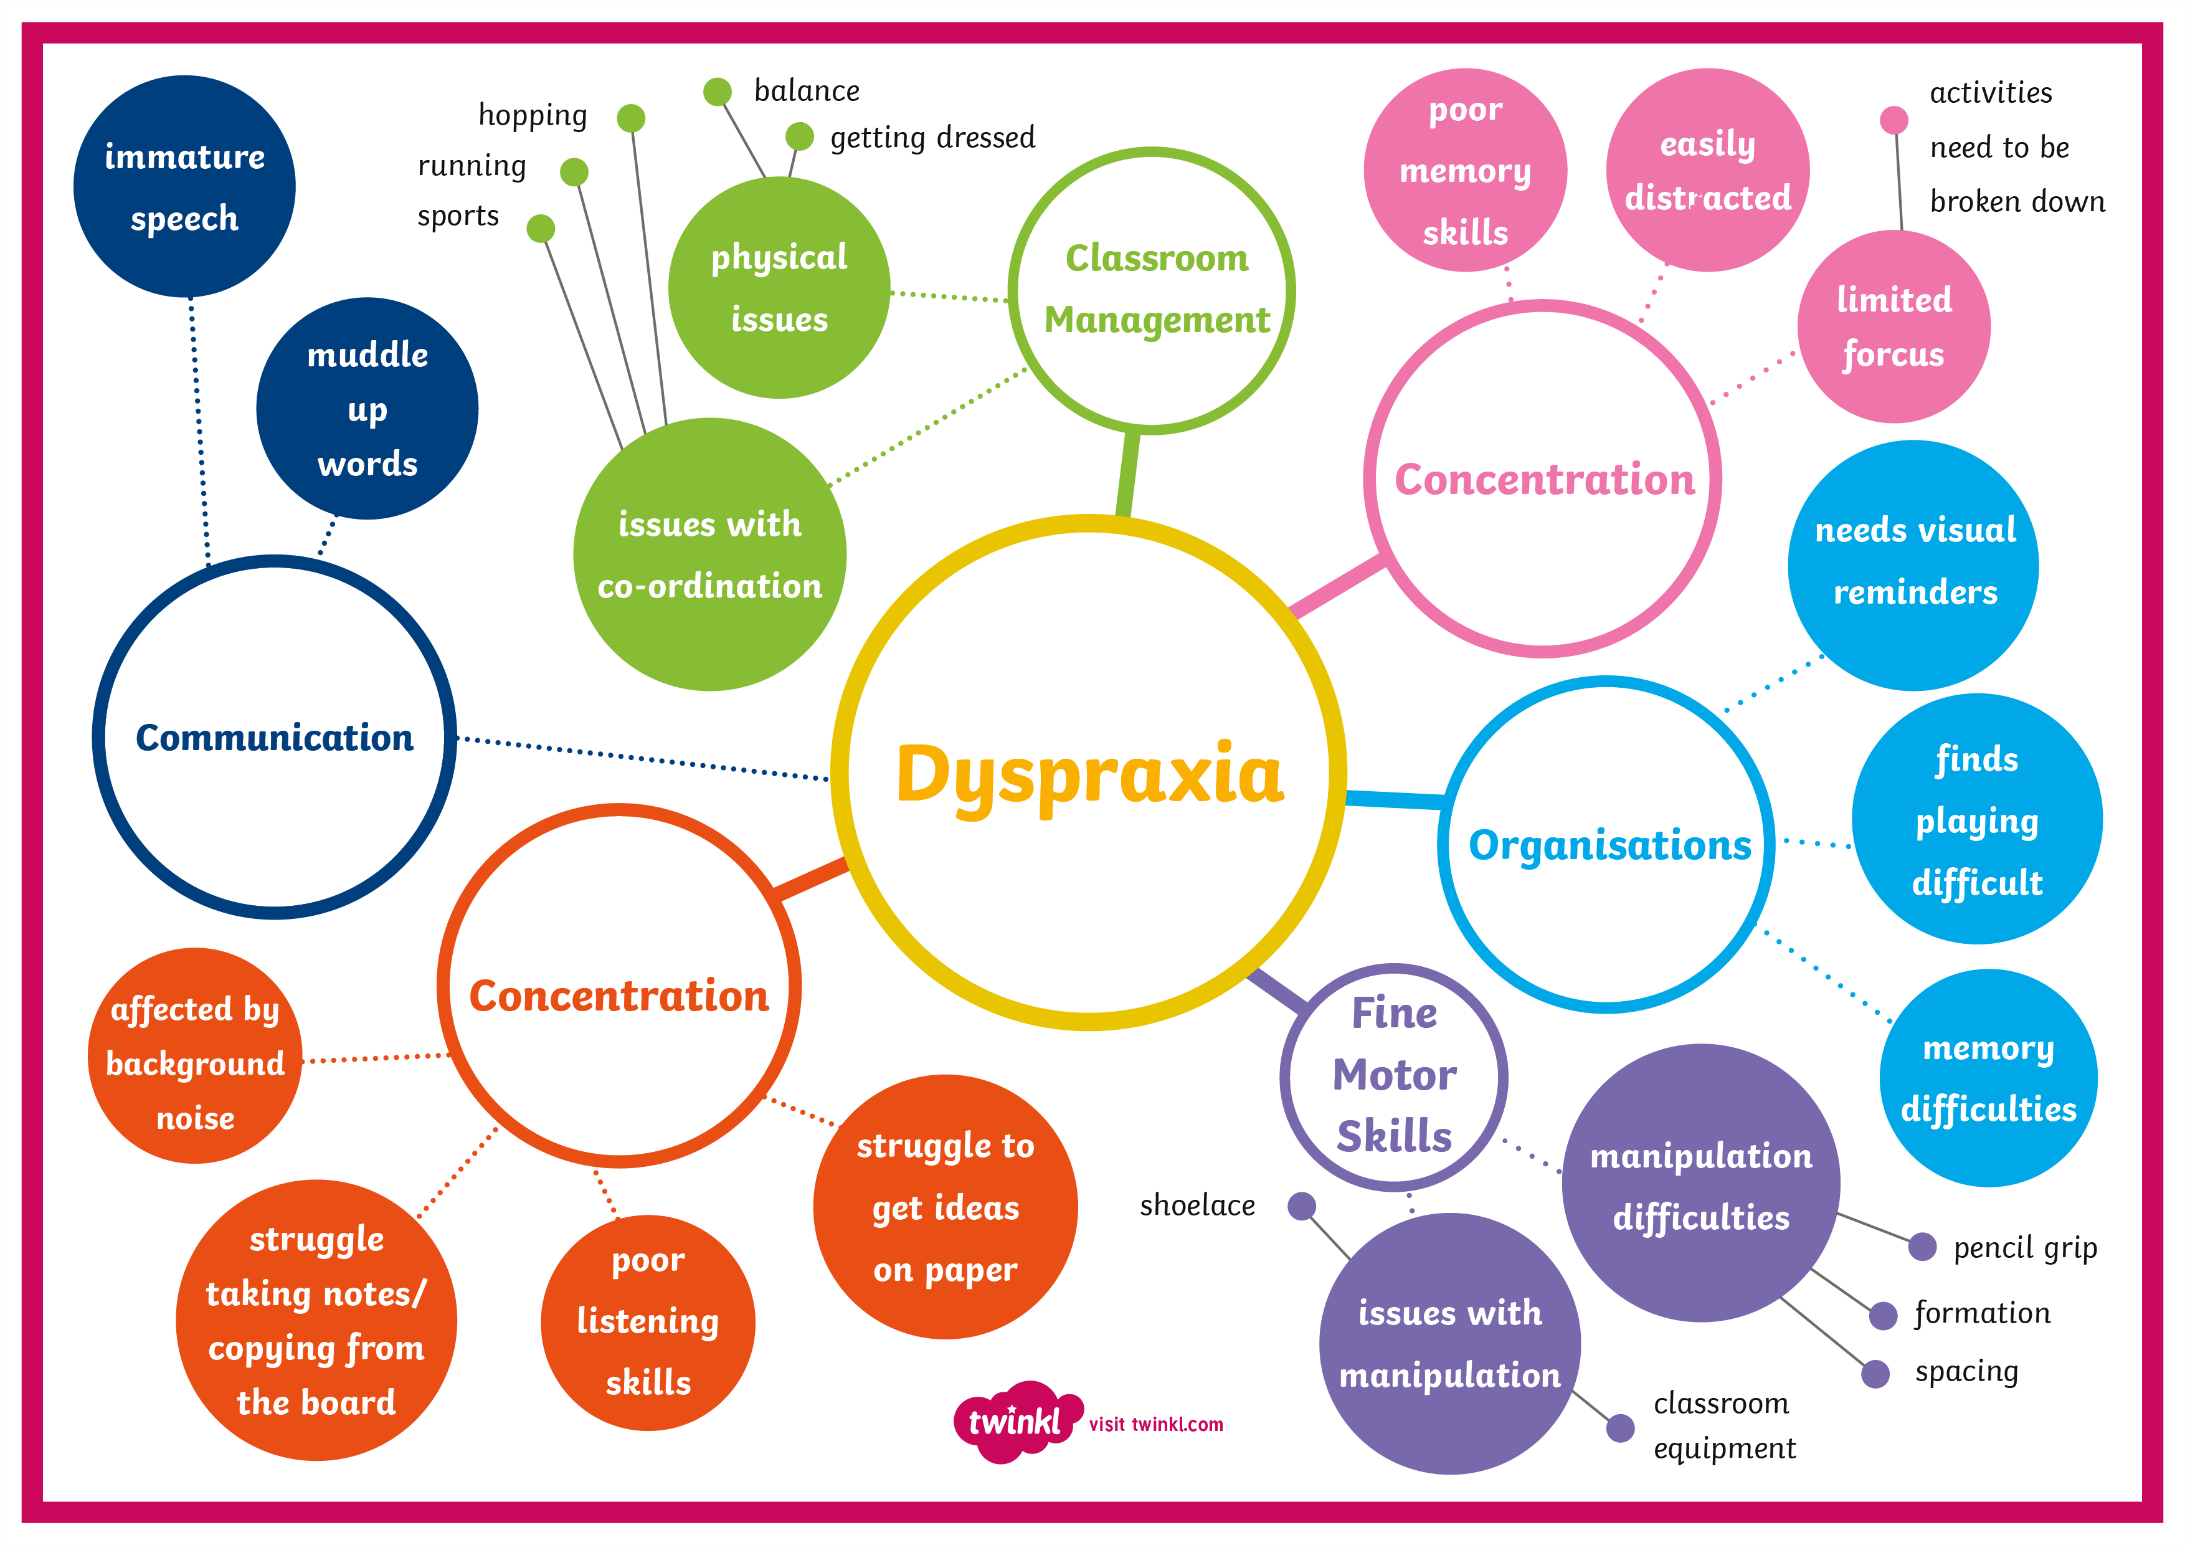

Slide 8
How Is Dyspraxia Diagnosed?
Dyspraxia in children is usually diagnosed by a paediatrician. There may be a combination of evidence from home, school and medical tests to confirm a diagnosis.
There is no known cause, at present.
According to the Dyspraxia Foundation, current research suggests that the disorder is a result of an immaturity of neuron development in the brain, rather than brain damage. People with dyspraxia have no clinical neurological abnormality to explain their condition.

Slide 9
What Is Dyspraxia?
Dyspraxia can also be present and overlap with a range of other difficulties including:
Speech, Language and Communication Difficulties.
Autistic Spectrum Difficulties
Specific Language Difficulties such as Dyslexia
Dyscalculia
Processing Disorders

Slide 10
What Is Dyspraxia?
Children with Dyspraxia may have delayed early developmental milestones, such as crawling, walking, self-feeding and dressing. During a normal school day, Dyspraxia can manifest itself through:
handwriting difficulties;
difficulty using tools, utensils and cutlery;
not being able to run in a straight line, or to effectively alter their path to avoid objects;
poor hand/eye coordination;
poor attention span;
difficulty understanding concepts such as ‘in’, ‘on’ and ‘in front of’;
poor organisation;
difficulty with some social skills/cues.

Slide 11
Current Statistics
Dyspraxia is estimated to affect around 10% of the UK population, with 2% being severely affected.
There is significant overlap between the signs and symptoms of Dyspraxia and Dyslexia – Kaplan et al (2018) suggest that children with Dyslexia have features of Dyspraxia.
The same research suggests up to 50% of people with Dyspraxia also have ADHD.
Taken from Dyspraxia Foundation

Slide 12
Thinking Point
What definitions have you seen used?
What do you know already about Dyspraxia?
In small groups, could you come up with your own definition that you think explains what Dyspraxia is?

Slide 13
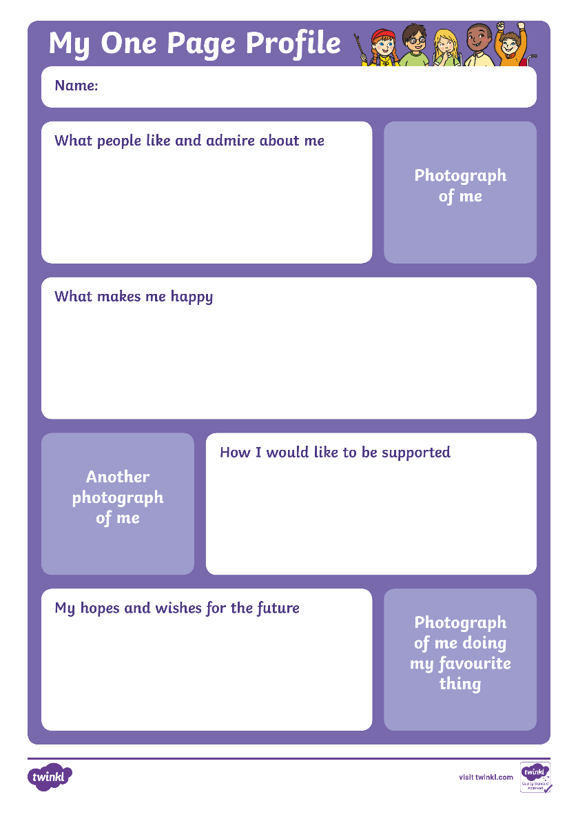
What Is Dyspraxia?
Think of a child you have worked with or are currently working with that has a diagnosis of Dyspraxia or displays dyspraxic traits.
Work in small groups to complete a one page profile on the child to detail their strengths and areas for development.
What do you think are their main barriers to learning?

Slide 14


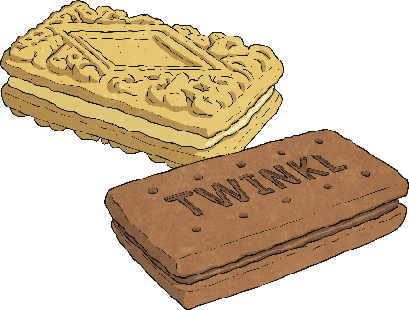
Break

Slide 15
Practical Strategies to Support
Pupils with Dyspraxia

Slide 16
Strategies to Support
The next part of the training will offer a range of useful support strategies that you could implement into your classroom provision to support pupils with Dyspraxia.
This is not an exhaustive list but a range of some of the possible strategies to support pupils in the classroom environment:
Quality First Teaching
Pupils with Dyspraxia should be adequately supported and differentiated for within the mainstream classroom. This includes teachers using a variety of teaching approaches such as visual, auditory and kinaesthetic, careful monitoring and assessment of pupils, use of support within the classroom with liaison and planning time, intervention mapped to need along with appropriate strategies to meet the needs of pupils including use of ICT, use of symbols and visual supports.
Careful thought needs to be given to appropriate seating on the carpet, table/chair height and position and writing equipment/resources.

Slide 17
Strategies to Support
Differentiation
Pupils with Dyspraxia should receive appropriate differentiation across all subjects which could include:
Extra processing time and time to complete any activities, especially those which may be physical in nature.
Visual supports such as word mats, sentence starters and writing frames.
Use of recording devices to aid working memory – such as talking tins, Dictaphones and talking pens.
Small group work, peer support or adult support.
Hands on, practical experiences with real-life resources, where possible.
Allow regular rest breaks.
Careful thought should be given to the pace of lessons, the amount of information to be learnt and how it is acquired.

Slide 18
Strategies to Support
Alternative Means to Record
Pupils with Dyspraxia will need alternative ways to record such as:
Access to word processors or speech to text software.
Teach touch typing.
Use of scribes and transcripts.
Recording in pictures or symbols.
Special writing aids such as writing slopes, pencil grips and special rulers with handles.
Voice recording on recording aids or tablet devices.

Slide 19
Strategies to Support
Use simple, clear language - support pupils’ understanding of language by keeping language clear, simple and free of ambiguity. Offer extra processing time and ask pupils to repeat back instructions to check they have understood.
Variety of multisensory intervention programmes available to support pupils to develop appropriate reading, spelling and handwriting skills.
Core Stability Programmes - use a core stability programme to develop pupils’ core strength. Refer pupils for specialist support via Occupational Therapy and Physiotherapy. This is usually through a GP referral.

Slide 20
Strategies to Support
Provide a non-slip mat to go under books.
Allow extra time to complete tasks.
Do not provide too many verbal or visual instructions at once.
Give step by step instructions and check they are understood.

Slide 21
Strategies to Support
If necessary, place simple written instructions on the pupil’s desk.
Sit the pupil near the board.
Use checklists and story planners.
Provide diagrams to label rather than asking the pupil to draw them.
Position the student away from distractions in the classroom.
Provide handouts where possible.
Encourage the use of mind maps, spider diagrams and lists.
Use lined paper with margins.
In Mathematics, use squared paper.
In Physical Education, a new skill may have to be fully demonstrated before the pupil can perform the task.

Slide 22
Strategies to Support
Provide a mini laminated timetable.
Encourage the pupil to make an equipment timetable to list what is needed each day.
Allow extra time for the pupil to pack up at the end of the lesson.
Provide specialist equipment to make practical activities more inclusive. Look at things like ridged rulers or looped scissors.
Give homework at the start of the lesson so the pupil has chance to make a clear note of it.
Work with parents to set up a system at home for a homework routine.
Suggest time limits for homework.

Slide 23
Thinking Point
What adjustments could you make to your learning environment, around school and in the classrooms to become more ‘Dyspraxia friendly’?

Slide 24
Causes for Concern
Note your concerns - make a list of what is concerning you and how your pupil presents in class and then arrange to speak to your SENCo in school. The SENCo will be able to observe the pupil and offer you support.
Speak to the parent/carer - explain your concerns and ask for them to share any useful information about their child and their development.

Slide 25
Questions and Discussion

Slide 26
Training Objectives
To improve knowledge and skills about pupils with Dyspraxia.
To develop an understanding of useful strategies to support pupils with Dyspraxia.

Slide 27
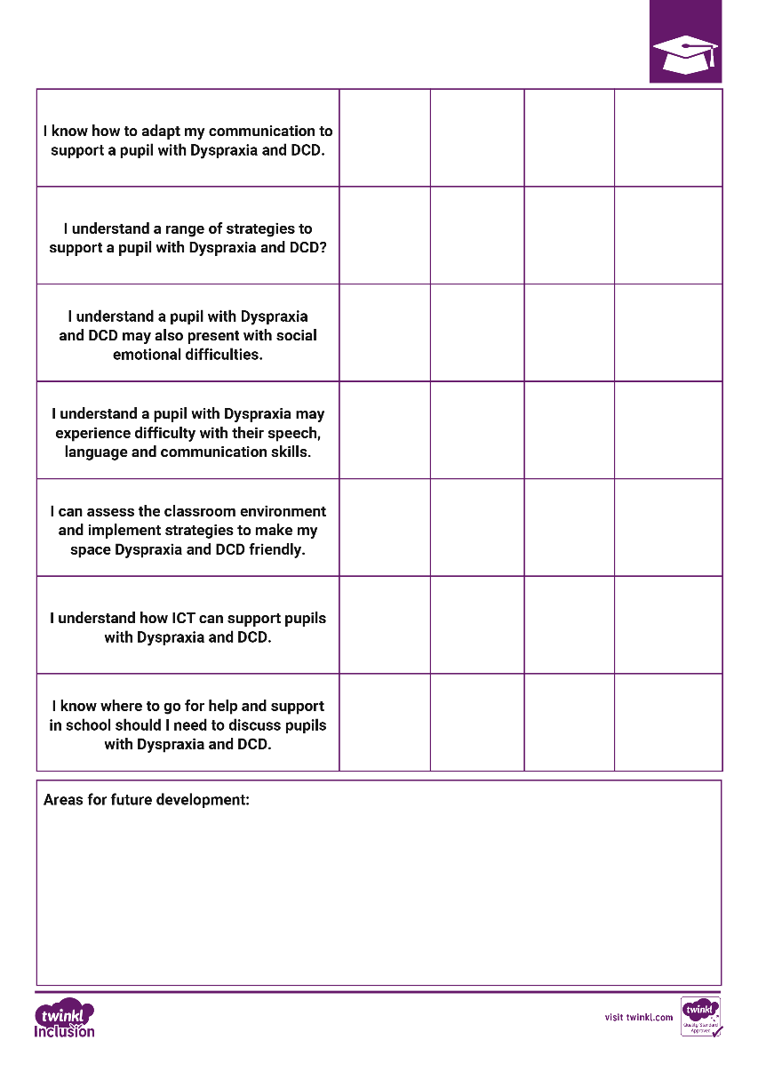
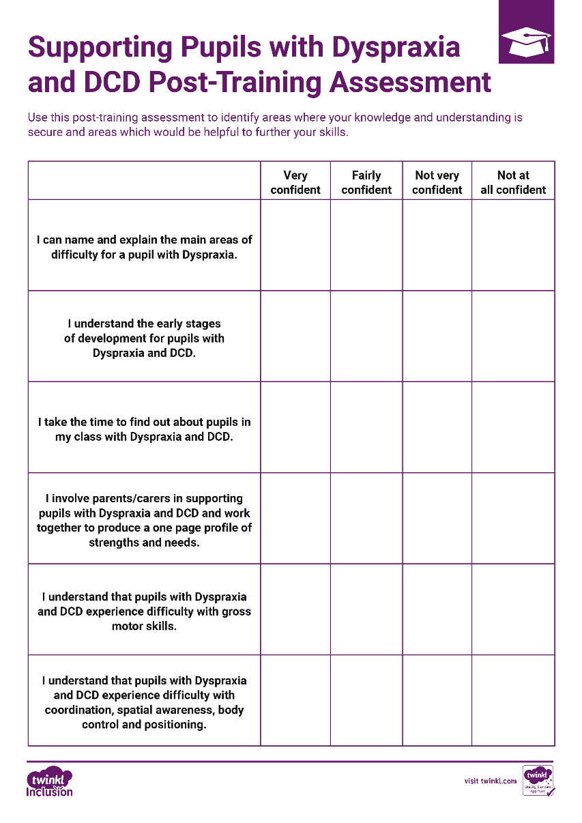
Post-Training Assessment
Take a few minutes to read and complete the Post-Training Assessment Sheet. This will help identify areas for further exploration and to assess your development of knowledge, skills and understanding following the training.
Remember to think about areas that you would like to research or explore further and note these at the bottom of your assessment sheet.

