Slide 2
What Is Global Developmental Delay?
The term Global Developmental Delay is used when a child takes longer to reach certain development milestones than their peers.
It is, therefore, the general term used to describe the condition in which children are significantly delayed in all areas of development.
It is often abbreviated to GDD.
Information taken from www.mencap.org.uk

Slide 3
Global Developmental Delay
Global Developmental Delay is believed to affect about 1-3% of the population.
The most common causes of Global Developmental Delay include:
chromosomal or genetic abnormalities
abnormalities with the structure or development of the brain or spinal cord
premature birth
infections, such as meningitis
However, the cause is often never fully identified.
Information taken from cindex.camden.gov.uk

Slide 4
Diagnosis
A child’s development can be grouped into four main areas:
Each area has specific milestones that children would be expected to reach, such as walking, talking and toilet training.
Children can be classed as having GDD if they don’t reach two or more milestones in all four areas of development.
In some children, GDD is suspected soon after birth because of problems, such as feeding issues. In others, it isn’t suspected until later, when learning or behaviour difficulties occur at school.
Information taken from cindex.camden.gov.uk
motor skills
speech and language
cognitive skills
social and emotional skills

Slide 5

Supporting a Child with GDD
There is no single treatment for Global Developmental Delay but finding the correct interventions can help with a child’s individual development.
These might include input from a range of professionals, including:
speech and language therapists
occupational therapists
physiotherapists
Information taken from cindex.camden.gov.uk

Slide 6
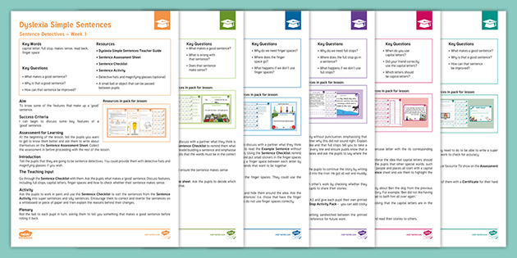
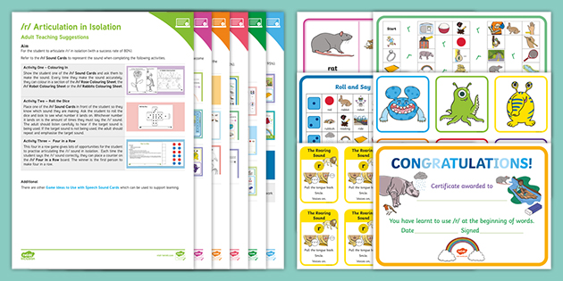
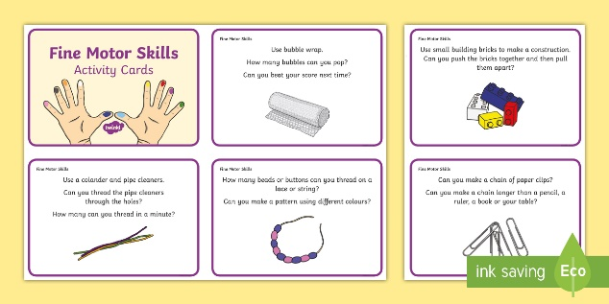
Interventions at School
Targeted interventions can make a huge difference in meeting a child’s different areas of need.
Remember - children with GDD will need time to revisit and consolidate learning.
Take a look at Twinkl Inclusion to explore our range of useful intervention resources.

Slide 7
References
Mencap. 2021. Global developmental delay. [online] Available at: <https://www.mencap.org.uk/learning-disability-explained/conditions/global-development-delay> [Accessed 17 February 2021].
Cindex.camden.gov.uk. 2021. What is global developmental delay? | Cindex. [online] Available at: <https://cindex.camden.gov.uk/kb5/camden/cd/advice.page?id=zuT_sNIGhk8&localofferchannel=0> [Accessed 17 February 2021].

