Slide 1

Trauma informed language in schools

Slide 2
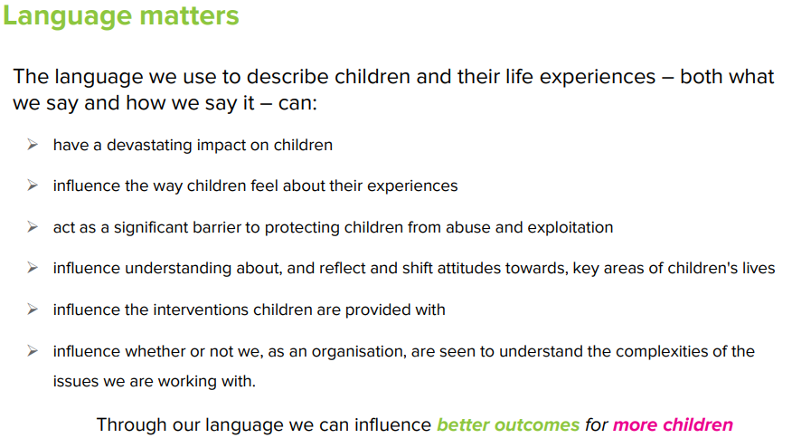
Barnardos - 'Changing language, changing policy and practice’: Use of language in child abuse & exploitation work

Slide 3

If we accept that trauma has a neurobiological impact on children and adults which can be long term - is it unkind to blame children who have experienced trauma for their behaviour?
How do we maintain high expectations without victim blaming?
Language is the key.

Slide 4


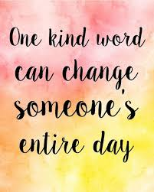
Language matters and words have power. When speaking to someone who has been through trauma, particularly about that trauma, you need to think carefully before you speak and speak with intention. We need to be aware of the words we choose, the tone we use and how we phrase our questions.
Think about a time when you had to talk to somebody about a personally traumatic experience. Did any words help or jar/block? What tone was adopted?
When people with post-traumatic stress disorder are faced with trauma-related words, they often have slower response times, showing that these words have more emotional content and that they are delaying the information being processed.

Slide 5

Things to consider when aiming for trauma sensitive language:
no labels
no judgement
no jargon.
Which words to use and avoid will depend on the individual and their situation. A person’s preferred words can also change. You need to speak to individuals and ask what their preference is.

Slide 6
