Slide 1
Trauma informed practice Safeguarding
Monday 15th November 2021

Slide 2
Childhood trauma and the brain
UK Trauma Council
https://www.youtube-nocookie.com/embed/EFrfBJrVLbE?feature=oembed

Slide 3
The repair of early trauma a bottom up approach
https://youtu.be/FOCTxcaNHeg
(watch at a later time if you want to)
The Window of Tolerance Animation
https://youtu.be/Wcm-1FBrDvU

Slide 4

Beaconhouse.org.uk/resources

Slide 5
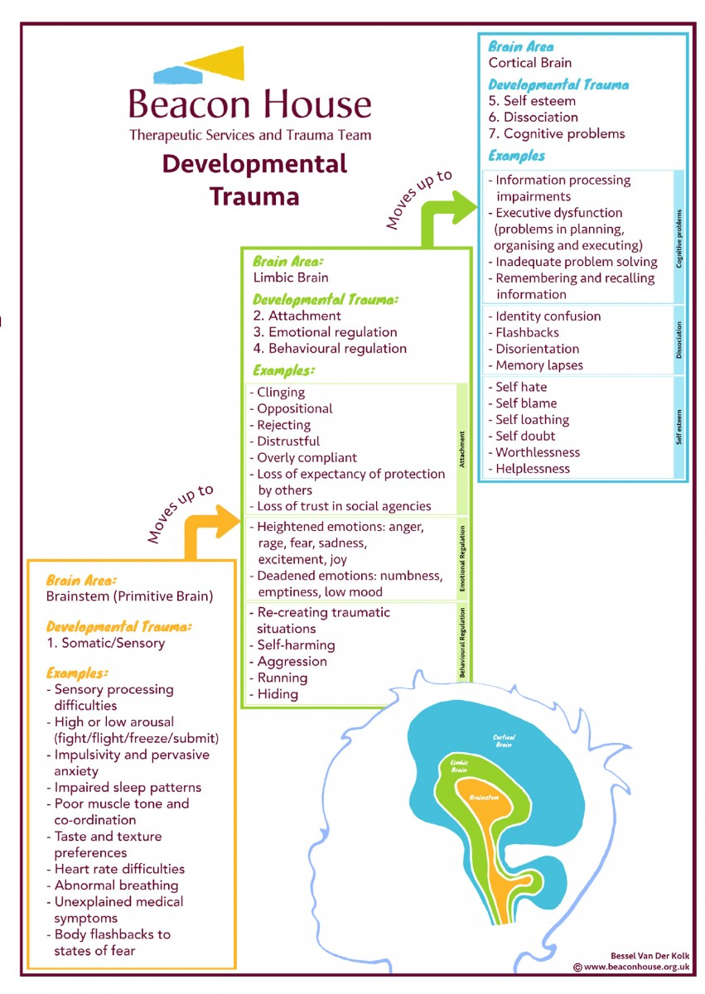

Slide 6
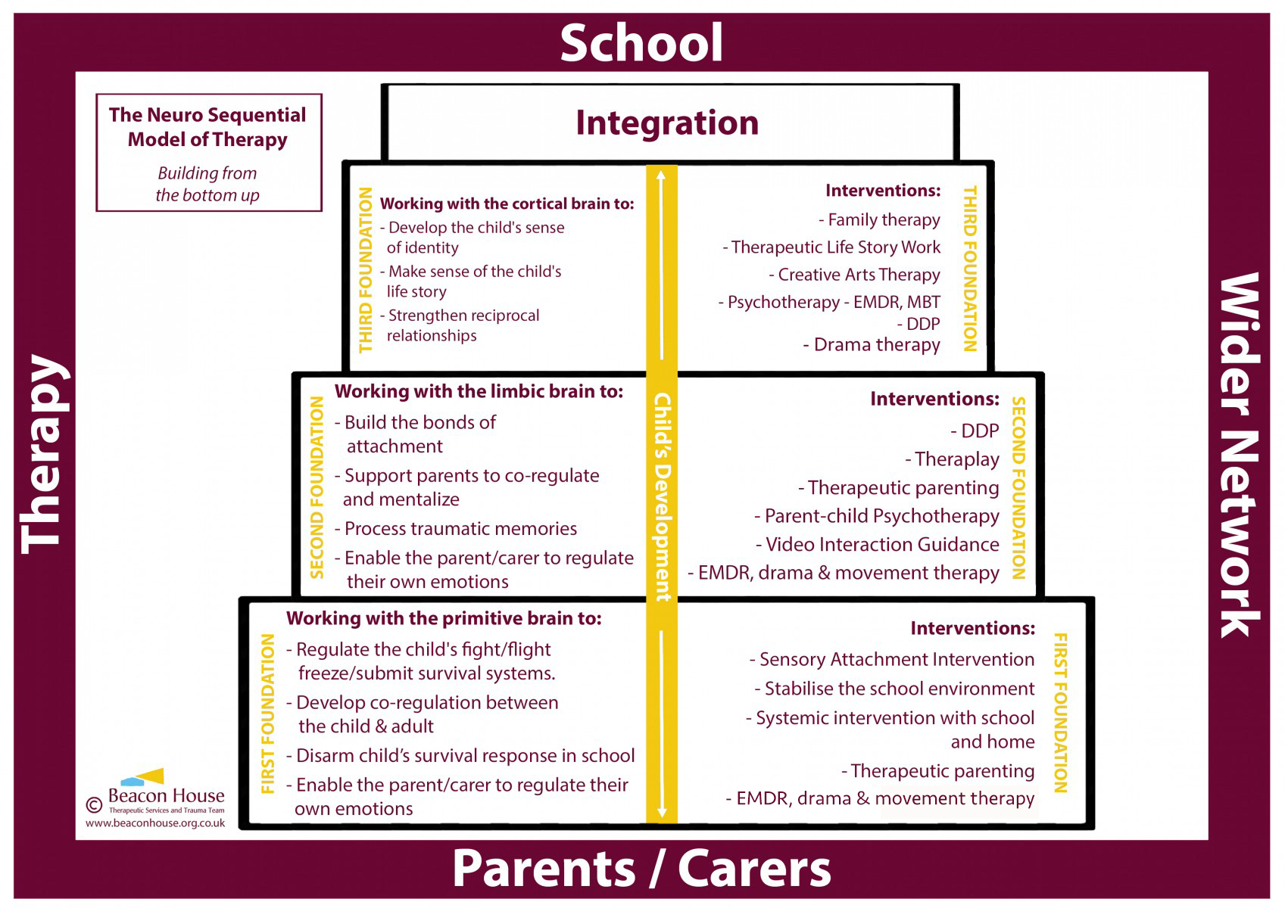

Slide 7
Ensuring safety around school!
Please ensure all pupils line up on the yard and are collected by staff to be walked into school.
Please make sure you are back from breaks on time and out on duty at the correct time.
Please make sure that pupils are not in a classroom or around school unsupervised.
Please make sure that you are giving the correct homework – if you are unsure please see the homework policy

Slide 8
Lesson observations/work
Thank you
Please can we ensure that work is marked using the marking policy with peer assessment and self assessment at times.
Interventions – pupils
Thank you for all the interventions you have sent through. I do not have all classes yet. Please can I have your class list if it is missing.

Slide 9
NSPCC – sexualised behaviour
NSPCC – Learning
Resources for schools and colleges
It's Not OK: teaching resources about positive relationships

Slide 10
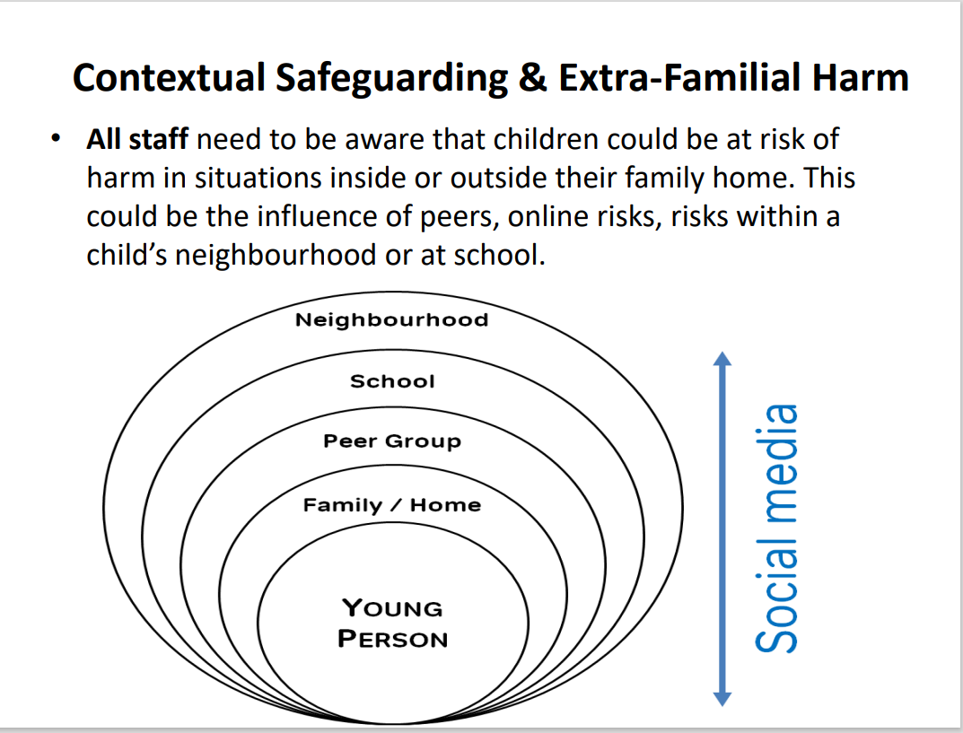

Slide 11
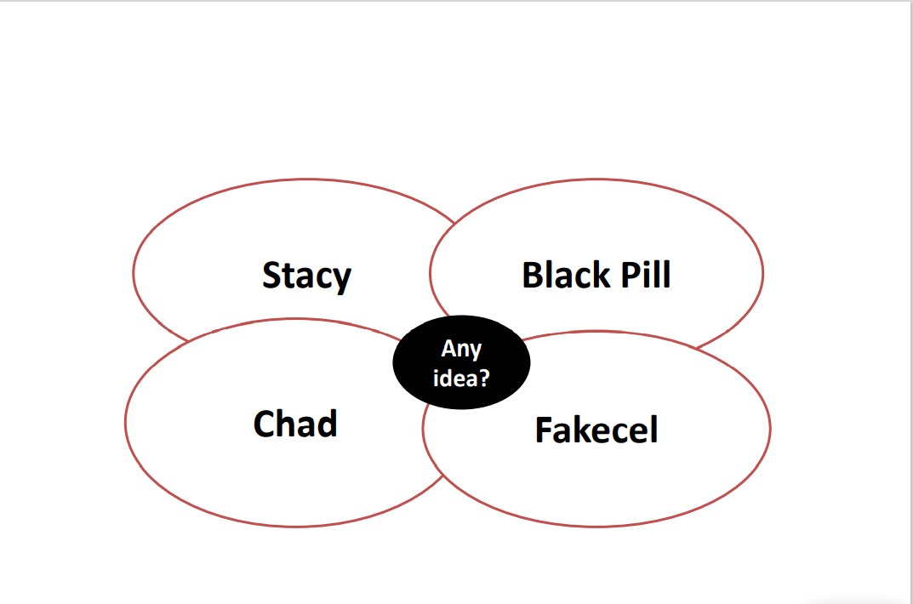

Slide 12
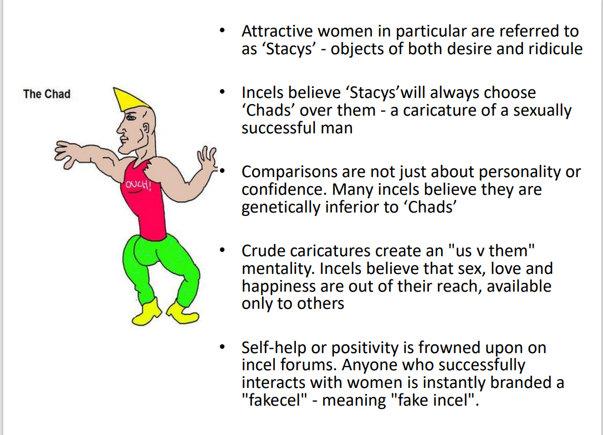

Slide 13
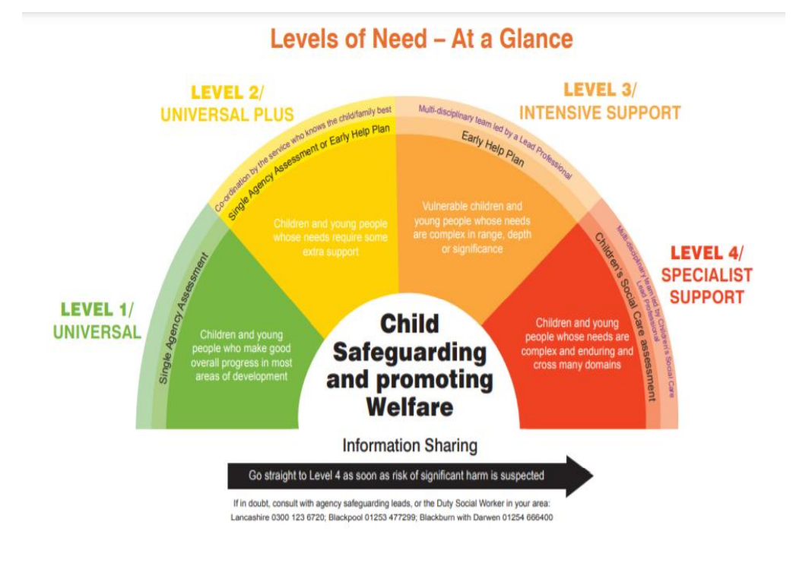

Slide 14
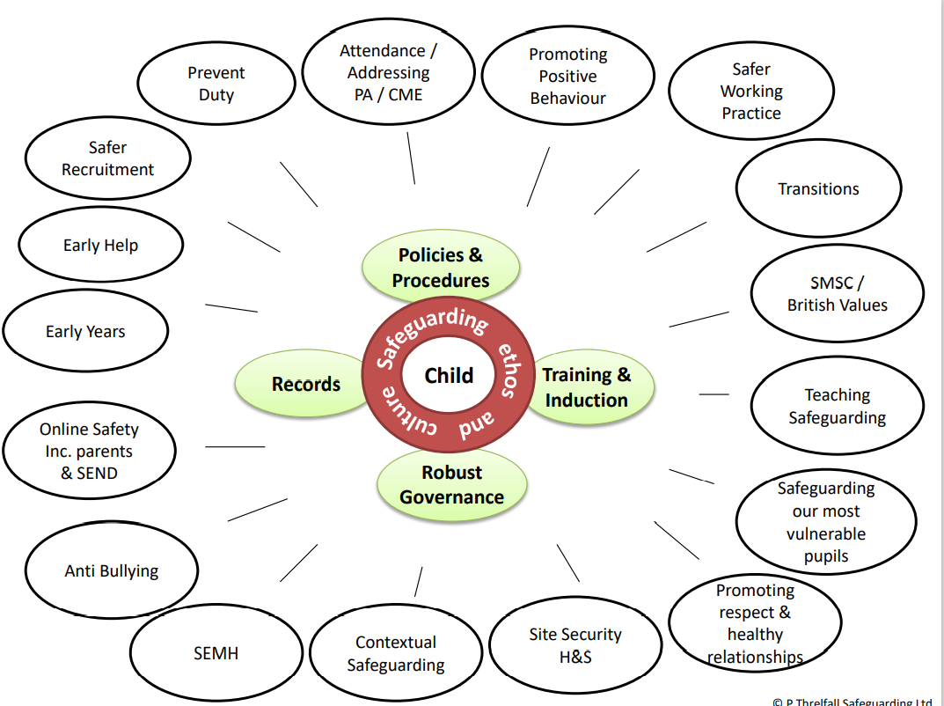

Slide 15
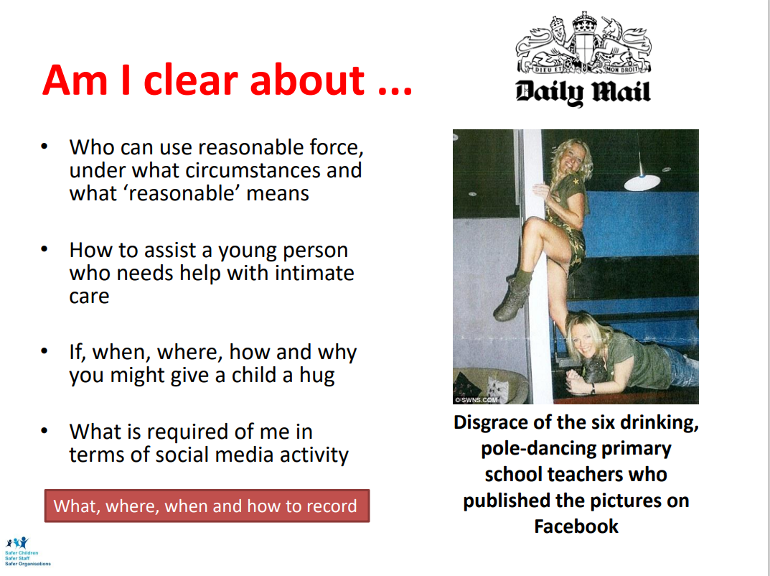

Slide 16
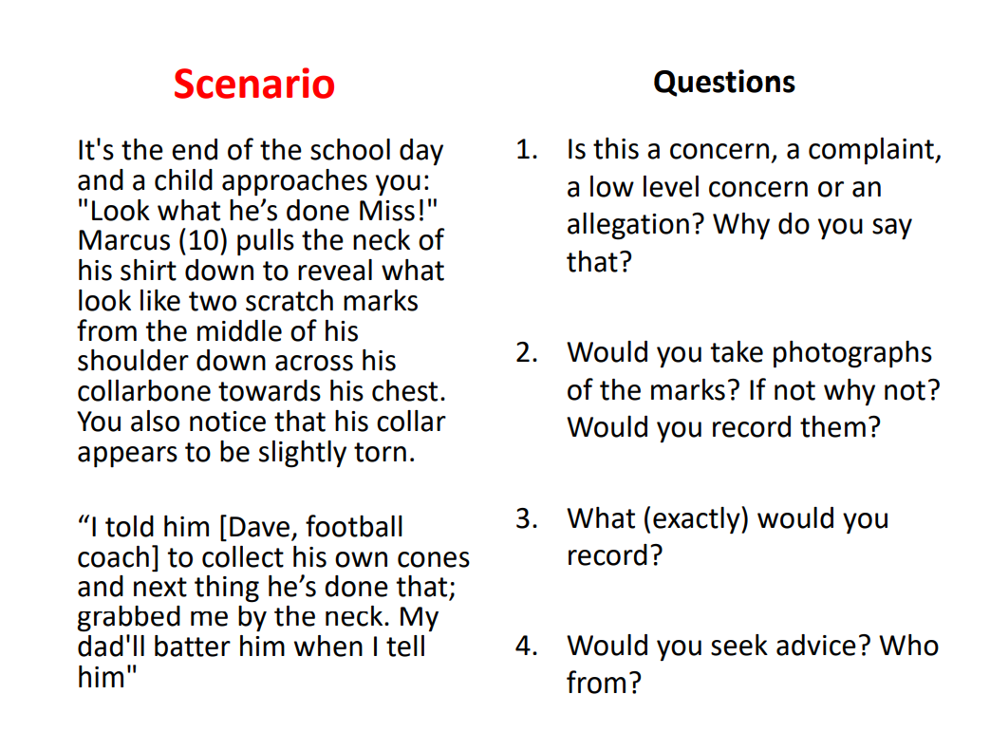

Slide 17
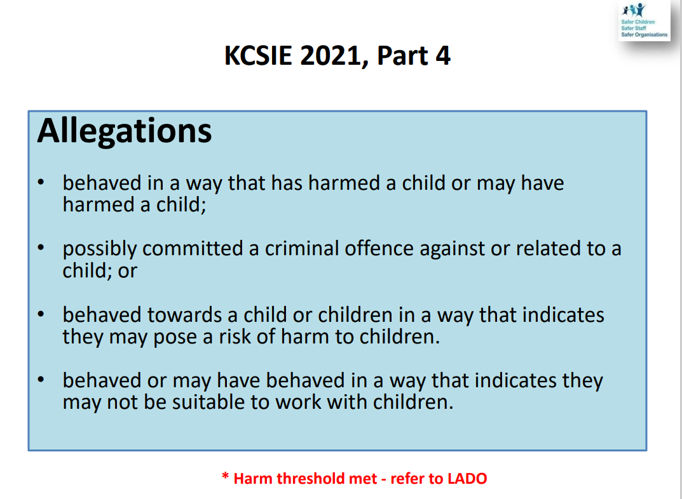

Slide 18
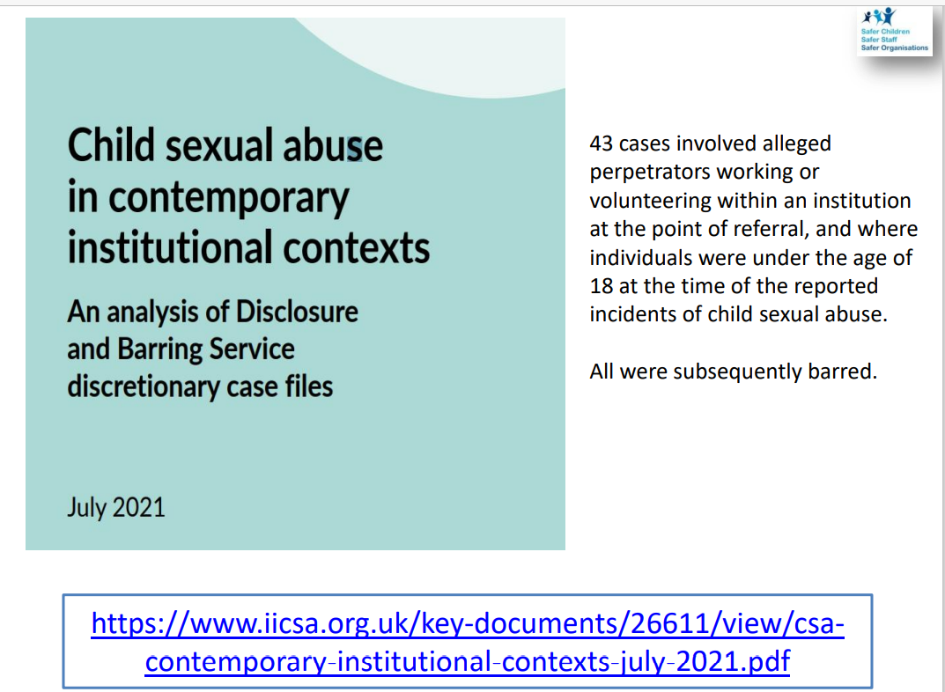

Slide 19
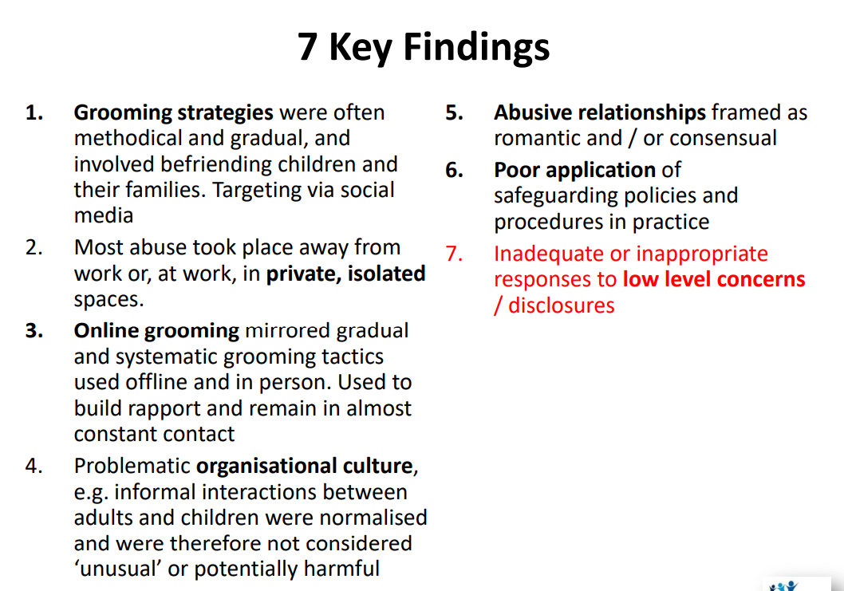

Slide 20
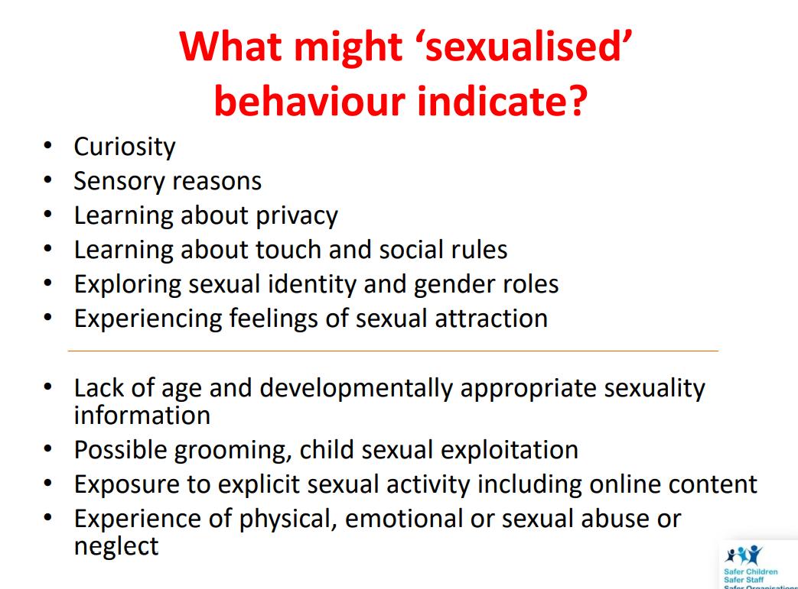

Slide 21
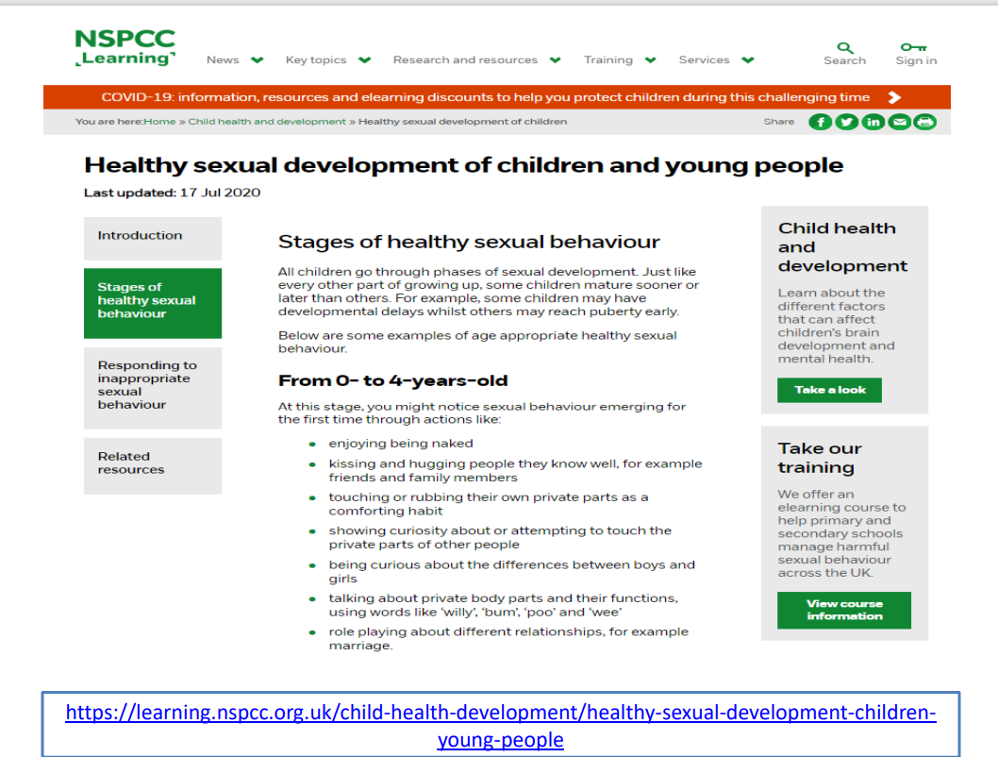

Slide 22
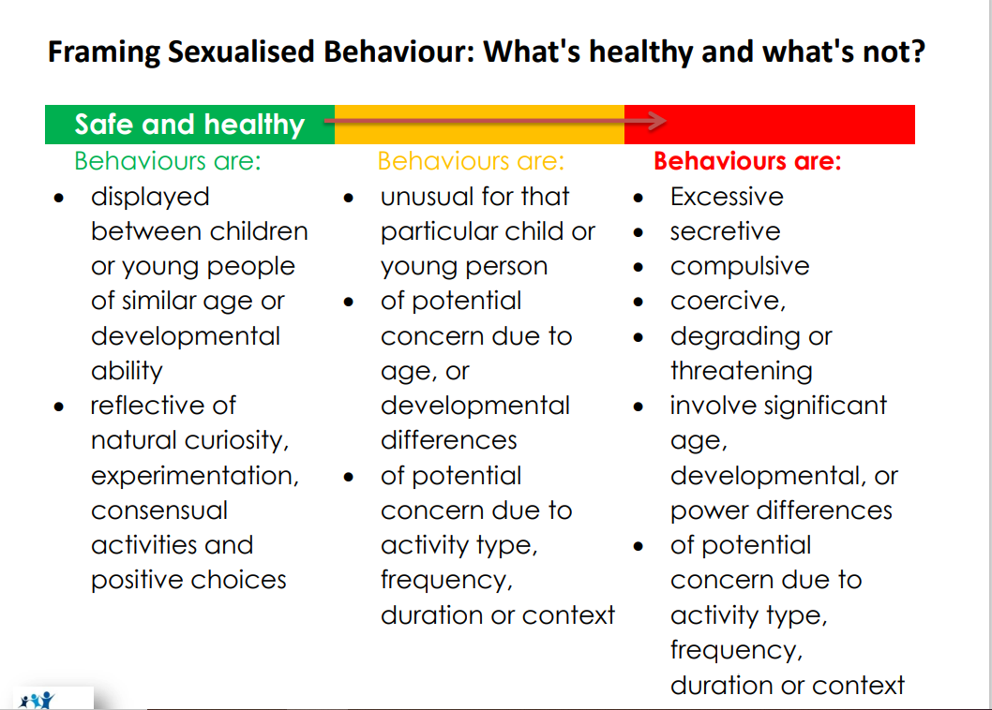

Slide 23
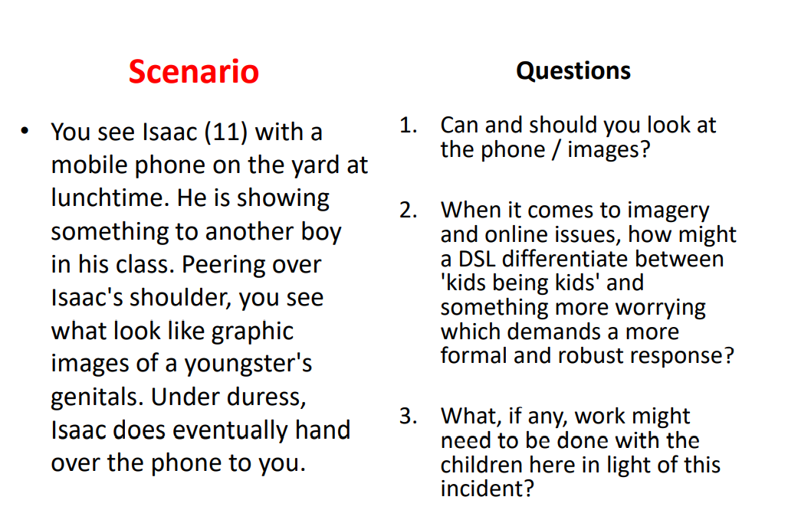

Slide 24
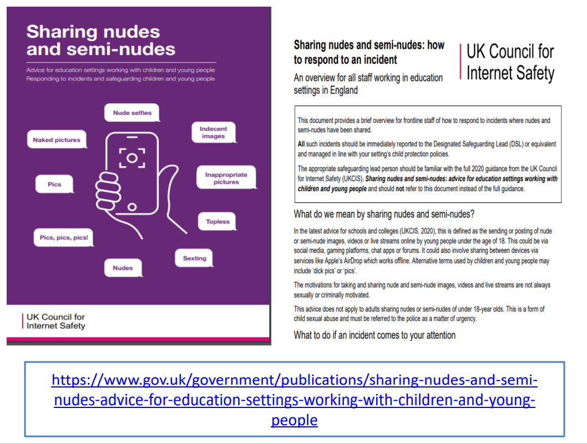

Slide 25
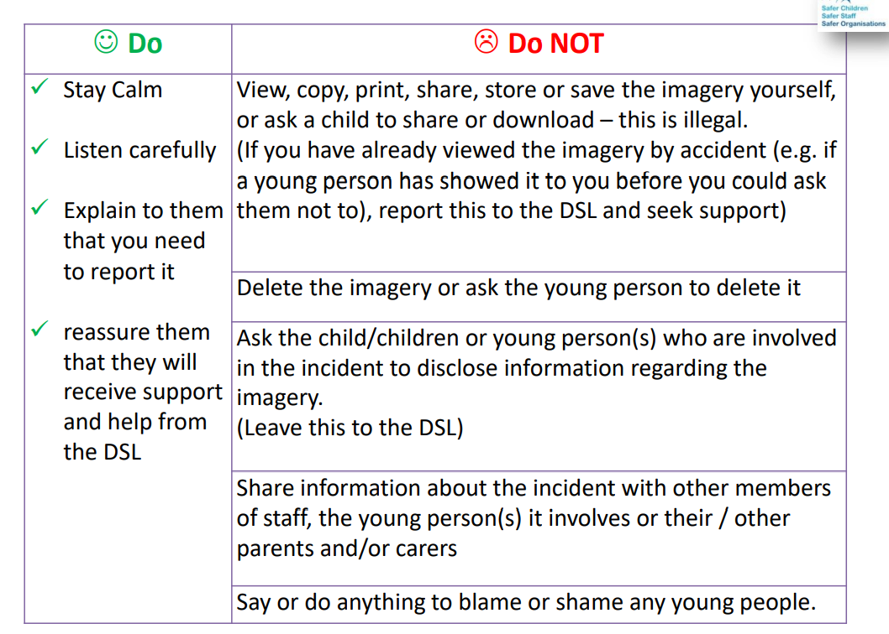

Slide 26
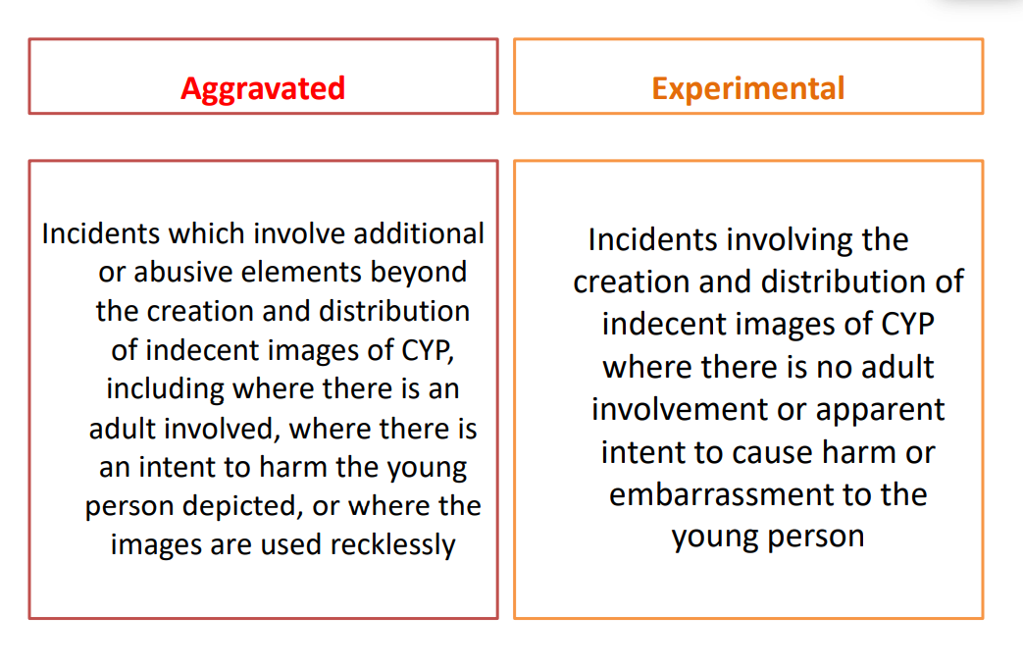

Slide 27
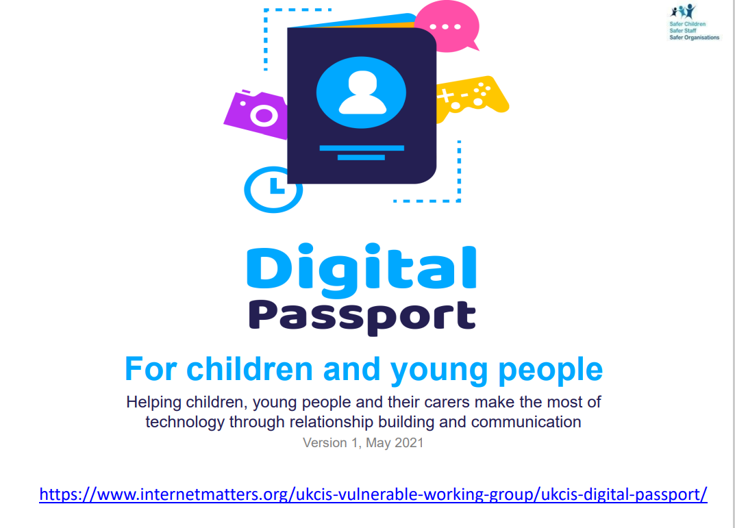

Slide 28
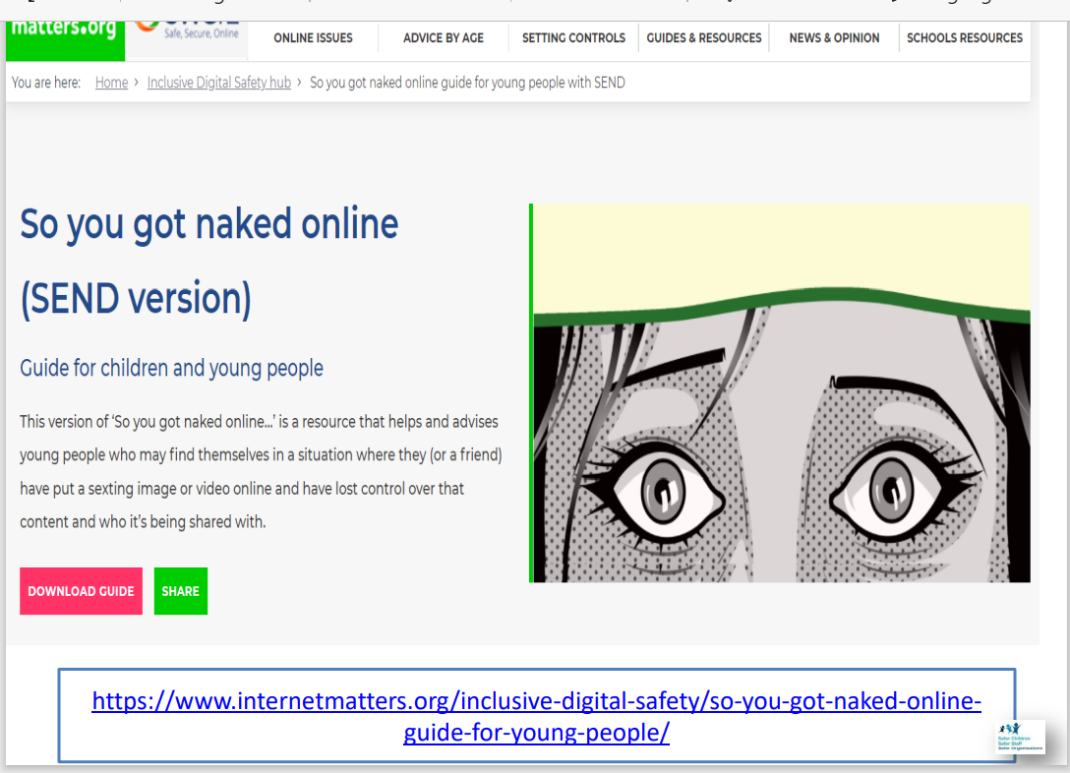

Slide 29
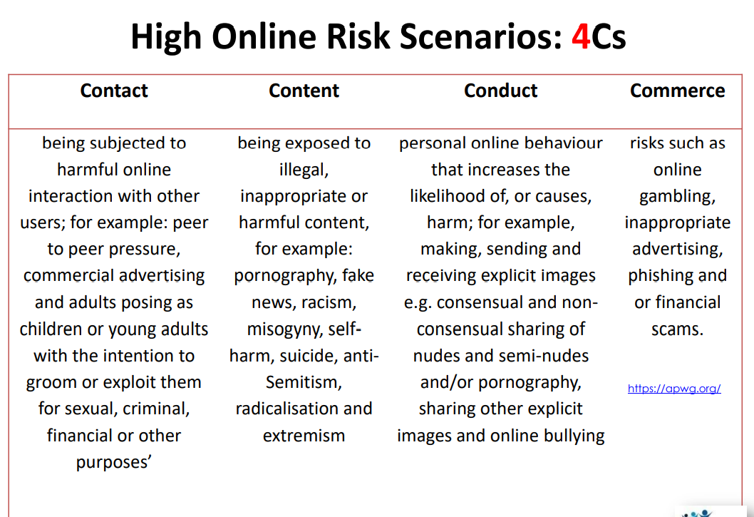

Slide 30
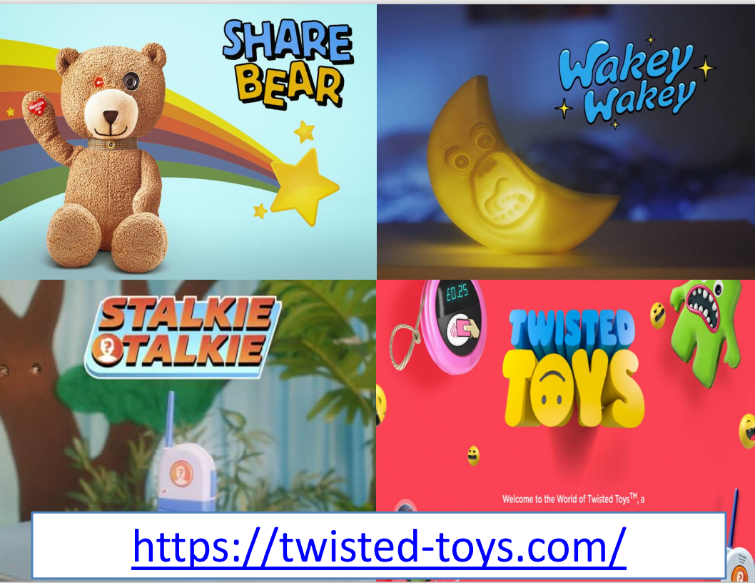

Slide 31
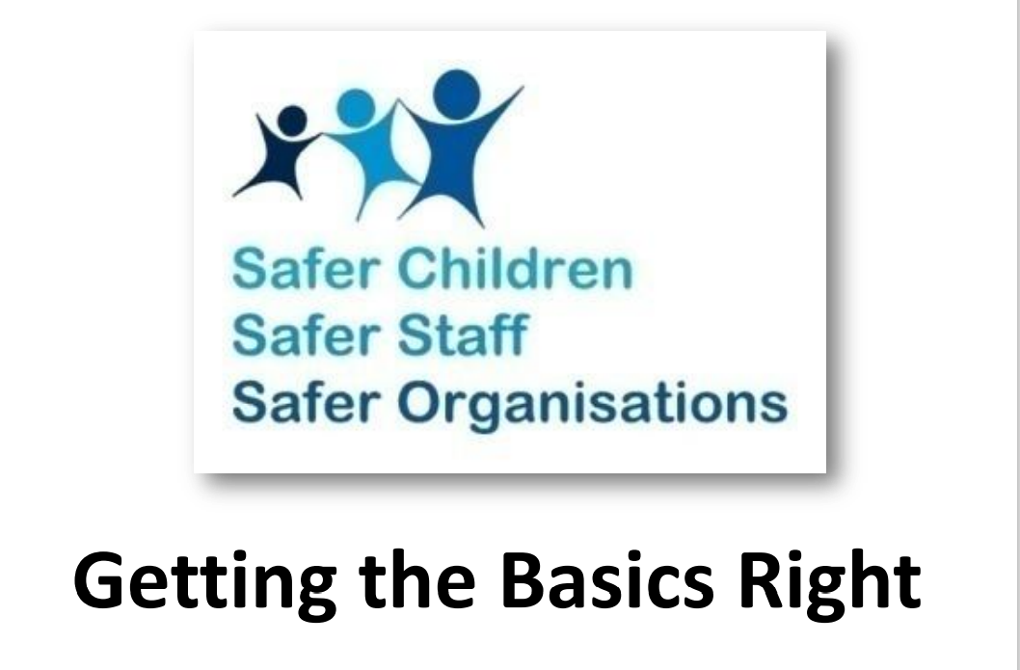

Slide 32
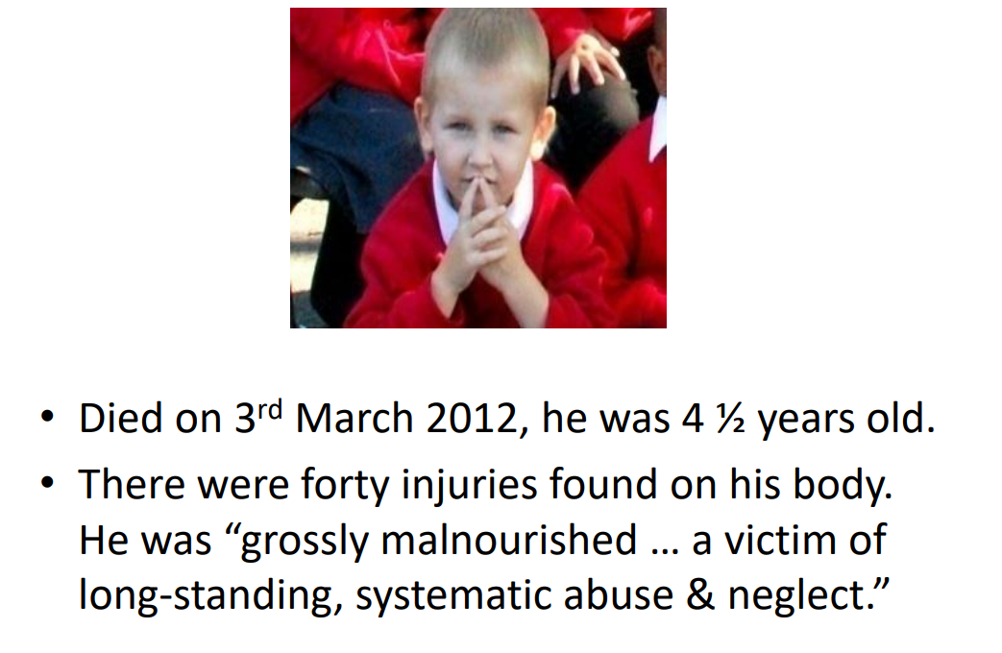

Slide 33
https://youtu.be/0MV136Qb68A

Slide 34


Slide 35
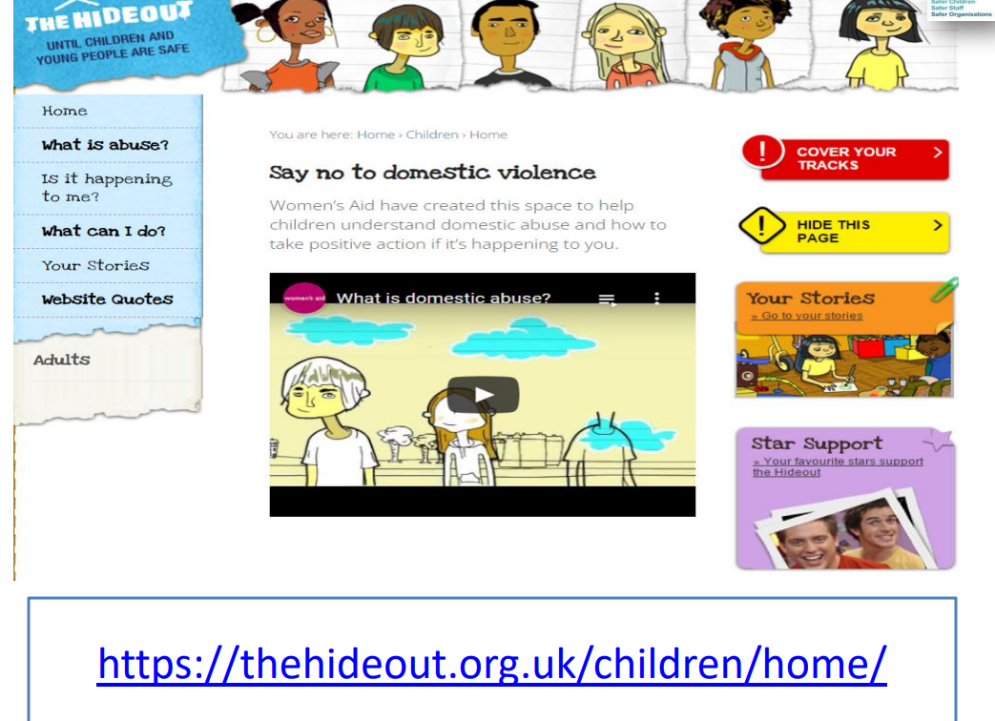

Slide 36
