Slide 1
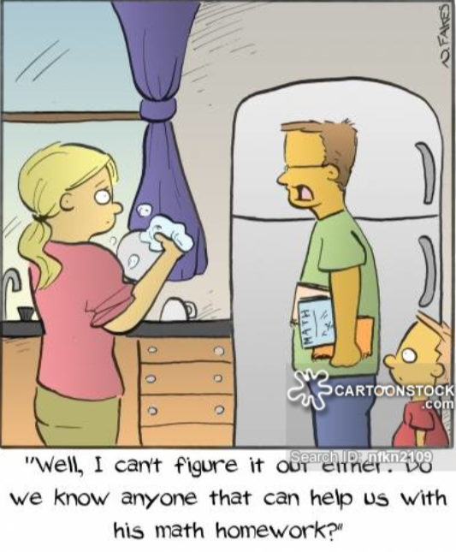
Fluency – what do we need to do?
Identify what exactly we want pupils to be fluent in.
Develop coherent routine for teaching these that makes
arithmetic less abstract and more accessible .

Slide 2
Session outcomes:
To understand what is meant by fluency.
To understand how Number Talk sessions can be used to develop both conceptual and procedural fluency.
Work collaboratively to:
plan a number talk session which will teach these skills.
identify different ways to visually represent strategies.
Beyond session:
Use Number talk document to plan a daily Number Talk consisting of 4-5 mixed questions a day.

Slide 3
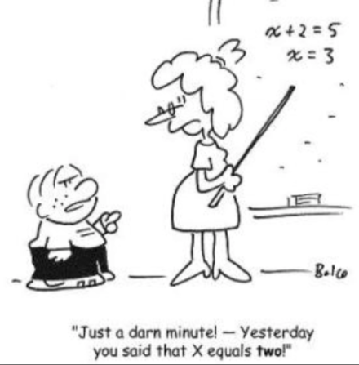
What is fluency?
Just knowing an answer?
Being confident with a method?
Being able to apply knowledge in different situations?
How important is it to understand the underlying concepts and properties of
numbers rather than following a method or procedure?
Notes:
If a child just knows an answer, is he/she necessarily fluent?

Slide 4
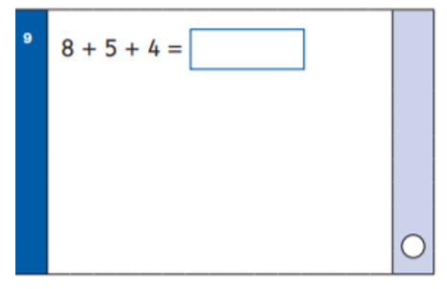
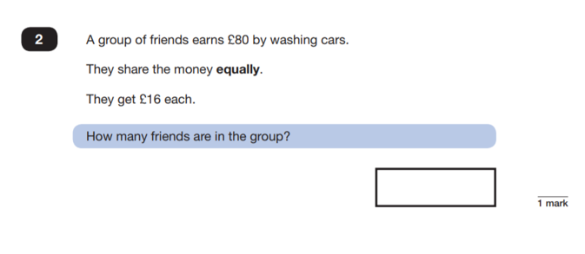
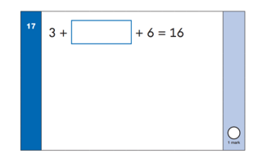
What do you need to understand in order to solve each calculation fluently?
Which concepts and skills do these rely upon?
Notes:
Make the point that fluency can’t necessarily be assessed through just a correct answer. It is the strategy used that will indicate whether a child is fluent or not.

Slide 5
36
6x
216_
4x6=24
24)216
6 x 6 x 6 = 6 x 4 x ___
6 x 6 x 6 = 6 x 4 x ___
36 36
Which method shows conceptual fluency? Which allows the child to carry out ‘easier’ Maths?

Slide 6
In the late 1970s, mathematics teaching in China came across big challenges regarding students’ mastery of mathematics:
Understanding of mathematical concept was ambiguous and vague because what they had learned in Maths was inflexible and unconnected.
Pupils could not identify the mathematics when its context was slightly changed.
Attention was given to variation as a teaching method.
‘It is better to have 5 ways of answering one question than one way of answering 5 questions!’ – Singapore Maths

Slide 7
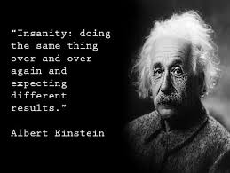
Intelligent Practice in Arithmetic
Zoltan Dienes
Children learn at a higher level through variation not repetition.

Slide 8
If we want children to have the fluency to apply learning in a range of contexts, we need to expose the underlying concepts.
Concepts need to be explored through a range of representations and strategies.
We need to teach them to pull numbers apart, manipulate them, examine and investigate patterns.

Slide 9
An easy way to develop this is through Number Talks

Slide 10
Ask a child to read the calculation, then explain their strategy.
The idea is that, as a child explains their strategy, the teacher visually represents it e.g. on a number line, bar model, part whole model, place value grid etc and explains/clarifies each stage.
By representing it visually, the concept becomes more accessible to those children not using that method and gradually, through seeing a variety of methods, they make connections which help them to understand the relationships between numbers, make connections, understand the essential features and develop number sense.
The session can be turned into a discussion rather than a question and answer by stopping a child as they are explaining and drawing other children in, e.g. ‘Why did they subtract 2?’
Once a child finishes explaining, ask if anyone used a different strategy?

Slide 11
For example, how could you solve?
645 + 198 = __
Some examples of strategies that may be used are:
Some children may add 200 and subtract 2.
Others may move 2 from the 645 to the 198 to make the equivalent calculation 643+200.
Others may partition the numbers and recombine at the end either mentally or using jottings.
Others may use a column method.

Slide 12
It is important that the teacher visually represents what the child says as this is what makes it accessible to other children.
Varying the representation can:
extract the essence of the concept.
draw out the structure of a concept – what it is and what it isn’t.
support the generalisation of a concept so it can be recognised in any context.
To find out what something is, we need to look at it from different angles – then we will know what it really looks like!

Slide 13
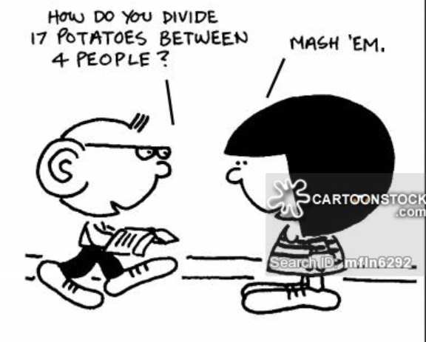
Benefits of Number Talks
Develop conceptual understanding –
fluency through variation – one problem, several solutions.
Help children to make connections and think
mathematically – develops number sense.
Improve ethos, self esteem, motivation.
Improve decision making and efficiency.
Develop both higher order and lower order Maths skills.

Slide 14
What are the barriers?
Ethos – this needs to be developed first.
Praise the thinking and the effort not the answer.
Value mistakes.
Encourage collaboration.
Language.
Model, rephrase, clarify.
Stem sentences.
Correct vocabulary.

Slide 15
Question stems:
What does it say?
What can that mean?
What strategy did you use?
What do you notice? / Is there anything about the numbers that could help us?
How can we solve it? Did anyone solve it in a different way?
(As explaining) How did you know that/what helped you work it out?
(Stop one child and ask another to take over their explanation).
So what would happen if we changed this for…If this was …
Would it still be the case if …….
Which part was hard?
What could go there/what couldn’t go there?
(Once established) Did anyone make an interesting mistake?

Slide 16
Mistakes:
Treat correct and incorrect answers in the same way. Write down what the child is
saying and wait for them or others to notice the mistake so they start to look
and engage themselves rather than expect you to let them know if it is right.
If they don’t, ask how we can check it or if anyone found it a different way
and compare the answers.
Remember- positive attitude to mistakes/wrong answers.
‘That’s really interesting – you made me think about that in a different way.’
Well done, I like the way you thought about that. You just needed to ….’
Lots of people find that confusing so you have helped us all learn an important idea’.
If child makes mistake that can’t correct, ask children to discuss with partner then come back
to them once they’ve discussed it and let them correct it: ‘Well done – you were thinking exactly
like a mathematician - you worked your way through and spotted your mistake.’ etc etc.

Slide 17
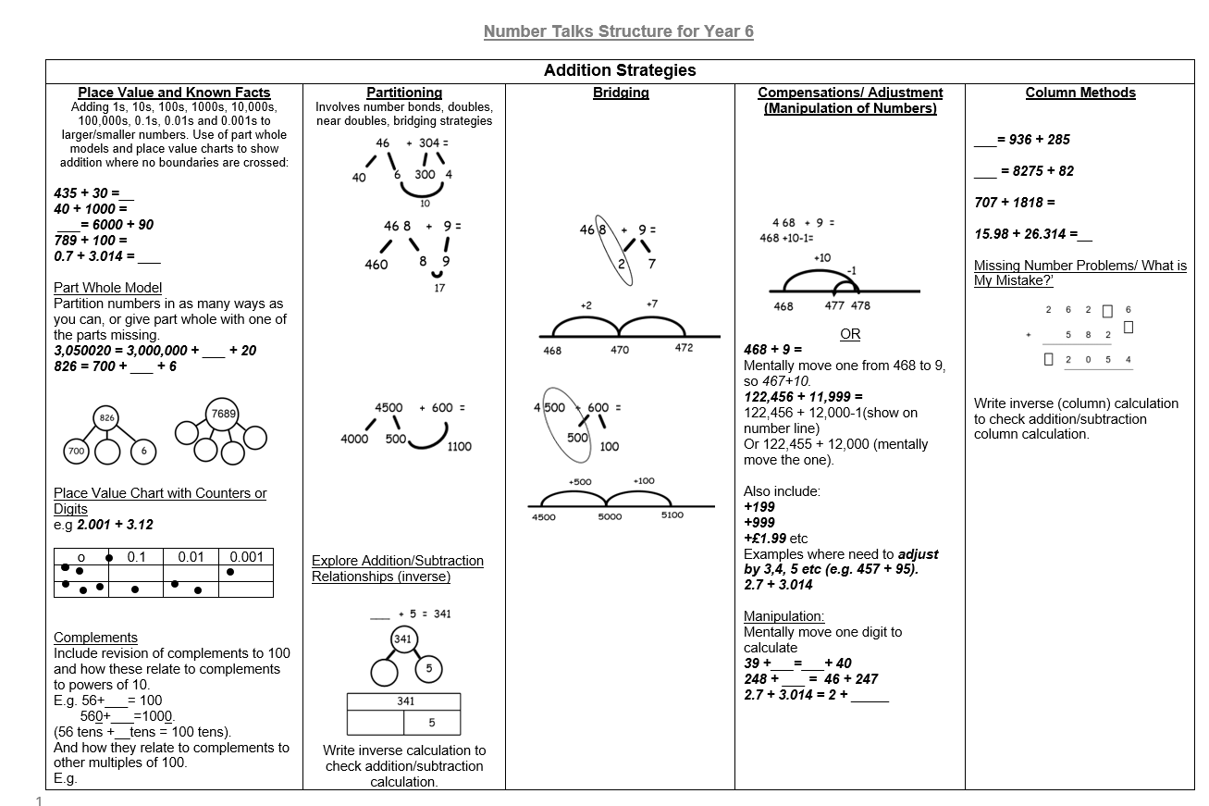
How will I know which strategies to teach?
How will I know how to visually represent them?
The ‘Mental Strategies for Number Talks’ documents map out the key mental skills for each year group (Y2-6) and demonstrate how to visually represent them.
The questions from the Y6 2016-2019 SATs arithmetic papers were collate and the questions scaled down for each year group using the same strategies with slightly lower numbers.
These questions can be used as Number Talk questions to ensure appropriate continuity and progression in arithmetic from years 2 to 6.
(EYFS and Y1 See Number Sense- Skills Progression).

