Slide 1
PD Day 06.09.16

Slide 2
Objectives:
To understand the concept behind the new ‘S’ plan format
To plan a unit of work for Mathematics, using the ‘S’ plan
To be clear about expectations for ‘next steps’, after ‘S’ planning

Slide 3
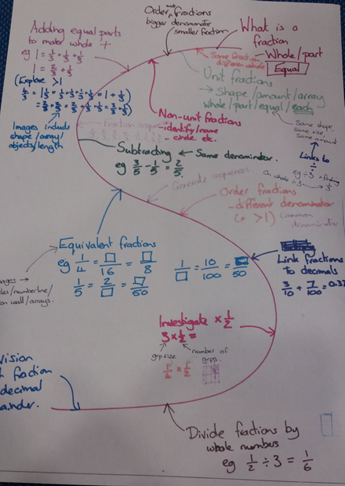
Ofsted have said that they do not look for any particular type / style of lesson plan.
Lesson planning should not be a ‘paper exercise’ and a ‘time waster’, which is not even adhered to, in lessons.
Effective planning should involve the planner thinking deeply about the steps needed to be taken (the ‘journey’) to enable ALL pupils to succeed and meet objectives.
Planning should ensure that the teacher is confident in the delivery of content, as it has been well thought out.
So… Meet the ‘S’ plan...

Slide 4
1.Start by identifying all of the key objectives in the unit for your year group (medium term planning). Sequence them, until you have an ‘S’ progression you are happy with (BLACK PEN)
2.Now, unpick the objectives to decide what the ‘key ideas’ needed to meet it would be (right from the beginning!) Write these on post-its first, if it helps, or sequence these straight on to the plan (BLUE PEN)
3.Consider ‘difficult points’ that you might encounter (e.g. barriers children might have to understanding, or misconceptions that crop up often or easily). Alongside these, consider teaching points / methods that might help overcome these or support pupils having difficulty (Practical? Representations? Stem sentences? Connections with other learning?) (RED PEN)
4.At the end, we will take a few minutes to move around and look at the other year group plans.

Slide 5
Next steps...
Look at your ‘S’ plan.
What does your first lesson need to look like?
Which representations might you use?
What equipment might you need?
Your slideshow for that lesson should reflect the journey.
It does NOT have to be an ‘all-singing-all-dancing’ slideshow, but it should be clear how the content enabled all learners to meet the objective.
There should also be opportunity for contextual and deeper thinking.
Maths Slideshow example
Intelligent Practice sheets

