Slide 1
Best daily plants
BEST PLANTING SERVICES IN TOWN AND VILLAGES
BY MAGNUS AND WALLACE

Slide 2
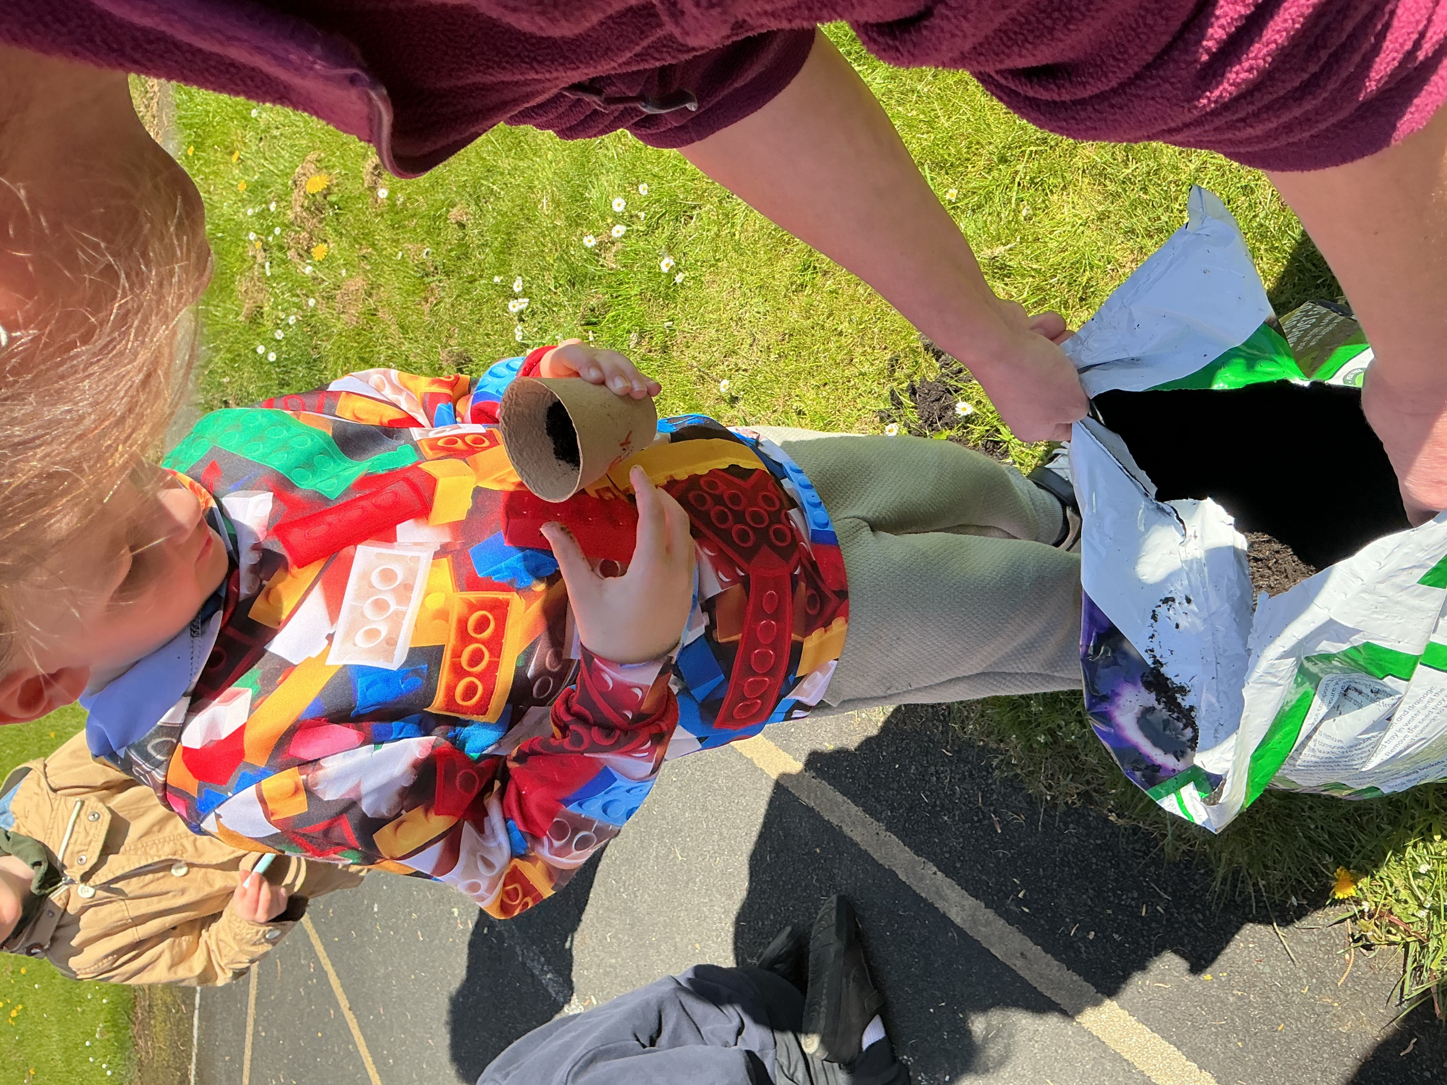
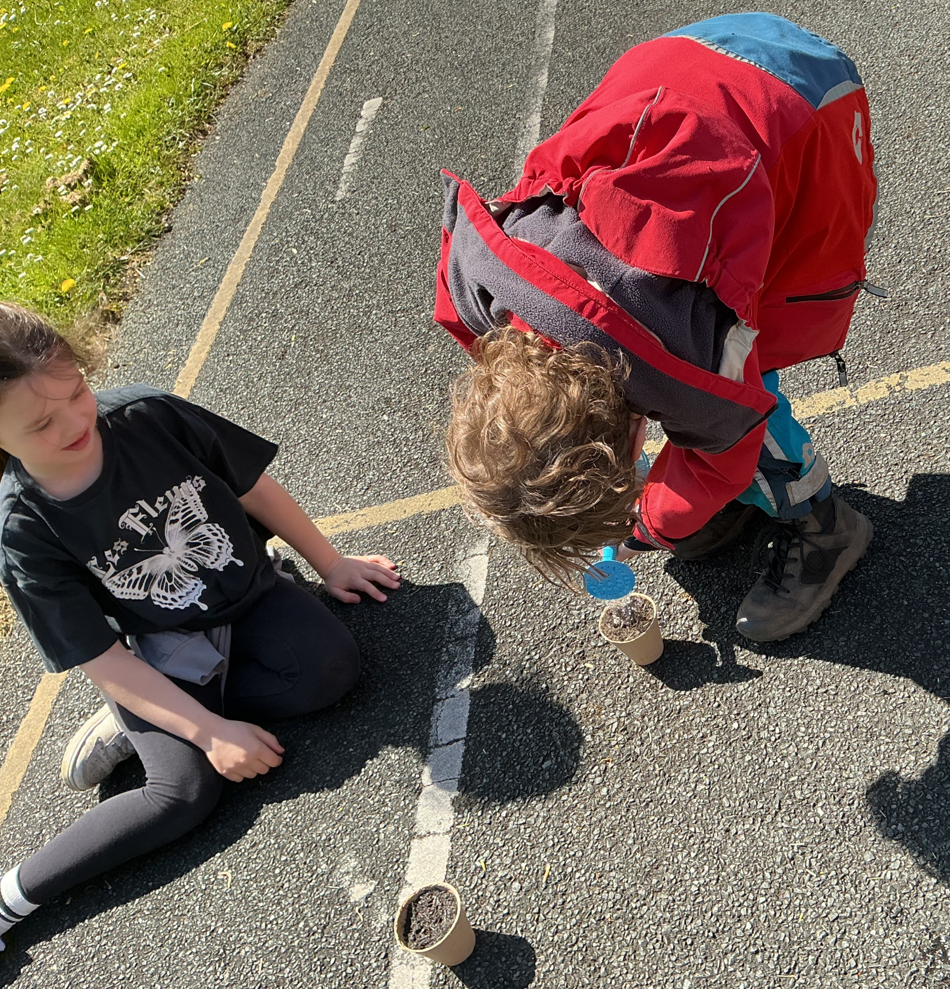









































FIRST ,WE PLANTED OUR SEEDS

Slide 3
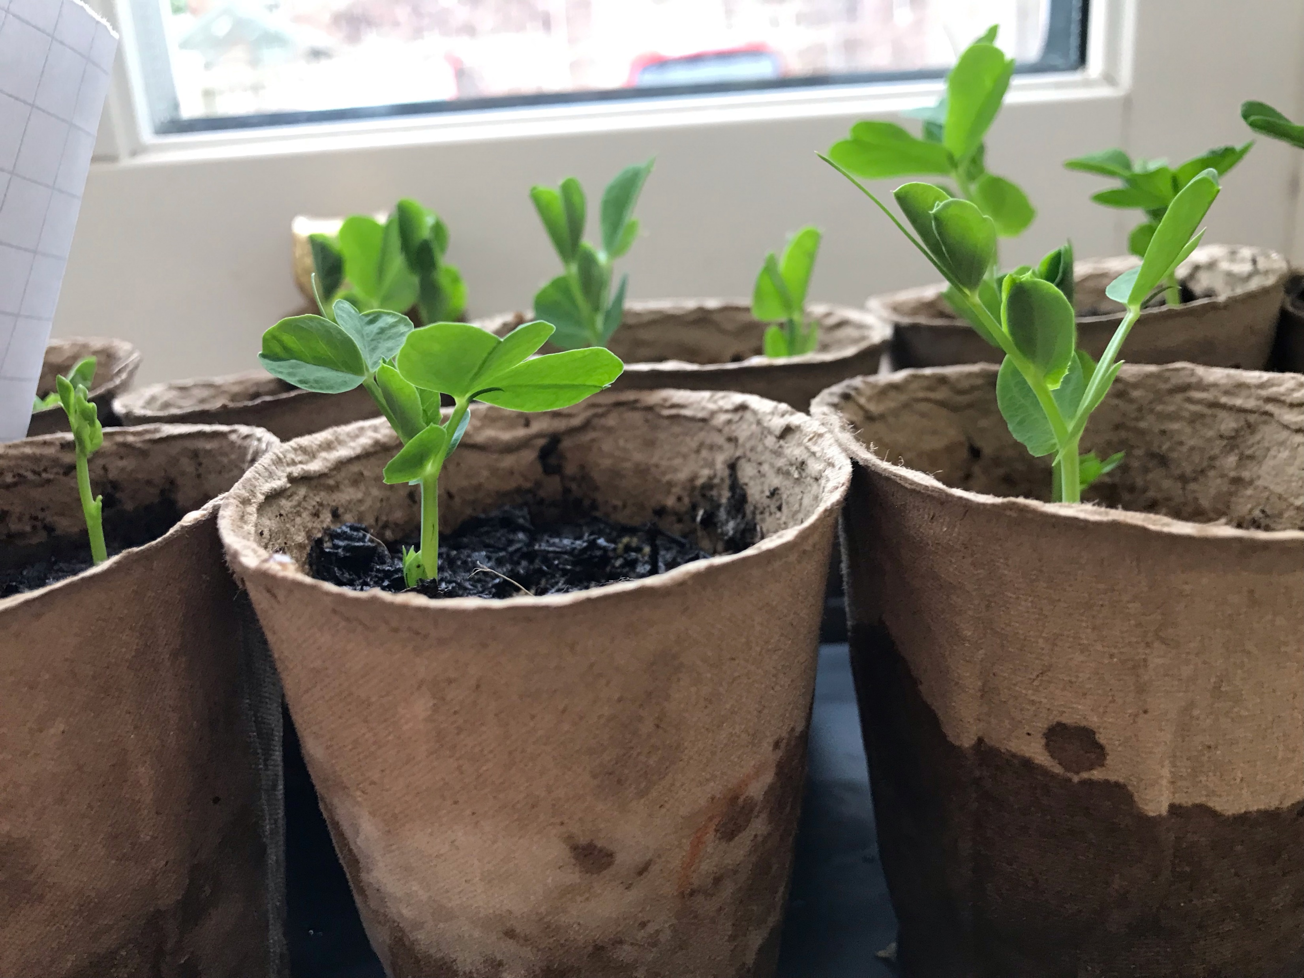

THE SEEDS START TO GROW

Slide 4
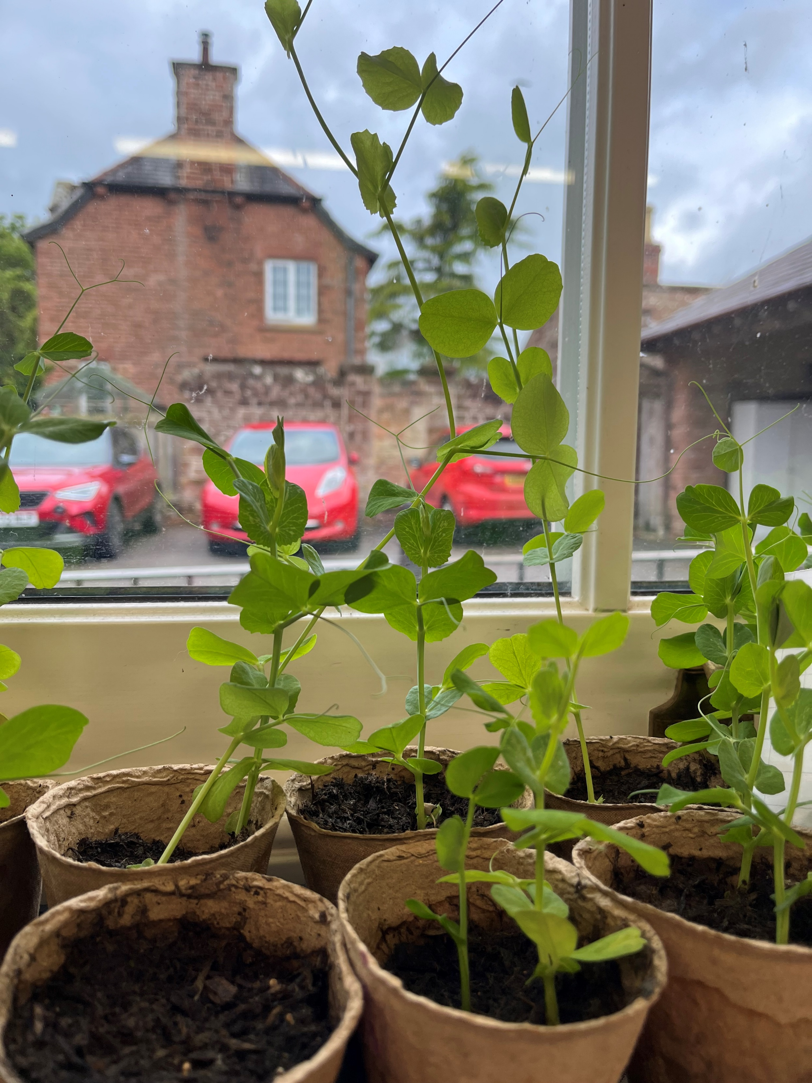

STILL GROWING

Slide 5























