Slide 1

PLANT EXPERIMENT
By Oscar and Caspar

Slide 2
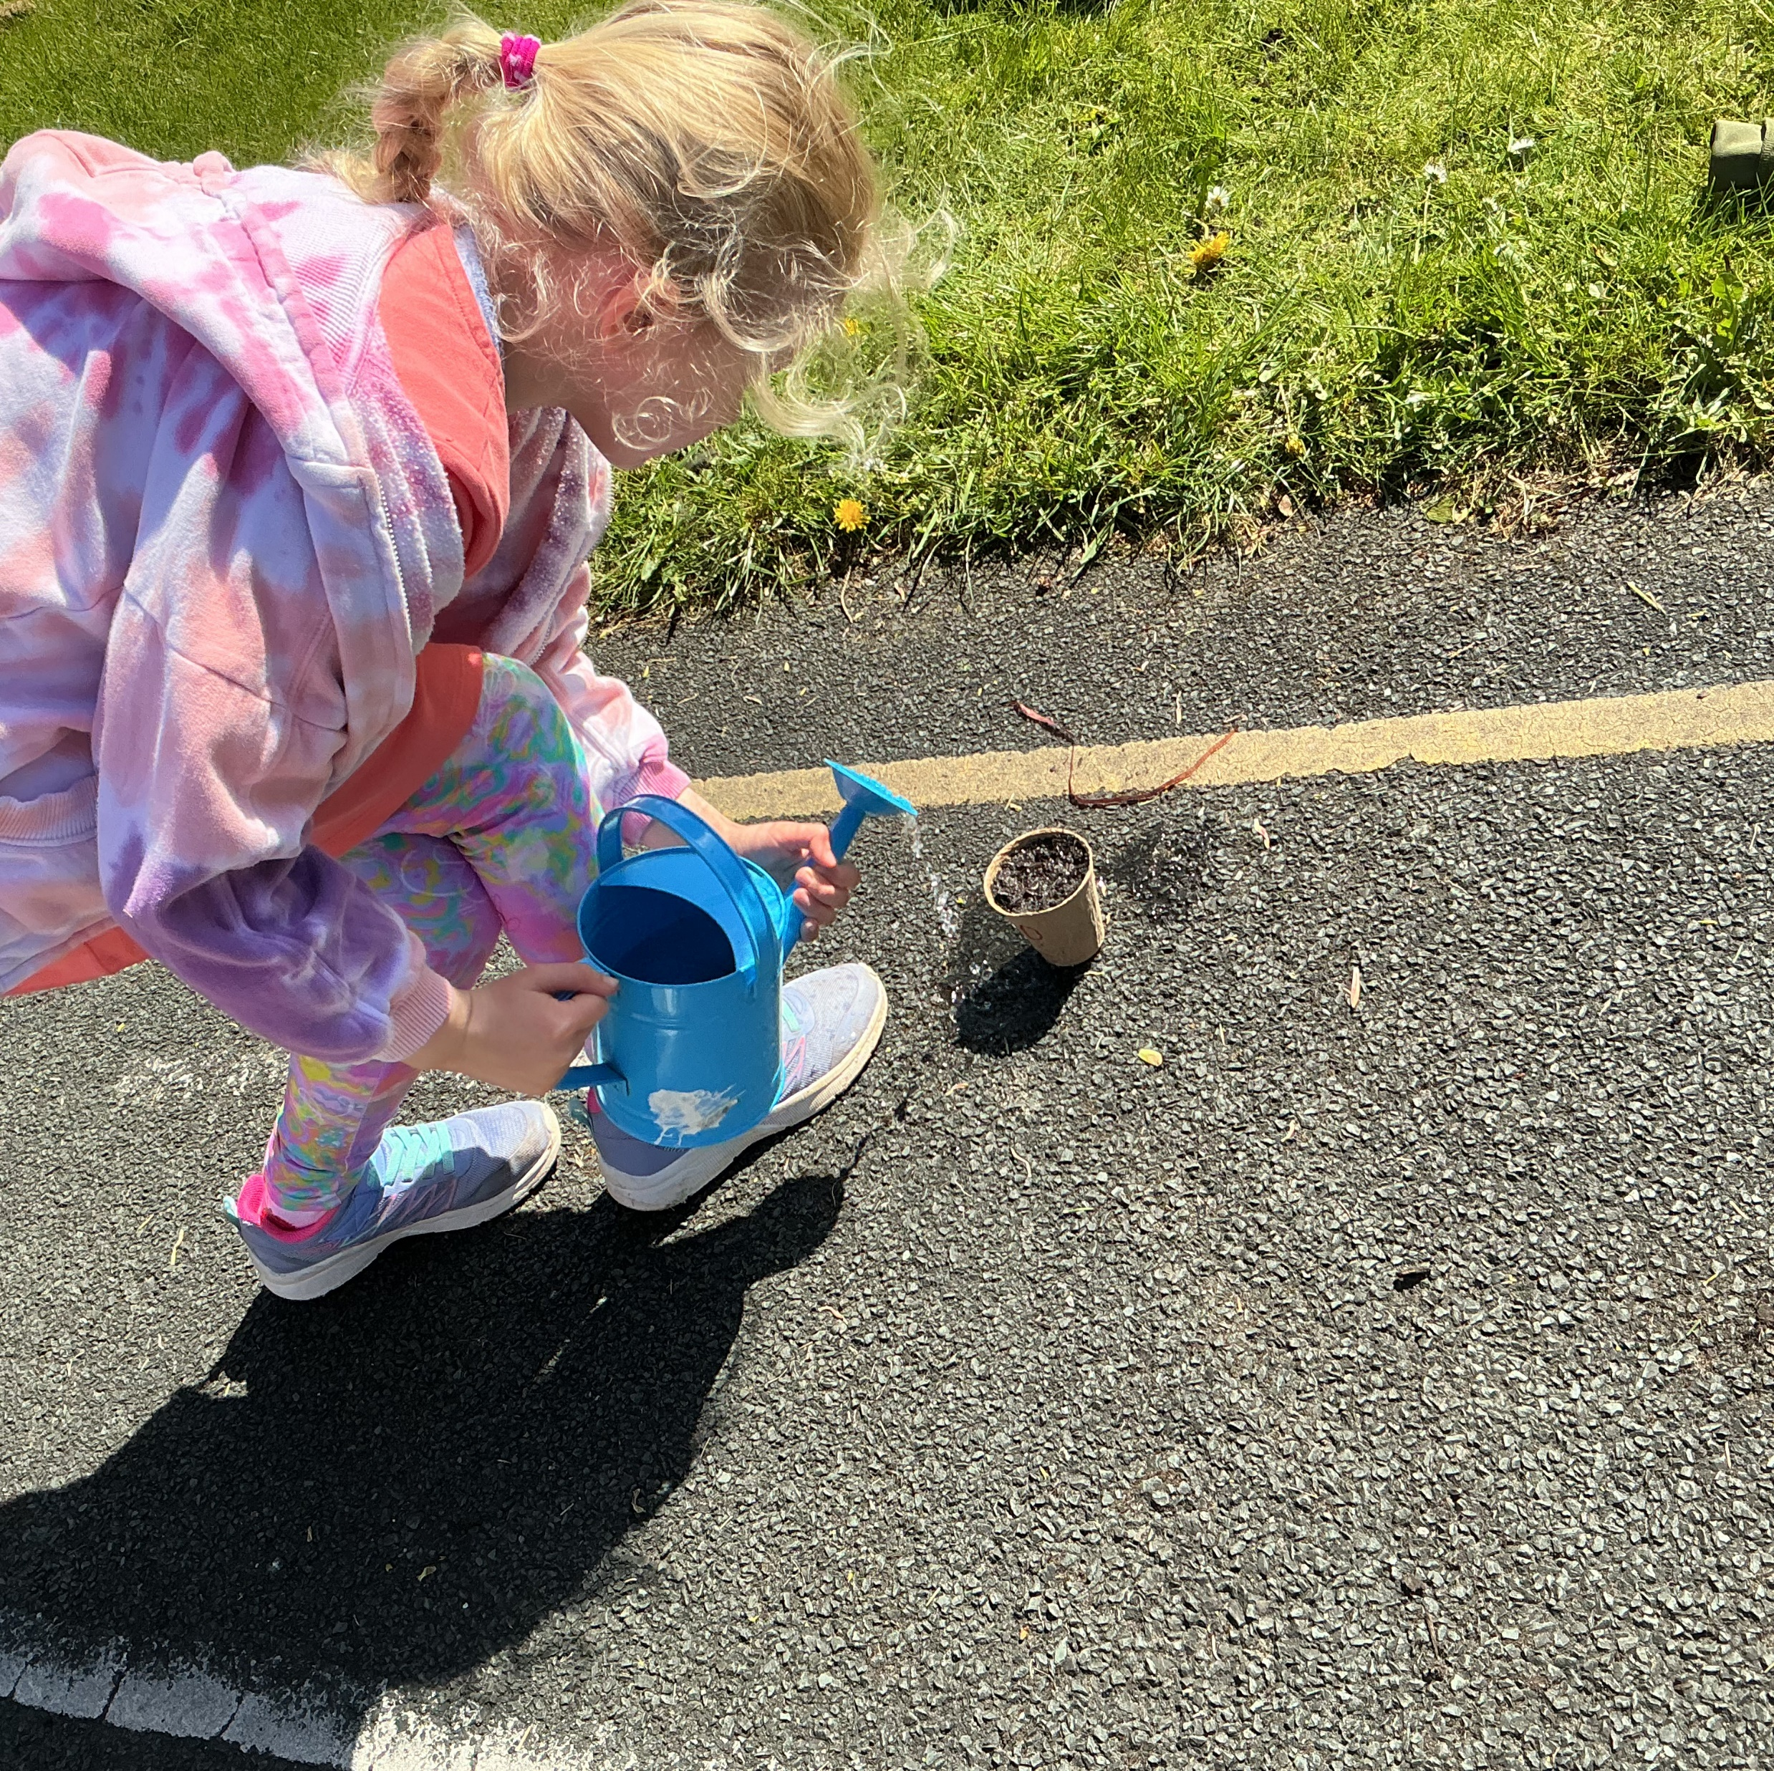
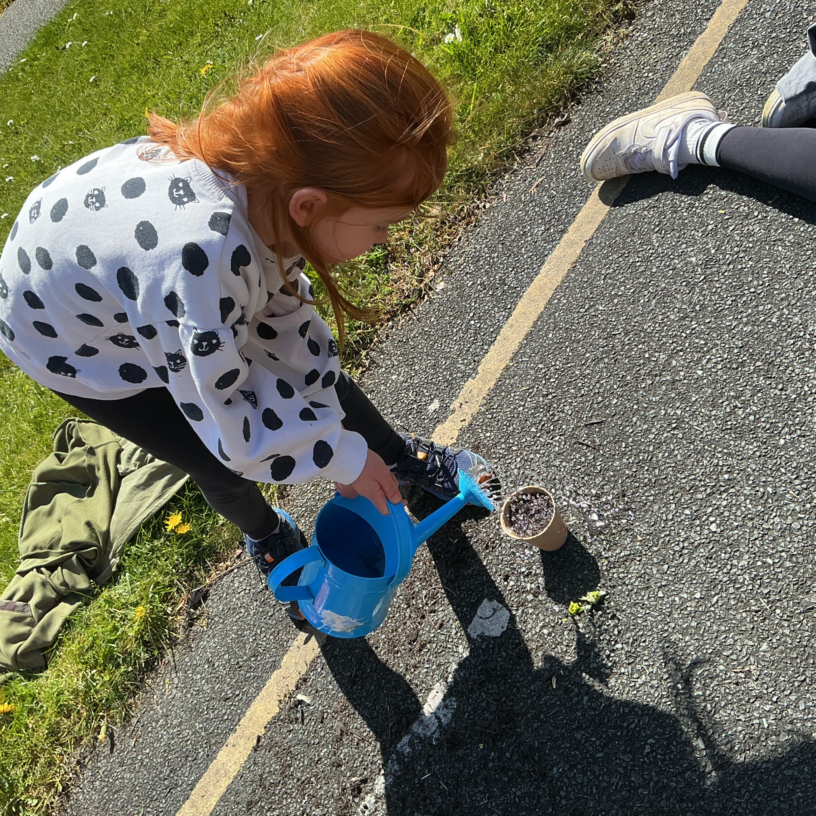





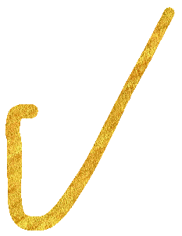

FIRST WE PLANTED OUR SEEDS.

Slide 3
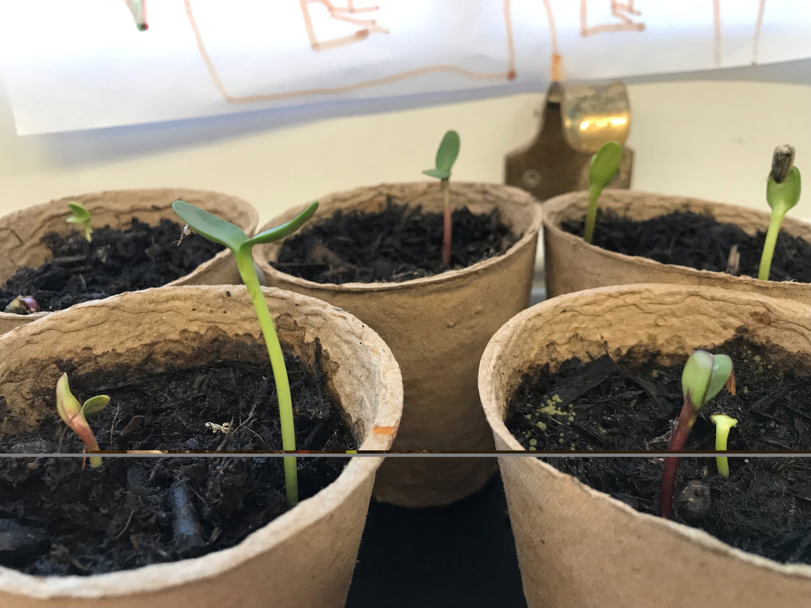
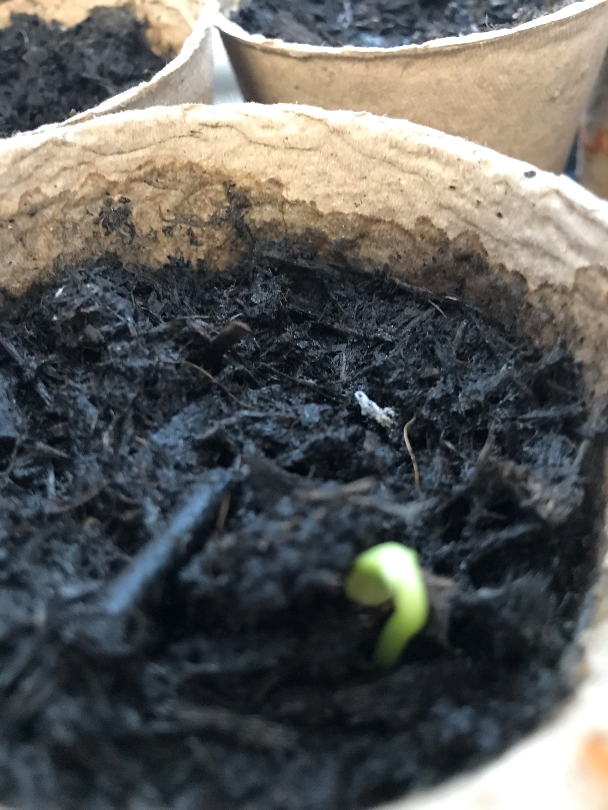












THE PLANTS STARTED TO GROW.

Slide 4
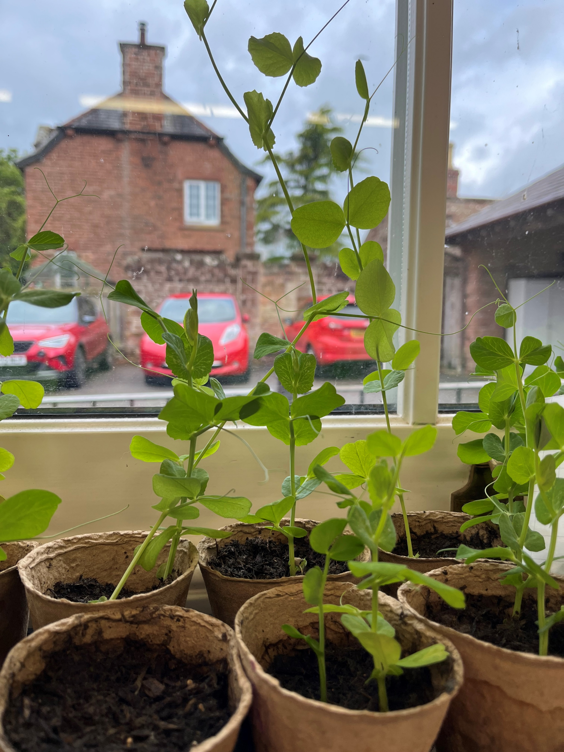





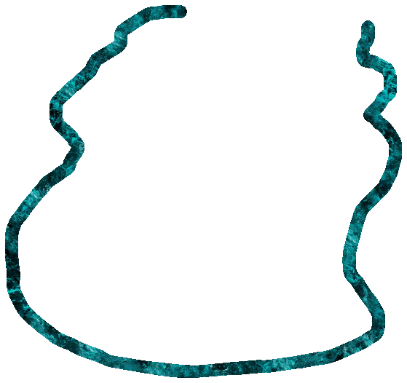

THEY GOT EVEN BIGGER.

Slide 5



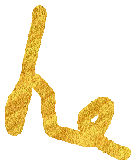






BYE BYE
SEE YOU AGAIN SOON.

