Slide 1

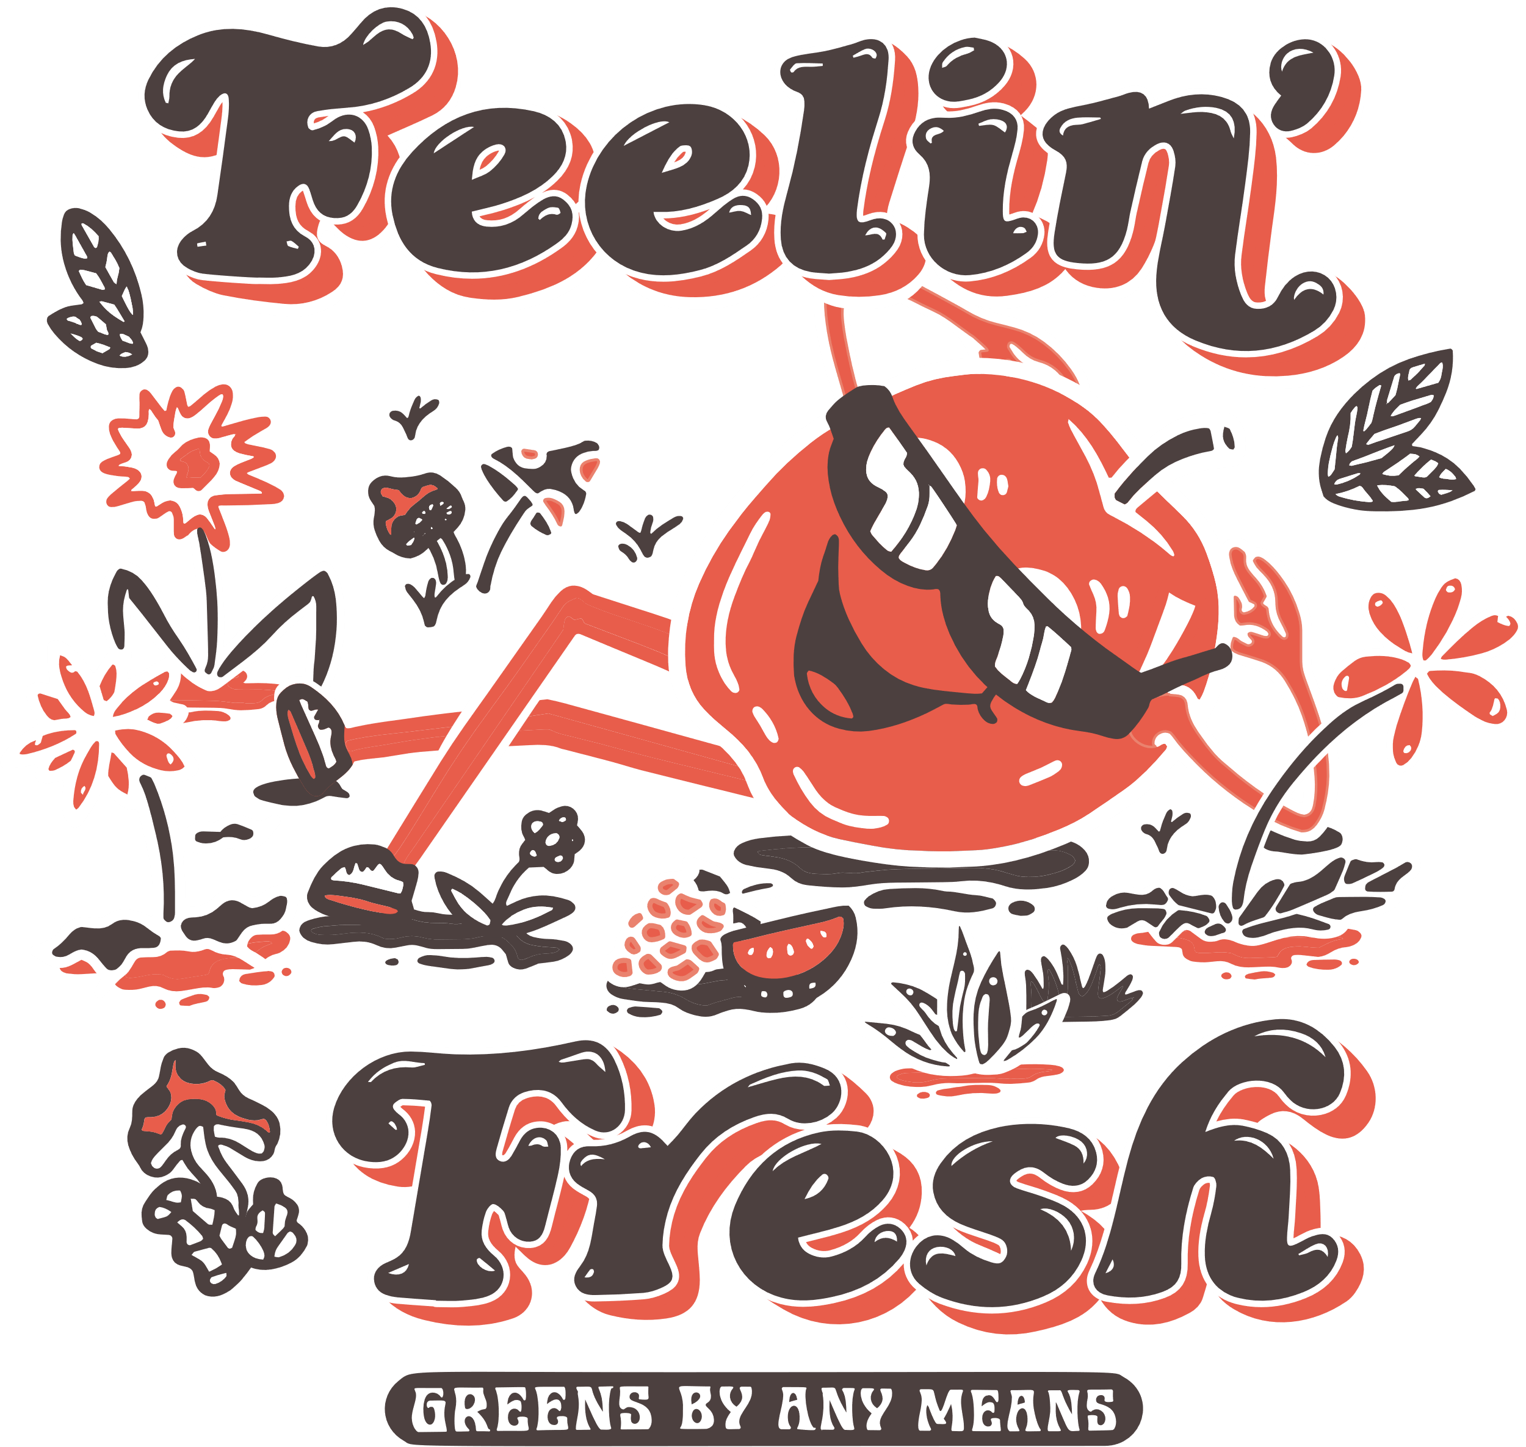


Café Vale
Week 1 | Monday | Tuesday | Wednesday | Thursday | Friday
Lunch 5/1; 26/1; 23/2; 16/3 | Pizza with potato wedges or Pasta bake and seasonal vegetables | Chicken Curry or Vegetarian Curry with rice and naan bread and seasonal vegetables | Roast Gammon or Roast Quorn with roast potatoes and seasonal vegetables | Cheese parcels with diced potatoes or Jackets potato with choice of fillings and seasonal vegetables | Fishfingers and chips or Beany bake and peas and sweetcorn
 | Chocolate sponge with chocolate sauce | Iced Shortbread | Cheese and crackers | School cake and custard | Rice crispy cake
 | Available everyday: yogurt and fresh fruit. A limited amount of jacket potatoes will be available daily unless stated as a choice on the main menu.
Allergies | Gluten, milk, eggs | Fish, gluten, milk | Fish, gluten, milk | Gluten, milk, fish | Fish, gluten, milk
Menu subject to change due to availability

Slide 2

Café Vale
Week 2 | Monday | Tuesday | Wednesday | Thursday | Friday
Lunch 12/1; 2/2; 2/3; 23/3 | Macaroni cheese with garlic bread or Vegetable nuggets with wedges and seasonal vegetables | Jacket potato with choice of fillings or BBQ Chicken wrap Or BBQ Quorn wrap with diced potatoes and seasonal vegetables | Sausage or Quorn sausage with Mashed potatoes, Yorkshire pudding and seasonal vegetables | Pasta bake or Jacket potato with choice of fillings and seasonal vegetables | Fish stars with chips or Jacket potato with choice of fillings and peas and sweetcorn
 | Iced carrot cake | Crispy Jam tart and custard | Honey and oat cookie | Cornflake tart and custard | Iced vanilla cup cakes
 | Available everyday: yogurt and fresh fruit. A limited amount of jacket potatoes will be available daily unless stated as a choice on the main menu.
Allergies | Milk, gluten | Milk, gluten, fish | Gluten, milk, | Milk, gluten, fish | Gluten, fish, milk, egg
Menu subject to change due to availability

Slide 3
Café Vale
Week 3 | Monday | Tuesday | Wednesday | Thursday | Friday
Lunch 19/1; 9/2; 9/3 | Vegan rolls with diced potatoes or 3 bean enchiladas and seasonal vegetables | Turkey pie or Cauliflower cheese bake with roast potatoes and seasonal vegetables | Spaghetti bolognaise or Veggie bolognaise with garlic bread and seasonal vegetables | Sausages or Veggie sausages With mashed potato, Yorkshire pudding and seasonal vegetables | Fish fingers and chips or Veggie curry with rice and naan bread and peas and sweetcorn
 | Butterscotch tart | Brownie | Jam sponge and custard | Flapjack | Chocolate chip muffin
 | Available everyday: yogurt and fresh fruit. A limited amount of jacket potatoes will be available daily unless stated as a choice on the main menu.
Allergies | Gluten, Milk | Gluten, fish, milk | Milk, Gluten, eggs | Milk, gluten | Gluten, fish, eggs and milk
Menu subject to change due to availability

