Slide 1
Emotional Literacy Support Assistant (ELSA) Programme.
Arnold Mill Primary School
Notes:
What is ELSA?
There will always be children and young people in schools facing life challenges that detract from their ability to engage with learning. Some will require greater support to increase their emotional literacy than others. ELSA is an initiative developed and supported by educational psychologists. It recognises that children learn better and are happier in school if their emotional needs are also addressed.
The majority of ELSA work is delivered on an individual basis, but sometimes small group work is more appropriate, especially in the areas of social and friendship skills. Sessions are fun, we use a range of activities such as: games, role-play with puppets or therapeutic activities such as mindfulness or arts and craft. ELSA sessions take place in our very own 'ELSA room' which provides a calm, safe space for the child to feel supported and nurtured.
In ELSA we aim to provide support for a wide range of emotional needs:
Recognising emotions
Anxiety Self-esteem Social skills Friendship skills
Anger management Loss and bereavement

Slide 2
What is Emotional Literacy?
Claude Steiner (1997) psychotherapist ‘To be emotionally literate is to be able to handle emotions in a way that improves your personal power and improves the quality of life around you.’
‘Emotional literacy improves relationships, creates loving possibilities between people, makes co-operative work possible, and facilitates the feeling of community.’
5 Key Elements:
1. Knowing your feelings
2. Having a sense of empathy
3. Learning to manage our emotions
4. Repairing emotional problems
5. Putting it all together: emotional interactivity

Slide 3
What is ELSA?
There will always be children and young people in schools facing life challenges that detract from their ability to engage with learning. Some will require greater support to increase their emotional literacy. ELSA is an initiative developed and supported by educational psychologists. It recognises that children learn better and are happier in school if their emotional needs are also addressed.
Most of our ELSA work is delivered on an individual basis, but sometimes small group work is more appropriate, especially in the areas of social and friendship skills. Sessions are fun; we use a range of activities to suit individual needs. Some of these include; targeted work, role-play with puppets, and games, as well as therapeutic activities such as mindfulness or arts and craft. ELSA sessions take place in our very own 'ELSA room' which provides a calm, safe space for the child to feel supported and nurtured. Each session lasts approximately half an hour.
In ELSA we aim to provide support for a wide range of emotional needs, including:
Recognising and Regulating Strong Emotions
Anxiety Self-esteem and Resilience Social Skills Belonging and Friendship skills
Anger Management Loss and Bereavement
Notes:
There will always be children and young people in schools facing life challenges that detract from their ability to engage with learning. Some will require greater support to increase their emotional literacy than others. ELSA is an initiative developed and supported by educational psychologists. It recognises that children learn better and are happier in school if their emotional needs are also addressed.
The majority of ELSA work is delivered on an individual basis, but sometimes small group work is more appropriate, especially in the areas of social and friendship skills. Sessions are fun, we use a range of activities such as: games, role-play with puppets or therapeutic activities such as mindfulness or arts and craft. ELSA sessions take place in our very own 'ELSA room' which provides a calm, safe space for the child to feel supported and nurtured.
In ELSA we aim to provide support for a wide range of emotional needs:
Recognising emotions
Anxiety Self-esteem Social skills Friendship skills
Anger management Loss and bereavement

Slide 4
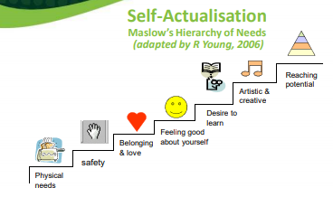
Why is Emotional Literacy Important?
If you cannot manage your emotions, it is harder to be content, sociable and learn.
If we are able to manage our emotions, we are not overwhelmed by them and this links with positive mental health.
All feelings are ok, it’s what we do with them that matters.

Slide 5
Positive Mental Health
What do we mean by positive mental health?
Mental health includes our emotional, psychological, and social well-being. It affects how we think, feel, and act.
It also helps determine how we handle stress, relate to others, and make choices (Mentalhealth.gov)
Mental health problems may well arise when: “…the demands placed on any individual exceed their resources and coping abilities” (World Health Organisation)
Notes:
Another focus which we have linked to the new PHSE curriculum is on mental health awareness. ELSA provides children with an emotional toolkit for when they may find themselves struggling. This will hopefully impact on behaviour outbursts and refusal to engage in learning for some pupils.

Slide 6
The benefits of focusing on Emotional Literacy
We feel good - we learn better
Raises standards
Makes learning more enjoyable
Reduces unnecessary stress
Turns vicious circles into virtuous circles
(Sharp, 2001)

Slide 7
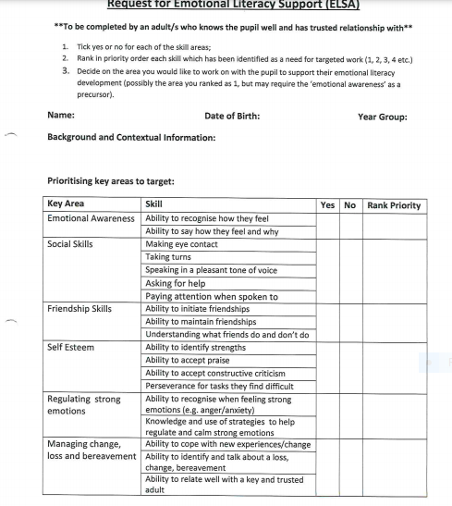
This is an example of the staff referral form when wanting to send a pupil to the ELSA programme. An assessment is then carried out prior to commencing programme to ascertain difficulties the child may have.
In School Mrs Hopewell is our main point of contact for ELSA support in school.
Please speak to your class teacher if you feel your child is struggling with their emotions and may need some support.
Notes:
This is an example of the staff referral form when wanting to send a pupil to the ELSA programme. An assessment is then carried out prior to commencing programme to ascertain difficulties the child may have.

