Slide 1

Reading at Arnold Mill
The purpose of this evening is to share with you how we teach children to read at Arnold Mill and how you can support your child’s learning at home.
1st October 2025

Slide 2
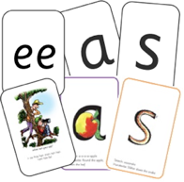
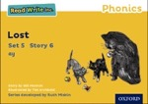
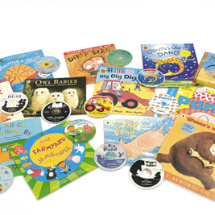



How does Read! Write! look like at Arnold Mill?
Read! Write! is a structured, systematic approach to reading.
It’s main purpose is to get children reading so that they can ‘read to learn’
Notes:
Alongside story books
Talk , discuss and respond to

Slide 3


Some codes are easier than others
This is why we need a systematic approach to teaching phonics!
English
44 speech sounds
26 letters
150+ graphemes
Spanish
24 speech sounds
26 letters
29 graphemes
Notes:
We use 44 sounds to make all the words in the English language. This means we’ve got a problem. Click. We’ve got 44 speech sounds, only (click) 26 letters to write them,
The 26 letters work singly, in pairs and sometimes in threes to represent one sound.
We have to group letters together to write some sounds e.g. ‘igh’, ‘air’.
And (click) over 150 graphemes – 150 different ways to spell the sounds.
This makes our language one of the most complex in the world!
Most languages have a simpler code.
Take Spanish. Spanish has (click) 24 speech sounds, (click) 26 letters in their alphabet and (click) 29 graphemes. Neat.
N.B. It can be argued that Spanish has 27 letters due to the 'ñ', a letter that plays a key role in the pronunciation of many Spanish words.
Spanish children learn to read quickly.
Children learning to read in English have the odds stacked against them.
This means that we can’t leave anything to chance.
We teach a simple alphabetic code first (point to Simple SS chart) - as if English were Spanish.
First, we teach one grapheme to represent each of the 44 sounds.

Slide 4
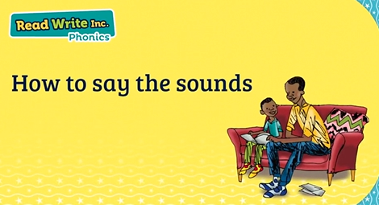
Learning to hear the sounds
It is really important to say each sound correctly and clearly.
This will help the children hear how the sounds are made and make it is easier to blend words together.

Slide 5
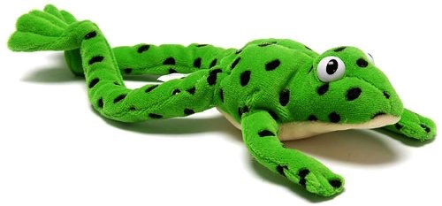
Fred Talk
Blending words together is the first and most important step of reading.
If a child can orally blend, then they will be able to hear the sounds to read words.

Slide 6
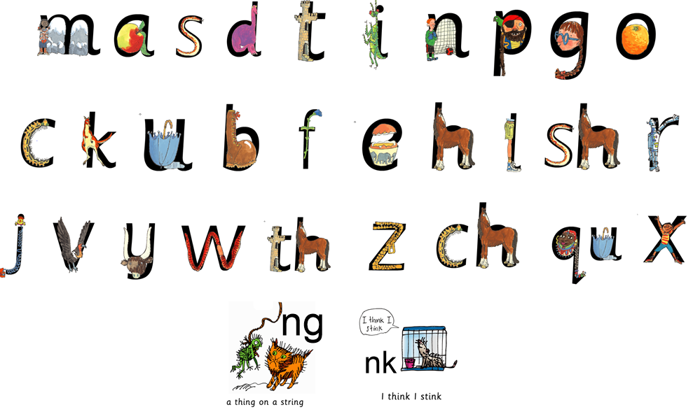
Learning to recognise the sounds
Each sound has an accompanying picture.
This helps the children to remember and make connections.

Slide 7
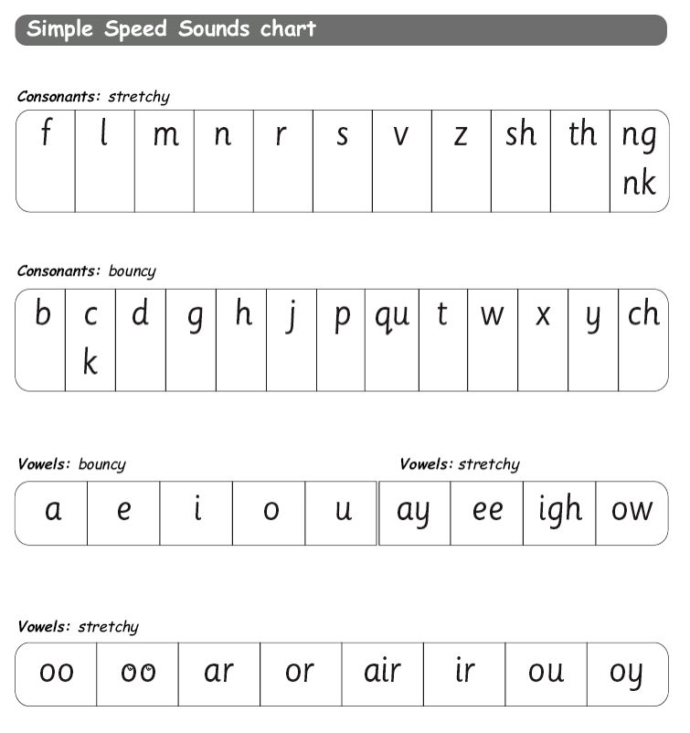
Letter sounds
This is how the sounds we teach are presented to the children. We teach these sounds systematically.
Notes:
+ ire, ear, ure

Slide 8
Fred Talk
All words are made up of sounds. Some are made up as single sounds others have more than one letter.
cat
c
a
t
ship
sh
i
p
light
l
igh
t

Slide 9

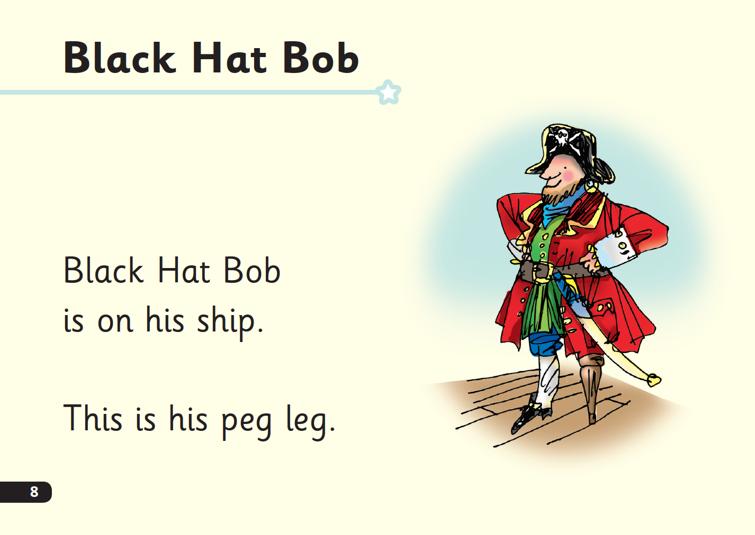
‘Special Friends’, ‘Fred Talk’, read the word
Notes:
E Children will be able to read all of the words in the Storybook.
If they hesitate, remind them to read the word using ‘Special Friends, Fred Talk, read the word’.
For example, this means they spot the ‘sh’, then Fred Talk and blend to read the word e.g. sh, sh-i-p, ship.

Slide 10

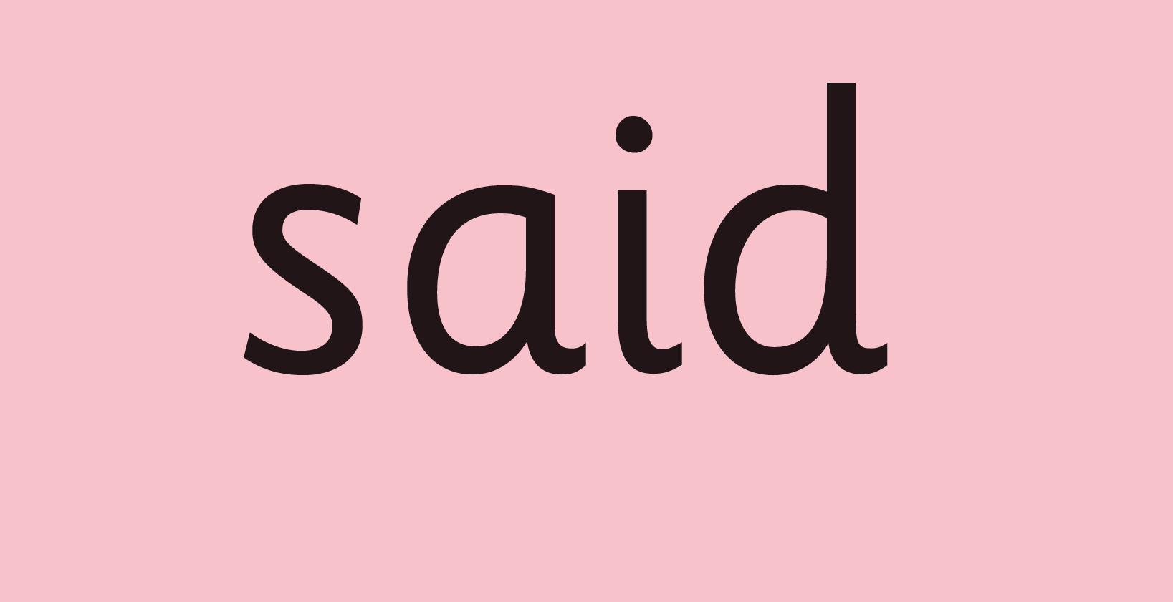
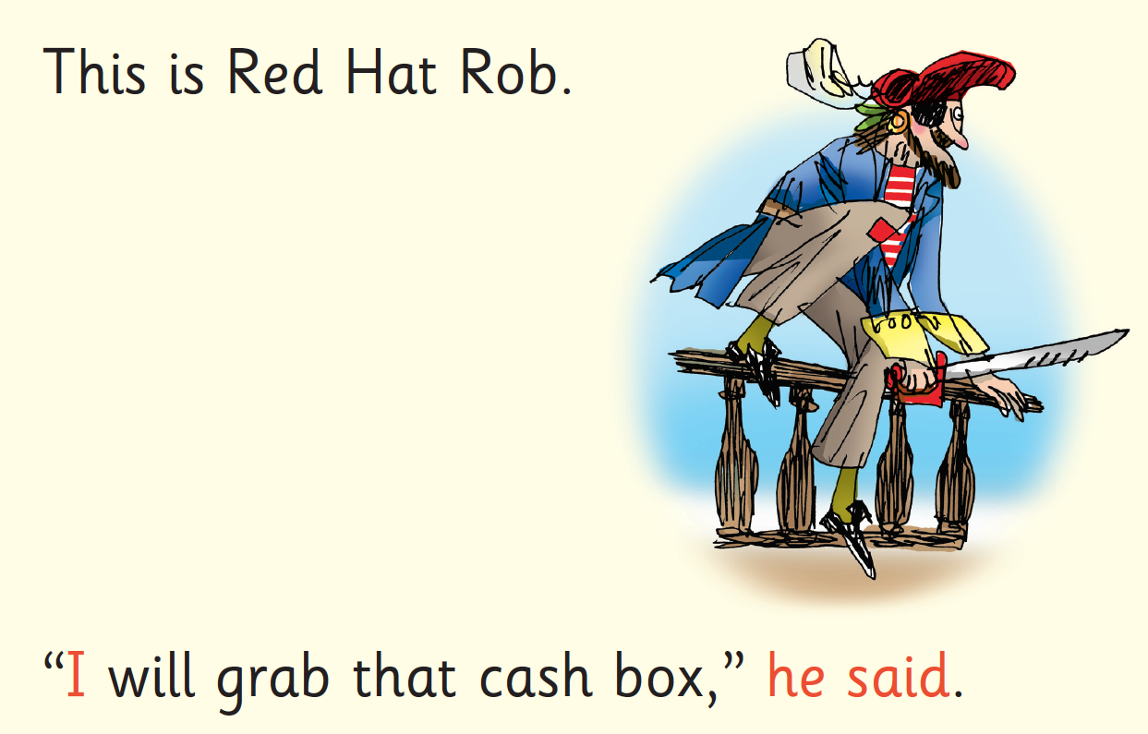
Red Words
Notes:
Some words are ‘tricky’ because they contain letters that don’t match the sounds the child has been taught.
For example, ‘said’ has ‘ai’ making an ‘e’ sound.
We teach these common exception words as Red words.
In the early Storybooks, these words are printed in red text.
Remind your child not to use Fred Talk to read Red words but instead to stop and think. Tell them the word if needed.

Slide 11
‘Three with me, four at home’
Accuracy
Fluency
Comprehension
Read and enjoy at home
Notes:
In our school, children read each Read Write Inc. Storybook three times in class with their partner.
Re-reading the same book helps children to become confident readers. Each time they re-read, they build their fluency/speed and comprehension.
They love reading and want to read because they can read all of the words in the Storybook.
We set a focus for each re-read in school.
(Click) The first read focuses on reading every word accurately.
(Click) The second on reading the story more quickly.
(Click) The third read on comprehension - understanding what they read.
Then your child brings the same book home to read and enjoy with you again and again at home.
It’s ‘three with me, four at home.’
We do not send stories home the children cannot read because we always want them to be set up to succeed in their reading.
We want to make sure they enjoy reading so that they want to read.
The more they read, the faster progress they will make.

Slide 12
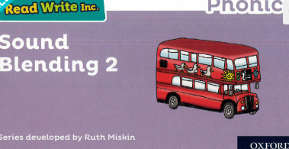
Which books will children bring home?
+
Notes:
In your child’s book bag, they will bring home:
- the Storybook they have read in class to practise reading what they can already read.
- if applicable a ‘Last and past’ Storybook – a previously read RWI Storybooks for extra practice. The children enjoy re-reading stories they know well. Their fluency improves on every reading.
- if applicable a Book Bag Book. I’ll explain more about these in one moment.
A picture book to share with you which has already been read to them so they care about it. You can read the story to them or they can retell the story by looking at the pictures. They are not expected to read the story themselves.
We make sure that every book that goes into your child’s book bag is a well-loved book – one they know already and want to read again and again.

Slide 13
What can you do?
Check the website to make sure you are using pure sounds with your child.
Use Fred talk throughout the day
Read and enjoy a variety of stories together
Visit the library
Share with us what they have read and are enjoying reading in their diary
Listen to your child read their storybooks.
Help by reading back the page to your child to keep the story moving. Their energy is going into reading the words.
Notes:
Provide copies of ‘Reading at Home Booklet 1 or 2’ from Oxford Owl.
Booklet 1 is sound groups and Ditty/ Red Groups and Booklet 2 for Green – Grey Storybooks.

Slide 14
Thank you
Read Write at Arnold Mill
https://www.ruthmiskin.com/parents/
https://home.oxfordowl.co.uk/reading/

