Slide 1

Welcome to the Foundation Unit
Starting in F1

Slide 2
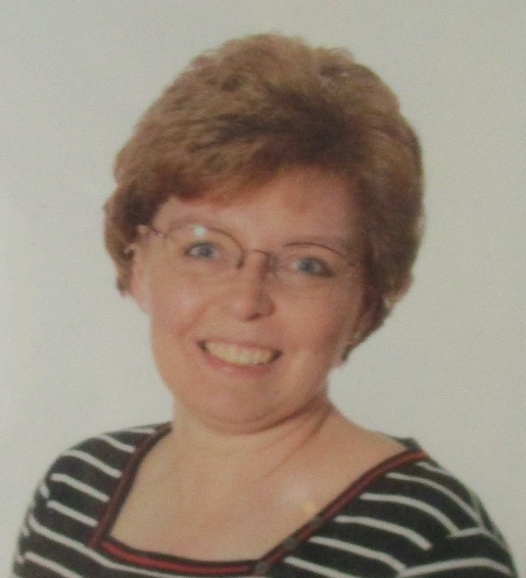
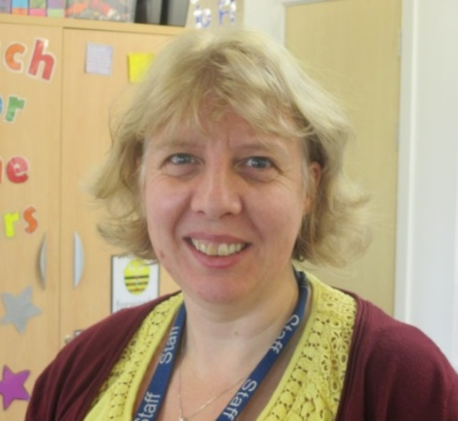
Adults in F1
Mrs Bennett/Mrs Smith
Miss Joynt

Slide 3
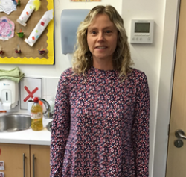
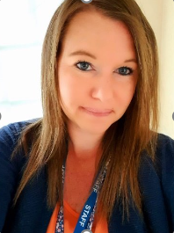
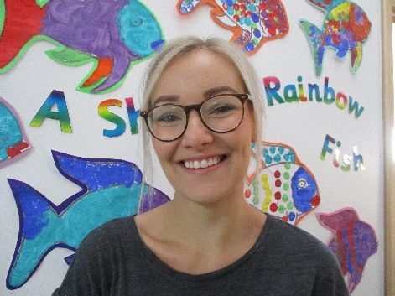
We have a fantastic team of Teaching Assistants in F1
Mrs Smith
Mrs Cook
Miss Elms
Miss Spencer
(when back from maternity)

Slide 4
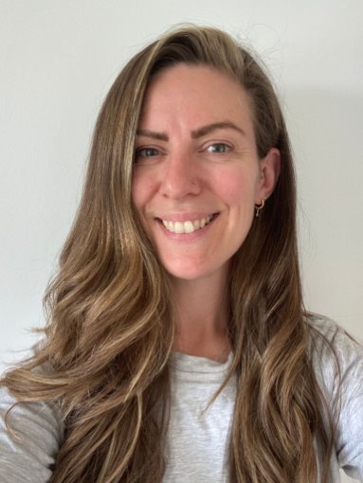
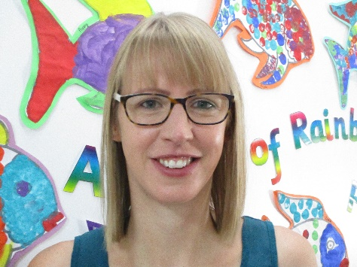
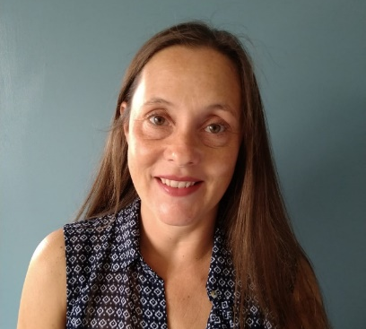
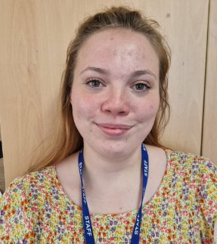
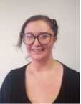

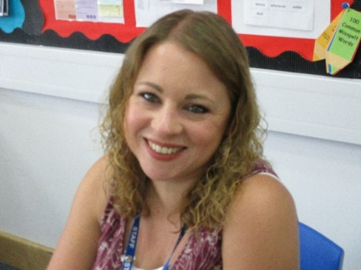
They may also see lots of other adults during the week.
Mrs Broniewska
EYFS Lead
Mrs Humphrey
F2 Teacher
Mrs Brumby
F2 Teacher
Mrs Farag
T.A
Miss Kemp T.A
Mrs Oldfield
Head teacher
Mrs Slater
SENCO
Mrs Greentree
P.E Teacher

Slide 5
The School Day
9.00am- 30 hour and morning children arrive
12.00pm Morning children go home
12.00pm-1.00pm- Lunch time (30hr children only)
12.30pm Afternoon children arrive
3.00pm End of 30hr children’s session (option to stay until 3.30pm)
3.30pm School day finishes

Slide 6
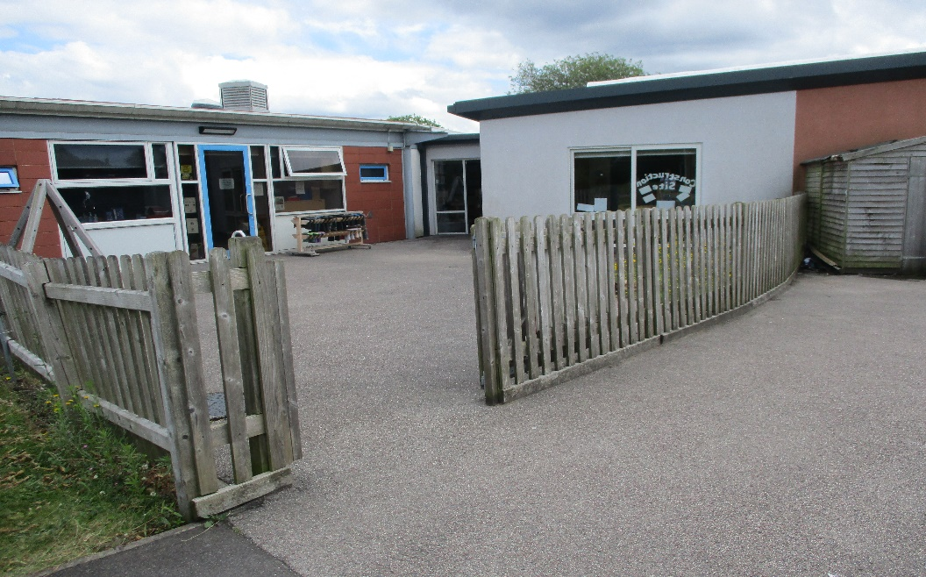
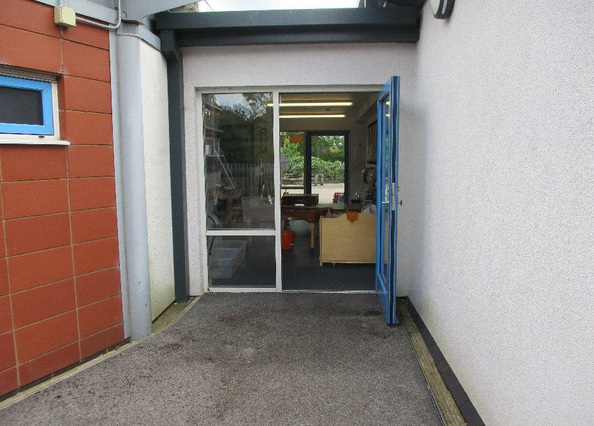
Drop Off and Pick Up Times
This is the gate you will come through at these times. We will share it with 2A so please be mindful where you wait.
This is the door your child will go through. We ask that you say goodbye at the door in the morning.

Slide 7
Clothing
Your child will need at least 1 spare pair of clothes in their bag in case they should get their clothes wet, due to messy play or toilet accidents.
We love to learn and explore, which can get a bit messy, so please dress appropriately.
Your child will need a pair of wellies to keep at school. (Please put a name in them)
The children have access to outdoors throughout the day so send them prepared for the weather each day.
We also do P.E twice a week (Tuesday morning and Friday afternoon). Your child should come to school that day wearing shorts, leggings or trousers. Please make sure socks and shoes are easy to take off and put on.

Slide 8
School Uniform
Although your child is not required to wear our school uniform, they can if you wish them too. We do ask that cardigans, jumpers and coats are labelled, so when the children take them off we know who they belong to, especially if they are in school uniform.
Please send children in shoes they can put on themselves, preferably no laces.

Slide 9
Toileting
We do ask that children are toilet trained before they start school although we understand that there may be specific reasons which we will discuss on individual cases.
We will support in helping the children to become more independent in using the toilet and washing their hands and ask that parents support doing this too.

Slide 10
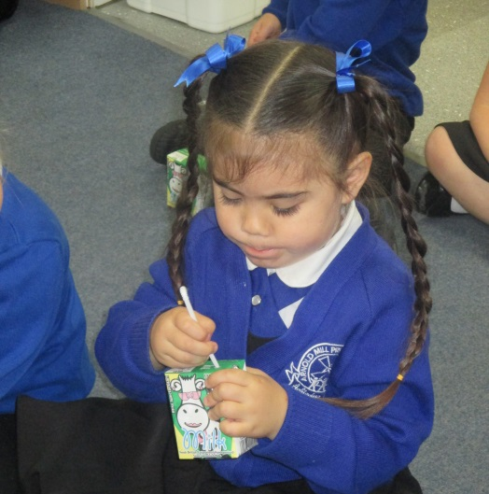
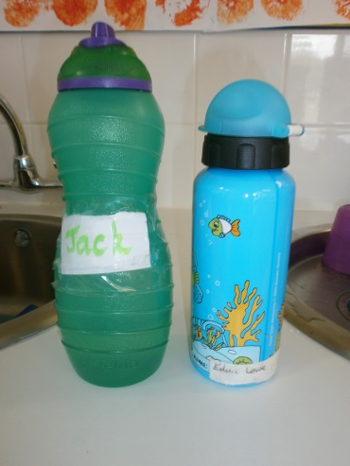

Milk and Water Bottles
Your child is entitled to free milk until their 5th birthday.
Milk has to be ordered and there was a slip in your starter pack. If you don’t order milk your child won’t be able to have any.
We encourage all children to bring a labelled water bottle to school every day and we teach the children to keep themselves hydrated as part of our health and self-care curriculum. Please do not send juice or flavoured water.

Slide 11
Lunch Time
The 30 hour children will stay for their lunch. They will go to lunch at 12pm.
They will eat in one of the F2 classrooms as it is a quieter space. Please make sure your child brings in a packed lunch to eat.
Once the children have finished their packed lunch, they will have time to play outside in the F2 outdoor area.

Slide 12
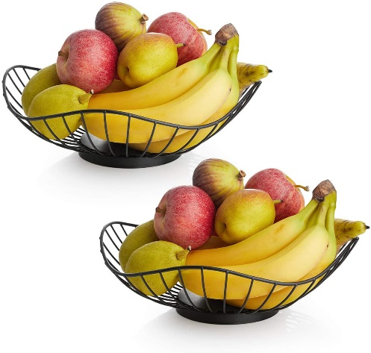
Snack
Every child is entitled to a piece of fruit every day from School.
The children that just attend the morning will have their fruit. If your child is 30 hours you may wish to send them with a healthy snack for the morning session.
The 30 hours and afternoon children will then have theirs nearer to the end of the day.
We encourage the children to try different fruits, except if there are allergies.

Slide 13

Name Writing & Forming Letters
We are really keen for the children to learn to write their names as they can then identify their own work. The first step of this is learning to read their own name.
When the children are ready to start writing, it is important that we help them to form their letters correctly. They may learn a picture and a rhyme to help them form the letters in their name correctly.

Slide 14

Phonics and Read Write Inc
This is a systematic phonics programme that teaches reading and writing. We use it throughout Foundation and Key Stage 1.
F1 start this usually in the summer term. In preparation for the children to be ready, we focus on lots of singing and story telling. We play lots of listening and sound games.

Slide 15
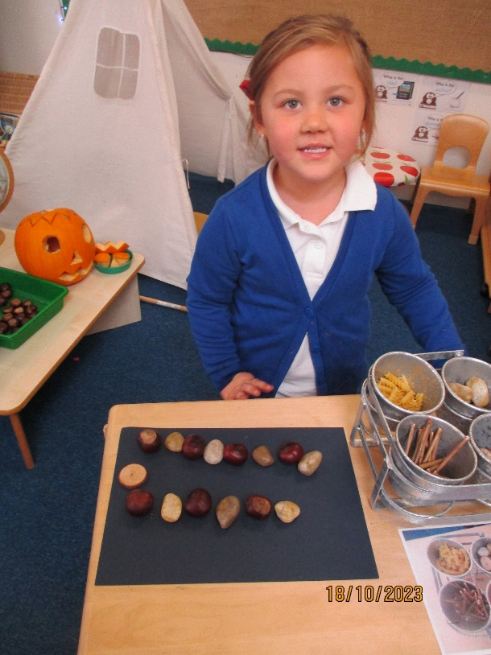
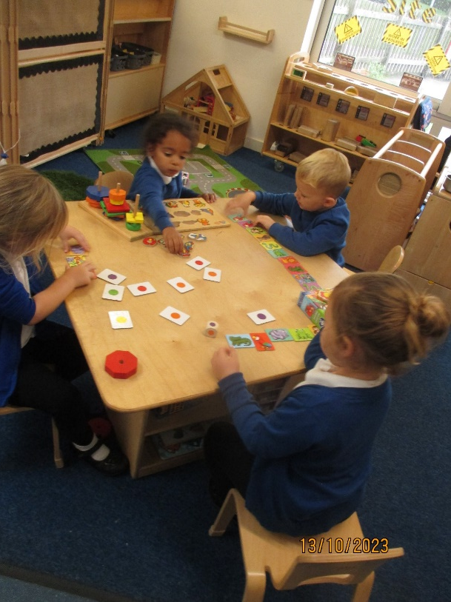
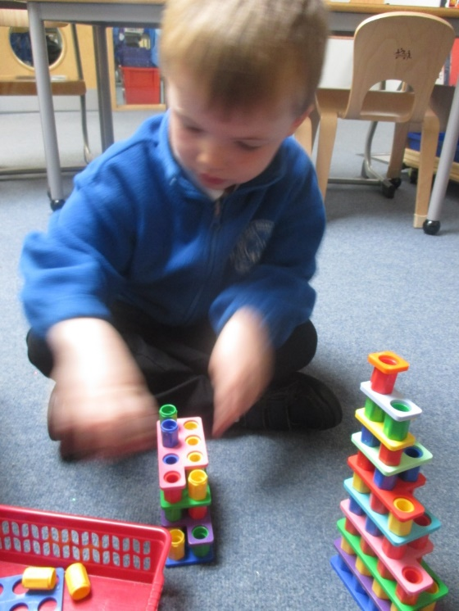
Number Work
We teach number and most of our maths is taught in a practical way.

Slide 16
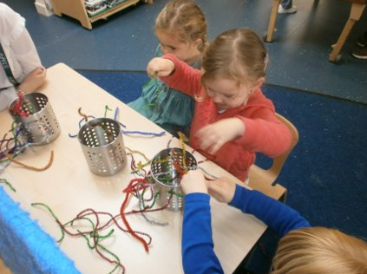
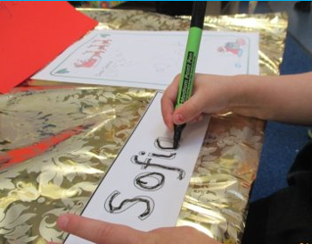
Funky Fingers- Fine Motor
We need to strengthen our hands and fingers in order to hold writing tools and scissors. We do fun activities such as pinching with tweezers, threading and snipping to help with this and support coordination.

Slide 17
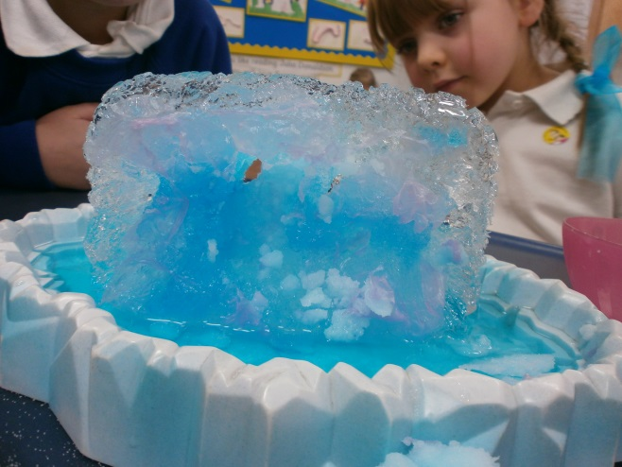
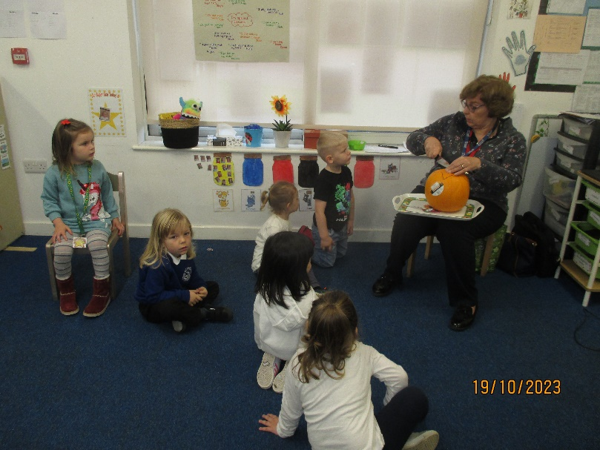
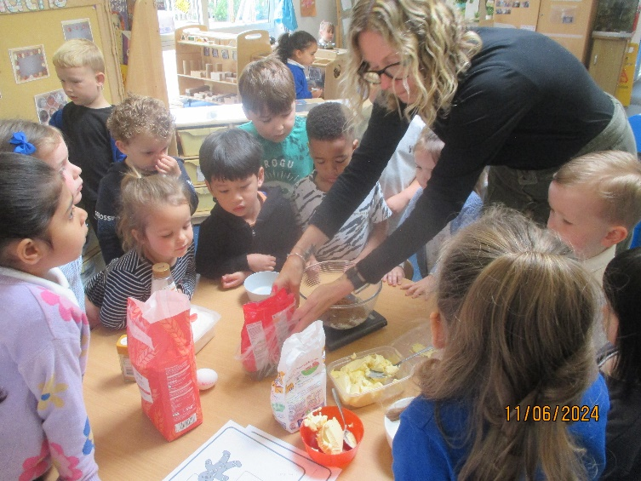
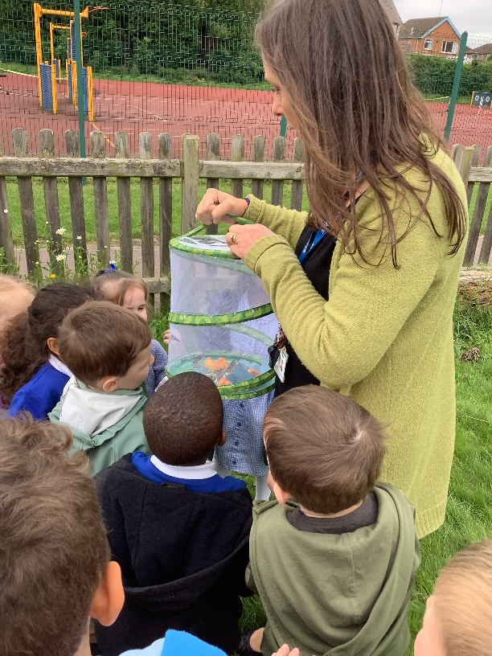
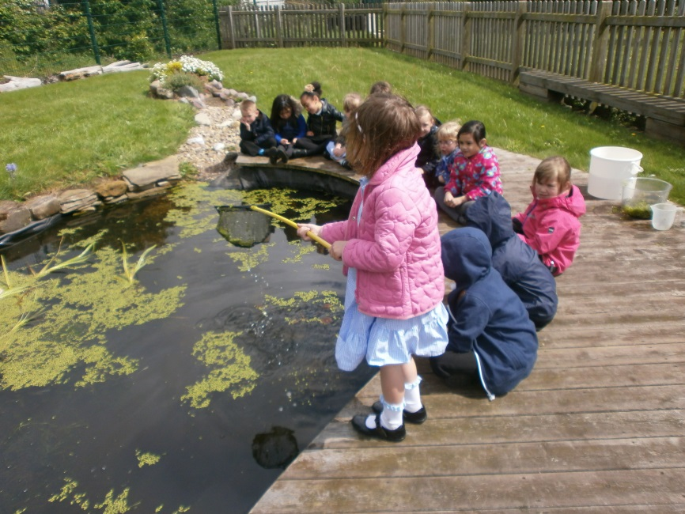
Topic- Understanding the World

Slide 18
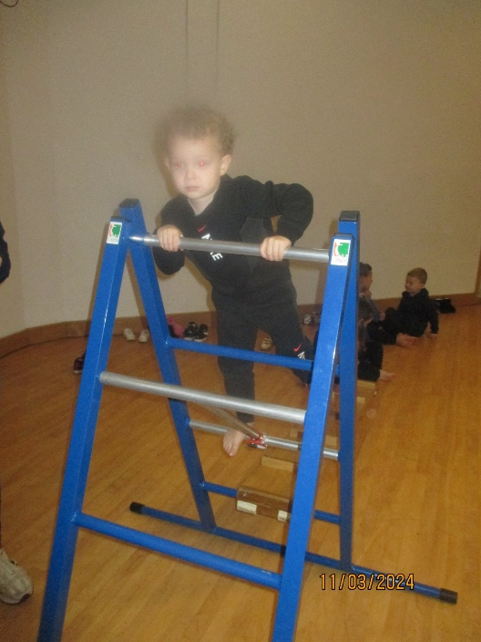
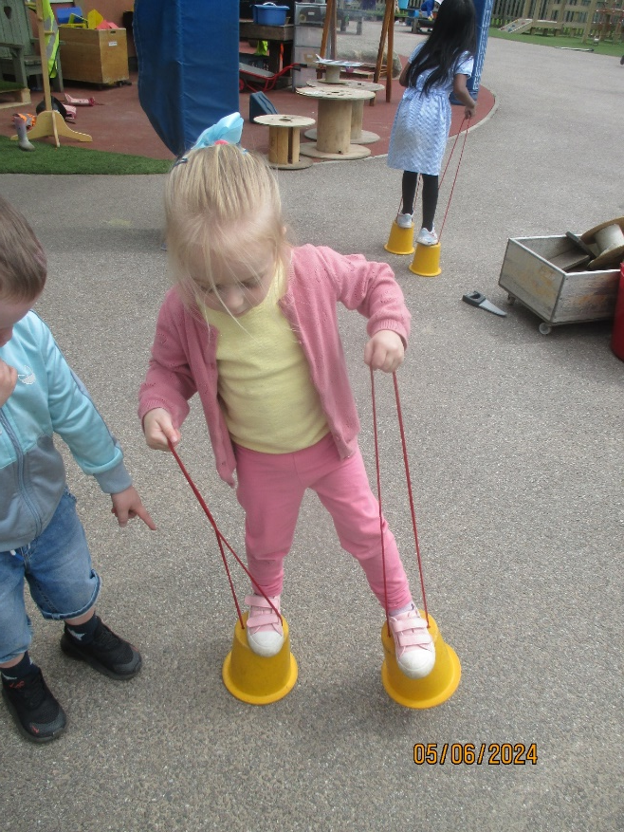
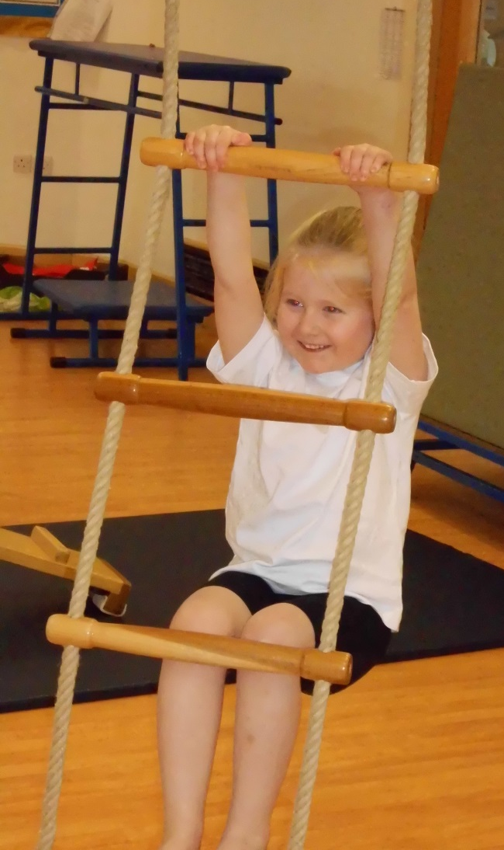
Physical Development

Slide 19
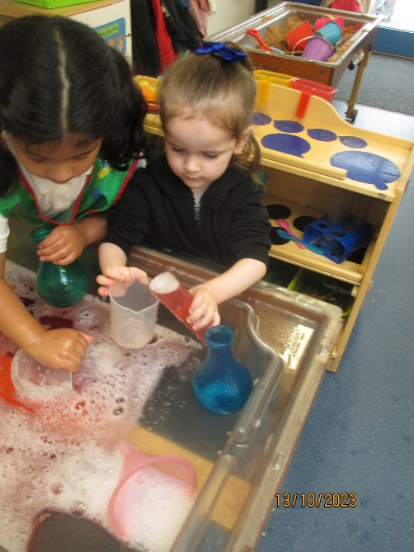
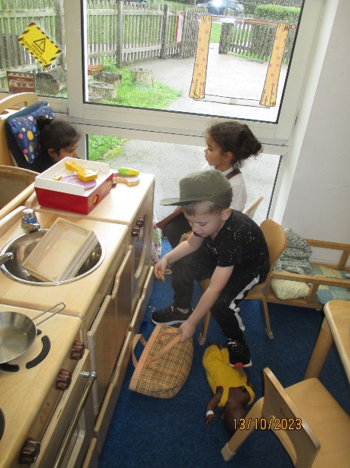
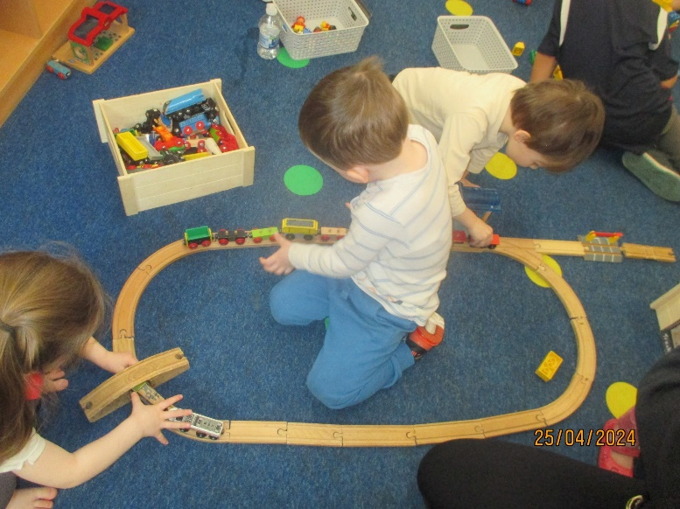
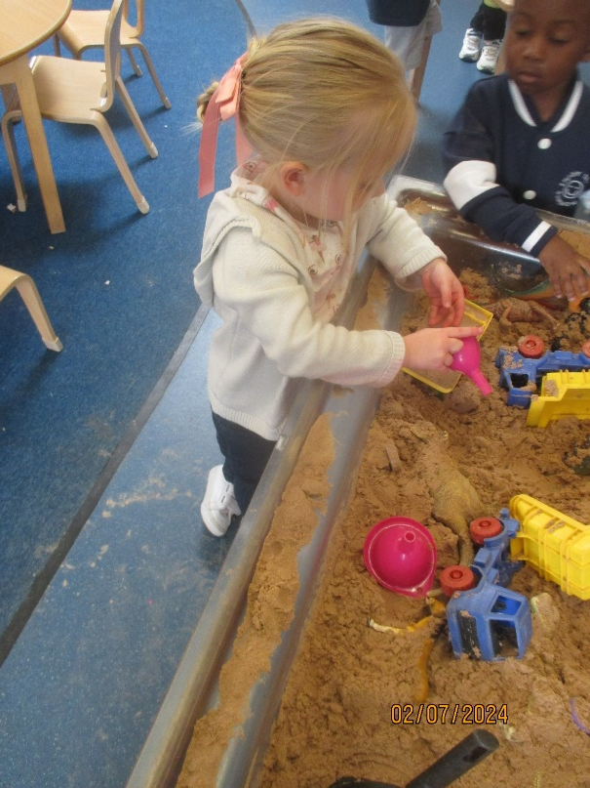
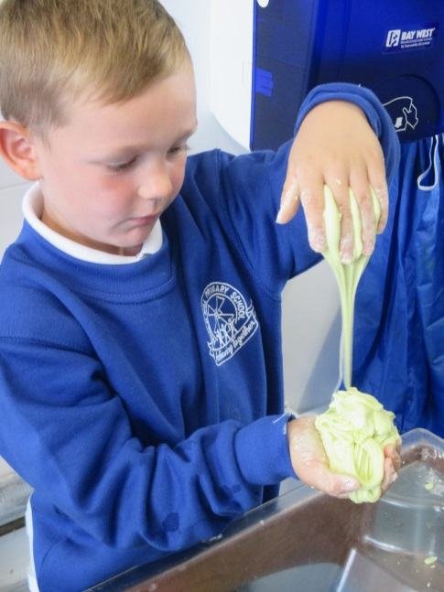
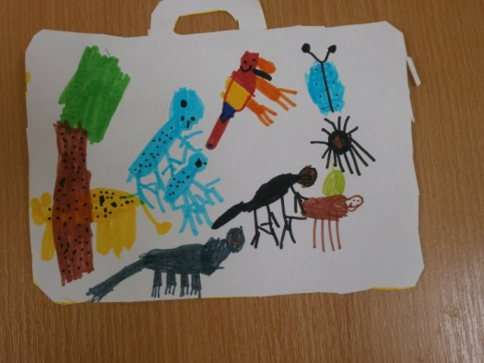
We learn inside…

Slide 20
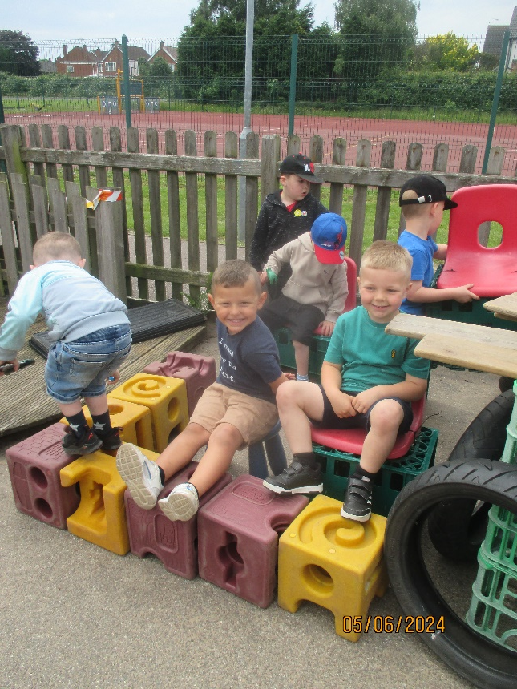
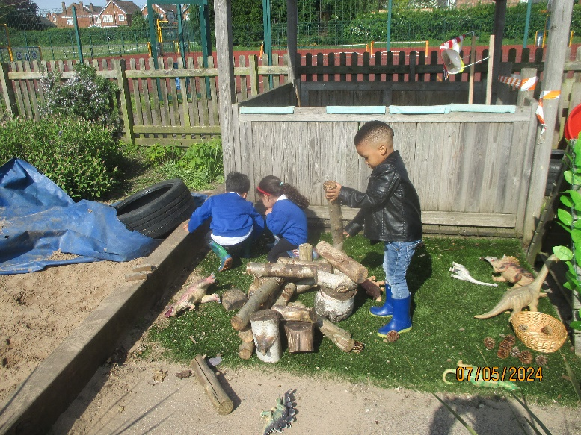
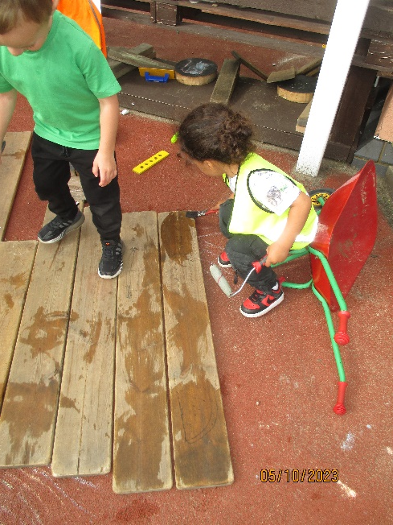
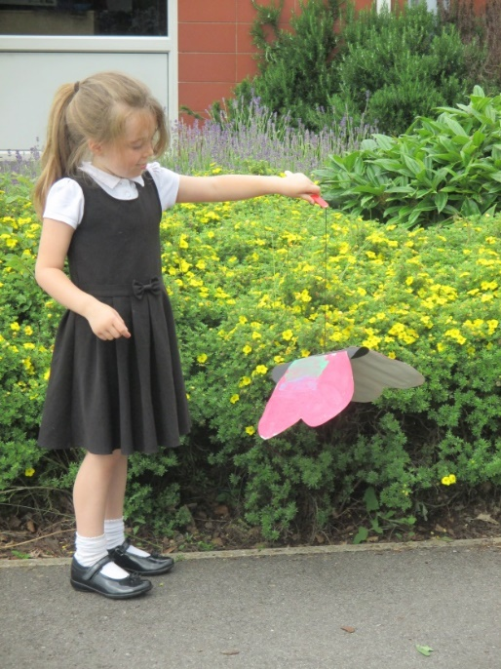
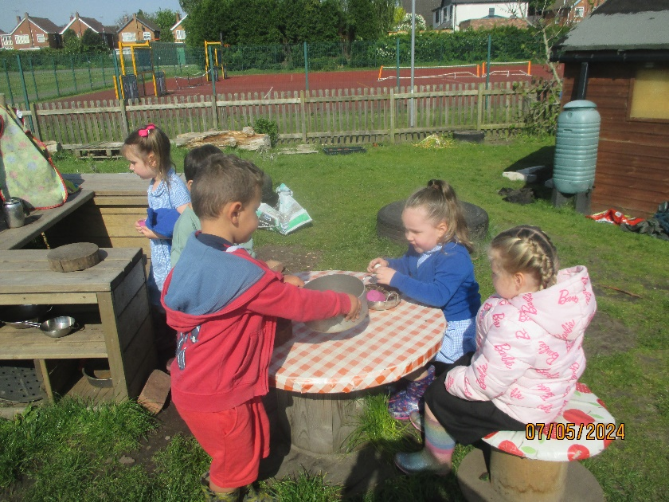
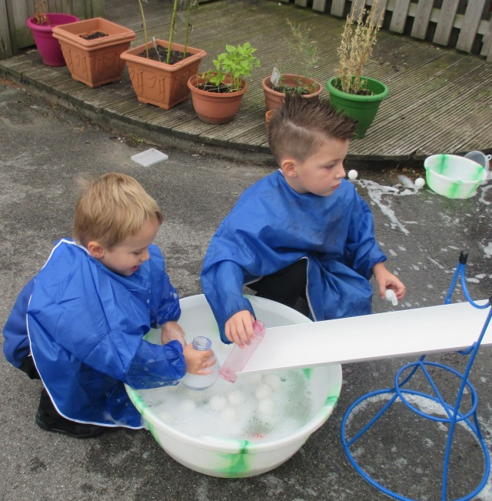
…and outside

Slide 21


Rainbow Rewards
To support positive behaviour, we put stamps or stickers on our charts which are colour coded to follow the colours of the rainbow. When the chart is full the children receive a certificate for earning their rainbow reward and we celebrate this with our friends.

Slide 22
Assessment and Progress
We build up a picture of your child from observations, assessments tasks and talking to you. A lot of what we see goes into your child’s Learning Journey so you see it too.
We will be also photos on class Dojo to let you know what we have been learning about so make sure you log in to your child’s account.
There are two Parent’s Evenings during the year.

Slide 23
What can I do to make sure my child is ready for F1?
The most important skill your child needs to be able to settle quickly into school life is independence.
Checklist
Can they go to the toilet and take care of their own personal hygiene?
Can they take off and put on their coat?
Can they recognise their own belongings?
Can they put on their own socks and shoes?

Slide 24
Settling In Days
Home Visits:
Wednesday 3rd September
Thursday 4th September
30 Minute Visit with Parents:
Friday 5th September
Monday 8th September
Tuesday 9th September

Slide 25
Settling In Days
2x 1 Hour Visit without Parents:
9.30am-10.30am or 1.30pm-2.30pm
Wednesday 10th September
Thursday 11th September
Friday 12th September
Monday 15th September
Tuesday 16th September start their full session if they are ready.

