Slide 1
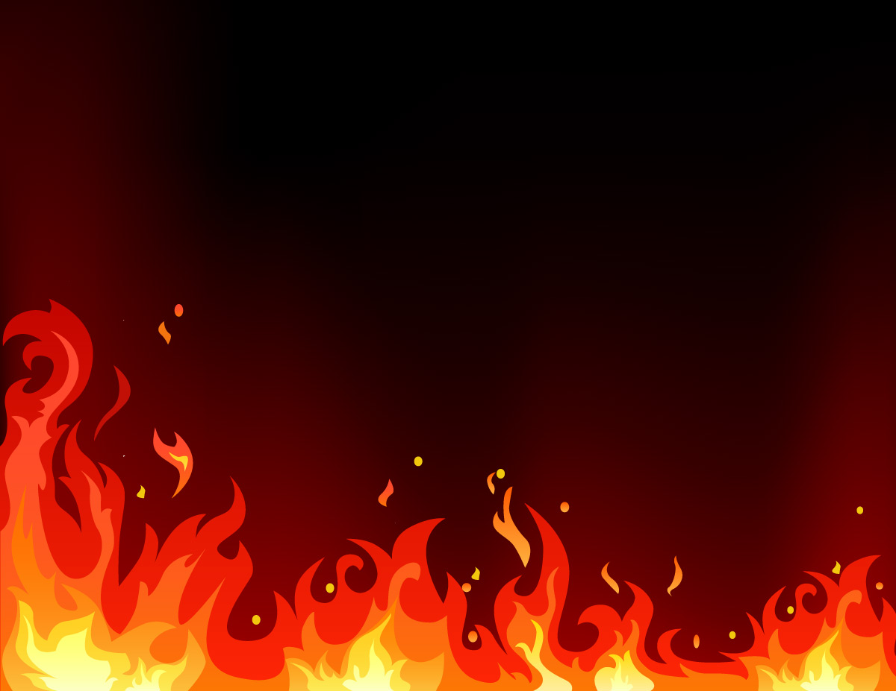
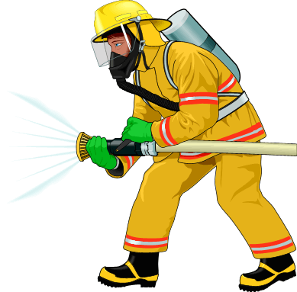
Fire Safety
Never play with fire
Get out and stay out
Test your smoke alarms weekly
call 999 ONLY in an emergency
Close your internal doors at night
Have working smoke alarms on every floor of your property

Slide 2
Night-time routine quiz
Turn off all your electrics at night?
Close all internal doors at night before bed?
Have a working phone upstairs
Make sure house keys are in a safe place
Make sure your exits are clear?

Slide 3
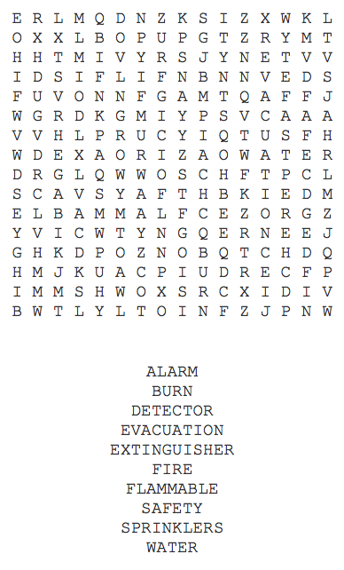
Fire Prevention

Slide 4
HOME SAFETY RULES
Put away _____ after playing to keep floors and steps clear and safe from falls.
Do not use the oven, stove or microwave unless an _____ helps you.
Never _____ with matches, Irons, Toasters or Candles.
Every home should have working _____ alarms.
_____ that is cooking should be carefully watched.
Call _____ in an emergency.
PLAY
SMOKE
999
TOYS
FOOD
ADULT

Slide 5
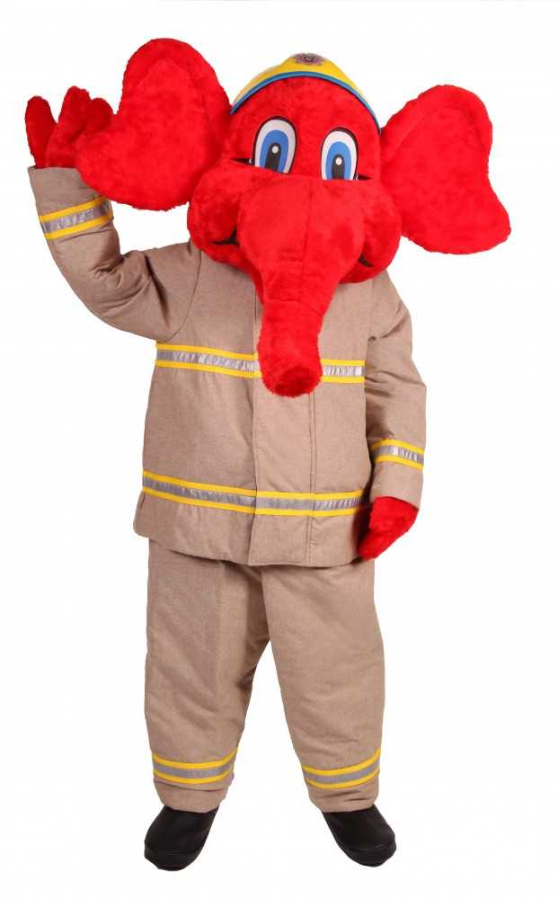

Slide 6
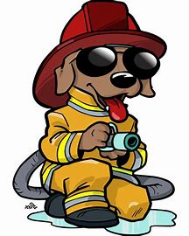
Fire Safety Certificate
I have learned about fire saftey and what to do if there is a fire.
I will follow fire safety rules to keep my family and myself safe.
Awarded to ______________________
Teacher_________________
Date:__________

