Slide 1
Infants Maths Evening
Welcome, thank you for coming.
A short presentation to discuss the progression in Mathematics education from Reception (Early Years Foundation Stage) through to the end of KS1.
Question and answer session.

Slide 2
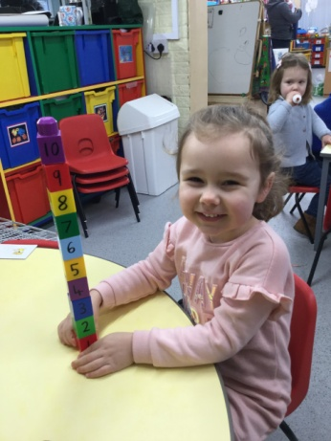
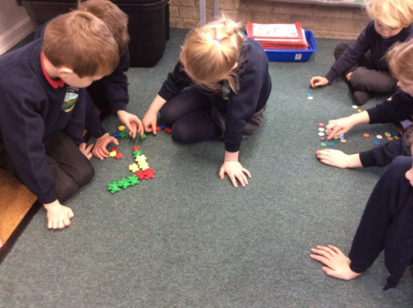
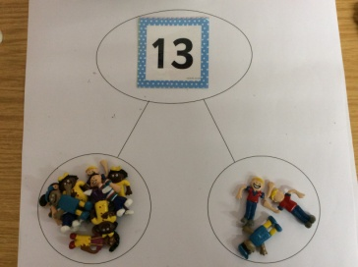
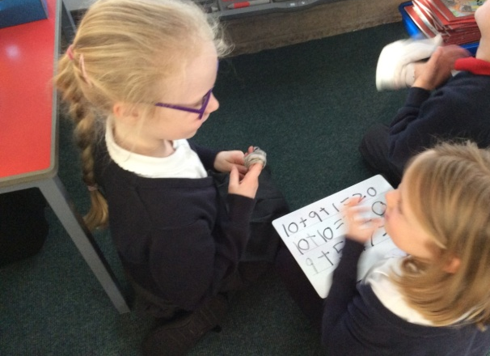
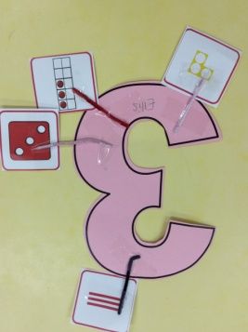
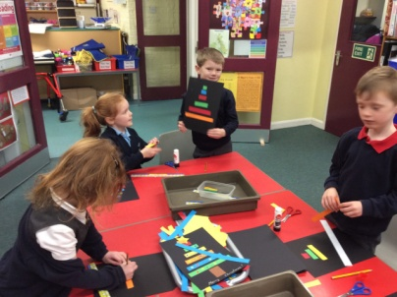
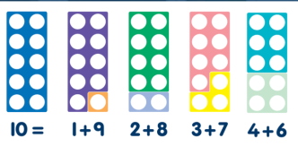
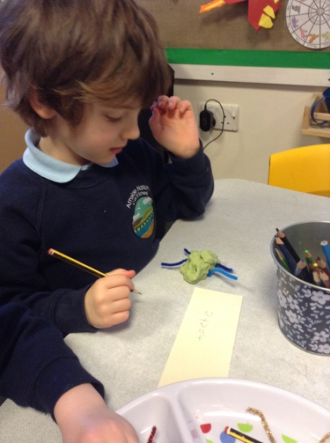
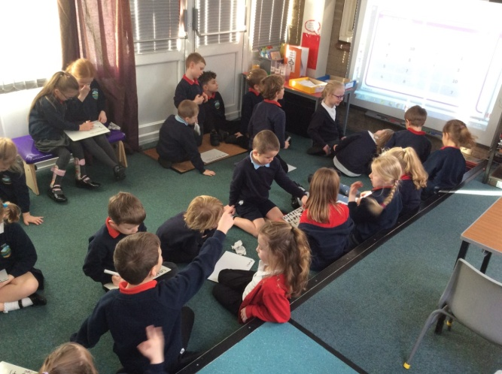
Maths at Arnside!
Notes:
A few examples of what Maths looks like

Slide 3
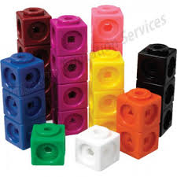
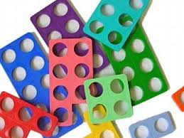
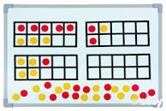
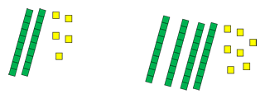
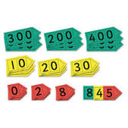
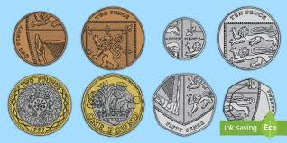
Using the resources, make the number 34.
Notes:
MC

Slide 4
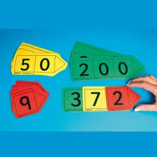
Place Value
Place value is at the heart of the number system. All digits have a value and a secure understanding of this will enable children to use and understand different calculation methods.
We always talk about what each digit in a number represents.
E.g. 34 – The 3 represents 3 tens, the 4 represents 4 ones.
Notes:
Sj

Slide 5
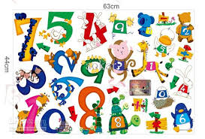
Number Sense!
Children need to understand the number system, starting with counting numbers, building an understanding of how our numbers work and fit together. This includes exploring place value and comparing and ordering numbers. Then
applying this understanding in different contexts.
Notes:
MC

Slide 6
Progression in addition

Slide 7
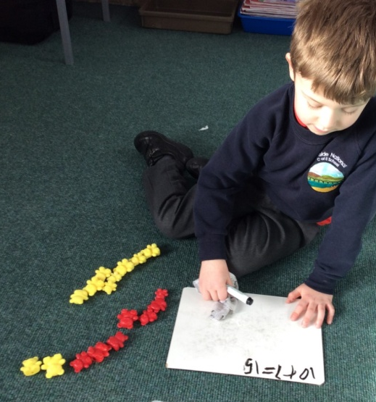
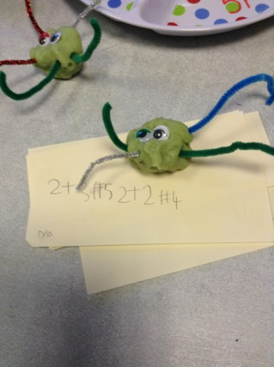
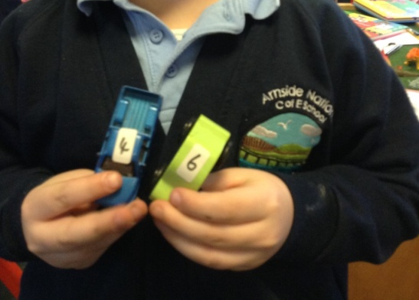
Examples
Year 1
Year 2
Reception

Slide 8
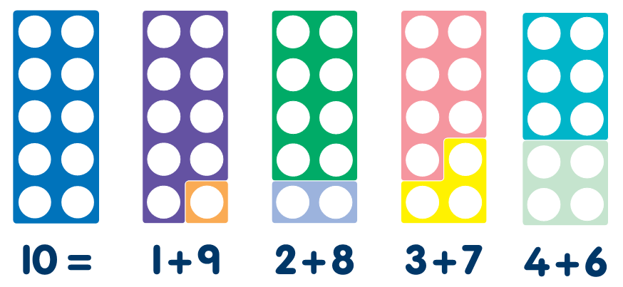
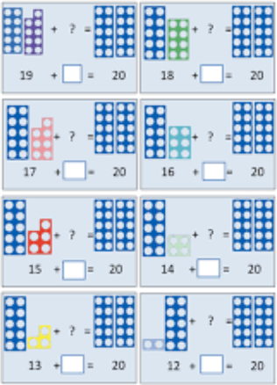
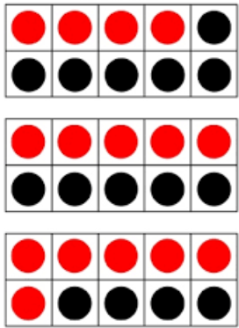
Number bonds to 10 & 20
Notes:
SJ

Slide 9
Progression in subtraction

Slide 10
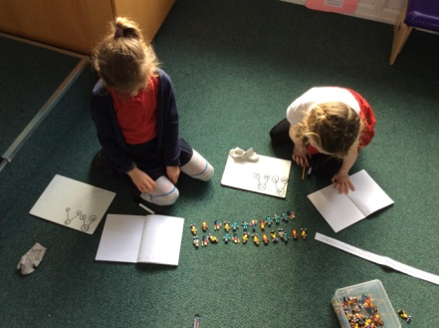
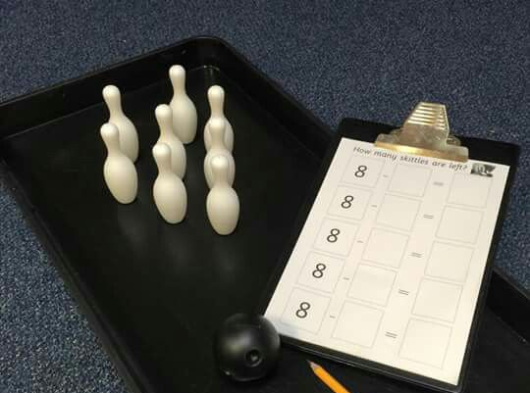
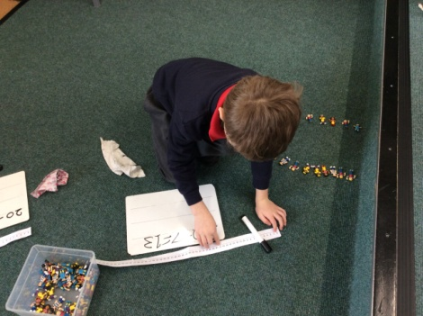
Examples
Reception
Year 1
Year 2

Slide 11
Progression in multiplication

Slide 12
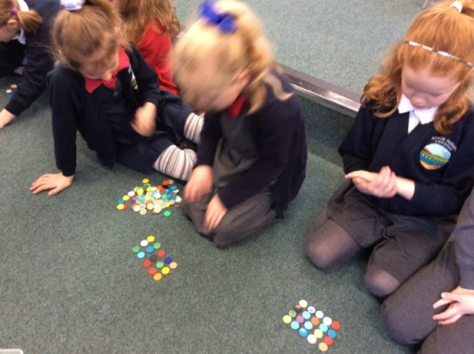
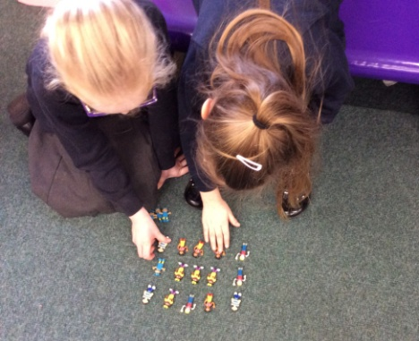
Examples
Reception
Year 1
Year 2

Slide 13
Progression in division

Slide 14
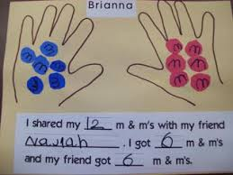
Examples
Reception
Year 1
Year 2

Slide 15
Money and Time

Slide 16
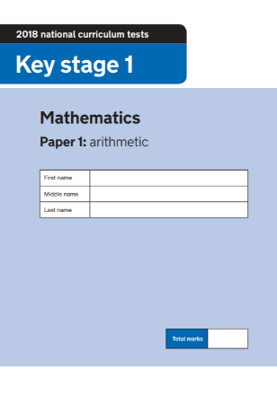
End of KS1 SATs
At the end of KS1 (Year 2) children will take their end of KS1 SATs.
This is done in school, with their class teachers. Children are encouraged to do their best.
The children complete 2 Maths papers, 2 Reading papers and 2 SPaG papers. This is spread out throughout two weeks.
The Maths SATs consist of an arithmetic paper and a reasoning paper.
The Arithmetic paper which contains 25 questions. Children will have 20 minutes to complete this although this is not strictly timed.
The Reasoning paper consists of 35 questions which can be read out to the children. The children have 30 minutes to complete this, although this is not strictly timed.
Notes:
SJ

Slide 17
Purple Mash

Slide 18
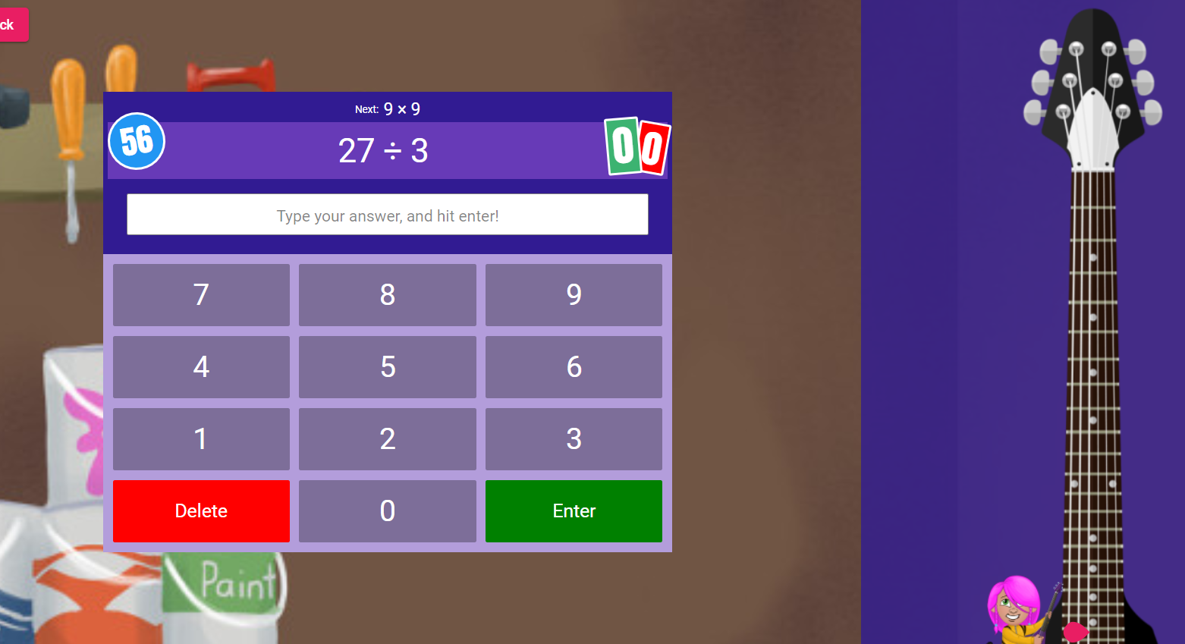
Times Tables Rock Stars

Slide 19
Questions

Slide 20
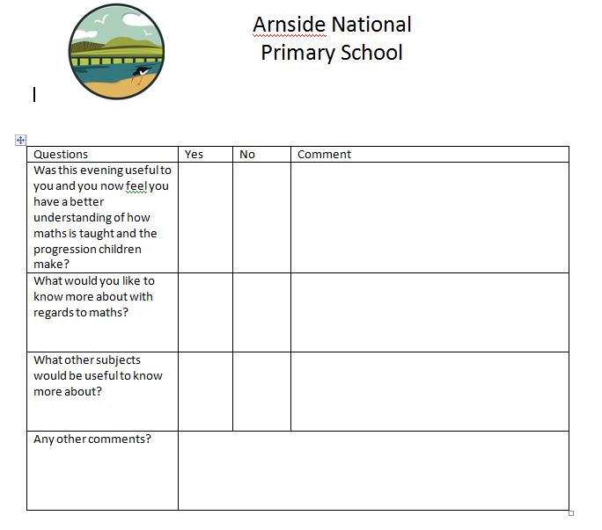
Feedback

