Slide 1
SEND Parents Meeting
14th June 2023

Slide 2
How does the school know if children/young people need extra help and what should I do if I think a child/young person may have special educational needs?
As a school, we measure children’s progress in learning against the National expectations and age related expectations.
The class teacher continually assesses each child and notes where they are improving and where extra support is needed. We track pupil’s progress from entry at Reception through to Year 6.
Children who are not making the expected progress are discussed at review meetings with Class Teacher, SENDCo, Deputy Head and Head Teacher. In this meeting a discussion takes place concerning why individual children are experiencing difficulty and what further support can be given to aid their progression.
You are welcome any time to make an appointment to meet with either the class teacher or the SENCo and discuss your child’s progress.

Slide 3
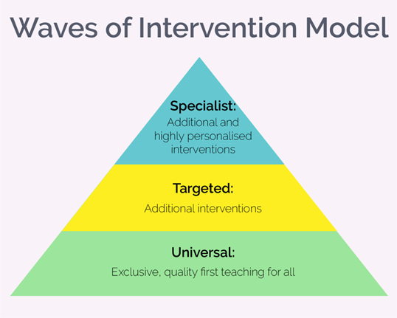
How will school staff support my child/young person?
Each pupil’s education programme will be planned by the class teacher. It will be differentiated accordingly to suit the pupils’ individual needs. This may include additional general support by the teacher or teaching assistant in the class.
Quality First Teaching
This involves different teaching styles/strategies, differentiated learning, different activities, different outcomes or different levels of support from Highly Trained Teaching Assistants in the classroom.
Intervention Programmes
We run a number of different small group intervention
programmes and booster sessions for a range of learners
in each year group depending on their individual needs.
.

Slide 5
How will I know how my child/young person is doing and how will you help me to support my child’s learning?
If your child is on the SEN Register they will have an Individual Education Plan (I.E.P) which will have targets and objectives set out for that term.
The I.E.P will outline strategies to help support the child at school and at home.
An I.E.P Review Meeting will be scheduled twice yearly to review the objectives/targets. New targets will be set and a new I.E.P will be written in discussion with parents.
We work in partnership with Cumbria Children’s Services who organise parent training/learning events to help support parents.

Slide 6
Individual Education Plan (I.E.P)
Name: | DOB: | IEP Date: | Stage:
Objectives/Need | Targets | Action/Strategies | Outcome – to be completed at review

Slide 7
What if we require specialist advice?
Early Help Assessment
Early Help is the response made when a professional identifies unmet needs with a child/family and works with other agencies to meet those needs.
At this level of need an Early Help Assessment - Signs of Well-being and Success (EHA) should be completed with the child and family to identify, what is working well, what the worries are and what wellbeing and success would look like? A clear plan will be developed by the agencies with the family that is SMART and is focused on what success will look like for the child/ren.

Slide 8
What specialist services and expertise are available or accessed by the school?
As a school we work closely with a number of external agencies that we feel are relevant to individual children’s needs including: Speech and Language therapists, Specialist Advisor Teacher for children with SEND, Play Therapist, Educational Psychologist, Bereavement Services, Physiotherapist Advice and Support, School Nurse.

Slide 9
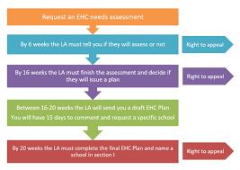
Education Health Care Plans (EHCP)
What is an EHCP?
An Educational Healthcare Plan (EHCP or EHC) is a legal document that sets out the education, healthcare and social needs of a child or a young person who requires extra support in school beyond what the school can provide.
Previously this was known as a "Statement of Special Educational Needs".

Slide 10
How will I be involved in discussions about and planning for my child’s education?
All parents are encouraged to contribute to their child’s education. This may be through:
Discussions with the class teacher
During parents evenings
Discussion with Miss Morris or other professionals Parents are encouraged to comment on their child’s IEP with possible suggestions that could be incorporated.

