Slide 1
Science Staff Meeting Spring 2023

Slide 2
Science Learning Walk feedback
Thank you
Engaged and excited
Activation of prior knowledge
Misconceptions addressed
Key vocabulary introduced
Big Questions and updated displays

Slide 3
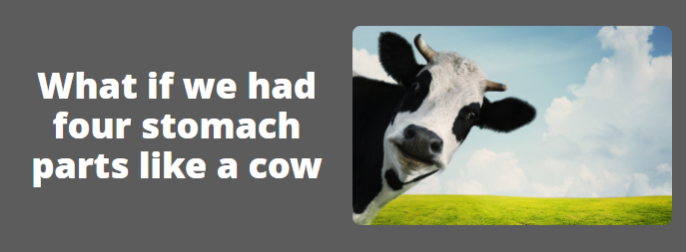
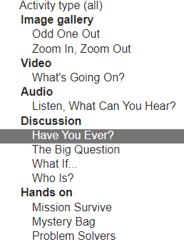
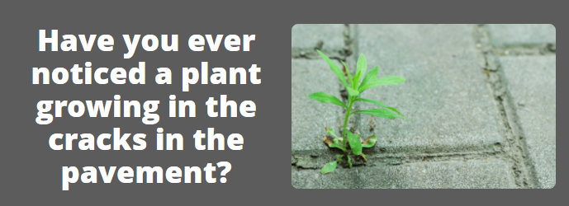
Skip a beat - Explorify

Slide 4
Planning and assessing
Substantive knowledge
What are we planning for and assessing?
Working Scientifically Skills
Disciplinary knowledge
Types of Enquiry

Slide 5
Science book scrutiny
What skills can we see developing?
Is there progression?
Do the children become more independent?
Where is the ‘working scientifically’?

Slide 6
Working Scientifically Skills-disciplinary knowledge
Asking simple questions and recognising that they can be answered in different ways
Observing closely, using simple equipment
Performing simple tests
Identifying and classifying
Using their observations and ideas to suggest answers to questions
Gathering and recording data to help in answering questions
These are the skills that we want children to gain and apply whilst gaining the knowledge.
We have to achieve these objectives a few times over the entire year. We do not have to fit every objective in in every topic but make we need to make sure we cover each one a few times per year.

Slide 7
Scientific Enquiry
The practical element of science when they are working scientifically can be categorised into at least one of the five different Scientific Enquiry types.

Slide 8
What and how will we assess?
Prior Knowledge
Thought showers at the beginning of each unit
Concept cartoons
KWL chart – What I know
Explorify task
Formative Assessment of knowledge
Diagrams
low stakes quiz
Add to thought showers in a different colour
KWL chart – What I want to know
Assessment quiz on Developing Experts
Concept cartoons
Explorify
Summative Assessment of knowledge
Developing Experts end of unit test
KWL – What I have learned
Add to thought shower in a different colour
Answer big questions
Cold tasks (e.g. finish a drawing or diagram, when given a small part)
Formative and Summative Assessment of Working Scientifically
Observations during experiments
Scientific write ups
TAPs focused assessments

Slide 9
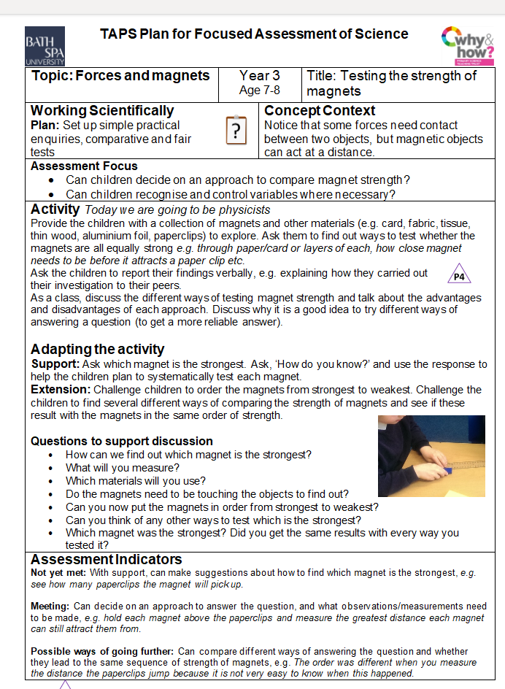
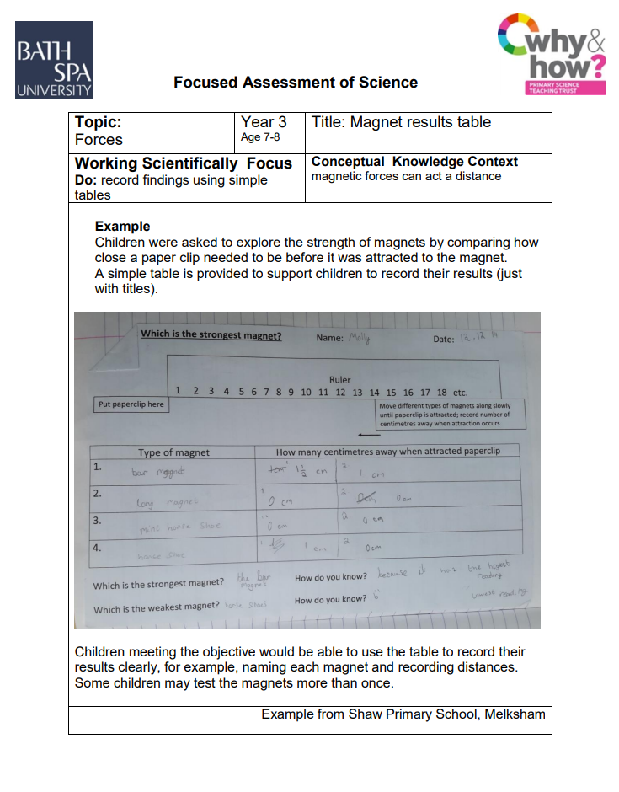
TAPs Focused Assessment Plans

Slide 10
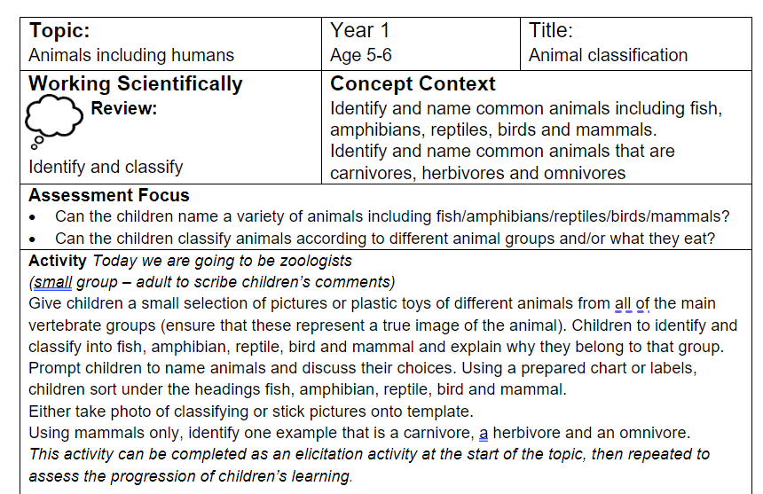
Year 1 TAPs Focused Assessment

Slide 11
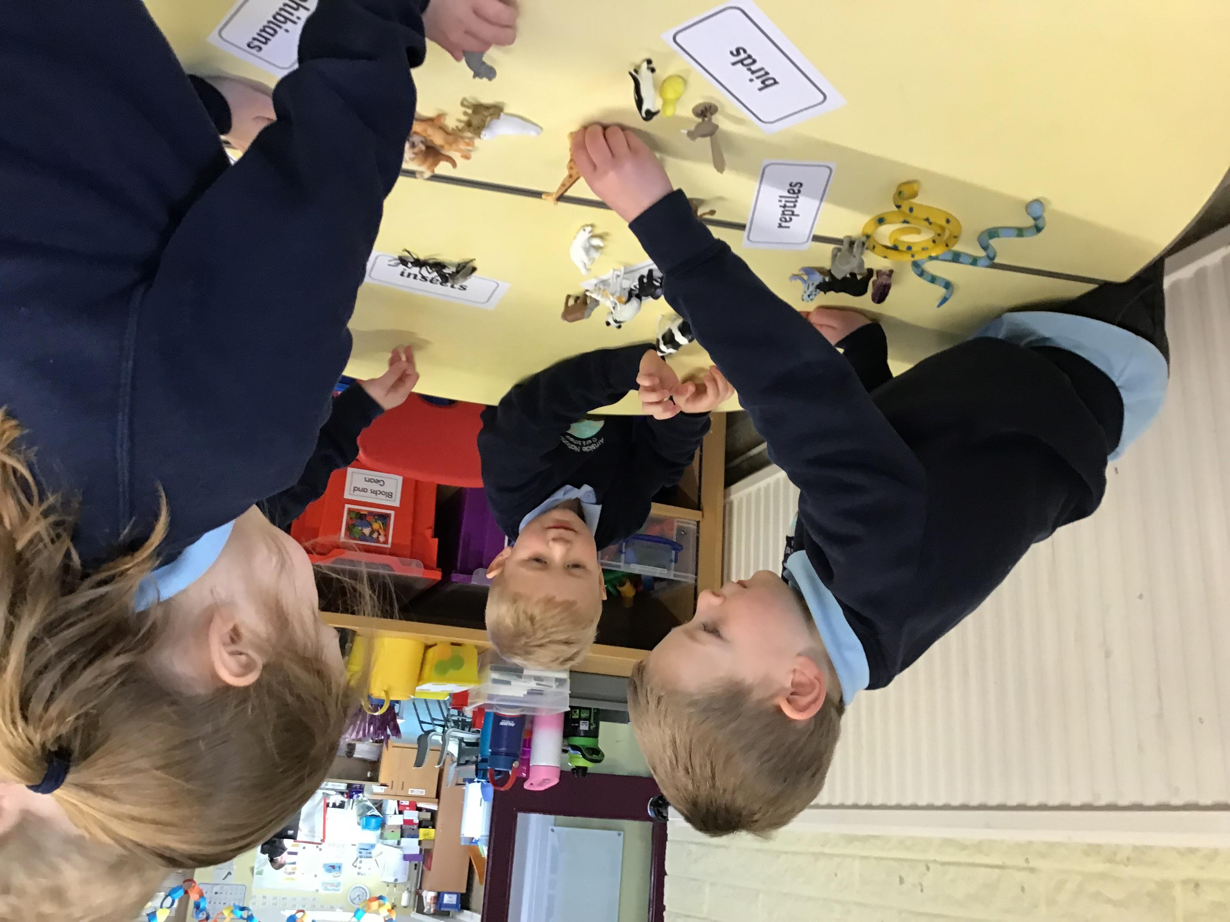
Year 1 TAPs Focused Assessment
‘I think it is a mammal, it has a little fur.’
‘A penguin is a bird’
Which animal has scales? Jack
Harper, ‘Fish’.
Matthew ‘What are scales?’
‘Tigers eat meat’
T - What type of eater are they? ‘carnivore’
‘Dogs eat biscuits, meat and vegetables’ ‘omnivore.’
‘A seal is a mammal. Mammal has fur, breathes air.’
‘I think a snake goes in the reptiles’ Matthew.
‘Yeah, because they are cold-blooded.’ Jack
‘Giraffes eat leaves.’
‘They are herbivores.’
‘A shark has scales’
‘I think a frog is an amphibian.’

Slide 12
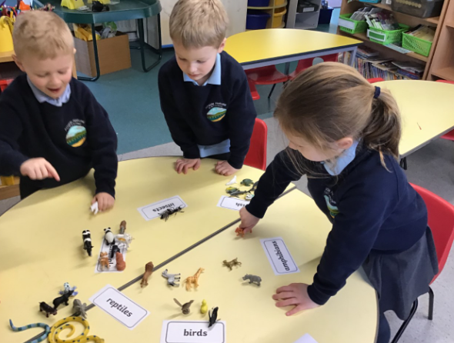
Year 1 TAPs Focused Assessment
T ‘Why does a hippopotamus go here? (Reptiles).
‘They are cold-blooded’.
‘What is a turtle?’ Robert
‘A fish’ Matthew
A poison dart frog is a reptile.
‘No, dogs aren’t amphibians, they don’t have scales.

Slide 13
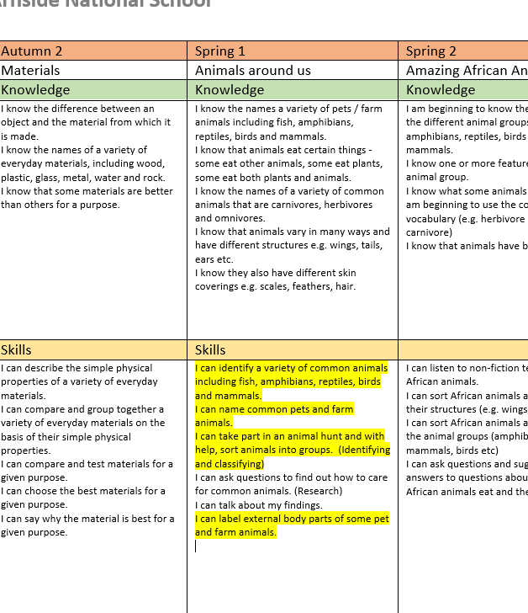
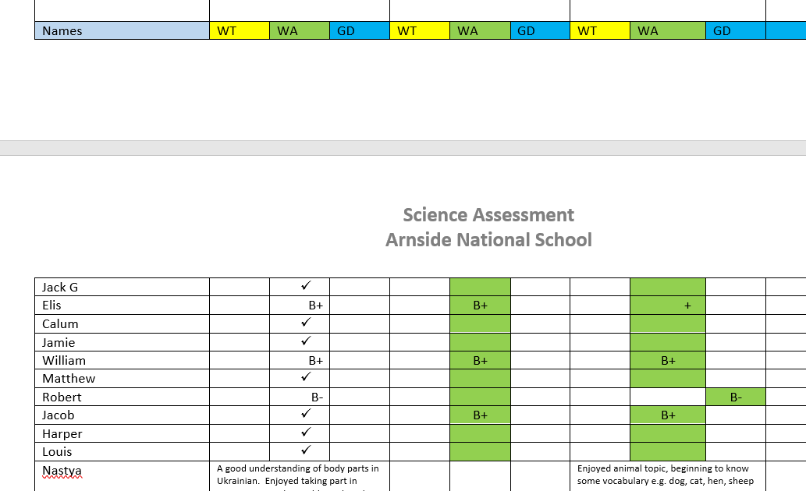

Slide 14
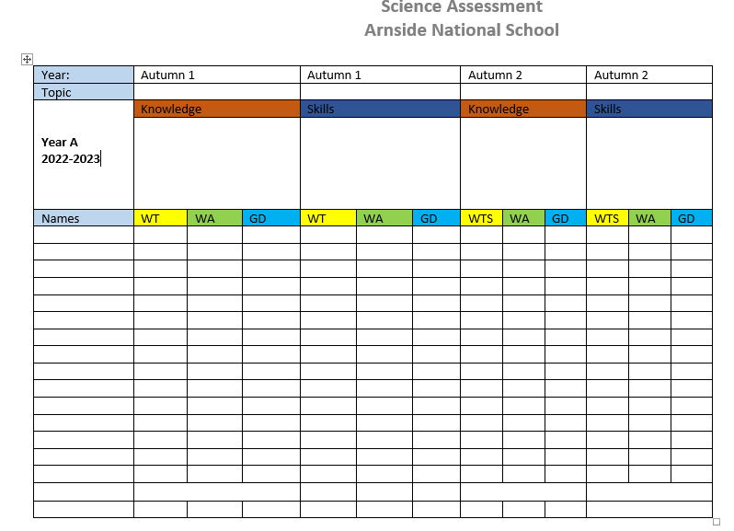

Slide 15
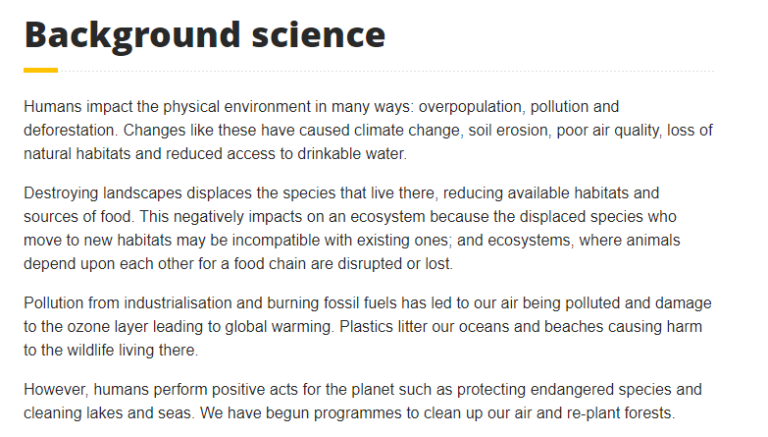
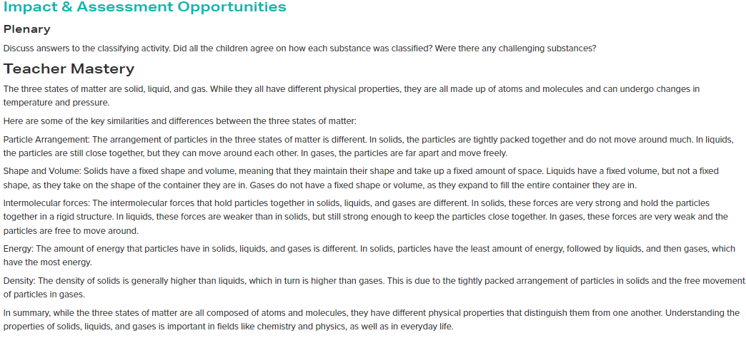
Science support
Primary Resources Science | Reach Out CPD

Slide 16
Thank you!

