Slide 1

Tapestry Online Learning Journal

Slide 2
What is Tapestry?
Tapestry is an online learning journal system
There is an app and browser version available
We can use it to record children’s learning and development using tablet devices and PCs
We can set you up as parents with your own secure logins so you can view and add your own observations to your child’s journal
When your child leaves, we can export a PDF copy of your child’s journal and a ZIP file including photos and videos for you
If they move to another setting also using Tapestry, their journal can be transferred across as well as your account

Slide 3
Why are we using Tapestry?
It creates a two way communication between staff and you
We can upload media, meaning you can see pictures and videos of what your child is doing whilst they are with us
There are greater opportunities to extend your child’s learning at home – you can add your own observations to show us their interests and achievements from home
Unlike a physical, hard copy book, it’s easy to share with groups of relatives, such as extended families, separated parents and relatives living overseas

Slide 4
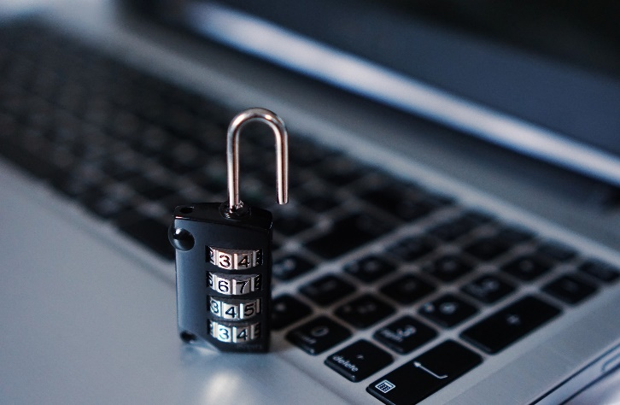
How is the data kept safe?
A password is required to access Tapestry, remember the stronger the password you set, the more secure your account is
You are linked manually to your child/children so you can only view observations for them
We don’t need to store any of the data entered onto Tapestry, they store it for us on secure cloud servers within the EU
Data is stored separately for each school
Tapestry’s developers and support personnel require our permission to access our Tapestry account
For more information about Tapestry security you can go on their website https://tapestry.info/security.html

Slide 5
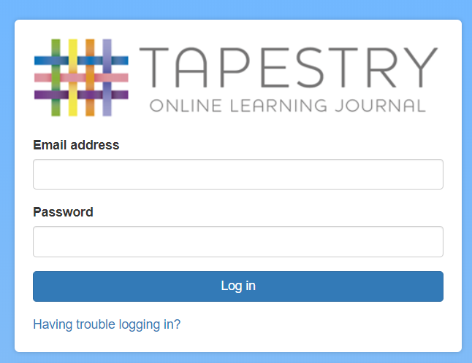
Logging in
To login to Tapestry we will need to have an email address for you
Once you activate your account you can then login using your email and password
You can reset your password by email if you forget it
Passwords are case sensitive
Remember to set a strong password
You can read this article for some guidance on how to set a strong and memorable password https://eyfs.info/forums/topic/47249-password-setting-advice/

Slide 6
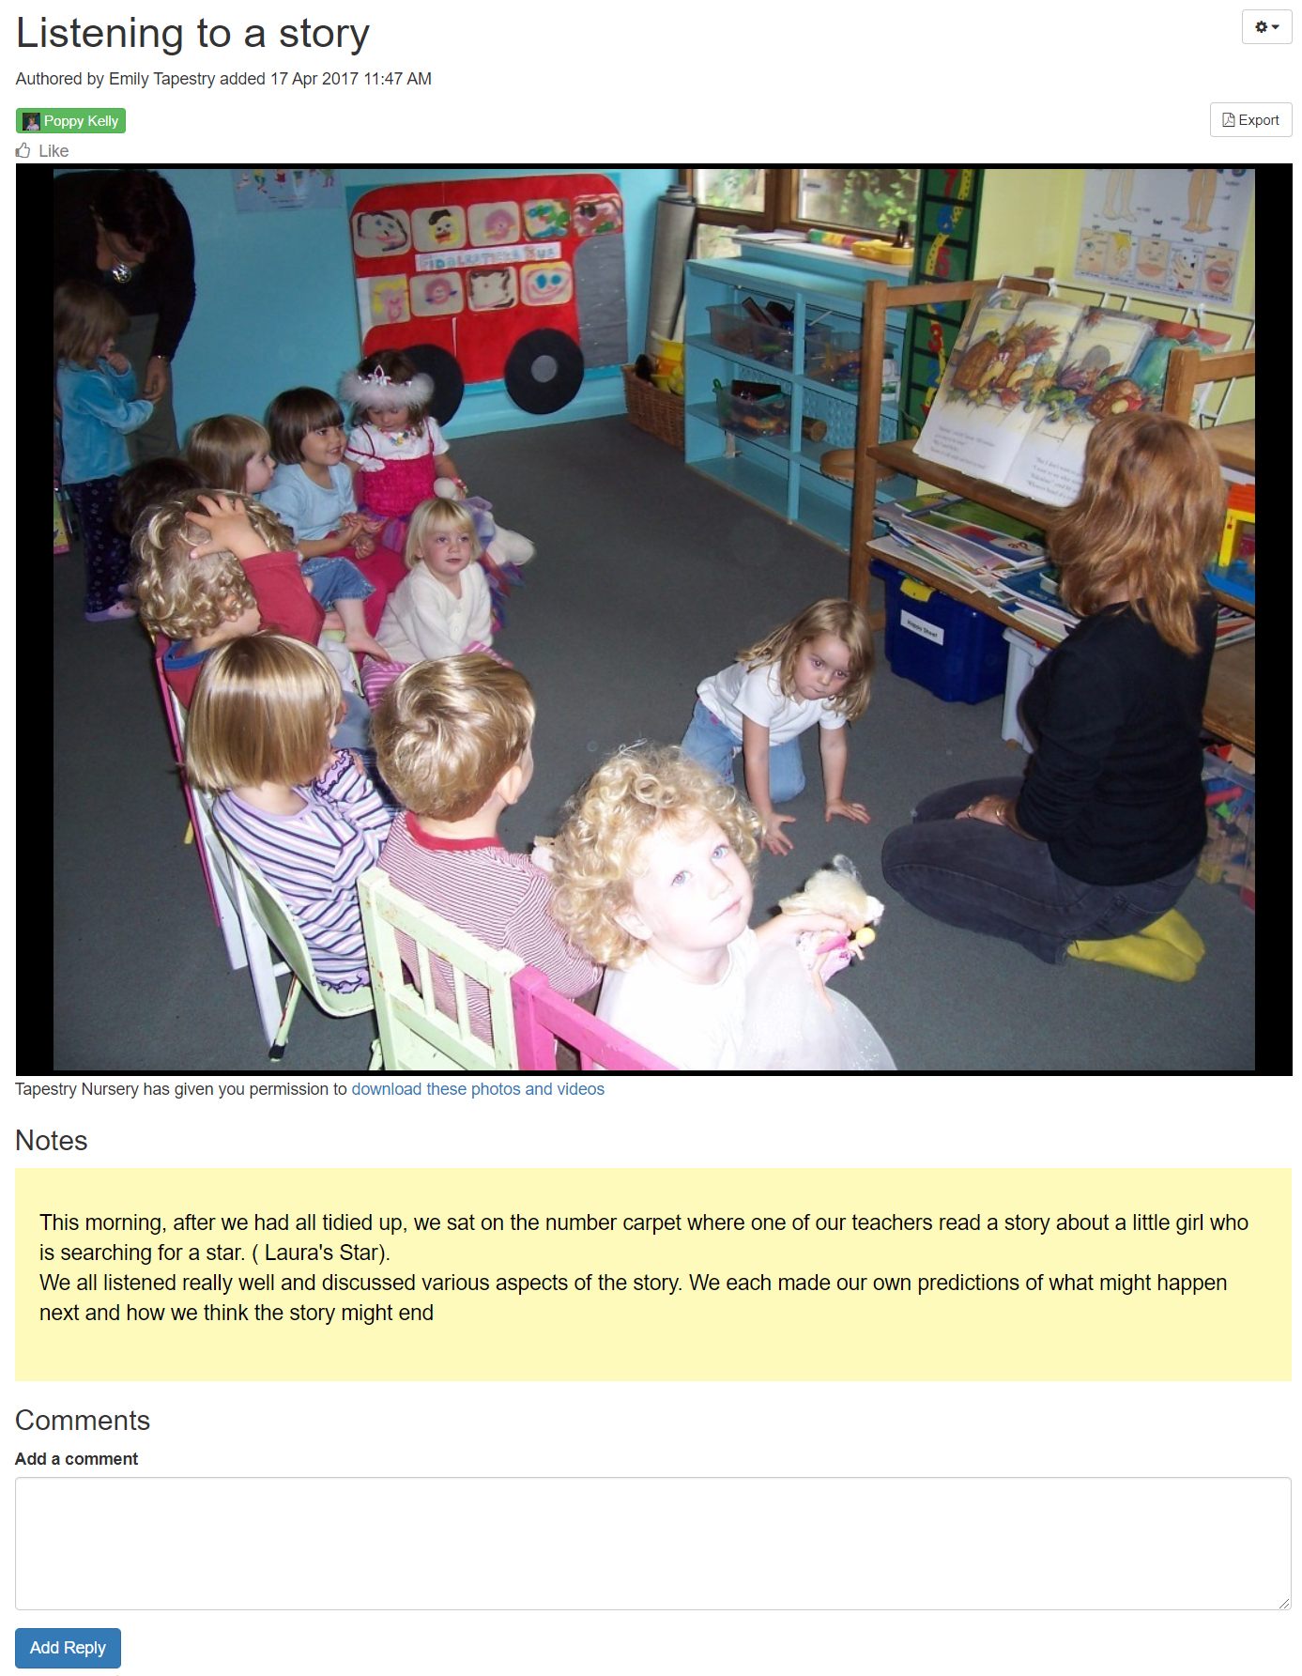
Observations
When you login to your account you will be able to see any observations for your child that have been added to their journal
Underneath the media you may also see any notes we have added
:You will also be able to add comments and like the observation
You can also add your own observations

Slide 7
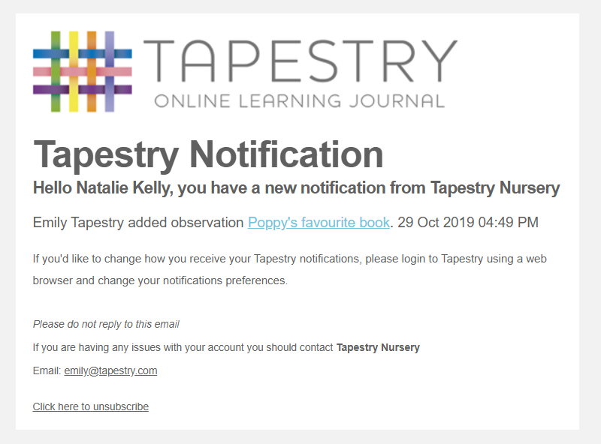
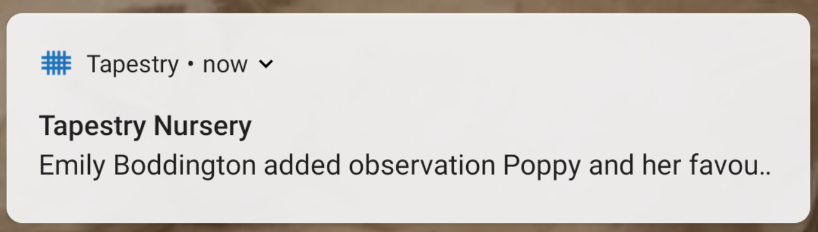
Notifications
If you would like to receive notifications it’s possible to receive email notifications immediately, daily or weekly
There are different notifications for things like new observations and observation comments
On the app (only on the new version) you can also receive push notifications

Slide 8
When will we get started?
We have handed out introductory letters and put our user guides on the class page on our school website
We should have your account ready soon and you will receive an email with the link to set a password for yourself, remember to check your spam/junk folders for this
Please note that it’s not possible for parents to both be set up using the same email address
Please get in touch with us if you have any problems getting started

