Slide 1


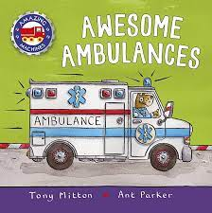


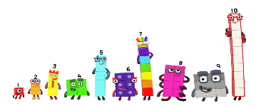


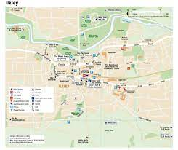

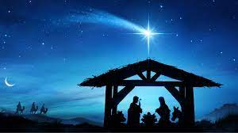

Reception - Autumn Term 2
This half term our topic is 'The Place Where I Live' and we will be finding out about our local community and the people who help us.
If you would like to come and share your job with the children – please let us know! We love having visitors to help bring our learning to life.
Literacy
Write my name correctly.
Begin to form lower case
letters correctly.
Write initial letter sounds in words.
Blend CVC word.
Some activities –Writing
captions, lists, labels
Maths Number
Developing a strong grounding in number is essential so that all children develop the necessary building blocks to excel mathematically. Children should be able to count confidently, develop a deep understanding of the numbers to 10, the relationships between them and the patterns within those numbers
Understanding of the World
Learning about and celebrating festivals.
Recognise that people have different beliefs and show respect for this.
-Bonfire Night
Christmas
Why are these occasions
celebrated?
What traditions do we
have in our own homes?
Personal, Social and Emotional Development
Self-Regulation: Show an understanding of their own feelings and those of others, and begin to regulate their behaviour accordingly; Set and work towards simple goals, being able to wait for what they want and control their immediate impulses when appropriate;
Physical Development
Movement and travelling, using space and negotiating obstacles. Demonstrate strength, balance and coordination
when playing
Work on tripod grip
Pencil control activities
Name writing
Find the pulse
Copy-clap the rhythm of
small phrases from songs.
Explore high pitch and low pitch in the context of the songs. Explore music making. Invent a pattern to go with a song
Communication and Language
Engage in non-fiction books
and use new vocabulary
Finding out about people in
our local area who help us.
Know about different houses
and homes where we live.
Know about some of the important buildings in our local community.
Expressive Arts and Design

Slide 2
Key knowledge and skills for Autumn 2
I can build respectful relationships with my classmates and adults at school
I can use my learning environment safely and respectfully
I know about the Learning Bees – Can Do Bee, Team Bee, Thinking Bee
I understand that some places are special to members of the community
I can orally blend cvc words
Key vocabulary
Can I play with you?
Can I help you?
It is my turn now
Staff roles at school
Examples of people who help us in the community: postman, fire fighter, doctor, nurse, vet, police officer, vicar, builder, refuse collector
Can we remind you that we play out in all weathers so please make sure your child has a warm, waterproof coat each day. Sometimes outdoor clothes do get messy.
If you have any questions, please do not hesitate to ask us in the playground, ‘phone or email me kate.hemming@ashlands.mlt.co.uk

