Slide 2
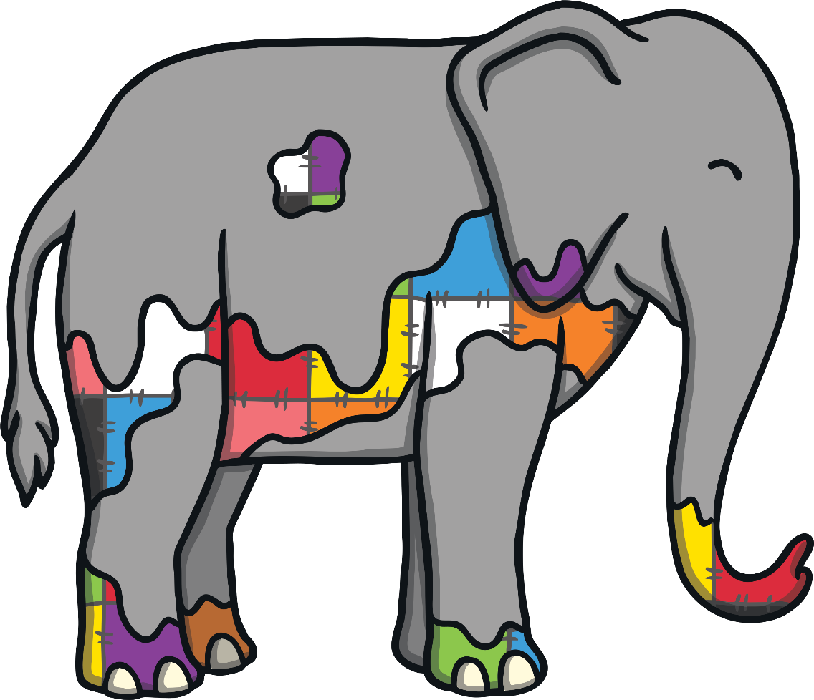
1, 2, 3, 4, 5, berries cover Elmer’s hide.
6, 7, 8, 9, 10, he re-joins the herd, but then….

Slide 3
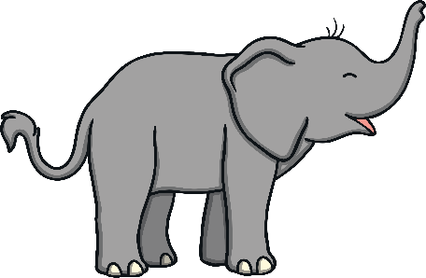
10, 9, 8, 7, 6, is this one of Elmer’s tricks?
5, 4, 3, 2 and 1, elephants having so much fun.

Slide 4
1, 2, 3, 4, 5, rain clouds up above arrive.
6, 7, 8, 9, 10, we see Elmer’s colour then.

Slide 5
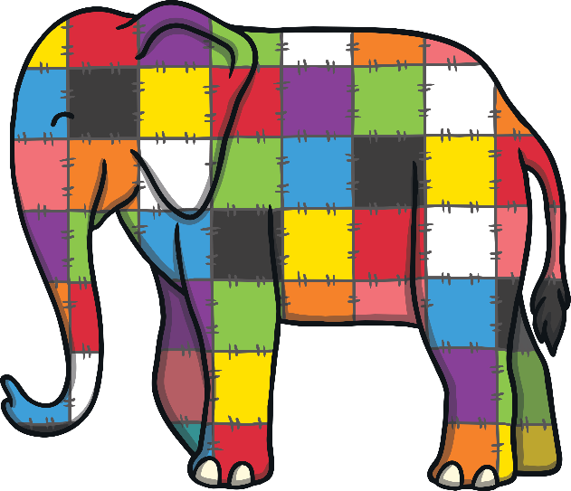
10, 9, 8, 7, 6, is this one of Elmer’s tricks?
5, 4, 3, 2 and 1, elephants having so much fun.

