Slide 1
Lesson 2: Programming sprites
Save a copy
Year 3 – Programming – Sequencing sounds
Notes:
Last updated: 01-07-20
This resource is available online at ncce.io/pg3a-2-s. Resources are updated regularly — please check that you are using the latest version.
This resource is licensed under the Open Government Licence, version 3. For more information on this licence, see ncce.io/ogl.

Slide 2
Lesson 2: Programming sprites
Objectives
To identify that commands have an outcome
I can identify that each sprite is controlled by the commands I choose
I can choose a word which describes an on-screen action for my design
I can create a program following a design

Slide 3
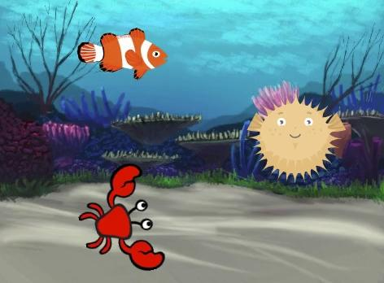
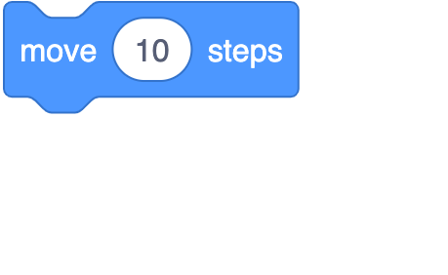
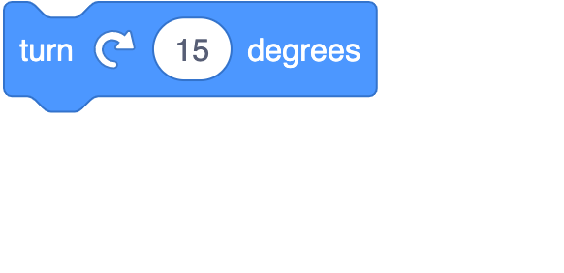
What’s happening in this project?
Introduction
Use the blocks below to write down what you think each sprite is doing.

Slide 4
Answers
Introduction
Fish
Crab
Pufferfish

Slide 5
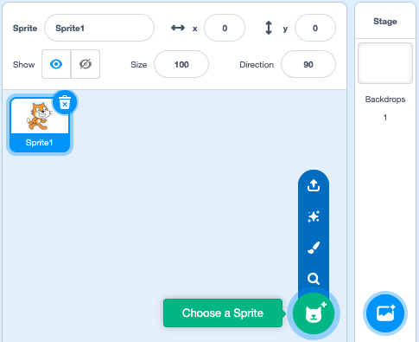
Adding a sprite
Activity 1
Click on the ‘Choose a Sprite’ button
Click on the sprite you want to choose

Slide 6
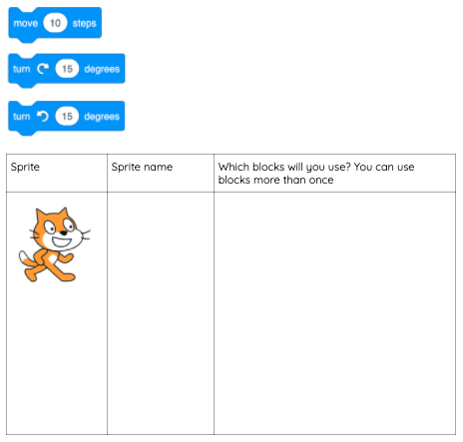
Designing your project
Activity 1
Which motion blocks will you use for each sprite?
Choose one motion blocks for each sprite:
Cat
Turn 15 degrees ↺

Slide 7
Plan your own movement
Activity 1
Use the same blocks to plan your own movement (one block per sprite).
Describe what you think your sprite will do.

Slide 8
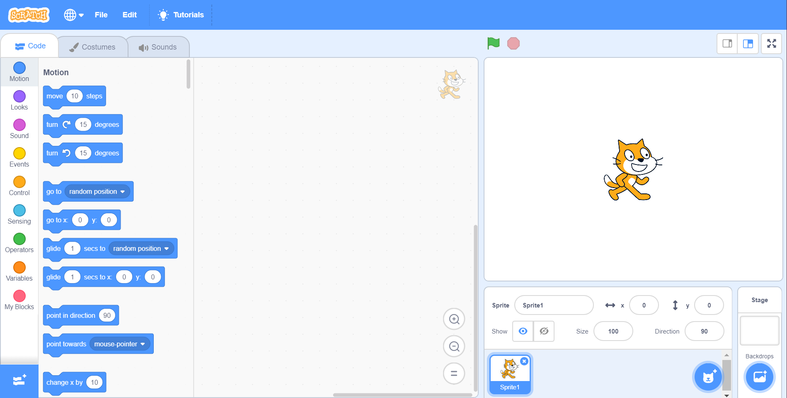
Now code your project
Activity 1
Click on your blocks to run the code. Did the sprite do what you wanted?

Slide 9
Moving more than one sprite
Activity 2
Delete Scratch the cat
Add three new sprites (hint: they are all animals)

Slide 10
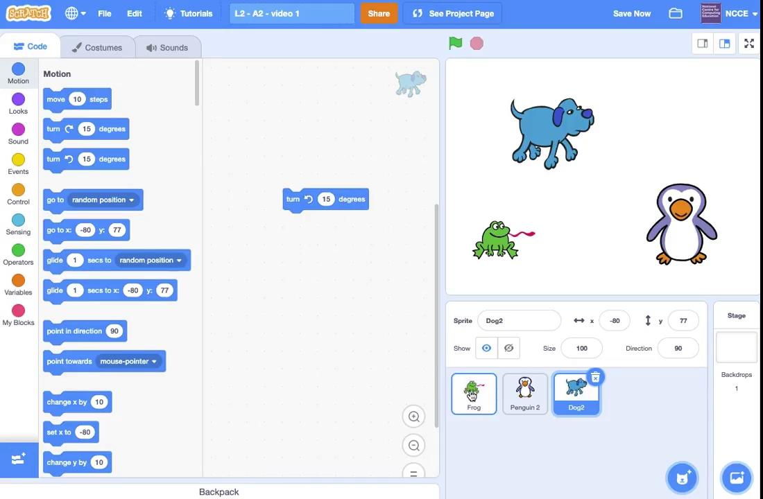
Adding motion to multiple sprites
Activity 2A

Slide 11
Follow this program design
Activity 2
 | Make the frog move 10 steps
 | Make the penguin turn clockwise
 | Make the dog turn anticlockwise

Slide 12
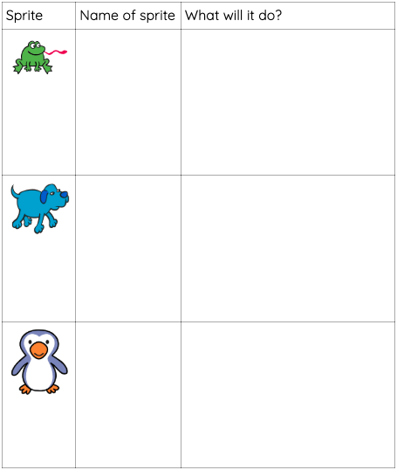
Exploratory task
Activity 2
Plan your own movement for these three sprites and code it!

Slide 13
Exploring more motion blocks
Activity 3
Try these blocks.
How are they different to the blocks you have already used?
What happens if you change the numbers within the blocks?

Slide 14
Match the blocks to the outcome
Activity 3
Sprite moves slowly to another part of the stage
Sprite points downwards
Sprite moves suddenly to another part of the stage

Slide 15
Ordering motion blocks
Plenary
This project uses three motion blocks. Which set of blocks are in the right order?
A
B
C

Slide 16
Assessment
How confident are you? (1–3)
I can identify that each sprite is controlled by the commands I choose
I can choose a word which describes an on-screen action for my design
I can create a program following a design
3 – Very confident
2 – Unsure
1 – Not confident
Notes:
Image source: https://pixabay.com/vectors/thumb-up-hand-like-confirm-go-top-307176

Slide 17
Next lesson
Summary
In this lesson, you…
Designed and planned motion for sprites in Scratch and explored new motion blocks.
Next lesson, you will…
Combine blocks to create sequences and look at ways to set up a program

