Slide 1
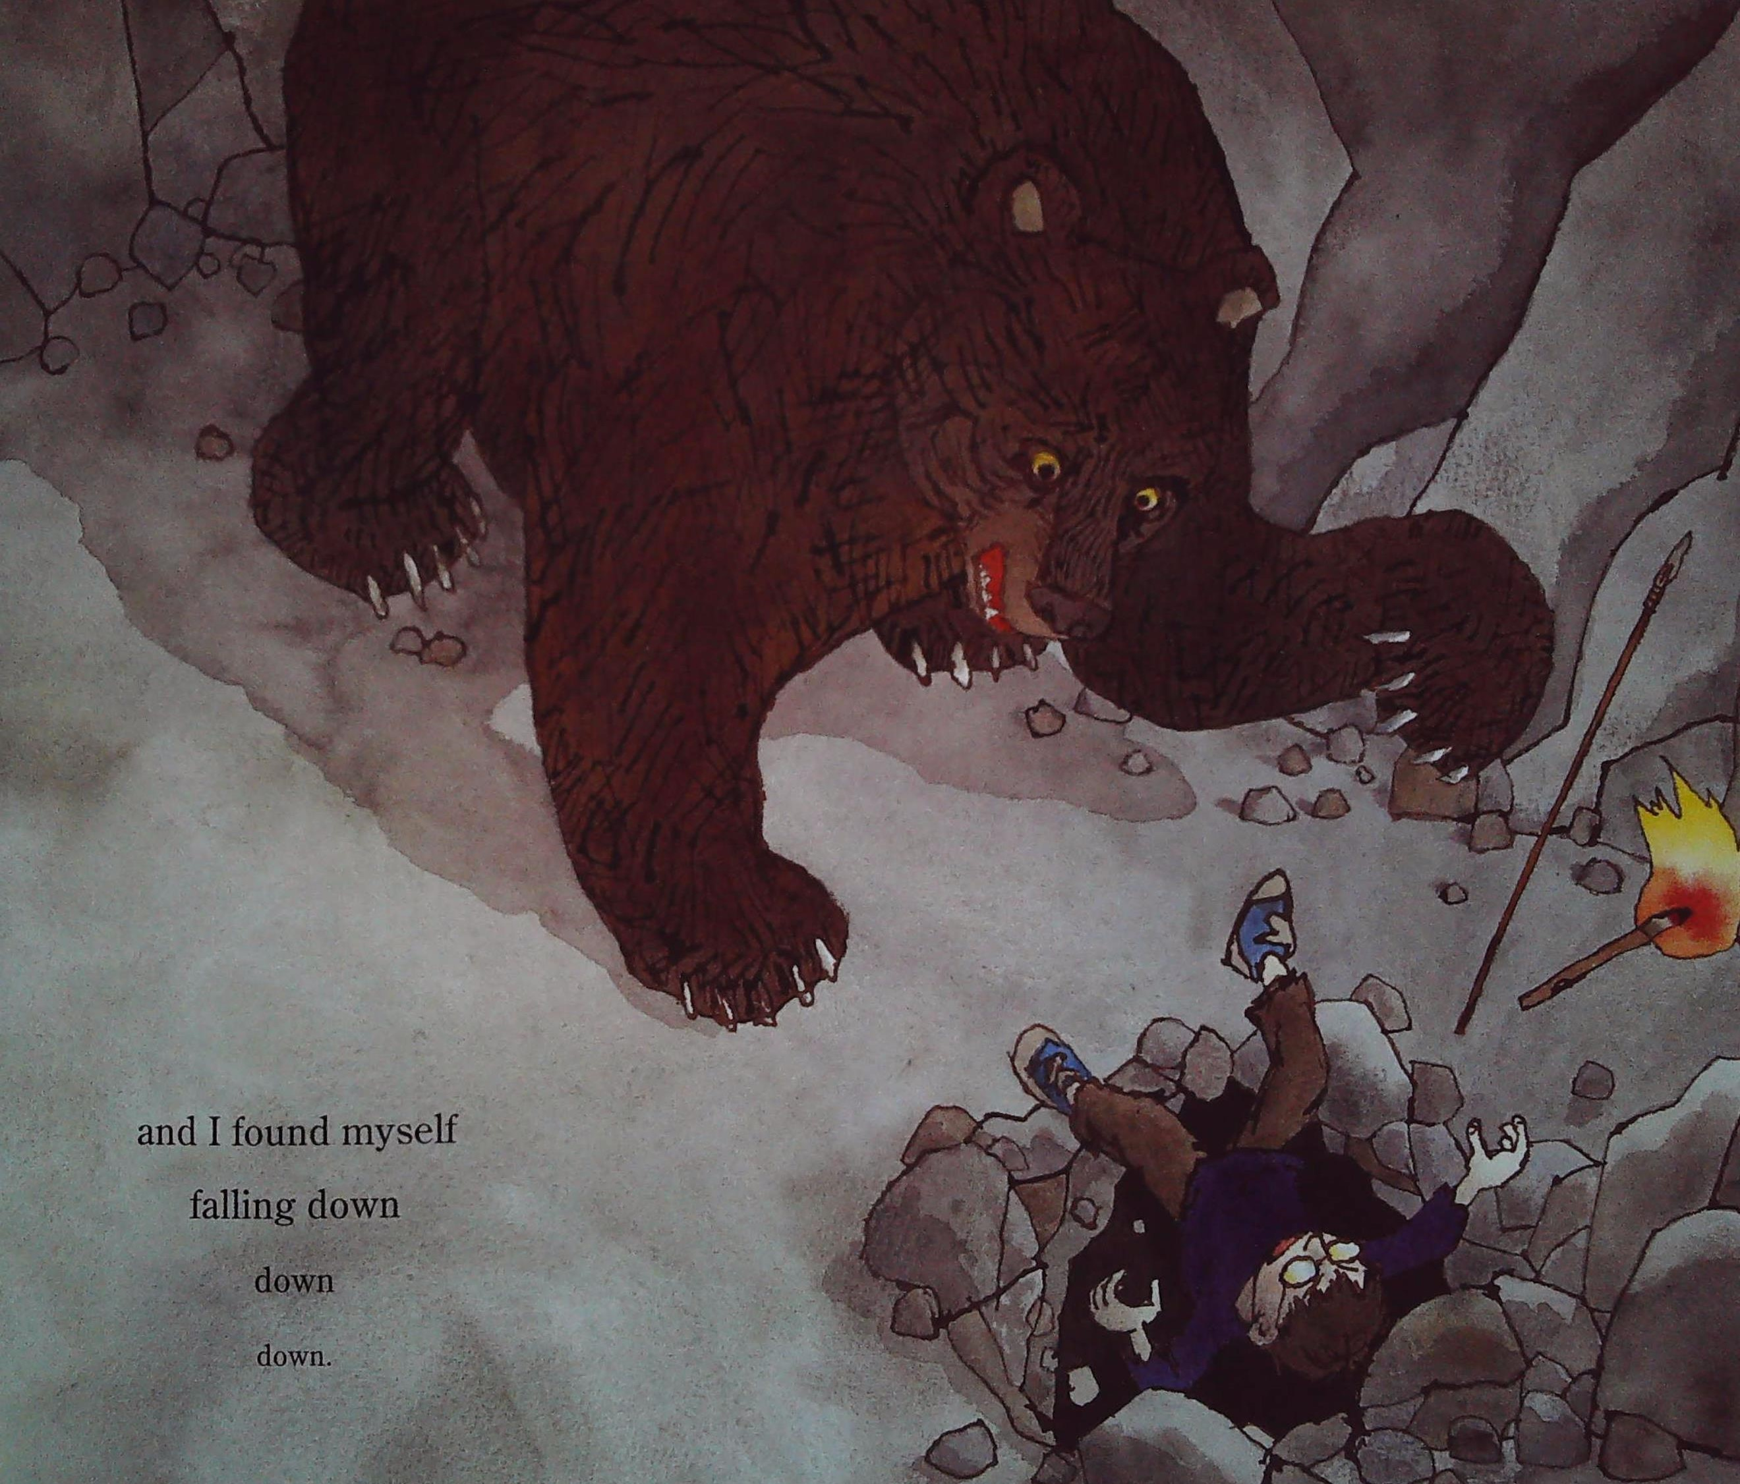

Slide 2
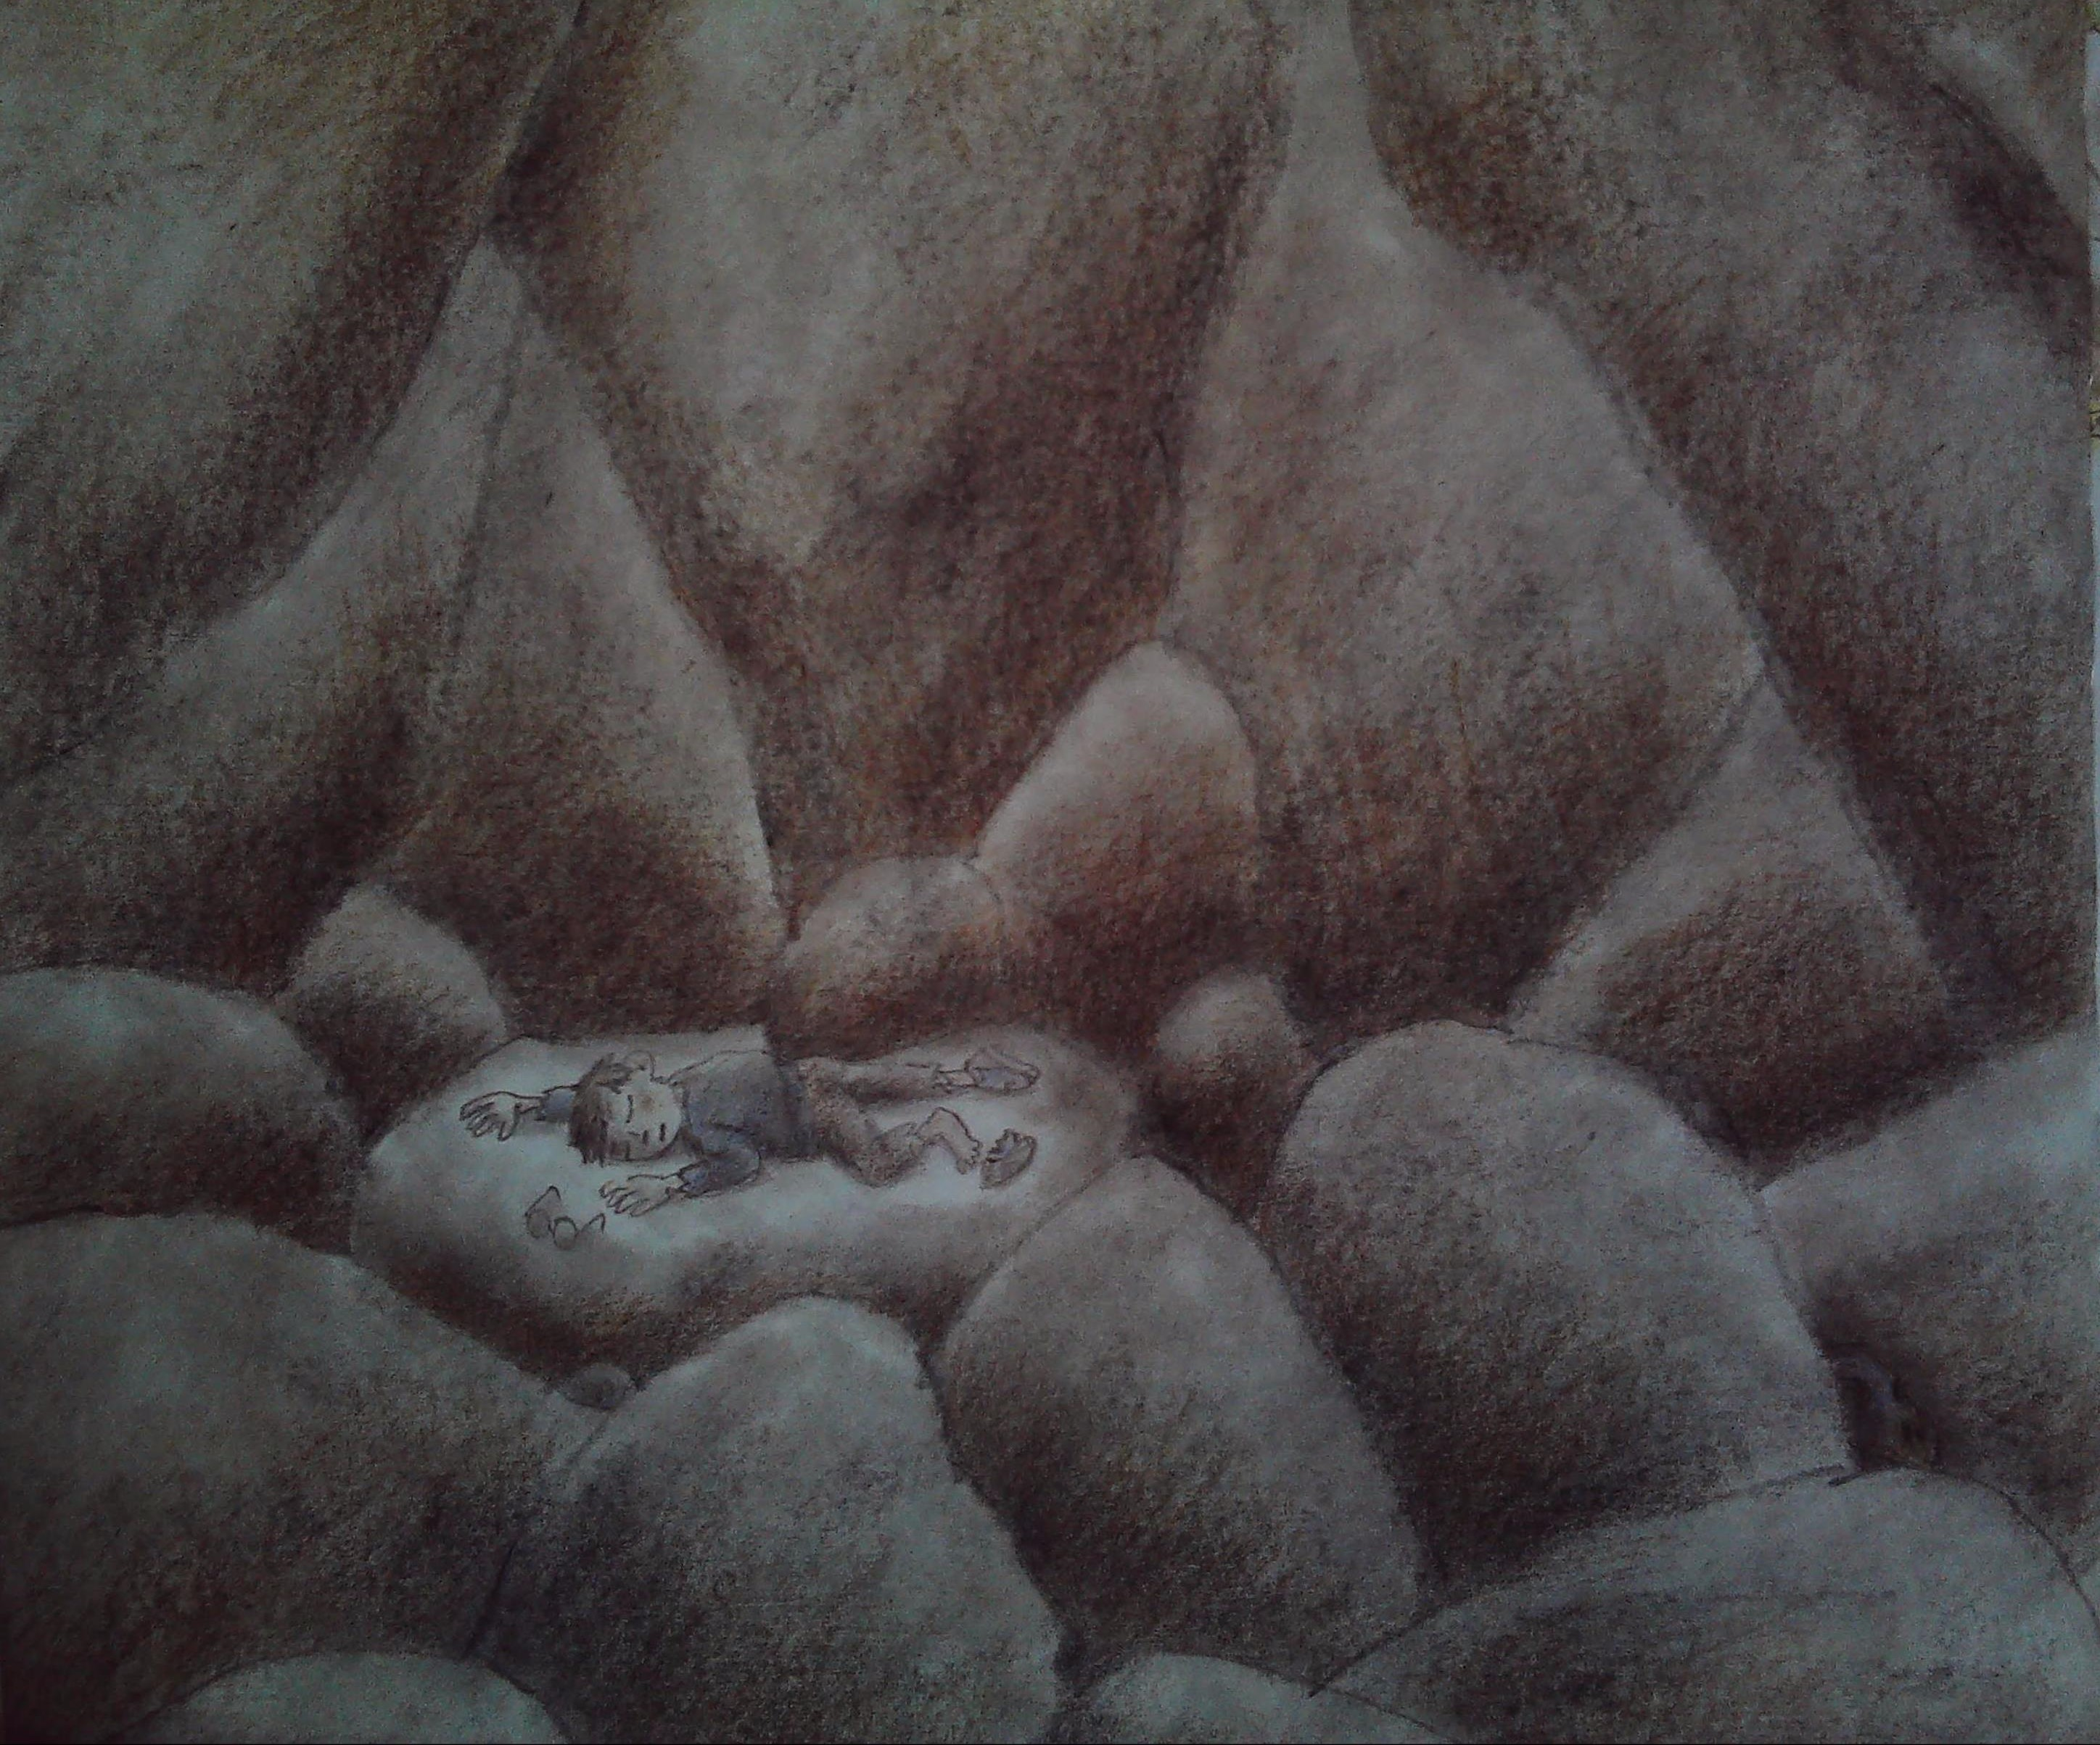

Slide 3
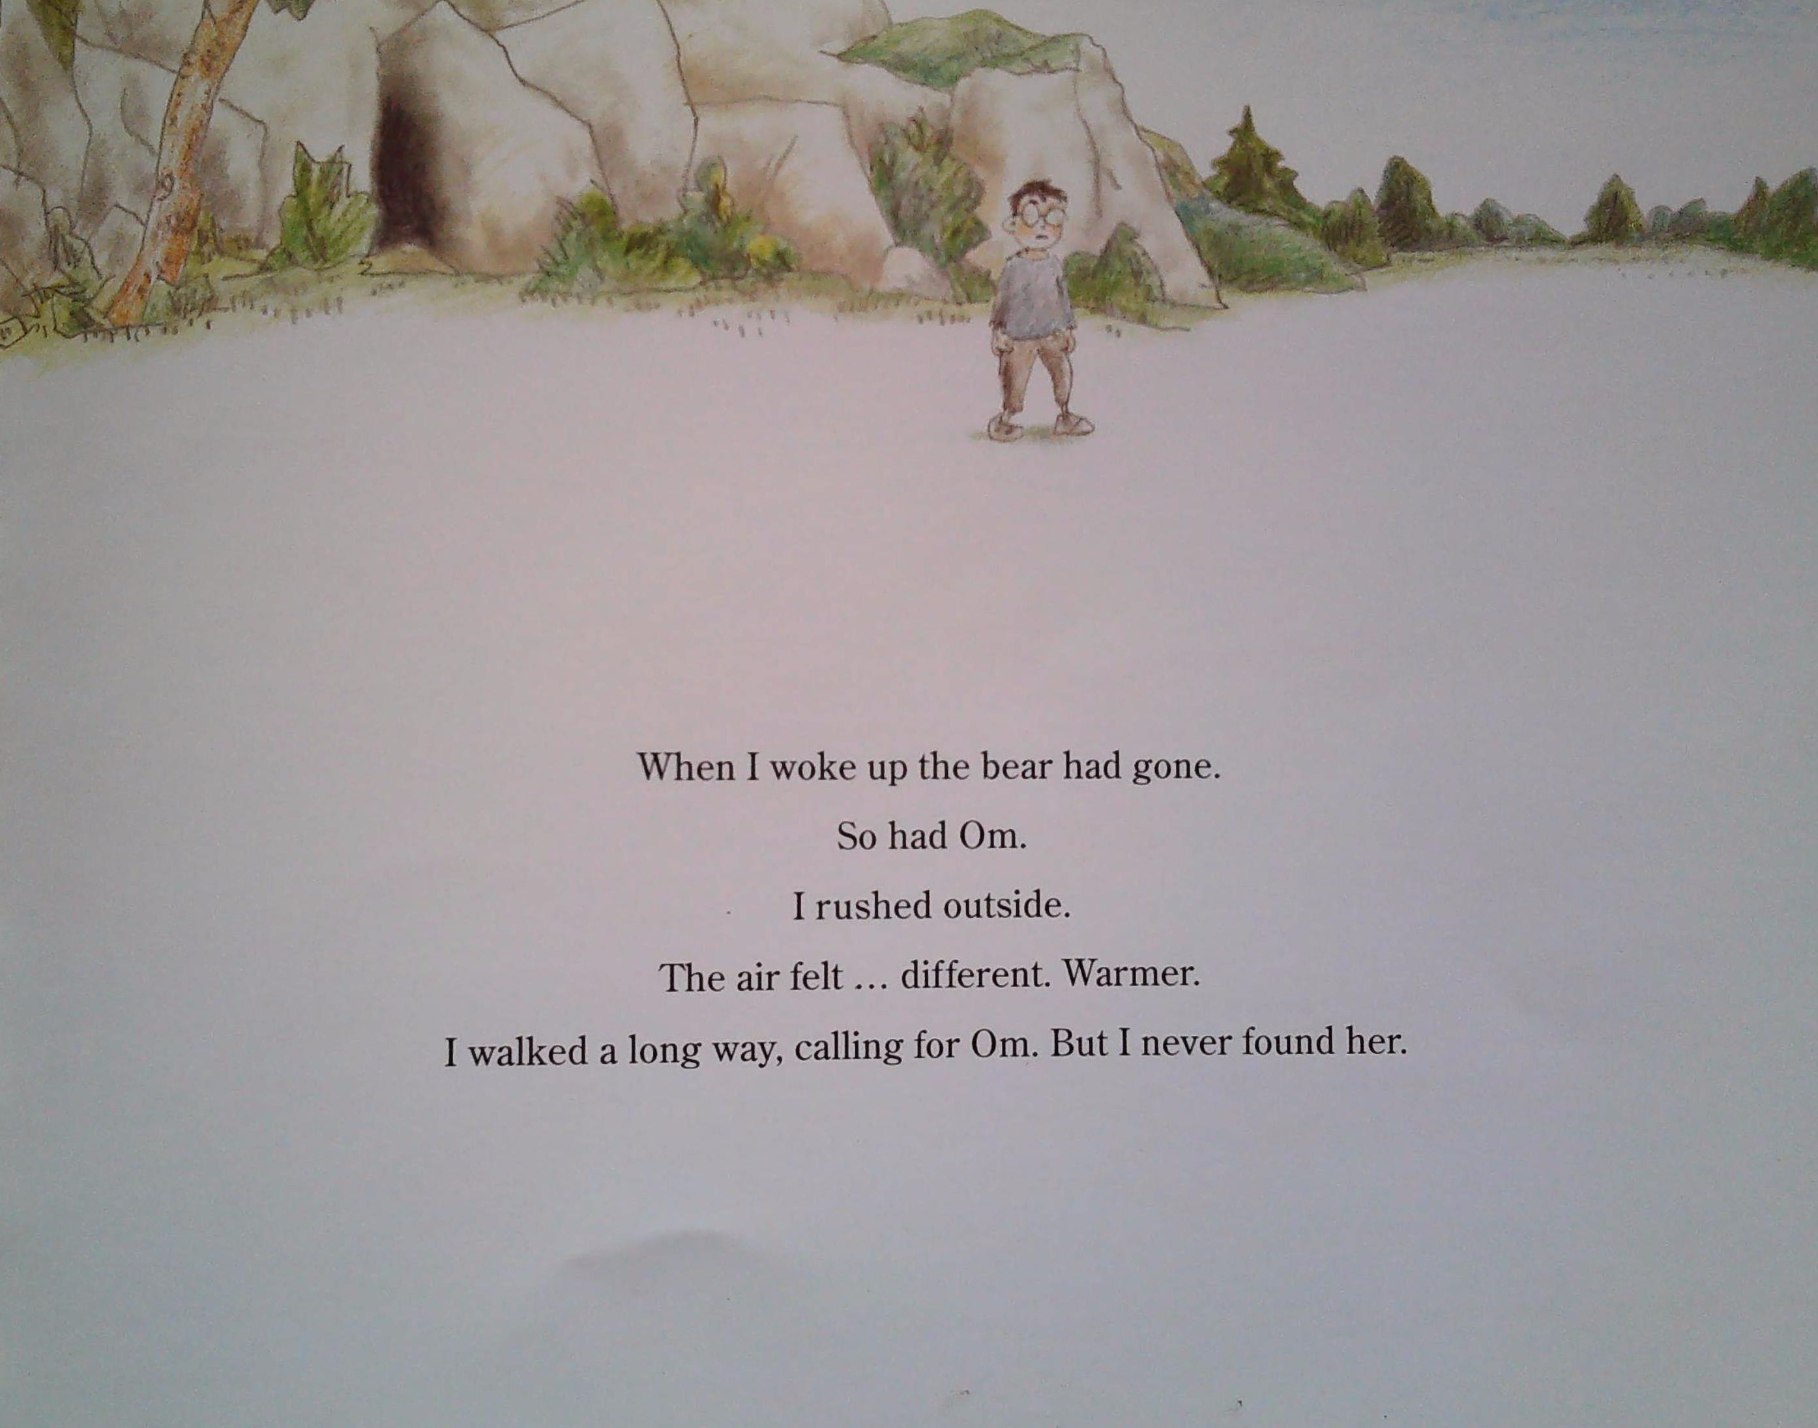

Slide 4
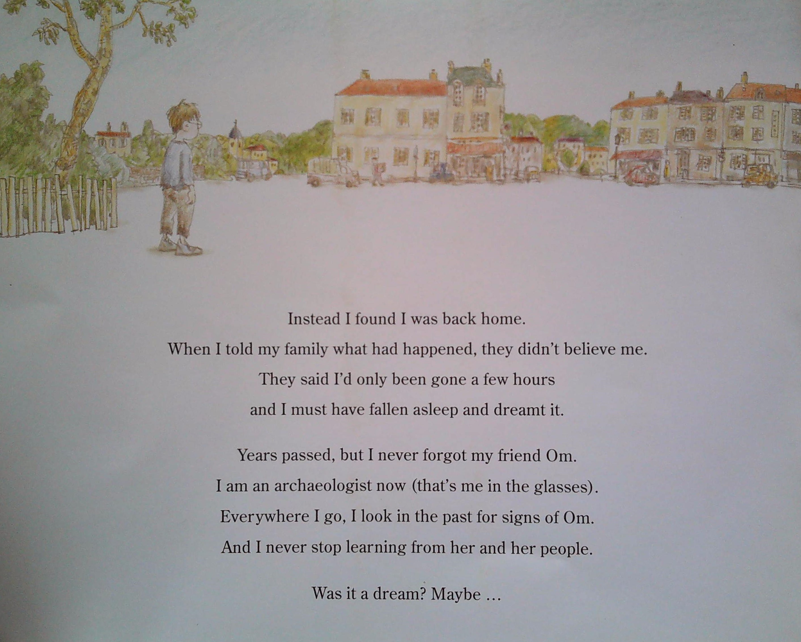

Slide 5
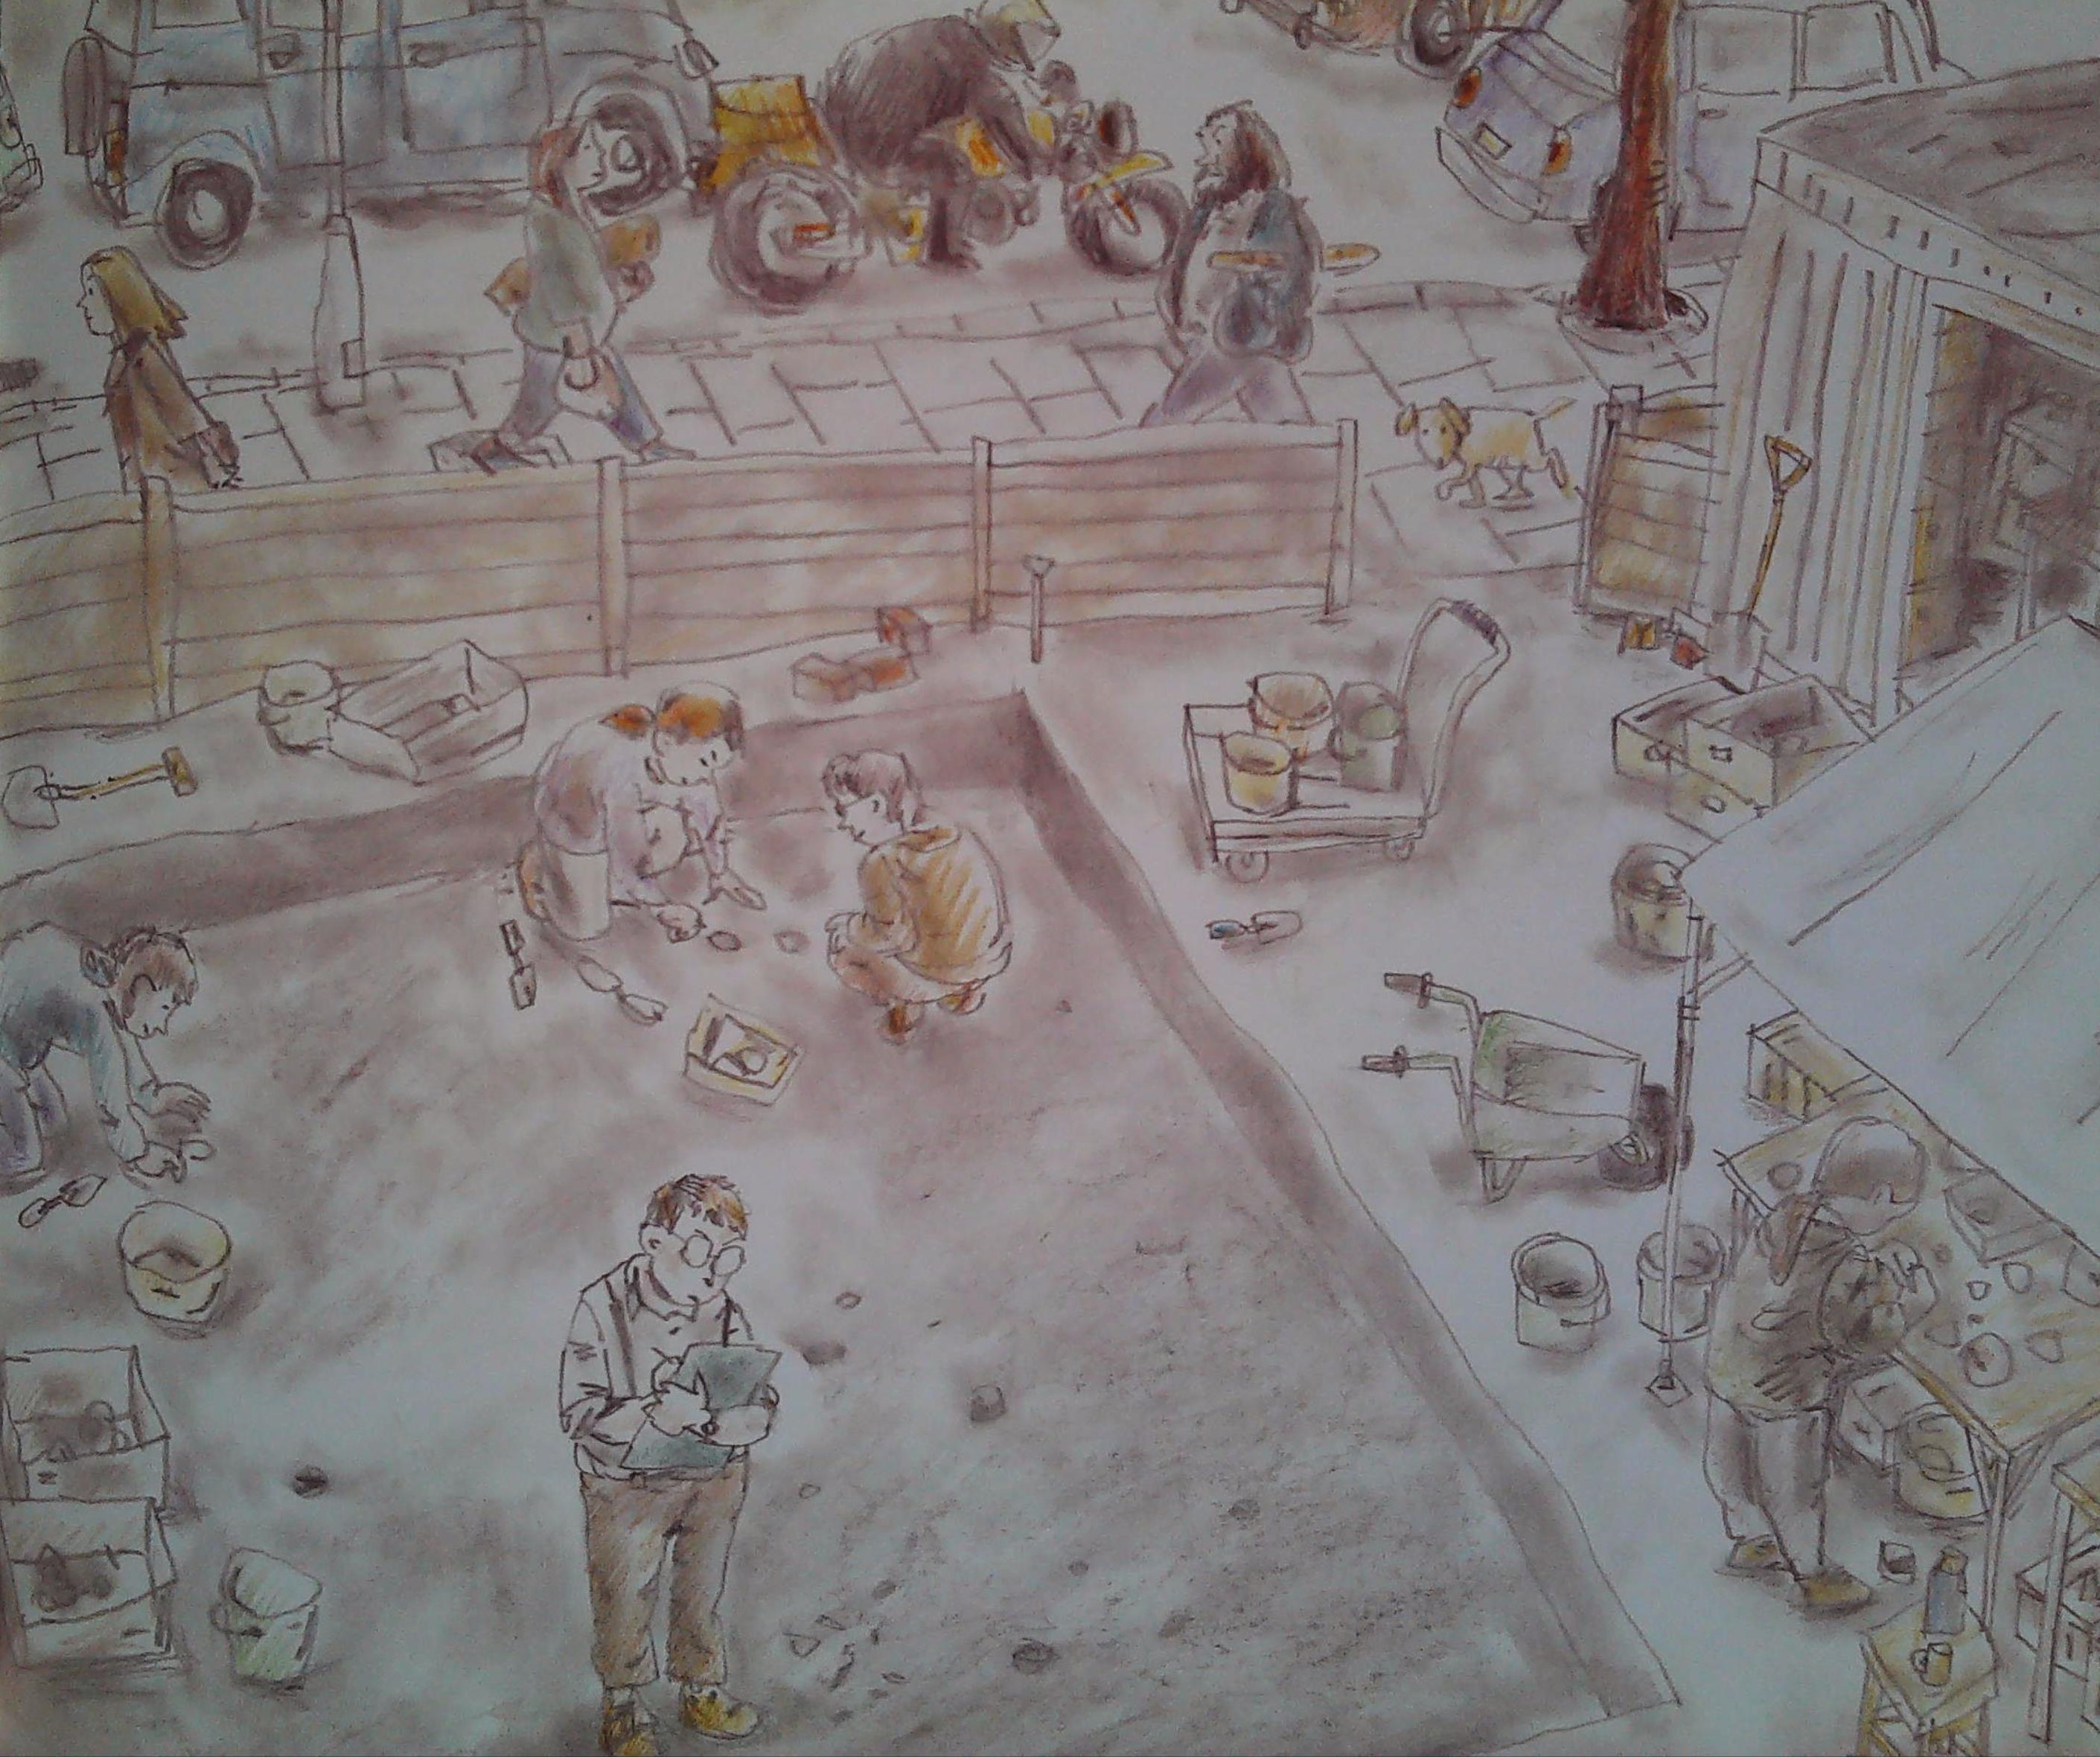

Slide 6
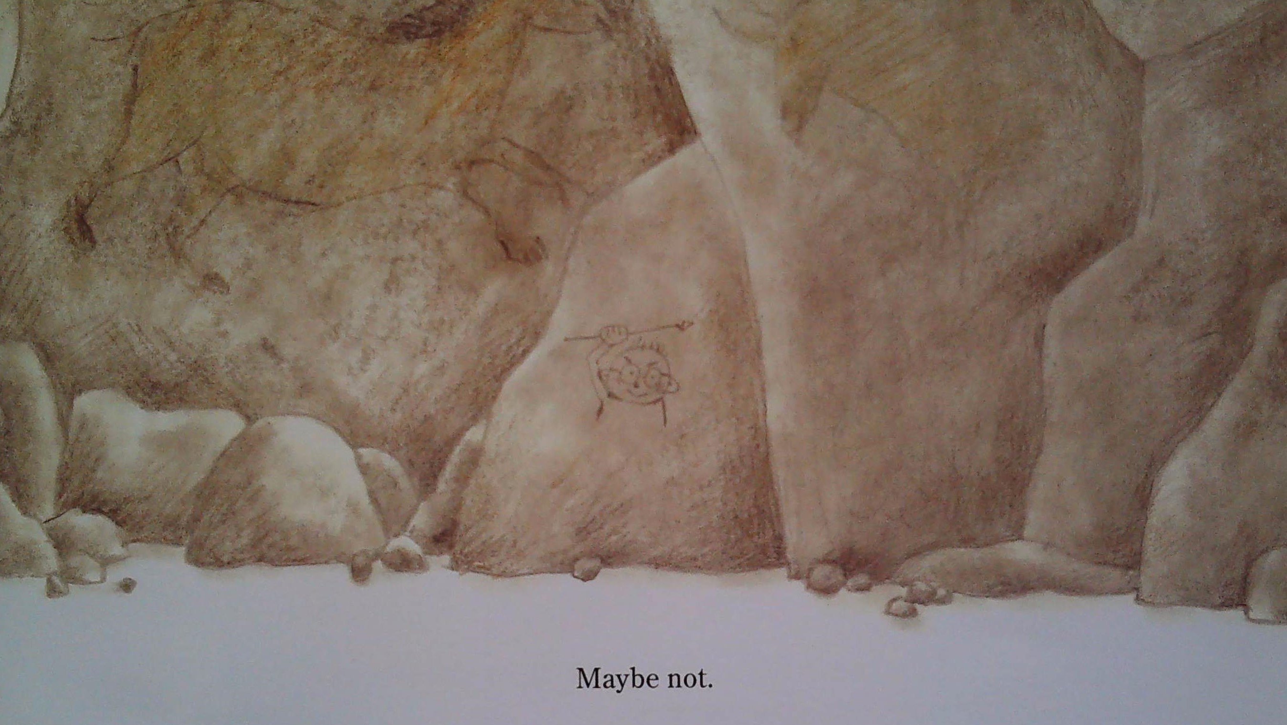

Slide 7
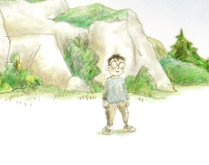
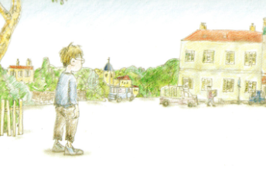
How do you think he feels when he finds himself back home?
Do you like the end of the story?
How did his adventure change him? How do you know?
I think … because …
I like/dislike the ending because …
In my opinion …
I know this because …

Slide 8
Why does the boy think ‘Maybe not’?

