Slide 1
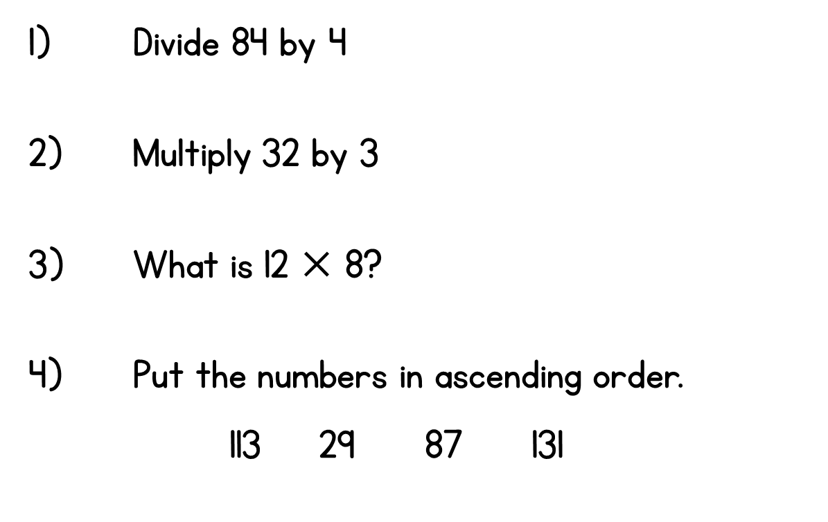
Year 3 | Week 2 | Day 4

