Slide 1




Ashurst Wood School Newsletter Week 2
22nd September 2025
THIS WEEK’S DATES TO REMEMBER
Dear Families
It was lovely to see so many families at our Praise Assembly on Friday! Your presence always brings such warmth and encouragement to the children, and we truly appreciate your continued support.
A big thank you to everyone who has signed up for our school lottery — we now have 10 wonderful supporters! Over the past six years, our lottery members have helped raise an incredible £5,000, all of which has gone directly back into enriching our children's experiences through events and equipment.
Remember, anyone can join — parents,
grandparents, friends, and members of the
wider community. Every sign-up makes a
difference!
Attendance this week: 97.38%
Attendance from September 2025: 98.63%
Monday 22nd September
Netball Club (Afterschool)
Tuesday 23rd September
Year 2 Forest School PM
Just Dance (Afterschool Club)
Wednesday 24th September
Tag Rugby Yr 3-4 AM
Tag Rugby Yr 5-6 PM
Football Club (Afterschool)
Thursday 25th September
Year 4 Forest School PM
Friday 19th September
Year 5 Forest School PM
Achievement Assembly – 3pm
Top Doodlers
Doodle Math’s: Falcons – Year 4 (77% of pupils in the green zone)
Doodle Tables: Osprey – Year 5 (19% of pupils in the green zone)
Doodle English: Falcons Year 3 and 4 (55% of pupils in the green zone)
Doodle Spell: Falcons Year 4 (31% of pupils in the green zone)
Polite Reminders & Notices
Lion King phot books now available to order on MCAS. The cost is £10. If you would like to have a look at the book before you place an order, please ask at the school office.
Cars (Action Required)
Could we please remind all parents to park considerately when dropping off and collecting their children. Thank you for your co-operation.
TAG Rugby Events – 24th September (Action Required)
We have been invited to attend both the Year 3-4 TAG Rugby event and the Year 5-6 TAG Rugby event on Wednesday 24th September at the East Grinstead Rugby Club. The Y3/4 event takes place between 9am and 11.30am and the Y5/6 event takes place between 11.30am and 3pm. Please could families of the invited children please refer to the letters sent out to them on the 24th September for further details.

Slide 2
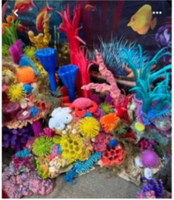
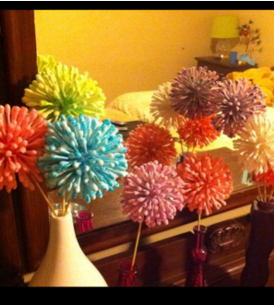
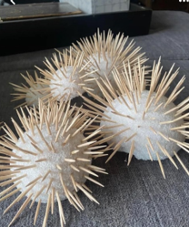
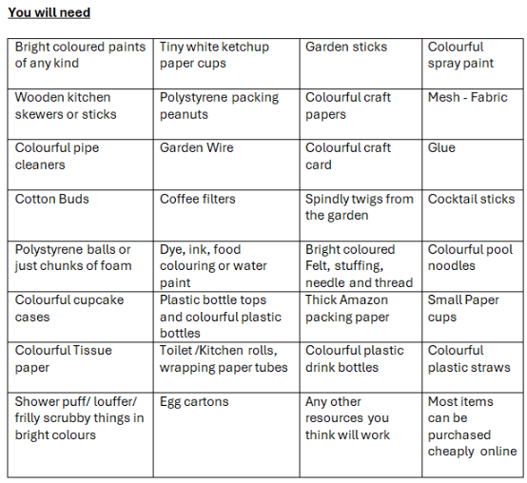


Ashurst Wood School Newsletter Week 1 8th September 2025
Summer Performance Weekly Crafts
Week 3- Anemones
Paint or dye Cotton tips and stick into a polystyrene balls. If you don’t have polystyrene, you could make or use something else for the entre.
Spikey Urchins out of cocktail sticks. Use hemispheres so there is a flat base to lift and avoid spiking your fingers, this will also help us attach to the reef display
Paint them whatever bright colour you like.
In order to prepare, below is the full list of resources that will need over the next 6 months if you wanted to join in with every craft on the list, we thought advance notice would help so that you can keep an eye out for supplies, save things in advance, recycle, look out for or buy if you would like to.
Join Our School Lottery – Raise Money the Fun Way & Win Big!
We’re inviting all parents, carers, and friends of the school to join our School Lottery through Your School Lottery. It’s a fun and easy way to support our school while being in with a chance to win exciting prizes!
Why sign up?
💙 70% of every ticket goes directly back to our school community – helping fund valuable resources and activities
🎁 Weekly cash prizes, including a national jackpot of £25,000
🏆 One of our parents is guaranteed to win a prize every week
🛒 Special this month: a chance to win a £1,000 Aldi gift card!
👥 Refer a Friend – for every person who signs up using your unique referral link, you’ll BOTH get an entry into an exclusive £200 prize draw!
Join your school community today and raise money the fun way! Signing up is quick and easy – just visit www.yourschoollottery.co.uk and search for our school.
Thank you for your continued support – together we can make a real difference!

Slide 3

Ashurst Wood School Newsletter Week 1 8th September 2025
THIS YEAR’S KEY DATES!
To help with organisation, below you will find key whole school dates for this term and outline dates for the remainder of the year to enable you to book time off to attend school events if you wish to do so. More details of specific events will be sent our closer to the time. If an event is in red it requires adult participation! There are more activities planned including PTFA events, but these are the key ones which need families to dedicate time to attend.
OCTOBER
NOVEMBER
DECEMBER
SPRING 2026
SUMMER 2026
Thursday 9th Break the rules day
Friday 10th INSET Day
Friday 17th
STAR BOOKS Café This event is for all families. Come and join us at the Star Books café and enjoy sharing books with your child, meeting the other parents and enjoying a cup of tea and a biscuit. CAKE SALE after school
Harvest Festival Tuesday 14th October 2.30pm @ St Dunstans
Monday 20th – Friday 24th
Year 6 at PGL
Saturday 25th
Village Bonfire Night
Monday 27th
HALF TERM
Remembrance Day - Tuesday 11th November Please join us at St Dunstan’s Church at 10.30am for a short service followed by remembrance at the village memorial.
Friday 21st Children in Need The children on the school council will be planning fundraising events for this day.
Children have a pantomime
(In school time)
24th – 28th Parliament Week
Friday 28th Non-Uniform Day for a hamper donation
Friday 5th Decoration afternoon
Book the afternoon to spend making Christmas decorations with your child. All family members are welcome. Then enjoy a drink and a cake in the hall at the Christmas Café while the children entertain you.
Friday 12th Christmas Jumper day
Elfdridges pm
Saturday 13th Christmas Crafts Day
Wednesday 17th
KS1 Nativity OWL Class
Thursday 18th
KS1 Nativity HAWK CLASS (Afternoons)
We designate one day for each class but there is some flexibility if needed.
KS2 Carol Service (evening) KS2 Carol Service - Tuesday 17th December at Holy Trinity Church, Forest Row.
Start the Christmas season with this traditional evening and enjoy a mulled wine and mince pie. The event is open to all families and the community to attend.
Friday 19th Last day of term
Monday 5th First day of term
Friday 23rd January – Non Uniform PJ Day
Monday 9th – Friday 13th February
Arts Week
Monday 16th – Friday 20th February
Half term
Friday 27th February – Art Exhibition
Friday 13th February Non Uniform Day
Thursday 5th March World Book Day (Not a dressing up year)
Friday 6th March
Cookie Sale
Monday 23rd march Easter Bonett Parade (Reception)
Easter Cake Competition (KS2)
Tuesday 24th March. Easter Service @ ST Dunstans. KS1 1pm / KS2 2pm
Thursday 26th March last day of term –
Easter Egg hunt
Friday 27th March INSET Day
Monday 13th April Term starts
Monday 13th – Friday 17th April Science Week
Friday 24th April
Non Uniform Day
Friday 8th May
Brownie Sale
Monday 11th - Thursday 14th May
Y6 SATs week
Saturday 16th May
Crazy Golf Day
Monday 18th – Friday 22nd May – Enrichment Week
Monday 1st – Friday 5th June
Y4 Multiplication tests
Monday 8th – Friday 12th June
Y1 Phonics screening
Friday 5th June
Rock paper Scissors Day
Friday 12th June
Non Uniform Day
Friday 19th June Sports Day
Friday 26th June Reserve Sports Day
Monday 8th – Friday 12th June
Y6 Bikeability
Thursday 25th June Movie Night
Friday 26th June Donut Sale
Wednesday 1st – Friday 3rd July Sackville Y6 transition days (TBC)
Monday 6th July week SHOW Week (TBC)
Monday 20th July Last Day of term
On Wednesday 22nd October at 2.15 we are hosting a Parent workshop
"supporting my child with their worries"
Come and join us for an informative session with practical ideas.

