Slide 1

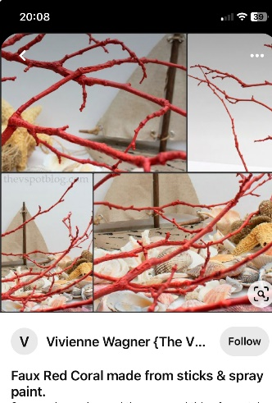
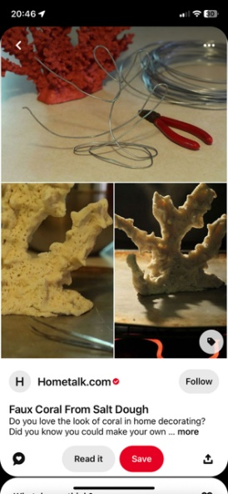
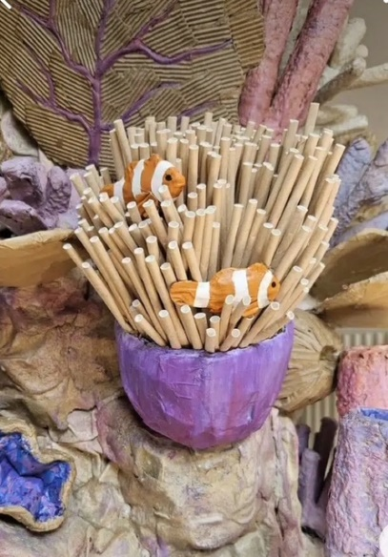
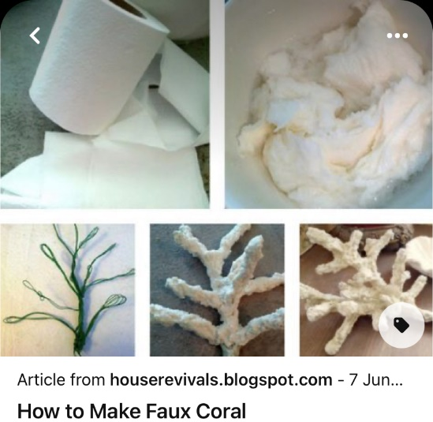
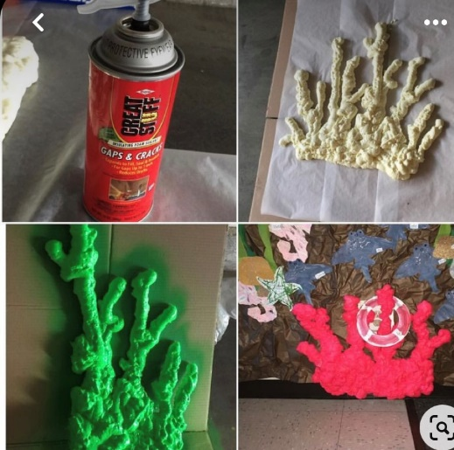
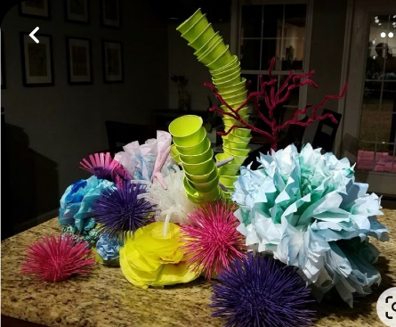

Ashurst Wood School Newsletter
2nd February 2026 (Week 19)
Our vision is for everyone to have a love of life, a love of learning and a love of people.
Be curious Be Resilient Be Compassionate Be Respectful Be Ready Be Safe
THIS WEEK’S DATES TO REMEMBER
Attendance this week: 95.61% Attendance from September 2025: 96.98%
Tuesday 3rd
Y2 Forest Schools (PM)
Wednesday 4th
Reception Forest Schools (PM)
Girls Football Matches @ EG Sports Club (3pm to 4.45pm)
Thursday 5th
Y4 Forest Schools (PM)
Friday 6th
Y5 Forest Schools (PM)
Achievement Assembly (3pm)
Dear Families,
Friday 6th February will be our final Celebration Assembly before half term, as on Friday 13th February we will be proudly exhibiting the artwork created by the children during Art Week. This year’s Art Week will begin with an exciting visit from an art historian, who will lead four special art history workshops to inspire the children. Throughout the week, pupils will explore colour, sculpture, and several themes introduced during the Monday session. All completed artwork will be displayed on Friday, and we look forward to welcoming families to view the exhibition from 2:30pm onwards. After school, there will be a cake sale to send everyone off into half term on a sweet note.
WEEKLY CRAFTS
WEEK 19 onwards. Free Style- Total Creative Freedom , please help us by making anything to enhance our coral reef scenery, single items or bigger displays will all be used.
Toilet roll paper Mache formed over wires
Upcycled twigs
Salt dough
Straws
Expandable foam
Stacked paper cups
Top Doodlers
Doodle Maths Year 4 69% Doodle English Year 4 54%
Doodle Tables Year 6 13% Doodle Spell Year 4 15%

Slide 2


Polite Reminders and Notices
Y4/Y5 PGL Residential Visit – October 2026
Just a polite reminder that the next instalment of £53.00 for the PGL Residential visit was due to 31st January 2026.
Girls Football Matches – Wednesday 4th February
The next matches for the girls’ football league are taking place on Wednesday 4th February. Please would you arrange to collect your child at 2.30pm and transport her to the East Grinstead Sports Club where Mr Gowers will meet the team. The event should be finished at 4.45pm when the children should be collected. Please refer to the letter dated 22nd January for further details. Please can all consent forms be returned to the school office no later than Monday 2nd February to enable your child to participate – thank you.
Polite Request – Children’s Magazines for After-School Club
If you have any unwanted children’s magazines at home, after-school club would be delighted to receive them. Please bring them along to the office. Thank you.
Chartwells ‘Back to School’ Menu – 23rd February
As we are on a ‘back to school’ menu after half term, Chartwells have asked us to advise parents that they will have to log in to ParentPay and reorder a meal for the first day back even if you have already placed an order for this date.
West Sussex County Council Wraparound Care Survey
West Sussex County Council’s Early Years and Childcare team has launched a new survey to understand families’ experiences of wraparound childcare. Wraparound childcare provides families with care for school aged children before and after the school day.
The survey is open to all families with primary school-aged children, whether they currently use wraparound childcare in West Sussex or not. It asks about what is working well, what could be improved, and how childcare outside of the school day can better meet the needs of local families.
The survey is anonymous, and your feedback will contribute to countywide planning and development. The deadline to complete the survey is 23:59 on Sunday 22 February. The link to the survey is: https://yourvoice.westsussex.gov.uk/embeds/projects/29982/survey-tools/54383
Join Our School Lottery!
This month, the school lottery has a bonus draw for £1,000 Aldi gift token alongside the usual chance to win cash. Remember, the more tickets we sell, the bigger the cash prize!
Please share with relatives and friends.
We’re aiming for 60 tickets and currently have 31. Sor far this January we have raised £38 and with 31 tickets we are on track to raise £577.60. Every ticket makes a Difference.
Thank you for your continued support!
Your School Lottery - Online Fundraising for Schools and PTAs - Your School Lottery

Slide 3
Ashurst Wood School Newsletter (Week 19) 2nd February 2026
THIS YEAR’S KEY DATES!
To help with organisation, below you will find key whole school dates for this term and outline dates for the remainder of the year to enable you to book time off to attend school events if you wish to do so. More details of specific events will be sent our closer to the time. If an event is in red it requires adult participation! There are more activities planned including PTFA events, but these are the key ones which need families to dedicate time to attend.
February 2026
March 2026
April 2026
June/July 2026
Monday 9th – Friday 13th February
Arts Week
Monday 9th February
Y2 Little Big Sing (AM)
Friday 13th February
Non Uniform Day
Parents Forum
Valentines Cake Sale
Monday 16th – Friday 20th February
Half Term
Friday 27th February – Art Exhibition
Thursday 5th March World Book Day (Not a dressing up year)
Friday 6th March
Cookie Sale
Wednesday 11th March – Parent Workshop ‘Healthy Friendships & Relationships’ (2.30pm)
Week commencing 16th March - Parent Consultations
Wednesday 18th March
2pm Rock Steady Concert
Monday 23rd March - Easter Bonnet Parade (Reception)
Easter Cake Competition (KS2)
Tuesday 24th March - Easter Service @ St Dunstans. KS1 1pm / KS2 2pm
Thursday 26th March
Last day of term (1.30pm finish) - Easter Egg Hunt
Friday 27th March – Inset Day
Monday 13th April Term starts
Monday 13th – Friday 17th April - Science Week
Friday 17th April
Kapla Club for whole school (funded by PTFA)
Friday 24th April
Non Uniform Day
Wednesday 29th April – Parent Workshop ‘Supporting my Child to Emotionally Regulate’
Monday 1st – Friday 5th June
Y4 Multiplication tests
Monday 8th – Friday 12th June
Y1 Phonics screening
Friday 5th June
Rock paper Scissors Day
Monday 8th – Friday 12th June
Y6 Bikeability
Friday 12th June
Non Uniform Day
Friday 19th June Sports Day
Friday 26th June Reserve Sports Day
Thursday 25th June Movie Night
Friday 26th June Donut Sale
Wednesday 1st – Friday 3rd July Sackville Y6 transition days (TBC)
Monday 6th July week SHOW Week
Wednesday 15th July
2pm Rock Steady Concert
Monday 20th July Last Day of term
May 2026
Monday 4th May
May Day Bank Holiday
Friday 8th May
Brownie Sale
Monday 11th - Thursday 14th May
Y6 SATs week
Saturday 16th May
Crazy Golf Day
Monday 18th – Friday 22nd May – Enrichment Week
Monday 25th to Friday 29th May - Half Term

