Slide 1
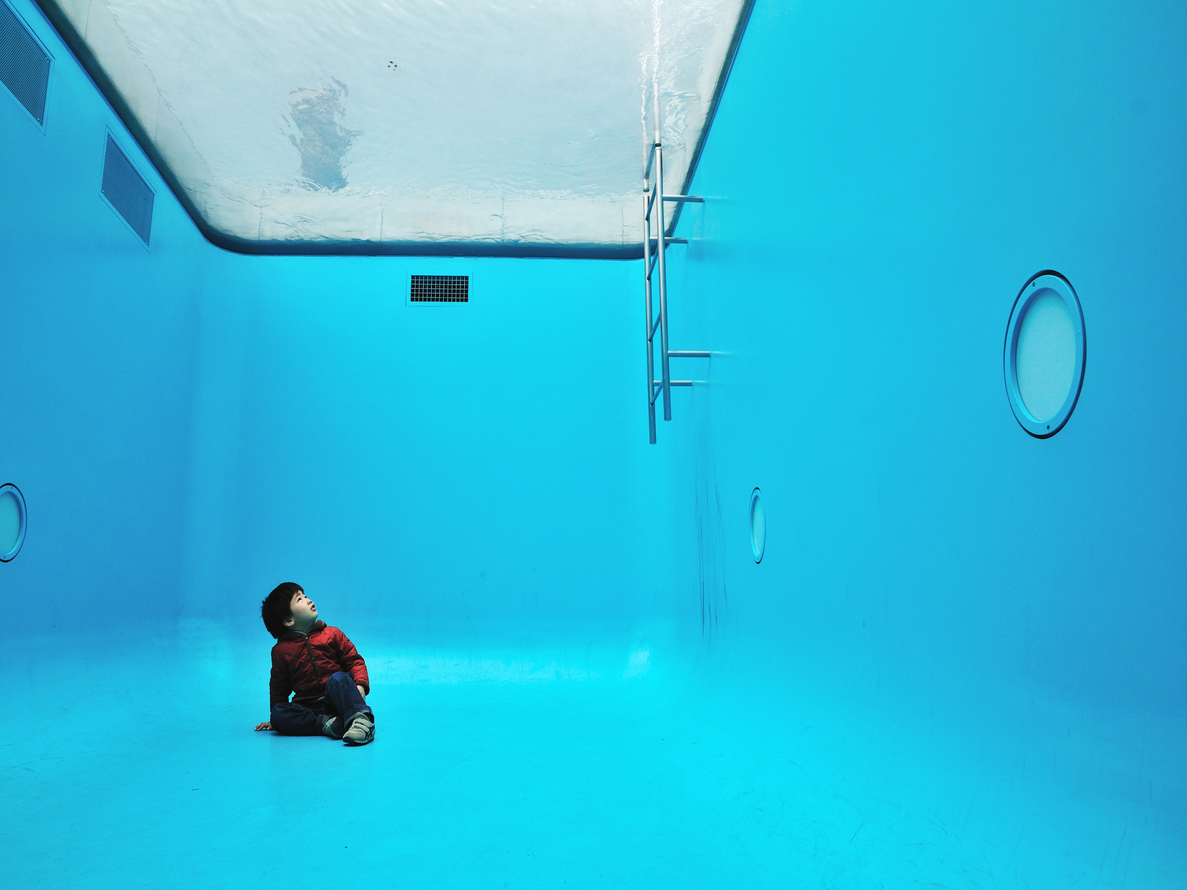
Internet Safety for Parents

Slide 2
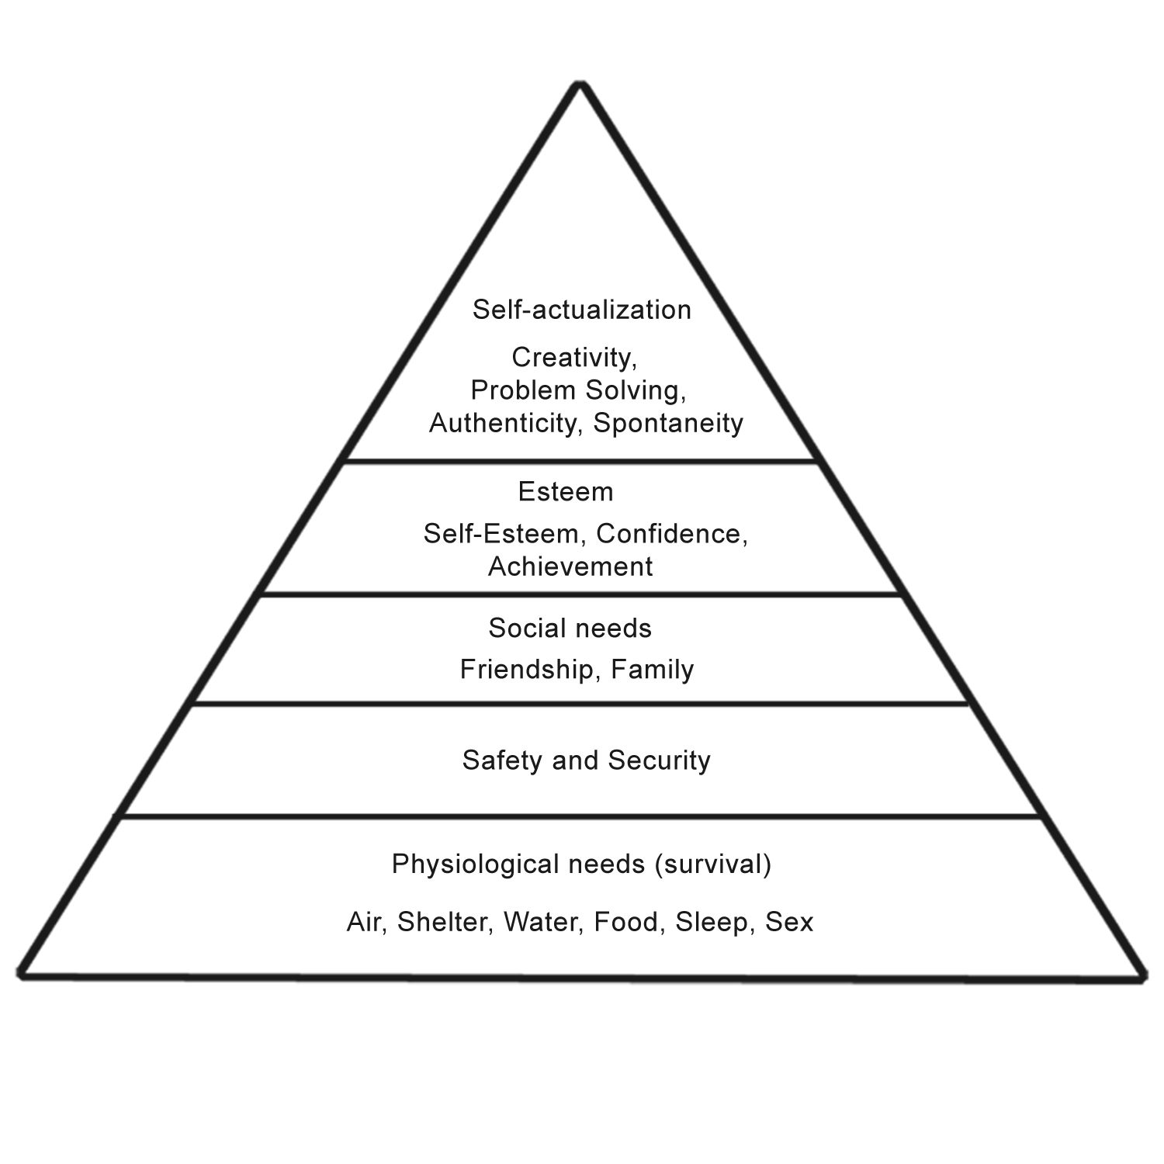
Notes:
Our children live in a different world. Business studies > Maslow > basic needs at the bottom.

Slide 3
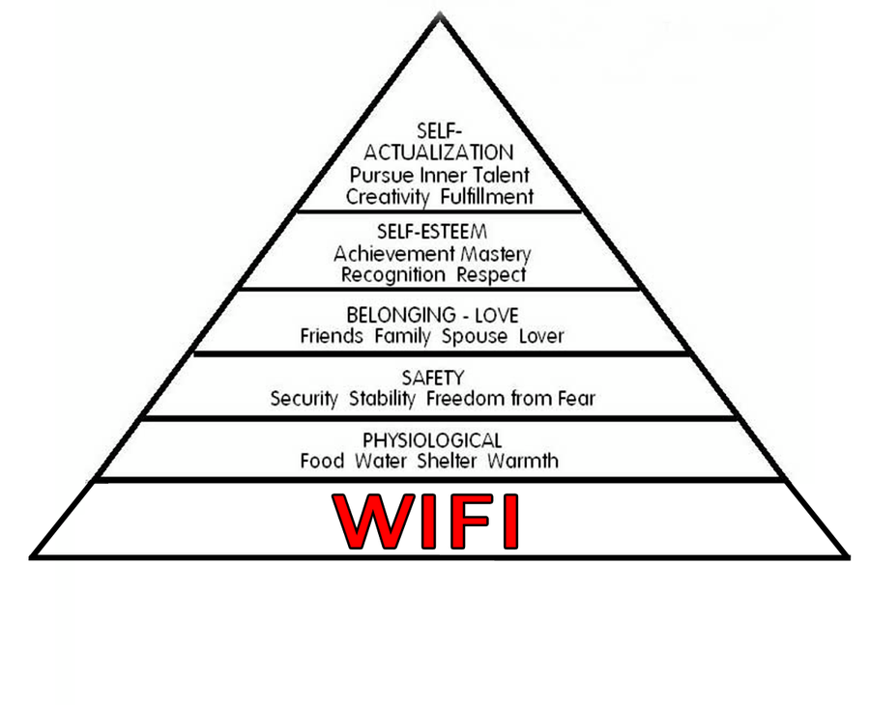
Notes:
The ‘teenager’s hierarchy of needs’.

Slide 4
Notes:
Don’t be afraid, technology affords us some fantastic parenting opportunities too!

Slide 5
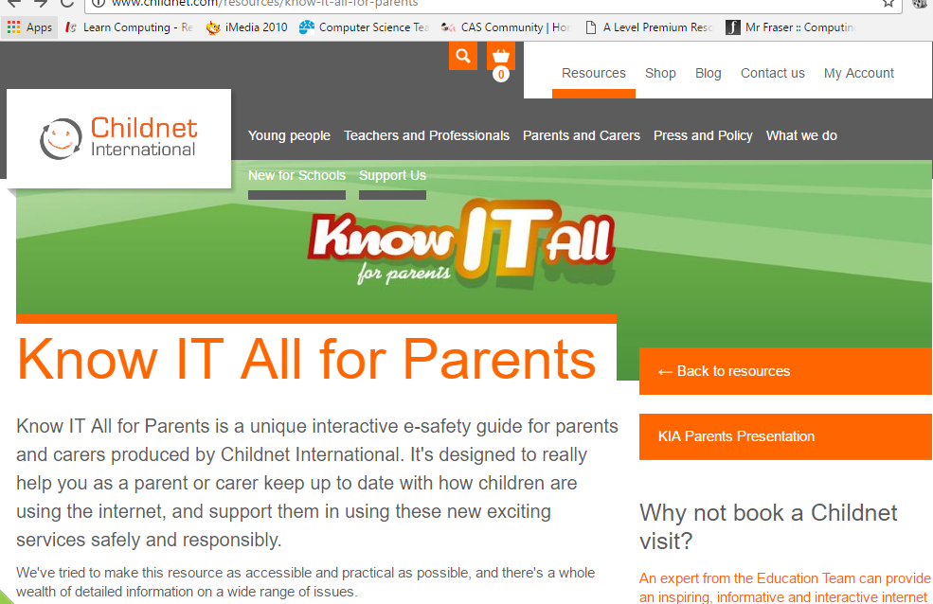
Useful site! (Childnet)

Slide 6
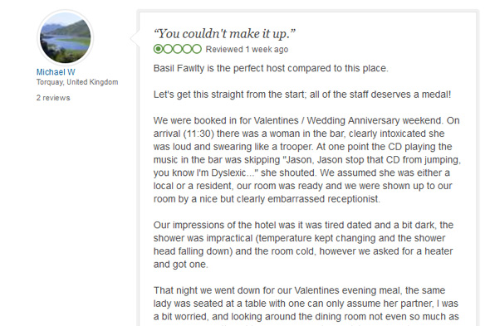
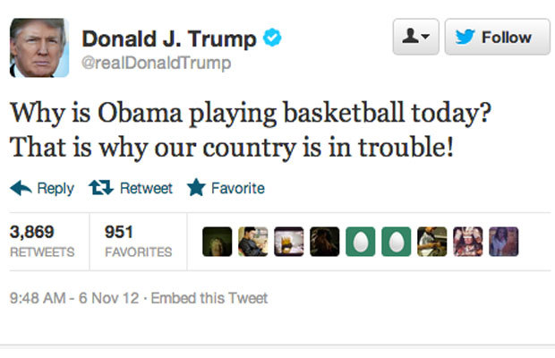
Learning from adults??

Slide 7
Overview of the session
The world of apps
What’s trending
Parental strategies
Where to look for information

Slide 8
Activity 1
How many devices do you have at home (in total) that contain your personal data?
Talk to a partner!
5 mins
Average number per household: 7

Slide 9
Activity 2
How do you monitor your child's internet usage at home?
Do you know what sites they are using?
Do you know the current trends in terms of apps/websites?

Slide 10
There's an app for that…
Notes:
So what makes some online spaces more risky than others?

Slide 11
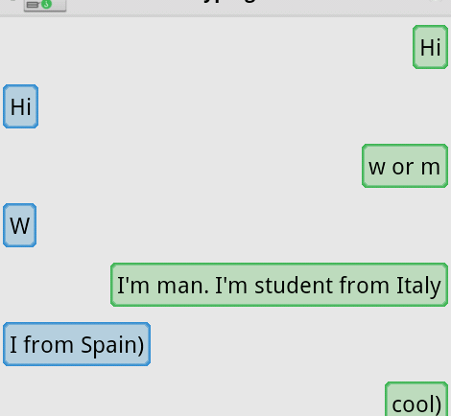
Anonymous chat
Ask.fm – post selfies and talk about themselves
YikYak – location aware for contact within a 5 mile radius
Omegele –linking strangers together anonymously in chat or video rooms
Whisper: A social "confessional" app users type a confession, add a background image and share it with the Whisper community. Intended for users age 17 and older.
Notes:
Anonymous chat – sites that allow you to talk without revealing your identity allow people to pretend to be whoever they want to be and can encourage inappropriate over sharing and some very nasty behavior. Ask.fm and Omegle are examples of anonymous chat sites but there are lots out there.
Yik Yak is an online bulletin board. It uses the GPS settings on your mobile phone or tablet to find your location and show you the most recent posts from other people around you. As well as posting your own content, you can post and vote on other people’s bulletin boards. Aimed at 17+
Omegle is a social networking site that randomly connects you to another person who’s on the site. It lets you talk to them in a one-to-one audio or video conversation. You can both appear as anonymous, unless you decide to share your personal information.
If you’re on social media, you’ll know there’s a difference between Facebook – which has a real name policy – and Twitter where you can use any name you like. And if you’ve been on online dating sites (after all, one in five relationships in the UK start online) then you’ll see a difference between Match.com – where you have to register and give your bank details – and Plenty of Fish which is free and you don’t have to prove who you are, giving you the opportunity to be anonymous….
Anonymity isn’t all bad. It can mean that young people feel able to ask for help when they need it. They can explore ideas that they might feel too shy to put their real name to. It can also create a space for bullies and some of the worst behavior online so it’s a really important question to ask your children. When you’re asking where they go online find out if they use anonymous chat services and if they do make sure they understand the risks.

Slide 12
No moderation or reporting
Snapchat - messaging app that lets users put a time limit on the pictures and videos they send before they disappear.
Burn Note - texting-only app that erases messages after a set period of time. Messages are stored until first view and then deleted.
http://www.net-aware.org.uk/
Notes:
Temporary Apps
Temporary apps allow people to send messages and images that self-destruct after a set window of time. Teens can use these apps to more carefully manage their digital trails -- so long as they don't share things they wouldn't normally send otherwise.
Snapchat is an app that lets you send a photo or short video to your friends. The ‘snap’ appears on screen for a matter of seconds before disappearing. There’s also a feature called Snapchat Story that lets you share lots of snaps in a sequence for up to 24 hours.
Burn Note Deleted texts cannot be recovered. Burn Note claims to completely expunge deleted messages from its server. Unread messages self-destruct after 30 days. Age 13 or over

Slide 13
Live streaming
Periscope - broadcast themselves live for short periods of time
Meerkat – additional tools allow saving of live stream and live chat
Facetime –
iOS app built in to Apple devices
Facebook Messenger –
available to all Facebook account holders
ooVoo –
video chat and instant message app. Can group video chat with up to 12 people
Notes:
Live streaming by its nature has no filters set on it and can be streamed from anywhere in the world from any location.
Periscope is becoming increasingly popular. Owned by Twitter, people broadcast themselves live for short periods of time – all you have to do is follow them and there is no editing or moderation.
Meerkat is another video streaming app.
Facetime, Snapchat and Facebook messenger facilitate live streaming . All of these very familiar services that are used by families to keep in touch with relatives around the world are great – but think about a child live streaming from the bathroom or bedroom and you can immediately see why they are also in the ‘more risky’ box.

Slide 14
Photo sharing
Instagram - users often list their Kik usernames in their bios so that other have some kind of way to contact them privately
Tumblr –
popular blogging platform largely dominated by visual content
WhatsApp - extremely popular app for individual and group messaging. Groups of up to 256 people can be contacted at the same time
http://www.net-aware.org.uk/
Notes:
A lot of kids still use Facebook Messenger on their phones to get in touch with their friends, but one of Facebook's biggest competitors is WhatsApp -- an extremely popular alternative for individual and group text messaging on mobile. As of October 2013, WhatsApp reported having over 300 million users. It's available on all major mobile platforms, and was free until a subscription fee of 99 cents per year was implemented in 2013.
Logo changed in May 2016. If you take a look on Instagram, you'll probably notice that a lot of profiles list their Kik usernames in their bios so that other Instagrammers have some kind of way to contact them privately. Used by ISIL/ISIS supporters to share photosets produced by ISIL media organisations or to show life in Syria suggesting they are living a full and happy life.
Tumblr is one of the web's most popular blogging platforms, and a lot of teens have admittedly traded in their Facebook accounts for a Tumblr blog instead. Like Snapchat, Instagram and Vine, Tumblr is largely dominated by visual content, and has become one of the number one platforms for animated GIF sharing. Although Tumblr allows its users to create blog posts in all sorts of formats like text, audio, quote and dialogue, it's arguably the visual content -- photos, videos and GIFs -- that make Tumblr worth spending so much time on. Used by ISIL/ISIS fighters to promote longer, theological arguments for travel. Popular with female ISIL supporters.

Slide 15
Peer to peer
eMule – used to find ‘rare content’. Fake versions ask for credit card details and distribute malware
BearShare – beware! Known for installing malware and other nasties on computers
KCeasy – free to download software making it easier to access and share files
Notes:
Finally peer to peer. These networks are by their nature risky because large amounts of content is shared and it isn’t age rated or checked for accuracy or appropriateness. Peer to peer advice and support of the kind you get on Mumsnet or Netmums is great and as an adult you can read it and decide what is worth following and what isn’t. Peer to peer for children is obviously risky for lots of reasons.
It can be used to bypass firewalls – so young people share content that they couldn’t access on other services simply by sharing it peer to peer.
Some peer to peer services that are designed for sharing dubious content or illegal streaming are also used to distribute malware.
Many peer to peer services are funded by advertising and the less scrupulous have a lot of popups including adverts for porn and gambling.
There is a HUGE amount of peer to peer content online. Think about YouTube and Facebook - there is no way to moderate all of that content.
Peer to peer content cannot be classified so it won’t have age rating and therefore it is much more difficult to filter. It relies on self moderation – the community flagging and reporting when stuff appears that isn’t OK.

Slide 16
Behaviour Vs Risk
Most young people do know the theory of what to do. But the theory is very different in practice.
We must understand that for many children and young people, risk-taking behaviour is a part of growing up…

Slide 17
Social Media use by ISIL
ISIL propaganda uses four main themes to encourage young people to travel to Syria and Iraq:
1. Celebrates and promotes an image of success to attract young people. ‘ISIL are the winning side and can offer them an exciting life.’
2. Portrays their ‘Caliphate’ as an ideal, utopian state where Muslims will find status and belonging. Claims that it is the duty of Muslim men and women in the West to travel there.
‘Real struggles need real men’
3. Insist that it is the personal duty of Muslims to support them and travel to the ‘Caliphate’
4. Portray ISIL as the only group able to defend Sunnis from the Assad regime.
Notes:
Caliphate – the name given to the territory the group controls in Iraq and Syria

Slide 18
Platforms used by ISIL
Private messaging
Notes:
Private messaging – Whats App, Kik, SureSpot and Viber

Slide 19
What's Trending? and what to look out for

Slide 20
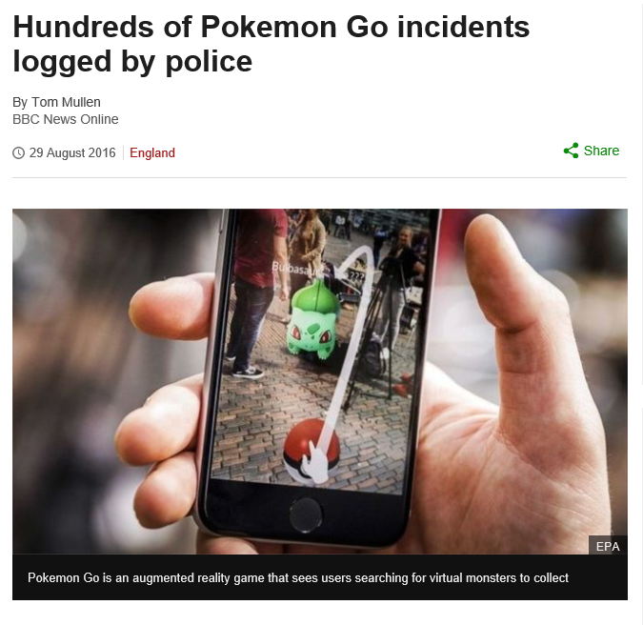

Slide 21
Doxers, trolls, abusive hashtag creators, and more could now face prosecution in the UK
The UK is clamping down on Internet trolls and their toxic online behavior. The Crown Prosecution Service (CPS) has published guidelines that could result in severe punishments for offensive hashtags, doxing, revenge porn, and other similar activities.
Notes:
http://www.techspot.com/news/66614-doxers-trolls-abusive-hashtag-creators-more-could-now.html
Doxing - the act of publicly posting a person’s information, such as their bank details and home address – will also face tougher penalties.
The BBC reports that the CPS will only pursue those who create “grossly offensive” posts and that prosecutors won’t be able to “stifle free speech.” The guidelines are subject to public consultation for 13 weeks. http://www.bbc.co.uk/news/uk-37601431

Slide 22
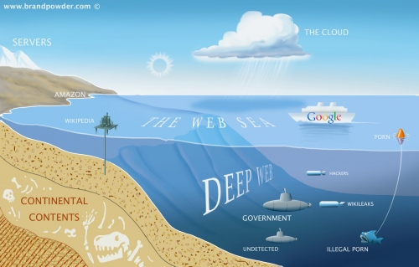
The Dark Net
Technically, a darknet is a variation on a virtual private network
Additional measures in place to ensure that the network and IP addresses of members are not discoverable. The purpose is to hide not only the communications themselves but the fact that information is being exchanged.
Members join with the expectation of being able to share information and/or files with little risk of detection.
Notes:
The Guardian May 2016 - Personal information from more than 65m Tumblr accounts has been discovered for sale on the darknet.
Tumblr disclosed the leak, which it says took place in early 2013, this month, but had not previously acknowledged the scale of the database that was compromised.
The database includes email addresses and passwords, but the latter are heavily protected: Tumblr salted and hashed the passwords, a procedure which renders it practically impossible to restore the passwords to a useable state. It has since turned up for sale on darknet marketplace The Real Deal, with a sale price of just $150

Slide 23
Selfie (n): a picture of person taken by that person
Selfies are everywhere.
In 2013 it was named word of the year by Oxford Dictionaries
In 2014 a song was released called #selfie
In July 2015 selfie sticks were banned in Disneyland
Recent figures show that 91% of teens have taken a selfie and over 1 million are taken each day
Young people sometimes forget that this isn’t real and compare themselves, (complete with flaws and bad days) to others perfected online versions of themselves, they can start to feel inferior and not as good as everyone else.
Remind young people that comparing themselves to others on social media is unhelpful, they’re comparing themselves to something which may be impossible and unattainable - nobody looks fantastic all the time and everyone has bad days.
Notes:
A selfie, normally refers to a non-sexual self-portrait, taken on a mobile device, either with friends or alone. It may or may not involve at least one of the people featured making a ‘duck face’ at the camera.

Slide 24
Online Image
Notes:
Harry Styles (One Direction singer) Amy Adams (Batman vs Superman actress)
Before and after ‘photoshop’ images. Children are exposed to perfect celebrities constantly, leading to unrealistic body image and to some young people developing unhealthy attitudes and ideas of size and weight.

Slide 25
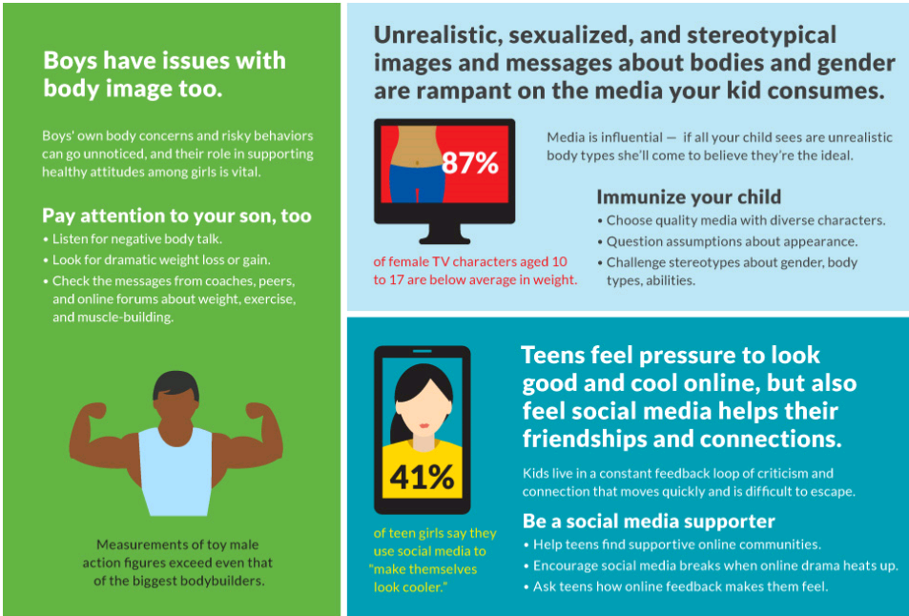
Media and Body Image
https://www.commonsensemedia.org/blog/research-what-parents-need-to-know-about-kids-media-and-body-image

Slide 26
Roast Me
https://www.reddit.com/r/RoastMe and www.roastme.co.uk
Roast brave victims or post a picture to be roasted if you dare! Do you have what it takes to Roast?
Roastees:
You must provide at least one high-quality picture of the roastee holding a sign with the text /r/RoastMe
You may post on behalf of other people, provided that everyone appears in the verification photo described in rule #1.
Your post will not appear until after it has been approved by a moderator. Please send this message if it takes longer than 30 minutes.
The minimum posting age is thirteen-years-old, your post will be rejected if you look younger.
Roasters:
This is a comedy subreddit, not a hate subreddit. Act as though you are trying to make an audience laugh.
We rely on user reports to manage the subreddit, please report all rule violations.
You are allowed to look through the roastee's post history.
Never post another user's personal information, referred to as 'doxxing'. We will always report violations to the admins.
Please don't use link shorteners in comments (bit.ly, tinyurl, etc.)

Slide 28
‘Nation of deeply depressed children’
NSPCC chief executive Peter Wanless - "The pressure to keep up with friends and have the perfect life online is adding to the sadness that many young people feel on a daily basis."
"I hate myself. When I look at other girls online posting photos of themselves it makes me feel really worthless and ugly. I'm struggling to cope with these feelings and stay in my bedroom most of the time.” 13 year old
Promote positive posting in general – do’s and don’ts
Promote posting supportive comments and emoji’s to others
Be Strong emoji’s – Vodaphone – A virtual hug
I am a witness emoji – Apple
Encourage looking out for others and reporting cyberbullying and other risky behaviour their friends may be involved with.
"I feel like crying all the time. I'm constantly worried about what other people are thinking of me and it's really getting me down. I use social media sometimes but that just makes me more depressed as I hardly have any friends online and no one likes my posts/photos.” 12 year old

Slide 29
You Now
YouNow is the best way to discover talented broadcasters, watch live streams and video chat live with people from around the world.
Notes:
Example of live conversation feed on a young persons broadcast!

Slide 30
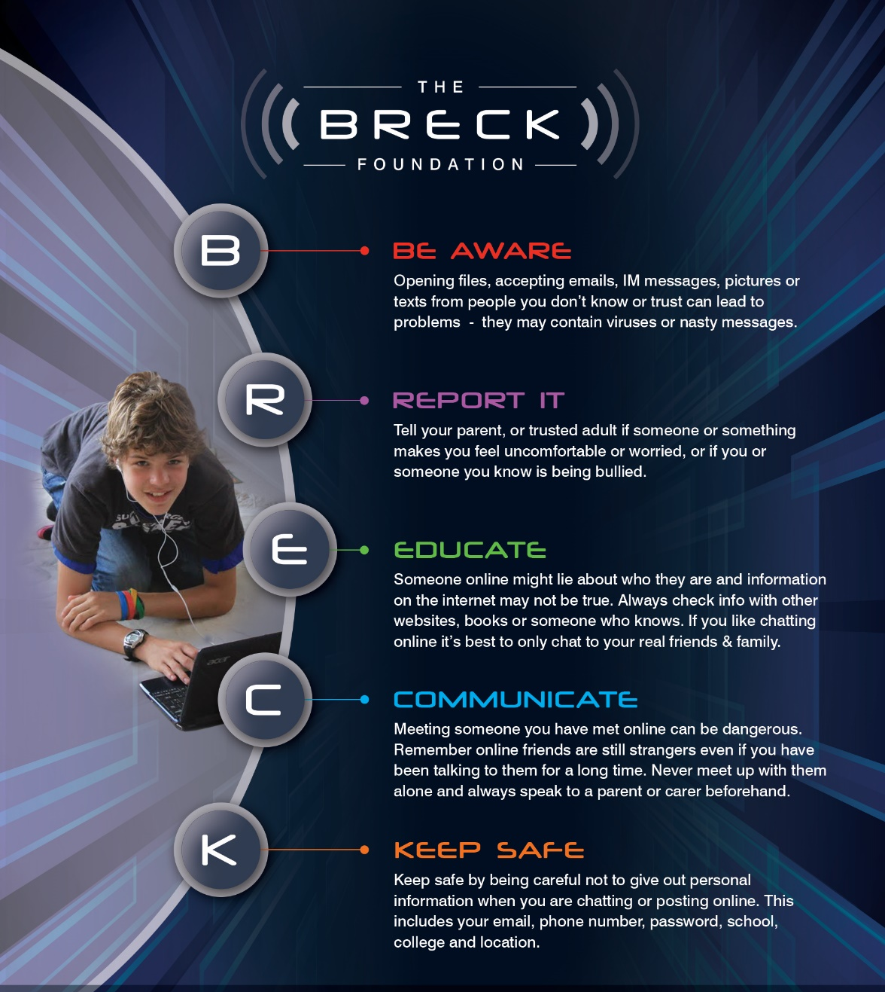
Play Virtual Live Real
http://www.breckfoundation.org/
Notes:
Breck Bednar was a 14 year old boy, from Caterham, Surrey, who loved technology and on-line gaming. He was groomed via the internet and sadly murdered on February 17th 2014 by someone he met on-line.
The Breck Foundation has been set up in his memory to help other young people to enjoy playing on-line but to be aware of some simple rules to stay safe. Remembering that the friends you make on-line are not like your real friends.

Slide 31
It’s not all bad…

Slide 32
Cyber security
https://www.thetechpartnership.com/tech-future-careers/
http://www.bigambition.co.uk/secure-futures/resources/

Slide 33
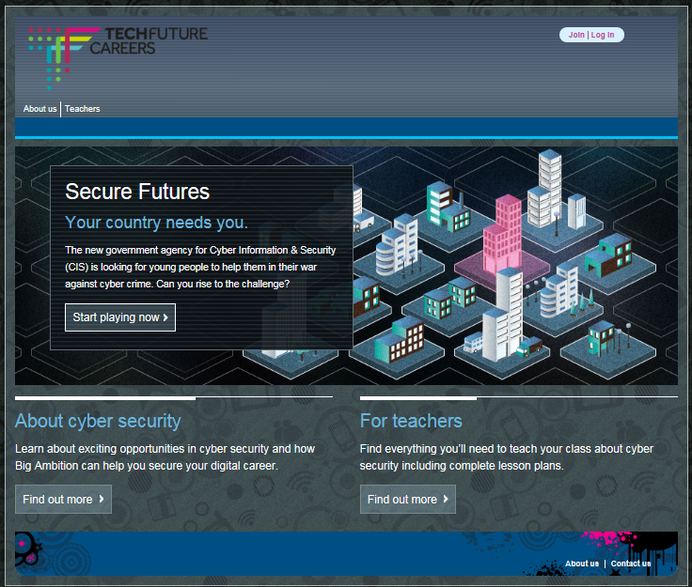

Slide 34
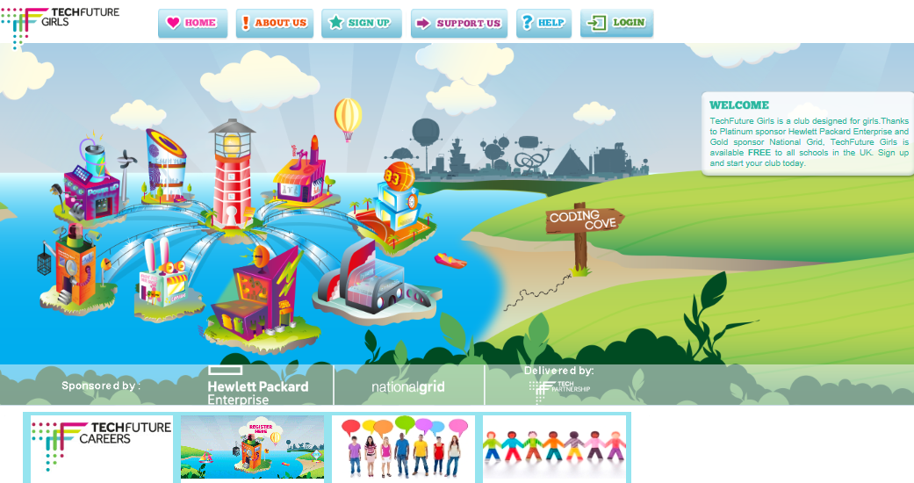
TechFuture Girls
Aimed at
Girls aged 9 to 14.

Slide 35
Key Stage 3 and 4
www.cybersecuritychallenge.org.uk/education/schools/

Slide 36
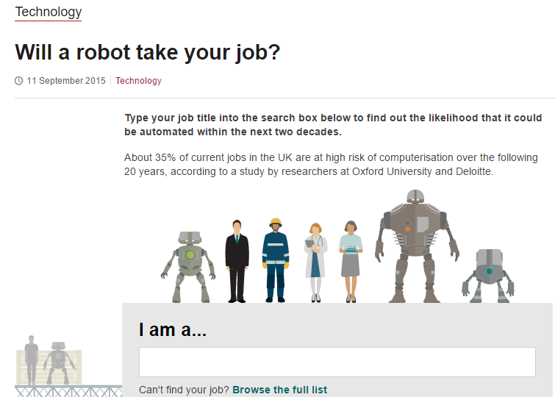
Robots/automation taking jobs

Slide 37
Learn to be a spy!

Slide 38
The future is tech!

Slide 39
Activity 3 – break!
Have a chat on your table…
Are you any wiser?
Questions?
What strategies are you going to use with your son/daughter?

Slide 40
Notes:
Research by ExecuNet showed that 77% of recruiters said they used search engines to find background data on candidates.
35% admitted they eliminated a candidate because of what they found online. (2011)
The same survey quizzed job candidates, too. It found that 82% expected recruiters to check out their names on a search engine, yet only 33% bothered to search for information on themselves, to see what their prospective employer might find out.

Slide 41
Notes:
POSITIVE footprint.

Slide 42
Topics
Parental Controls
Gaming
Messaging & Chat
Sharing (images video etc.)
Talking to your child about online activity
Using a Phone
Bullying
General Top Tips
Great Resources

Slide 43
Parental Controls
Main Menu
Type of Service
Internet Service Providers (ISP’s).
Devices that connect to the internet.
Software.
Type of Control
Filtering
Time limits
Monitoring
Reporting
How to set ISP parental controls
Notes:
Internet Service Providers (ISP’s). These are the organisations that pipe the internet to your home (like Virgin Media, Talk Talk, Sky and BT). All of the major ISP’s provide parental control packages. These can allow you to apply controls across all of the devices that access the internet through your home connection – such as laptops or games consoles.
Devices that connect to the internet. Most computers, mobiles and games consoles now come with parental controls that can be applied. For example, within Windows and the Mac operating systems, there are parental controls that can be set for individual devices.
Software. There are a wide range of packages available to buy or sometimes download for free – always look for reputable companies and check out reviews online
Filtering – content to restrict access to particular sites, such as pornographic websites.
Time limits – restrict the amount of time your child can be online, or set periods of time where your child can access certain sites.
Monitoring – where you are informed of certain sites that your child is attempting to gain access to.
Reporting – where you are provided with information about what sites your child has used.
Parental controls will never make the internet 100% ‘safe’. They should not be used as a substitute for communicating safety messages to your child. Make sure that you talk to your child about their behaviour online and remember, your home is not the only place they will be accessing the internet! (look at navigation bar).
Never ask your children to set these settings, if you are not confident in putting these in place ask a family friend or the shop assistant to help.

Slide 44
Gaming
Main Menu
PEGI – age ratings for games
Engage: Find out what your children are playing and take an interest. Better still, join in the fun and play alongside them yourself!
Lighten up: Games should be played in well-lit rooms.
Take breaks: Encourage your children to take regular breaks – at least five minutes every 45-60 minutes as a rule of thumb.
Use parental controls: In addition to clear age rating symbols and descriptor icons, all of today’s consoles offer parental controls.
More information available at the ask about games site.
Xbox parental controls
PlayStation parental controls
Wii parental controls
Notes:
Parental controls can be used to restrict the amount of time spent playing games, limit internet access and they allow control of access to age appropriate content.
Darkened rooms, where games are played on old CRT (cathode ray tube) TV sets, have been known to trigger epilepsy issues amongst some children.

Slide 45
Talking to People
Main Menu
Instant Messaging – (Windows Live Messenger, Facebook Chat etc.)
Webcams
Ratting(malware)
Chat Rooms(forums)
Random Chat (Chat Roulette)
Notes:
Instant messaging (IM) is instant text chat between two or more people. This tends to be private un-moderated chat. You can build a list of ‘friends’ or ‘buddies’ that you can chat to, they can see when you are online and start conversations with you. It is important for young people to know how to manage this list, for example, blocking contacts they don’t want to talk to.
Windows Live Messenger is a popular IM service; however, many sites, including Facebook, provide instant messaging.
Webcams let you see the person you’re talking to while you’re chatting. Services like Skype are very popular and free. This can be a great way for young people to chat to each other; however, it is important to remember that what appears on webcam can be recorded and shared with other people in ways that you wouldn’t want. Young people should be aware that it is never a good idea to reveal too much of themselves on webcam; this includes engaging in sexual behaviour. Hackers are able to gain access to a victim's computers using a piece of malicious software (malware) called a Remote-Access Trojan (Rat) which infects the victim's computer or device with a virus. These are sometimes referred to more generally as remote access tools.
Many of these 'Rats' now include a function allowing a hacker to access the victim's webcam without their knowledge.
A chat room is a forum where groups of people meet to chat online – this can sometimes be about a particular topic, or can be friends meeting to discuss something. Sometimes chat rooms are moderated; this means that someone, or a computer program, is looking out for inappropriate language or behaviour. Some chat rooms, even those aimed at young people, do contain a lot of sexual chat and online flirting. It is important for young people not to engage in sexual chat with people they do not know, or reveal too much about themselves.
These sites connect individuals at random with strangers to enable them to chat, either by text or webcam. The random element of connecting you with someone anywhere in the world is the main appeal of these sites.
This type of site is often unmoderated and frequently used for chat and actions of a highly sexual and inappropriate nature which can be harmful to young people.
We would recommend restricting access to any site which randomly connects users to strangers.

Slide 46
Sharing
Main Menu
Pictures & Videos (Facebook, Twitter, Instagram, Snapchat……)
Personal information
Location
Snapchat guide
Ask.fm guide
Notes:
It couldn’t be easier to share pictures and videos online. With cameras on every mobile phone, a picture can be posted and shared in an instant. When you can share at the click of a button, there is no time to think whether it is the right thing to do. It’s easy to make mistakes. Tell your child not to share anything online that they would be embarrassed to show you.
Young people might be tempted to share pictures of a sexual nature of themselves – this might be with people they trust, like a boyfriend or girlfriend; however, this can easily get out of hand.
Personal information
The more information you share about yourself, the easier it is for a stranger to build a picture about you. You should discuss what information your child actually needs to share.
If your child is using social networks, like Facebook, make sure you go through the privacy settings with them so they can control what they share, and with whom.
Location
Social networking sites increasingly allow you to share your exact location with your friends through your mobile phone. Services like ‘Facebook Places’ allow you to ‘tag’ yourself – which pinpoints you on a map and tells your friends where you are.
There are obvious risks with young people sharing this type of information. We recommend that people under 18 turn off this function on any social networks or services that they use.

Slide 47
Bullying
Main Menu
28% of 11 – to 16 year olds have been deliberately targeted, threatened or humiliated by an individual or group through the use of mobile phone or the internet.
Beatbullying, Virtual Violence II.
Offer reassurance and support.
Tell your child that if they are being bullied to always keep the evidence.
Block the bullies.
Report any bullying content to the website it’s hosted on.
Beat Bullying Site
CEOP
Notes:
Offer reassurance and support. Your child may be in need of emotional support or feel like they have nowhere to turn. It is rare that cyberbullying is only taking place online and is often someone your child knows through school or a group they attend. Their school should have policies and procedures for dealing with cyberbullying. Your child could visit CyberMentors. This is an online counselling service with a difference; the counsellors are also children and young people.
Tell your child that if they are being bullied to always keep the evidence. Whether it’s a text message or email, tell them not to reply to the bully or delete the comments. Ask your child if they know the bully or where the messages are coming from. Often it is someone within the school environment and can be dealt with quickly and effectively with assistance from the school.
Block the bullies. If someone is bullying your child on a social networking or chat site encourage them to block or delete the individual so that they can’t be contacted by them anymore.
Report any bullying content to the website it’s hosted on. If content has been posted, for example a video or image, which is upsetting your child you should report it to the website, for example, Facebook. Learn how you would report content on sites like Facebook and YouTube; every site is different. Contacting the website is the only way to get the offensive content removed, unless it is illegal. In cases of illegal content for example indecent images or videos of young people under 18, contact your local police or report it to CEOP.

Slide 48
Using a Phone
Main Menu
Parental settings
Understand what your child’s phone can do
Set a pin code on your child’s phone
Set boundaries and monitor usage
Discuss what they can share
Discuss and monitor costs
Keep their mobile number private
Be prepared in case the phone is lost or stolen
Vodafone parental settings
O2 parental settings
Orange/EE parental settings
T-mobile parental settings
Notes:
Parental settings – some mobile phone service providers allow you to set certain controls over your child’s phone. This can include blocking access to certain sites and monitoring your child’s activities. When buying a mobile, speak to the sales representative to find out more about what services they offer. You can find out more about what controls are available by looking at ‘parents’ sections online; here are a few to get you started:
Loopholes Many phones can access the internet through Wifi, which could be available on your street and picked up for free. Accessing someone else’s Wifi may mean that your safety settings no longer apply.
Set a pin: Without a password, others may use your child’s phone. This could enable them to access personal information, online accounts or run up expensive bills.
Set Boundaries: You can set rules with them about where it is used and how long for. For example, if you don’t want your child to use their mobile at night, why not only charge it overnight in the living room?
Discuss sharing - such as sharing their location.
Costs - As well as bills, costs can be run up through downloading apps, music or leaving data-roaming on abroad. Your child should be made aware of the financial responsibility that comes with owning a phone. There are different ways to manage costs, such having a contract or pay-as-you-go deals; make sure you discuss this in the shop. Younger children –disable in app purchases.
Blocking - Every phone has a unique ‘IMEI’ number; make sure you write this down so if the phone is stolen, the police can identify the phone if they find it. You can get this by dialling *#06#.

Slide 49
Top Tips
Be involved in your child’s online life.
Keep up-to-date with your child’s development online.
Set boundaries in the online world just as you would in the real world.
Know what connects to the internet and how.
Consider the use of parental controls on devices that link to the internet, such as the TV, laptops, computers, games consoles and mobile phones.
Emphasise that not everyone is who they say they are.
Know what to do if something goes wrong.
Notes:
Be involved in your child’s online life. For many of today’s young people there is no line between the online and offline worlds. Young people use the internet to socialise and grow and, just as you guide and support them offline, you should be there for them online too. Talk to them about what they’re doing, if they know you understand they are more likely to approach you if they need support.
Keep up-to-date with your child’s development online. Be inquisitive and interested in the new gadgets and sites that your child is using. It’s important that as your child learns more, so do you.
Set boundaries in the online world just as you would in the real world. Think about what they might see, what they share, who they talk to and how long they spend online. It is important to continue to discuss boundaries so that they evolve as your child’s use of technology does.
Know what connects to the internet and how. Nowadays even the TV connects to the internet. Your child will use all sorts of devices and gadgets; make sure you’re aware of which ones can connect to the internet, such as their phone or games console. Also, find out how they are accessing the internet – is it your connection or a neighbour’s Wifi? This will affect whether your safety settings are being applied.
Consider the use of parental controls on devices that link to the internet, such as the TV, laptops, computers, games consoles and mobile phones. Parental controls are not just about locking and blocking, they are a tool to help you set appropriate boundaries as your child grows and develops. They are not the answer to your child’s online safety, but they are a good start and are not as difficult to install as you might think. Service providers are working hard to make them simple, effective and user friendly. Find your service provider and learn how to set your controls
Emphasise that not everyone is who they say they are. Make sure your child knows never to meet up with someone they only know online. People might not always be who they say they are. Make sure your child understands that they should never meet up with anyone they only know online without taking a trusted adult with them.
Know what to do if something goes wrong. Just as in the offline world, you want to help your child when they need it. Therefore, it is important to know when and how to report any problem.

Slide 50
Resources from tonight
Available at http://www.sackville.w-sussex.sch.uk/new/

Slide 51
Credits/Useful sites
CEOP – for reporting online abuse | www.CEOP.police.uk
Think u Know – advice for parents and children | www.thinkuknow.co.uk
Parents’ guide to smartphones | http://www.saferinternet.org.uk/advice-and-resources/parents-and-carers/parents-guide-to-technology/smartphones
Parents’ guide to gaming devices | http://www.saferinternet.org.uk/advice-and-resources/parents-and-carers/parents-guide-to-technology/gaming-devices
Parents’ guide to Internet enabled devices | http://www.saferinternet.org.uk/advice-and-resources/parents-and-carers/parents-guide-to-technology/internet-enabled-devices
‘So You Got Naked Online’ – Advice about dealing with the consequences of sexting. | http://www.saferinternet.org.uk/ufiles/Sexting%20Toolkit.pdf
The parents’ guide to dealing with sexting. | http://www.saferinternet.org.uk/ufiles/A-Parents-Guide-to-Dealing-with-Sexting-26SEP13.pdf
The ‘Accidental Outlaw’ test – do you know if you’re breaking the law online? | http://accidentaloutlaw.knowthenet.org.uk/
Horrible histories guide to Internet privacy settings. | http://www.bbc.co.uk/cbbc/clips/p01g2pt6
The digital universe of your children | http://www.saferinternet.org/digitaluniverse

Slide 52
Credits/Useful sites
9 useful parental control programs | http://www.techradar.com/news/software/applications/best-free-parental-control-software-9-programs-to-keep-your-kids-safe-1140315
Guide to parental controls | http://www.bbc.co.uk/webwise/0/25917527
Top 10 tips for online safety | http://www.bbc.co.uk/webwise/0/21259413
Webcam safety advice | http://www.bbc.co.uk/webwise/0/25812110
Iplayer parental controls | http://iplayerhelp.external.bbc.co.uk/help/using_bbc_iplayer/downloads_guidance
ITV parental controls | https://www.itv.com/itvplayer/help/faq/10
C4 Parental Controls | http://www.channel4.com/static/global/html/parentalContent.html
C5 Parental Controls | http://www.channel5.com/help/can-i-restrict-which-programmes-my-children-have-access-to
Sky parental controls | http://help.sky.com/tv/set-up-your-sky-tv/set-up-parental-controls-on-your-tv
Sky Go Parental controls | http://help.sky.com/tv/sky-tv-on-other-devices/set-up-parental-controls-for-sky-go

Slide 53
Credits/Useful sites
Internet provider parental controls | http://www.saferinternet.org.uk/advice-and-resources/parents-and-carers/parental-controls/

